Slide 1
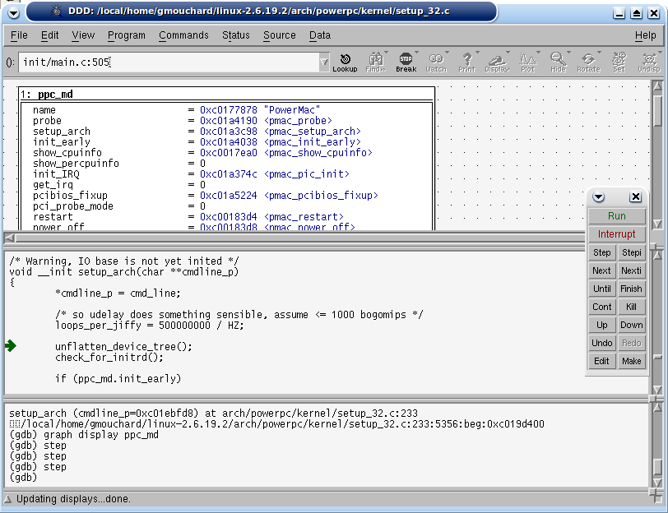
GDB Debugger
ppcemu
TCP/IP
GDB Server
Front Side Bus
Memory
Bridge
RAM
G3/G4
Crafty v14.3
White(1): White(1): pondering disabled.
White(1): noise level set to 0.
White(1): search time set to 99999.00.
White(1): verbosity set to 5.
White(1): White(1): search depth set to 12.
White(1):
clearing hash tables
depth time score variation (1)
1 ###.## 4.14 Qxb6
1-> ###.## 4.14 Qxb6
2 ###.## 4.01 Qxb6 e4
2-> ###.## 4.01 Qxb6 e4
3 ###.## ++ Qxb6!!
3 ###.## 4.32 Qxb6 Rf6 Qd8+ Kh7
3-> ###.## 4.32 Qxb6 Rf6 Qd8+ Kh7
4 ###.## 4.22 Qxb6 e4 Qe6 Rf2
4-> ###.## 4.22 Qxb6 e4 Qe6 Rf2
5 ###.## 4.15 Qxb6 Rf2 Qd8+ Kh7 Qd3+ e4 Qd6
5-> ###.## 4.15 Qxb6 Rf2 Qd8+ Kh7 Qd3+ e4 Qd6
6 ###.## 4.01 Qxb6 Rf2 Qd8+ Kh7 Qd5 Qe2 b4
6-> ###.## 4.01 Qxb6 Rf2 Qd8+ Kh7 Qd5 Qe2 b4
7 ###.## -- Qxb6
7 ###.## 0.09 Qxb6 Rf1 Qd8+ Kh7 Qd3+ e4 Qxf1 Qxf1
b4
Linux
Application
Linux
System Call
Translator
ELF
Loader
Host OS API
Host Operating System:
Linux
Windows
MacOSX
Host
File system

