Slide 1
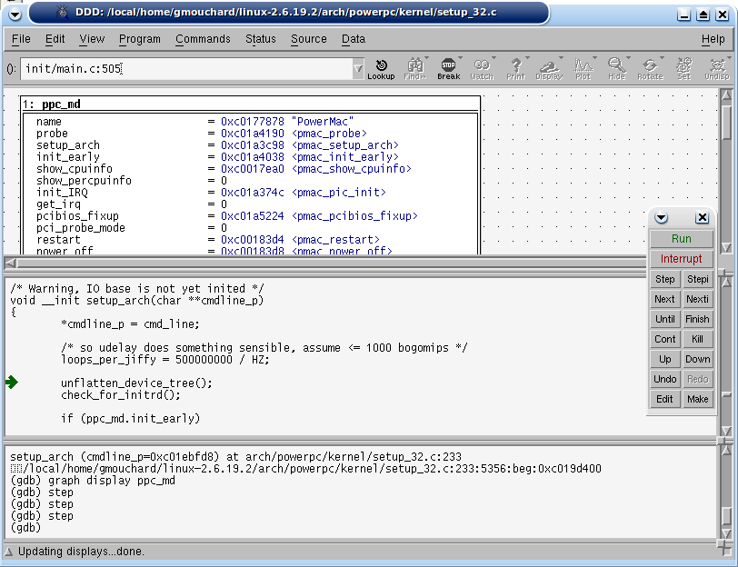
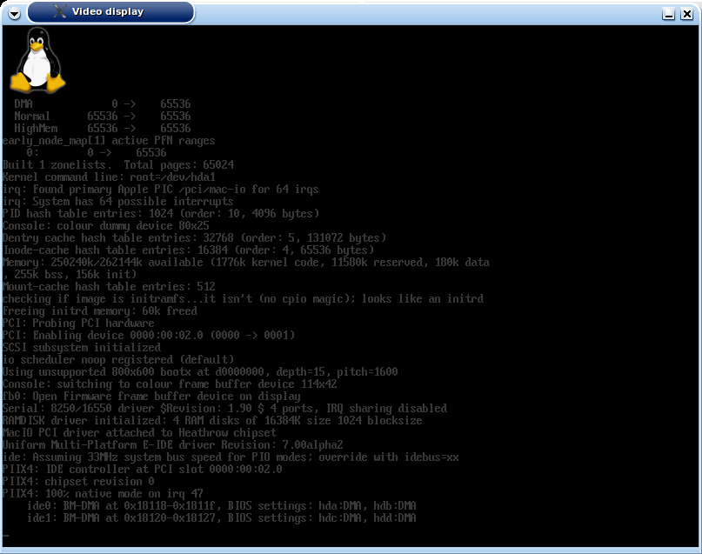
GDB Debugger
ppcemu-system
TCP/IP
GDB Server
Linux
kernel
(vmlinux)
Front Side Bus
Chipset
(MPC107)
Flash Mem.
(AM29LVXXXX)
Flash Ctrl
DMA
ROM
RAM
PMacBootX
Loader
Video Display
EPIC
G3/G4
PCI Ctrl
G3/G4
Compressed
Initial
Ramdisk
(initrd)
PCI Bus
SDL
SDL
Display
Heathrow
PIC
PIIX4
IDE Ctrl
Hard Disk
Image

