Slide 1
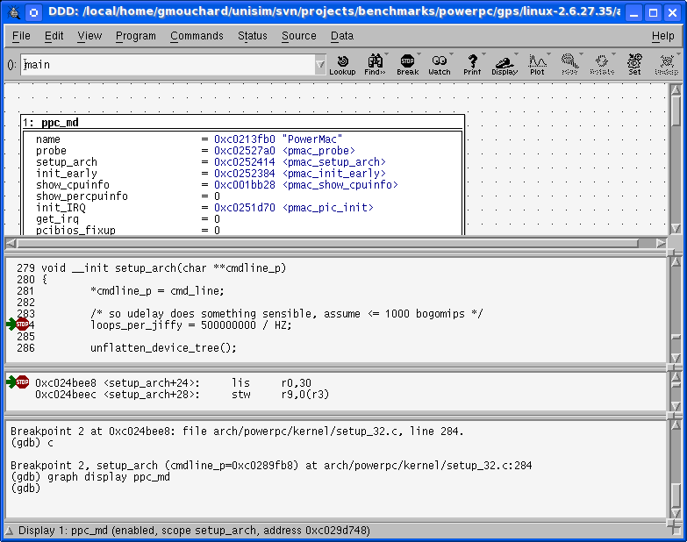
UNISIM Virtex 5 FXT Simulator
Binary Files
PPC440 Embedded Processor Block
SPLB0
SPLB1
Crossbar
Boot loader
Multi
Format
Loader
ELF
S19
COFF
Raw
ICURD
MCI
MCI
RAM
DCR
Controller
DCUWR
Operating
System
DCURD
GDB Debugger
MPLB
Applications
PPC440x5
MPLB
NOR Flash
S29GL256P
MMU
Caches
GDB
Server
DTLB
UTLB
DL1
BRAM
TCP/IP
ITLB
IL1
HW FPU
(optional APU)
XPS
GPIO
Telnet/Putty
External
Input
Interrupt
XPS
Timer
Trying 127.0.0.1...
Connected to localhost.
Escape character is '^]'.
Booting...
Hello world !
> _
XPS
UART Lite
Telnet
TCP/IP
XPS
IntC

