Slide 1
E-ANGANWADI MINI PROJECT
Department of MCA,MES College of Engineering,Kuttippuram
25th OCTOBER 2023
PREPARED BY
BINSHA UNNIKRISHNAN(MES22MCA-2015)

Slide 2
GUIDED BY DR. GEEVAR C ZACHARIAS
ASSISTANT PROFESSOR
MASTER OF COMPUTER APPLICATIONS
MES COLLEGE OF ENGINEERING, KUTTIPPURAM

Slide 3
CONTENTS:-
Introduction
Modules
Product Backlog
Project Plan
Sprint
Data Flow Diagram

Slide 4
INTRODUCTION:-
The Anganwadi system, a cornerstone of India's social welfare initiatives, has been an unwavering beacon of hope in addressing some of the nation's most pressing challenges—child hunger, malnutrition, and child health.
Today, as we're on the edge of a big shift into the digital age, we suggest a major step forward—creating a digital version of Anganwadi called E-Anganwadi. We want to carefully build this using the programming language Python.
E-Anganwadi, in its digital splendor, embodies a transformative journey towards India where the health and nutrition of its citizens, especially the vulnerable children residing in remote rural areas, are elevated to new heights.
This system does not merely offer streamlined operations; it is a lifeline, a digital tapestry interwoven with the aspirations of a healthier and more prosperous nation. But it doesn't stop there.
Our vision extends beyond the administrative corridors of Anganwadi centres to embrace the very heart of these communities.
It incorporates a web application component, oversees product management, provides essential healthcare to young students, and even extends a helping hand with educational materials—a holistic approach to nurturing the holistic development of those it serves

Slide 5
In essence, E-Anganwadi is more than just software; it is a testament to India's commitment to the well-being of its future generations.
It is a digital symphony of compassion, a harmonious blend of technology and heart, set to redefine the very landscape of child healthcare.
With this system, we embark on a journey toward a brighter, healthier, and more prosperous India, where no one is left behind, and every child receives the care they need and deserve.

Slide 6
MODULES
ADMIN
LOGIN
MANAGE STAFF
BLOCK/UNBLOCK STAFF
MANAGE WORKING TIME
MANAGE FOOD ITEMS & SCHEDULE
SYLLABUS MANAGEMENT
MANAGE ANGANWADI
VIEW COMPLAINT & SEND REPLY
ASSIGN STAFF TO ANGANWADI
STAFF
LOGIN
VIEW PROFILE
VIEW ASSIGNED ANGANWADI
VIEW WORKING TIME
VIEW SYLLABUS
VIEW FEEDBACKS
VIEW LEAVE REQUEST
GROUP CHAT WITH PARENT
UPLOAD STUDY NOTES & VIDEOS
VIEW FOOD ITEMS & SCHEDULE
MANAGE STUDENT DETAILS

Slide 7
PARENT
LOGIN
VIEW STUDENT DETAILS
VIEW WORKING TIME
VIEW NOTES & VIDEOS
VIEW FOOD ITEMS & SCHEDULE
ADD FEEDBACK
SEND COMPLAINTS & VIEW REPLY
SEND LEAVE REQUEST
CHAT

Slide 8
DEVELOPMENT ENVIRONMENT
HARDWARE SPECIFICATION
Processor : Intel i3 or above
Hard Disk : 512 GB and above
RAM : 4 GB or above
SOFTWARE SPECIFICATION
Operating System : Windows 8 or above
Front End : HTML, CSS, Bootstrap and Javascript
Back End : Python
Framework : Django
Database : MySQL
IDE : Jet BrainsPycharm

Slide 9
PRODUCT PLAN
ID | TASK NAME | START DATE | END DATE | PROJECT HOURS | STATUS
1 | Sprint 1 | 15/09/2023 | 12/10/2023 | 13 | Planned
2 | Sprint 2 | 13/10/2023 | 03/11/2023 | 14 | Planned
3 | Sprint 3 | 08/11/2023 | 30/11/2023 | 14 | Planned

Slide 10
PRODUCT BACKLOG
ID | PRIORITY | SIZE (Hours) | SPRINT | STATUS | NAME
1 | Medium | 8 | 1 | Planned | Registration
2 | Medium | 4 |  | Planned | Login
3 | High | 10 | 2 | Planned | Table Design
4 | High | 9 |  | Planned | Coding
5 | Medium | 4 | 3 | Planned | Testing data
6 | High | 6 |  | Planned | Output generation

Slide 11
USER STORY
User story ID | As < type of user> | I want to | So that I can
1 | ADMIN | Login | Login successful with correct Username and Password
2 | ADMIN | Manage Staff | Manage all the staff
3 | ADMIN | Block/Unblock Staff | Block and Unblock all the staffs
4 | ADMIN | Manage Working Time | Schedule working time
5 | ADMIN | Manage food items and schedule | Schedule the time for food
6 | ADMIN | Syllabus management | Manage the syllabus for students
7 | ADMIN | Manage Anganwadi | Manage all the Anganwadi’s
8 | ADMIN | View Complaints and send reply | View complaints from parents and sent appropriate reply to them

Slide 12
USER STORY
User story ID | As < type of user> | I want to | So that I can
9 | ADMIN | Assign staff to Anganwadi | Assign staff to each Anganwadi
10 | STAFF | Login | Login Successful with correct username and password
11 | STAFF | View profile | View staff details
12 | STAFF | View Assigned Anganwadi | Able to view the allocated Anganwadi
13 | STAFF | View Working Time | View the working Schedule in Anganwadi
14 | STAFF | View Syllabus | View syllabus
15 | STAFF | View Feedback | View feedback from parents
16 | STAFF | View leave request | View leave request from students

Slide 13
USER STORY
User story ID | As < type of user> | I want to | So that I can
17 | STAFF | Group chat with parent | Communicate with parents
18 | STAFF | Upload study notes & videos | Provide study materials
19 | STAFF | View food items & schedule | View scheduled time for food and list of food items
20 | STAFF | Manage student details | Manage students
21 | PARENT | Login | Login successful with correct username and password
22 | PARENT | View Student details | View student profile
23 | PARENT | View working time | View working time
24 | PARENT | View notes and videos | View study materials

Slide 14
USER STORY
User story ID | As < type of user> | I want to | So that I can
25 | PARENT | View food items & schedule | View scheduled time for food and list of food items
26 | PARENT | Add feedback | Give feedback
27 | PARENT | Send complaints and view reply | Send complaints and view reply
28 | PARENT | Send leave request | Send leave request
29 | PARENT | Chat | Communicate with staff

Slide 15
PROJECT PLAN
User Story ID | Sprint | Start Date | End Date | Days | Status
1 , 2 ,3 ,4, 10,21,25 | Sprint 1 | 15/09/23 | 29/09/23 | 14 | Planned
5,6,7,20 |  | 30/09/23 | 12/10/23 | 13 | Planned
8,11,12,13,9, 18,19,23 | Sprint 2 | 13/10/23 | 29/10/23 | 16 | Planned
14 , 15,16 | Sprint 4 | 30/10/23 | 3/11/23 | 4 | Planned
17,29,22,26,27,28,24 | Sprint 3 | 8/11/23 | 30/11/23 | 22 | Planned

Slide 16
SPRINT PLAN
SPRINT 1:-
Backlog Item | Status and Completion date | Original Estimate in hours | Day 1 15/09 | Day 2 20/09 | Day 3 21/09 | Day 4 28/09 | Day 5 29/09 | Day 6 04/10 | Day 7 05/10 | Day 8 06/10 | Day 9 11/10 | Day 10 12/10
Form Design | 15/09/2023 | 2 | 2 | 0 | 0 | 0 | 0 | 0 | 0 | 0 | 0 | 0
Table Design | 28/09/2023 | 3 | 0 | 1 | 1 | 1 | 0 | 0 | 0 | 0 | 0 | 0
Coding | 06/10/2023 | 6 | 0 | 0 | 0 | 0 | 2 | 1 | 1 | 2 | 0 | 0
Testing & Validation | 12/10/2023 | 2 | 0 | 0 | 0 | 0 | 0 | 0 | 0 | 0 | 1 | 1
Total |  | 13 | 2 | 1 | 1 | 1 | 2 | 1 | 1 | 2 | 1 | 1

Slide 17
SPRINT 2 :-
Backlog Item | Status and Completion date | Original Estimate in hours | Day 1 13/10 | Day 2 18/10 | Day 3 19/10 | Day 4 20/10 | Day 5 25/10 | Day 6 26/10 | Day 7 27/10 | Day 8 01/11 | Day 9 02/11 | Day 10 03/11
Form Design | 13/10/2023 | 2 | 2 | 0 | 0 | 0 | 0 | 0 | 0 | 0 | 0 | 0
Table Design | 18/10/2023 | 1 | 0 | 1 | 0 | 0 | 0 | 0 | 0 | 0 | 0 | 0
Coding | 01/11/2023 | 8 | 0 | 0 | 1 | 2 | 1 | 1 | 2 | 1 | 0 | 0
Testing & Validation | 03/11/2023 | 3 | 0 | 0 | 0 | 0 | 0 | 0 | 0 | 0 | 1 | 2
Total |  | 14 | 2 | 1 | 1 | 2 | 1 | 1 | 2 | 1 | 1 | 2

Slide 18
SPRINT 3 :-
Backlog Item | Status and Completion date | Original Estimate in hours | Day 1 08/11 | Day 2 09/11 | Day 3 10/11 | Day 4 15/11 | Day 5 16/11 | Day 6 17/11 | Day 7 22/11 | Day 8 23/11 | Day 9 24/11 | Day 10 29/11 | Day 11 30/11
Coding | 22/11/2023 | 9 | 1 | 1 | 2 | 1 | 1 | 2 | 1 | 0 | 0 | 0 | 0
Testing & Validation | 30/11/2023 | 5 | 0 | 0 | 0 | 0 | 0 | 0 | 0 | 1 | 2 | 1 | 1
Total |  | 14 | 1 | 1 | 2 | 1 | 1 | 2 | 1 | 1 | 2 | 1 | 1

Slide 19
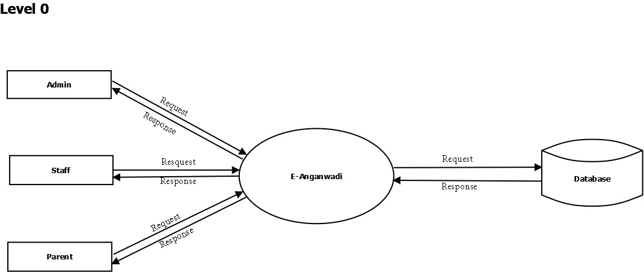
DATA FLOW DIAGRAM

Slide 20
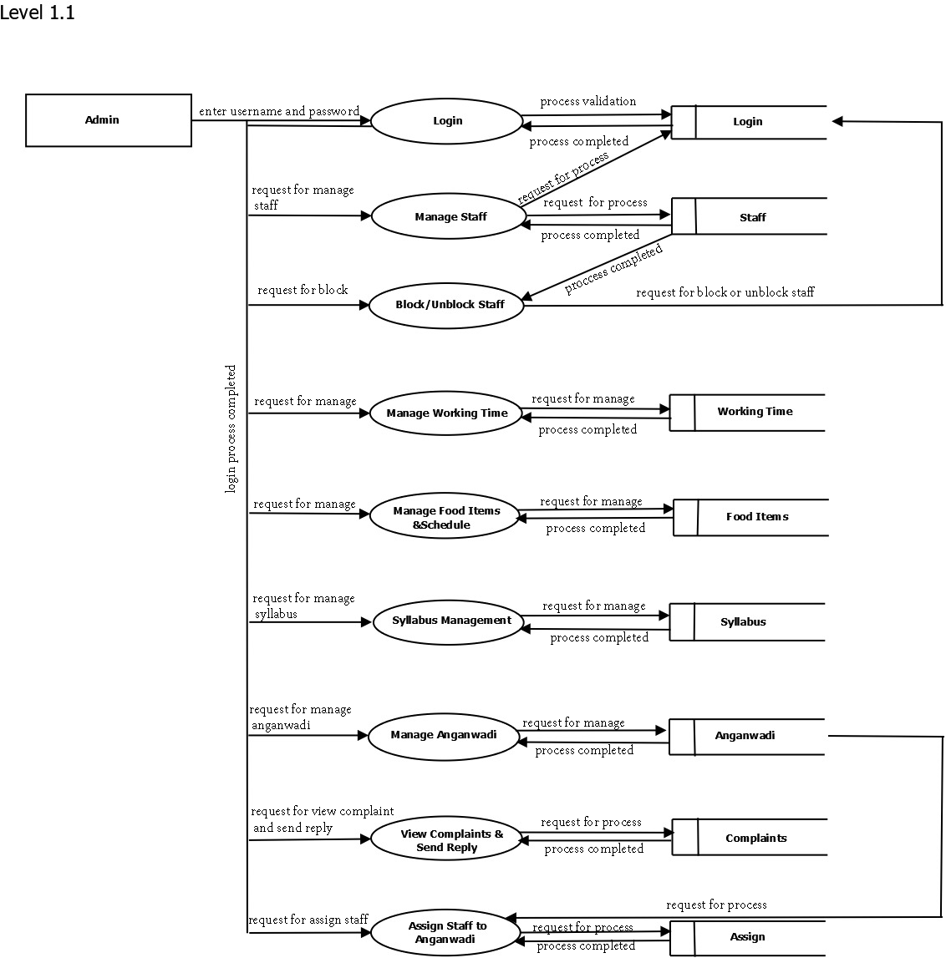

Slide 21
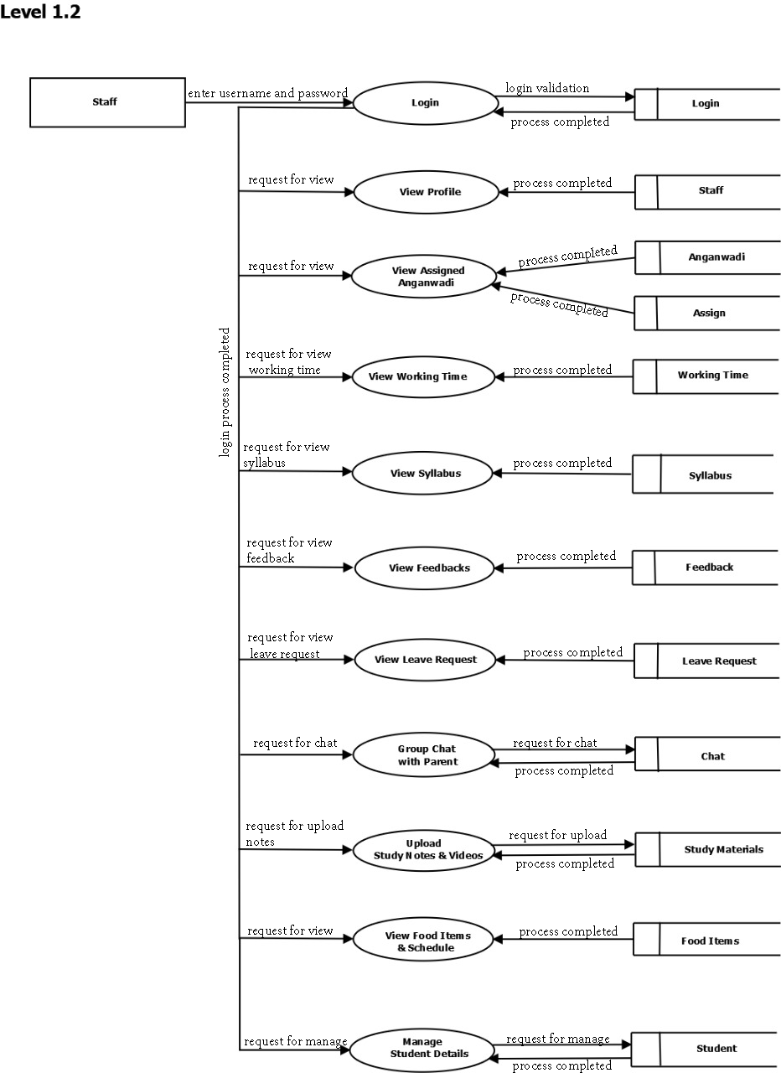

Slide 22
