Slide 1




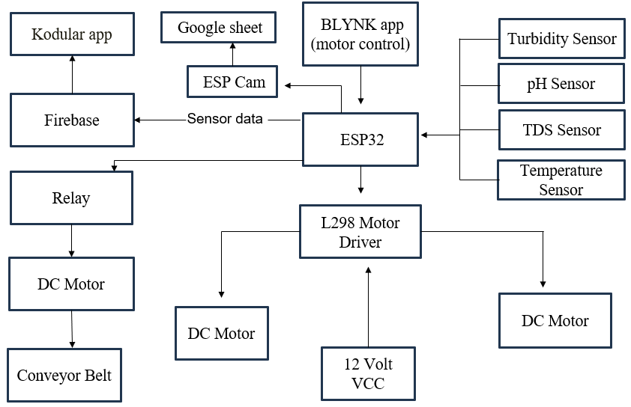
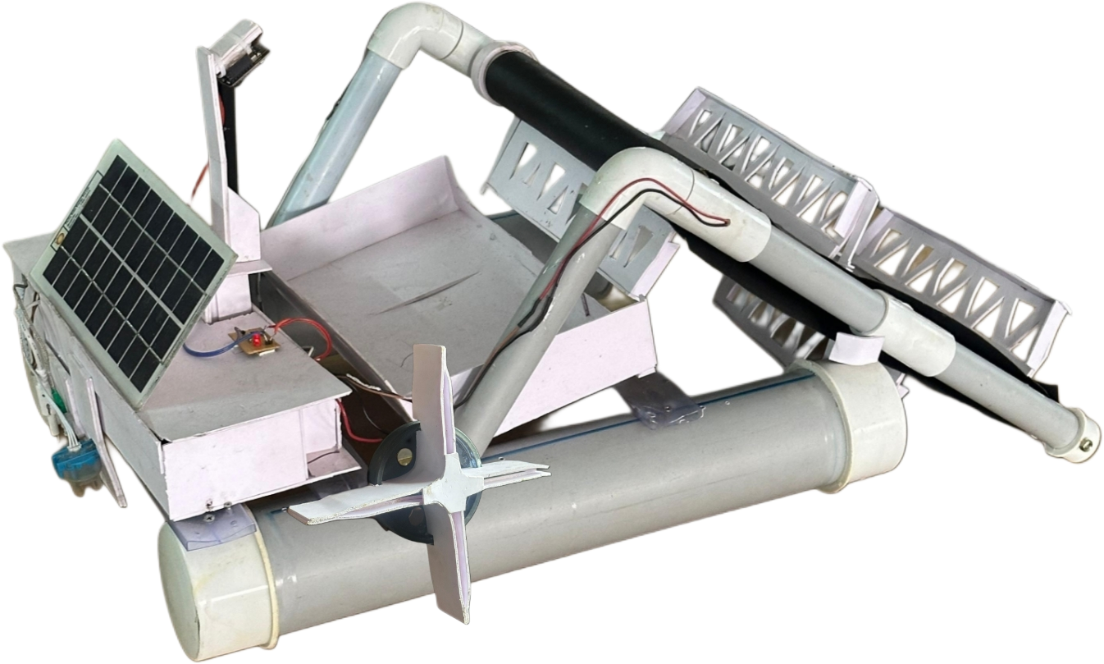
INNOVATIVE SOLAR BOAT: A DUAL APPROACH TO WASTE COLLECTION AND WATER QUALITY ASSESSMENT
OBJECTIVE
BLOCK DIAGRAM
Solar-powered USV that detects and removes floating water debris.
Water quality monitoring sensors track pH, turbidity, TDS, and temperature in real time to detect pollutants.
Real-time application for water quality monitoring and boat navigation.
Waste collection: A conveyor belt mechanism to collect floating waste and stored in an onboard compartment
Waste detection: A camera detects and classifies collected waste as plastic, organic, or other materials.
Waste data analysis: Tracks and stores waste types for better waste management.
KEY FEATURES
Solar-powered operation
Waste collection system
AI waste detection
Real time water quality monitoring
Eco-friendly solution
User friendly interface
DONE BY: ASFAN M M, ASLAHA FARHA, BINSIL JOHN, DENITTA DAVIS
GUIDED BY: MR MANESH V M, (Assistant Professor, Dept of ECE)
Vidya Bharathi Nagar, Kalady, Ernakulam, Kerala, India
0484 2463825, 2461933 | www.adishankara.ac.in

