Slide 1
PSLM DATA EXPLORATION
Education spending
and literacy in rural Balochistan
ECO346
ASSIGNMENT
01
DATA VISUALIZATION
TECHNIQUES FOR ECONOMISTS
Prepared by: FA24-BED-078
A focused look at household spending patterns and literacy differences.
Variant 6 • Rural Balochistan

Slide 2
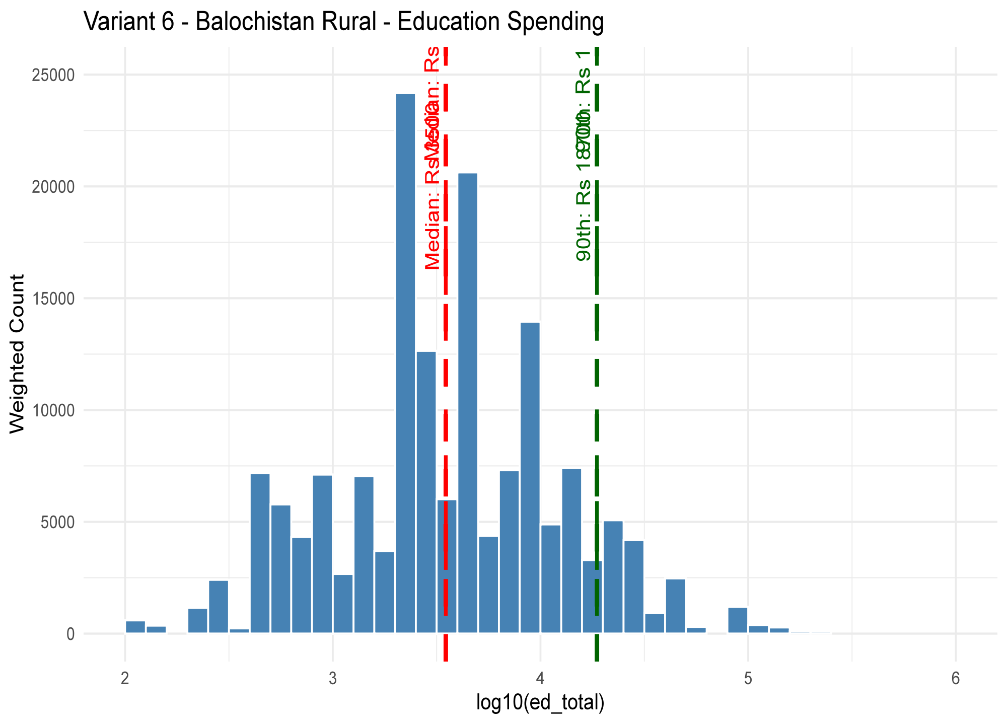
QUESTION 2 / DISTRIBUTION
How is education spending distributed?
PURPOSE
INSERT YOUR R GRPH HERE
Describe household education spending using a weighted distribution.
METHOD
Use the rural Balochistan subset and household weights. Display positive spending on a log scale where appropriate.
INTERPRETATION
Median weighted Rs 5200 (unweighted 6000). Distribution right-skewed. P90 is Rs 26000, P10 is Rs 1200, ratio 21.7 shows high inequality. 4 obs excluded.
ECO346 • ASSIGNMENT 01 02 / 05

Slide 3
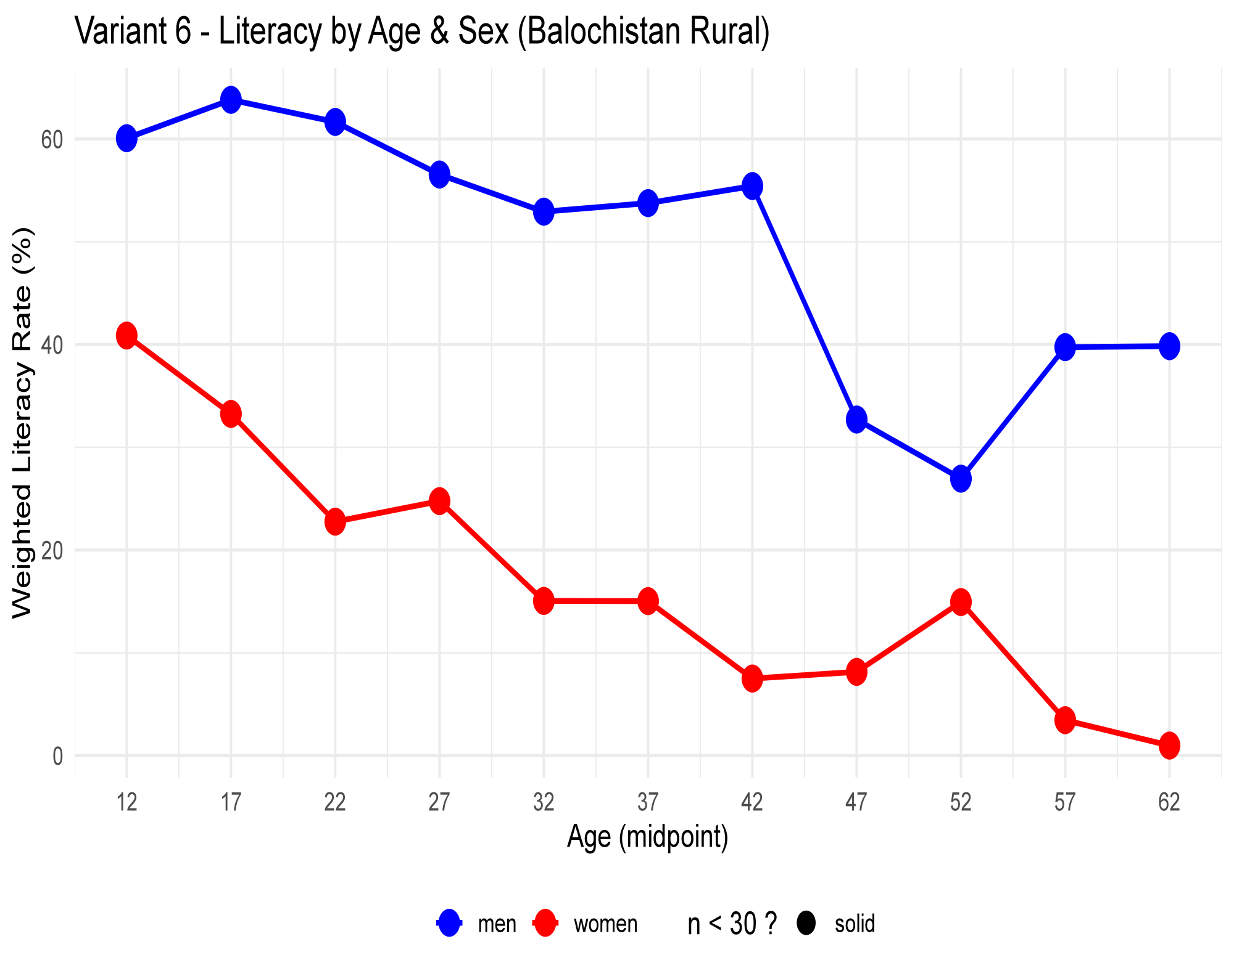
QUESTION 3 / LITERACY
How does literacy vary by age and sex?
COMPARE
Male literacy higher than female in all age groups. At age 12: 59.7% Male vs 41.1% Female (18.6pp gap). At age 32: 53% vs 15% (38pp gap). Gender gap persists across all ages.
INSERT YOUR WEIGHTED LITERACY GRAPH
LOOK FOR
Gap is widest at age 42: 55% Male vs 7.5% Female = 47.5pp gap. Literacy declines with age. Female literacy drops below 15% after age 32. Male literacy drops sharply after age 42 (55% to 32%).
REPORT
Male
Female
Weighted estimates: Youngest (12yr) 60% Male, 41% Female. Middle (32yr) 53% Male, 15% Female. Oldest (62yr) 39% Male, 1% Female. Shows strong age effect + persistent gender disparity in Balochistan Rural.
Illustrative only — replace with your computed graph.
ECO346 • ASSIGNMENT 01 03 / 05

Slide 4
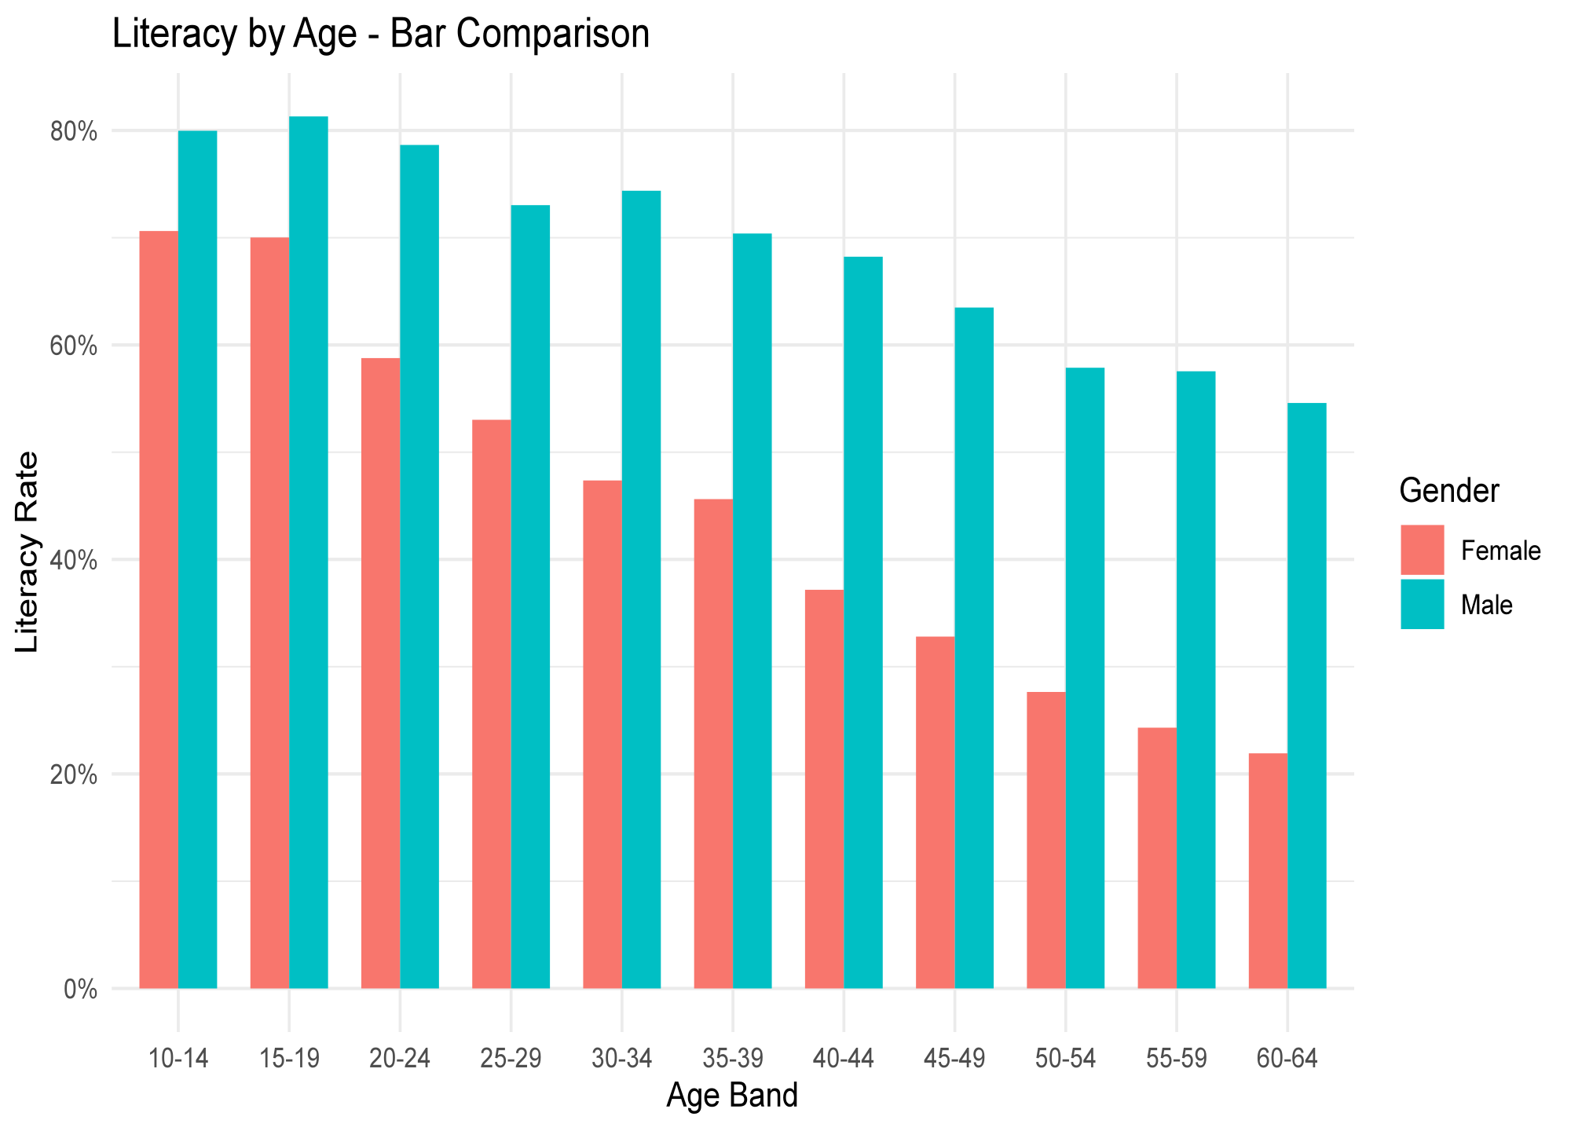
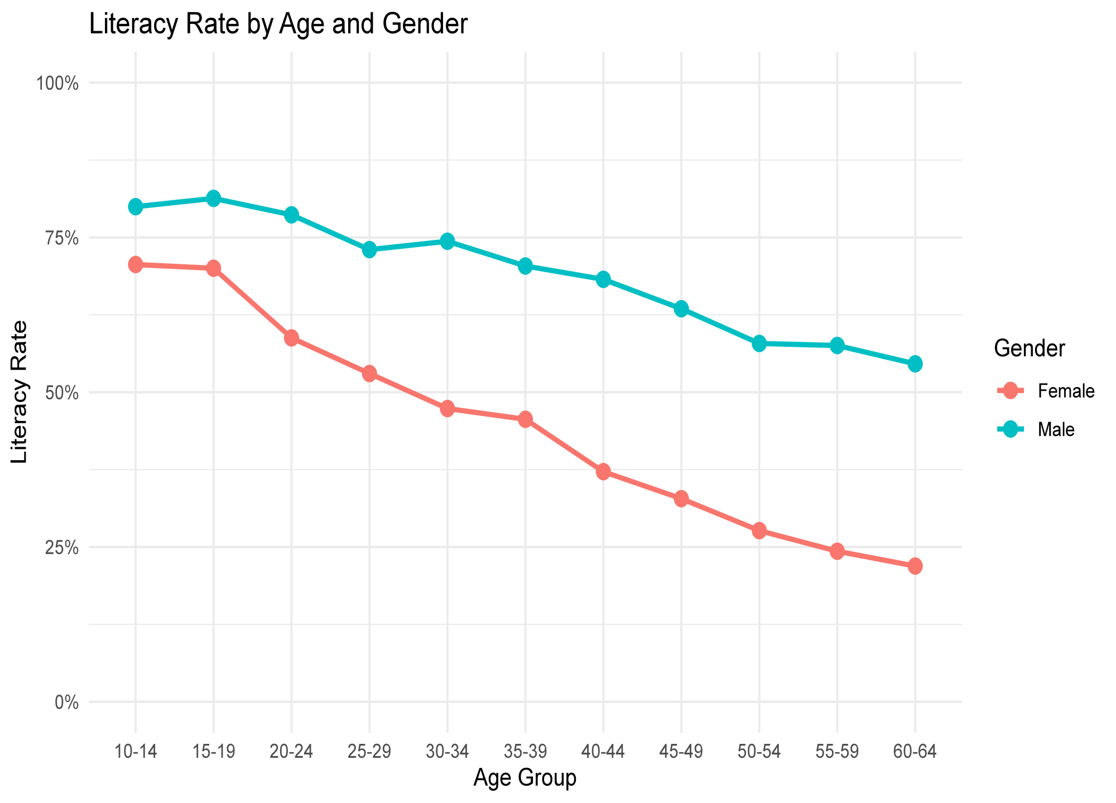
QUESTION 4 / REDESIGN
From a basic chart to a clearer story
BEFORE
AFTER
DESIGN CHOICES
Explain how each design change helps readers compare the data accurately.
ECO346 • ASSIGNMENT 01 04 / 05

