Slide 1
EVIDENCE-LED DATA ANALYSIS
Education spending & literacy
PSLM household and person data
06
VARIANT 06
BALOCHISTAN | RURAL
Weighted analysis • R + Python
PRESENTED BY • ZAINAB ASHRAF
REGISTRATION NO. • FA24-BED-078
ECO346 • ASSIGNMENT 1 • FA24-BED-078
01

Slide 2
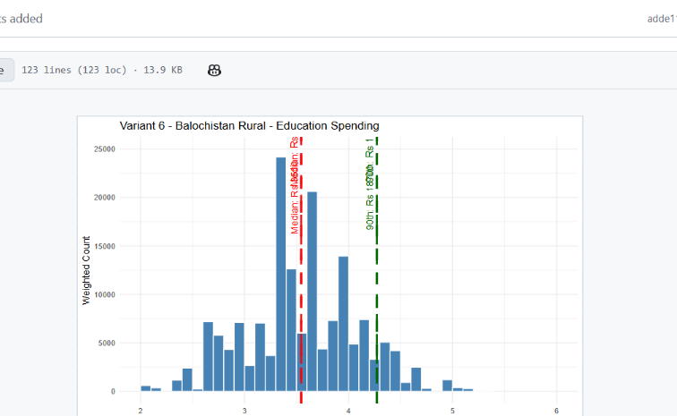
QUESTION 2
Education spending distribution
What the chart examines
Annual education spending among students with positive spending.
Check before submission
Use weighted density, rupee tick labels and weighted median / P90 annotations.
ECO346 • ASSIGNMENT 1 • FA24-BED-078
02

Slide 3
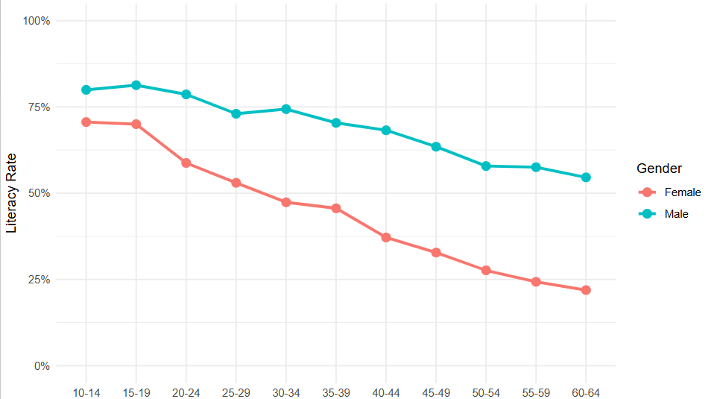
QUESTION 3
Literacy changes across age groups
KEY PATTERN
Literacy generally declines in older age groups.
The plotted female and male series show a persistent gender difference.
ECO346 • ASSIGNMENT 1 • FA24-BED-078
03

Slide 4
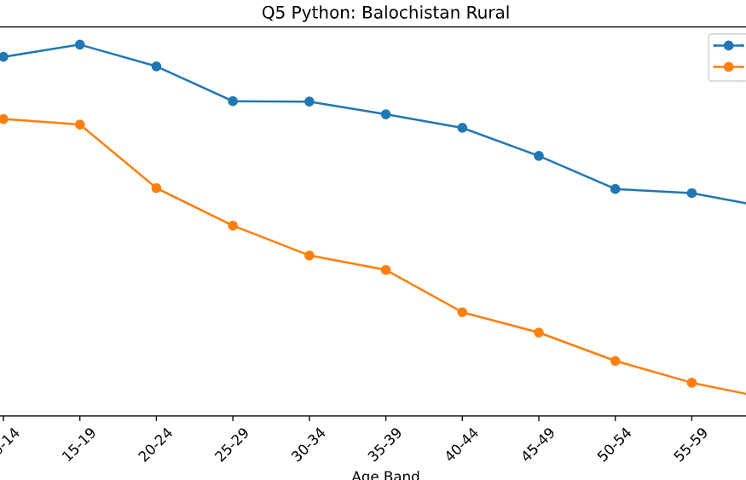
QUESTIONS 4 & 5
From default chart to reproducible insight
Q4 • VISUAL REDESIGN
Default: basic scatterplot
Redesign: labeled women/men trends, age bands and emphasis on the largest literacy gap.
Keep default.svg committed before the redesigned SVG.
Q5 • Python cross-check of age-band literacy
ECO346 • ASSIGNMENT 1 • FA24-BED-078
04

Slide 5
PRESENTATION CLOSE
Thank you!
Questions & discussion
Balochistan Rural • Education spending • Literacy gaps
FA24-BED-078
ECO346 • ASSIGNMENT 1 • FA24-BED-078
05

