Slide 1
ECO346 / ASSIGNMENT 01
Education spending
& literacy
LARGEST LITERACY GAP
47.92
An evidence-led look at rural Balochistan
PSLM household + person survey data
percentage points • ages 40–44
PRESENTED BY
Men 55.42%
Zainab Ashraf
Women 7.50%
Registration: FA24-BED-078 • Variant 6
1,464 students with positive spending • Rs 3,500 weighted median • R & Python agree
Notes:
Assalam-o-Alaikum everyone. Good morning, respected teacher and classmates. My name is Zainab Ashraf, and my registration number is FA24-BED-078. Today I am presenting my ECO346 assignment about education spending and literacy in rural Balochistan. I used PSLM household and person data. My main focus is education spending and differences in literacy between men and women. I used R for the analysis and Python to check the literacy results. Let me explain the main findings.

Slide 2
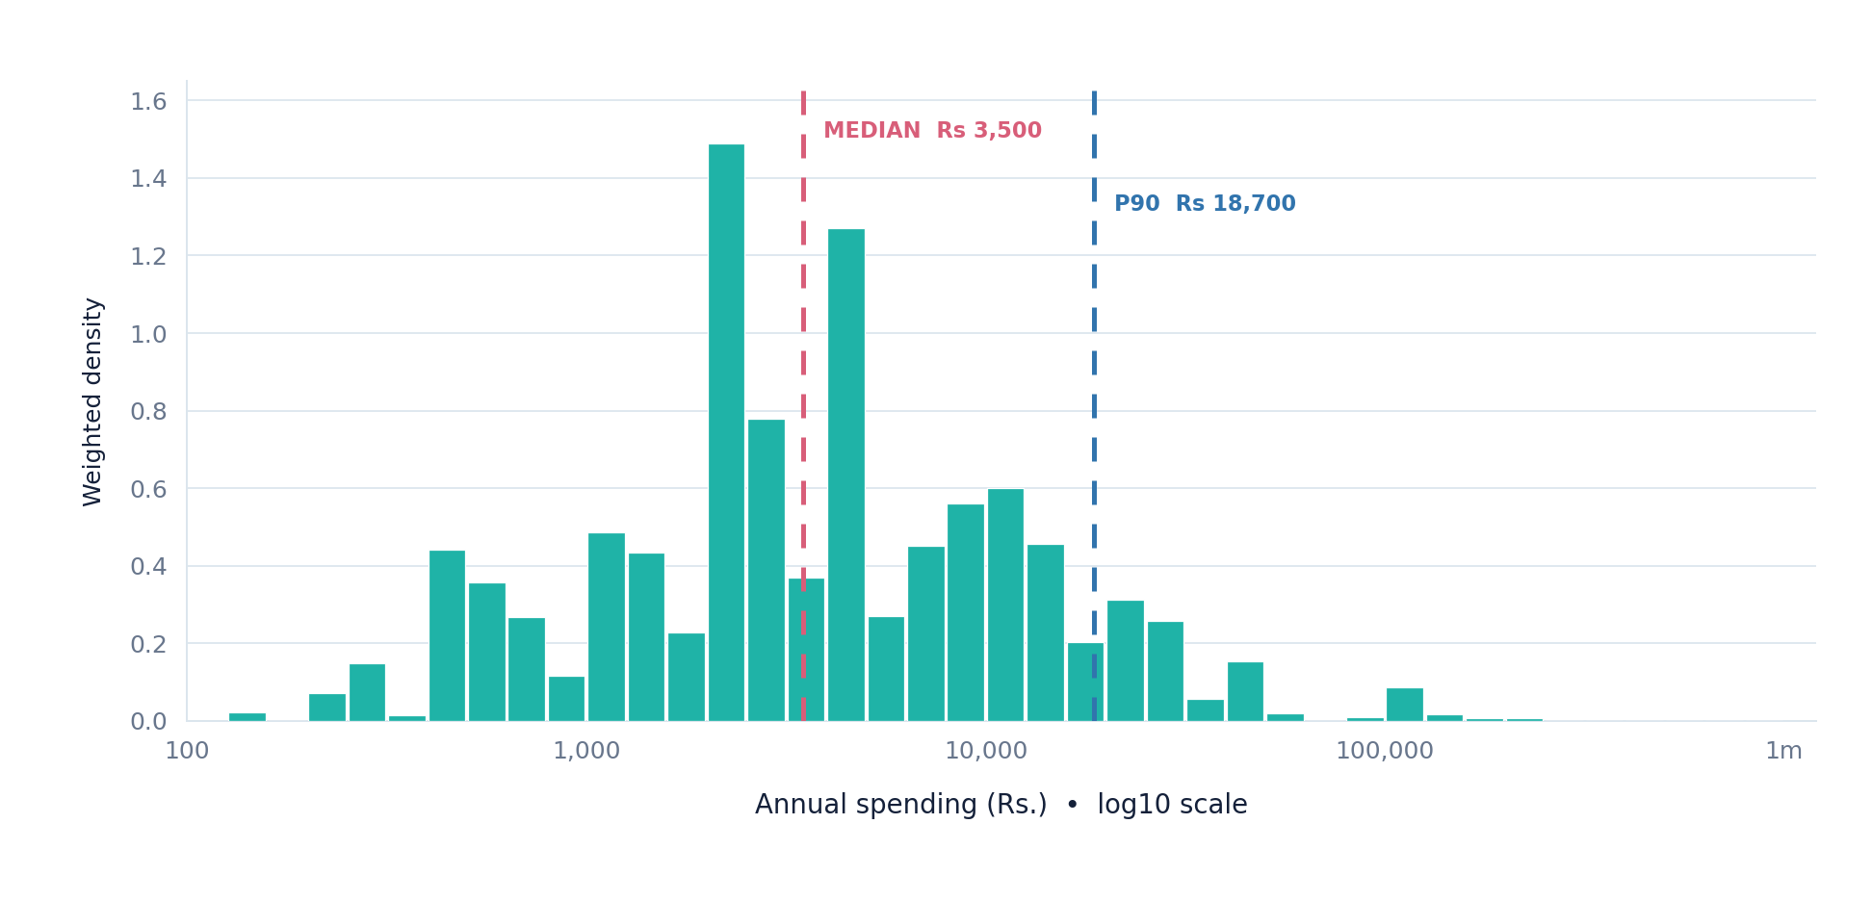
ECO346 / ASSIGNMENT 01
How much do students spend on education?
QUESTION 2 • WEIGHTED ANNUAL EXPENDITURE
WEIGHTED P10
WEIGHTED MEDIAN
WEIGHTED P90
STUDENTS
Rs 600
Rs 3,500
Rs 18,700
1,464
WHAT THIS TELLS US
P90 is 5.34× the median.
Spending differs a lot across students. The graph uses a log scale so both lower and higher spending are easier to see.
1 observation outside chart range.
ZAINAB ASHRAF • FA24-BED-078 • VARIANT 06
02 / 05
Notes:
This slide shows education spending in rural Balochistan. There are 1,464 students with positive spending and valid weights. The weighted 10th percentile is 600 rupees. The weighted median is 3,500 rupees, and the weighted 90th percentile is 18,700 rupees. The 90th percentile is about 5.34 times the median. This means education expenses vary a lot among students. We use a log scale because spending values can be very different. One eligible observation was outside the chart's displayed range. These are survey-weighted results from my R analysis.

Slide 3
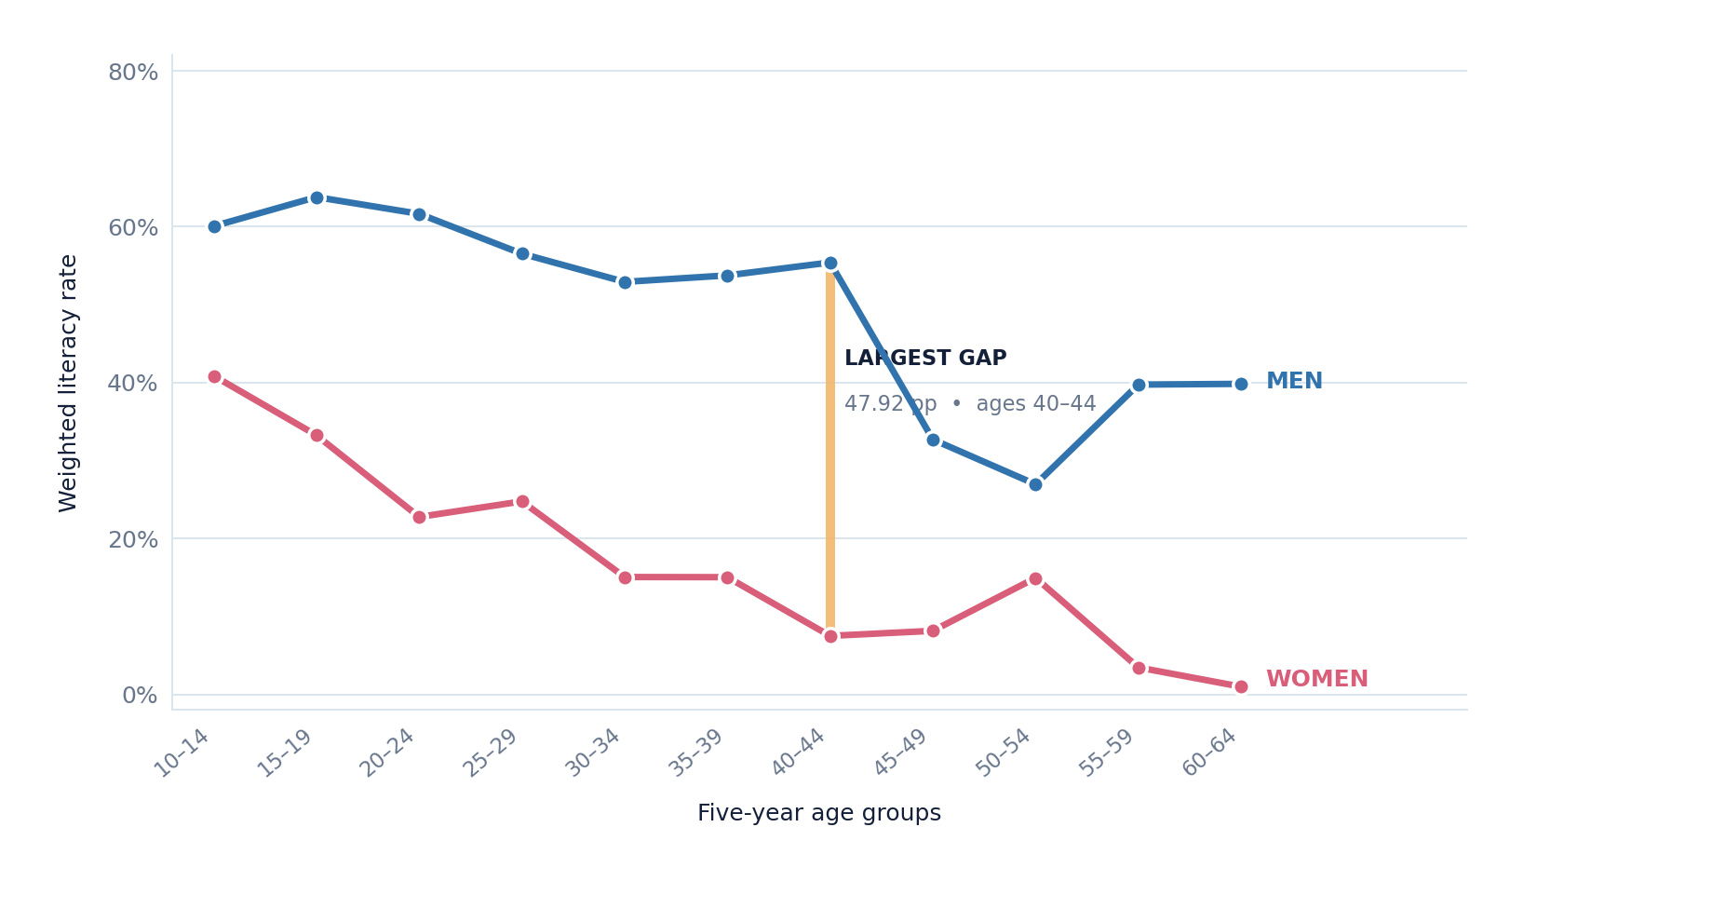
ECO346 / ASSIGNMENT 01
The literacy gap differs across age groups
QUESTION 3 • WEIGHTED LITERACY RATES (%)
SPOTLIGHT AGE GROUPS
AGES 15–19
63.81% men
33.25% women
AGES 55–59
39.75% men
3.45% women
Largest gap: 47.92 pp
at ages 40–44
ZAINAB ASHRAF • FA24-BED-078 • VARIANT 06
03 / 05
Notes:
This slide compares literacy rates for men and women across age groups. The values are weighted using household survey weights. Among people aged 15 to 19, men's literacy is 63.81 percent and women's is 33.25 percent. Among ages 55 to 59, men have 39.75 percent literacy, while women have 3.45 percent. The largest gap is among ages 40 to 44. In this group, male literacy is 55.42 percent, female literacy is 7.50 percent, and the gap is 47.92 percentage points. These differences describe the survey data; they do not prove what caused the gap.

Slide 4
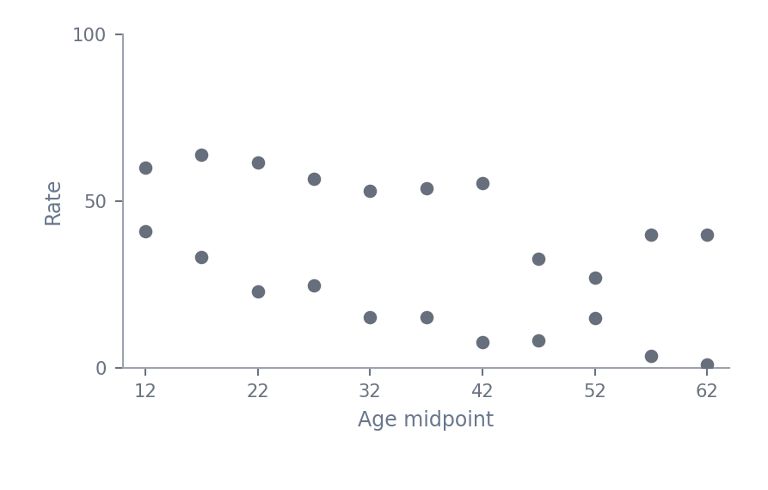
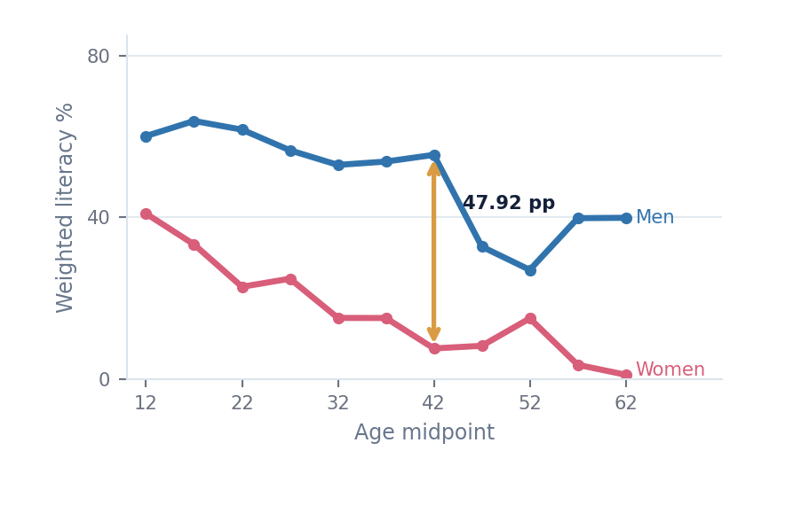
ECO346 / ASSIGNMENT 01
Clearer graphs. Matching results.
QUESTIONS 4 & 5 • VISUAL REDESIGN & PYTHON VERIFICATION
DEFAULT-STYLE VIEW
REDESIGNED WEIGHTED VIEW
Schematic: unstyled age-band points; actual default.svg in GitHub.
Actual weighted R age-band rates with direct labels and gap.
DESIGN IMPROVEMENTS
PYTHON CHECK OF R
Clear trend lines • Direct gender labels • Largest-gap highlight
22 / 22 rates match • 1 decimal
Conclusion: Male literacy is higher in every age band in this sample.
22 / 22 MATCH ✓
ZAINAB ASHRAF • FA24-BED-078 • VARIANT 06
04 / 05
Notes:
Finally, Question 4 is about making a graph easier to understand. The picture on the left is a simple sketch of a default-style point graph; the exact original default graph is saved in the GitHub repository. On the right, the redesigned graph connects weighted literacy rates, labels men and women directly, and highlights the largest gap. These changes make comparisons easier. Question 5 checks the results using Python. The Python age-band rates match the R results for all 22 age-and-gender groups to one decimal place. For women aged 15 to 19, both programs report 33.25 percent. In conclusion, spending differs widely, and literacy is higher for men in every observed age group. The next slide summarizes the findings. I will close with the main takeaways.

Slide 5
ECO346 • ASSIGNMENT 01
Thank you!
THE BIG PICTURE
Education spending & literacy in rural Balochistan
47.92 pp
THREE MAIN TAKEAWAYS
01
Spending varies widely
Weighted median Rs 3,500 • P90 Rs 18,700
Largest male–female literacy difference at ages 40–44.
02
Gender gaps remain large
Largest gap: ages 40–44 • 47.92 pp
Your questions are welcome.
03
The results are reproducible
R and Python agree for all 22 age-sex rates
ZAINAB ASHRAF • FA24-BED-078 • VARIANT 06 / BALOCHISTAN RURAL
Notes:
In conclusion, the weighted median annual education spending is 3,500 rupees, and the 90th percentile is 18,700 rupees. This shows that spending varies a lot among students. The literacy results show a large gender gap, especially at ages 40 to 44, where the difference is 47.92 percentage points. My R and Python rates also match to one decimal place across all 22 age-and-gender groups. These are sample-based descriptive findings. Thank you for listening. I am happy to answer any questions.

