Slide 1
Multi-Party Computation Forever for Cloud Computing and Beyond
Shlomi Dolev
Joint works with Limor Lahiani, Moti Yung, Juan Garay, Niv Gilboa and Vladimir Kolesnikov

Slide 2
Secret Swarm Unit Reactive K-Secret Sharing
INDOCRYPT 2007
Shlomi Dolev¹, Limor Lahiani¹, Moti Yung²
Department of Computer Science
1 Ben-Gurion University of the Negev
2 Columbia University

Slide 3
Talk Outline
Introduction & motivation
The problem
Swarm settings
Reactive k-secret sharing solutions
Polynomial based solution
Chinese remaindering based solution
Vandermonde-matrix based solution
Virtual I/O automaton
Conclusions
Notes:
3

Slide 4
The Polynomial Based Solution Shamir’s (k,n)-threshold scheme
Secret: Globl secret gs
p(x) = a₀+a₁x+a₂x²+…+a_{k}x^{k}
a₁..a_{k} are random
Secret: a₀ = gs
Secret distribution
n distinct points: (x_{i},p(x_{i})), x_{i} ≠ 0
gs = p(0)
Any k+1 points reveals the secret
No less than k+1 reveals it
Notes:
4

Slide 5
The Polynomial Based counter
Increment counter: gs ← gs+δ
p(x) = gs+a₁x+a₂x²+…+a_{k}x^{k}
q(x) = p(x) + δ
q(x) is defined by ⟨x_{i},p(x_{i})+δ⟩
Multiply : gs ← gs·μ
p(x) = gs+a₁x+a₂x²+…+ a_{k}x^{k}
q(x) = p(x)·μ
q(x) is defined by ⟨x_{i},p(x_{i})·μ⟩
Notes:
5
Lagranze interpolation imply

Slide 6



The Polynomial based solution Swarm input: set
set( ⟨x_{i},p(x_{i})⟩)
Notes:
6

Slide 7
The Polynomial based solution Swarm input: step
step()
δ
⟨x_{i}, p(x_{i})⟩ ← ⟨x_{i}, p(x_{i})+δ⟩
And the same for multiplication by μ
Notes:
7

Slide 8



The Polynomial based solution input: regain consistency request
regainConsistencyReq()
leader
⟨x_{i}, p(x_{i})⟩
Notes:
8

Slide 9
The Polynomial based solution input: regain consistency request
leader
Notes:
9

Slide 10
The Polynomial based solution input: regain consistency reply
leader
⟨x_{i}, p(x_{i})⟩
Notes:
10

Slide 11

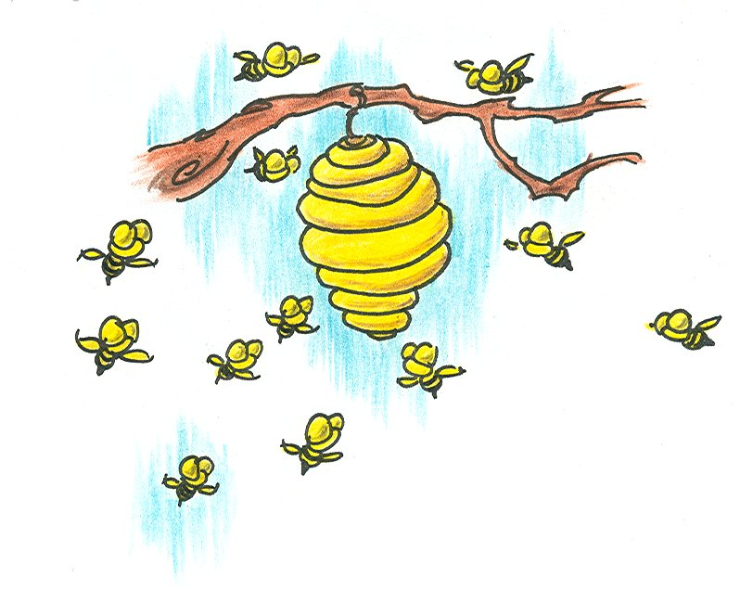

The Polynomial based solution input: join request & reply
joinReq()
joinReply()
Notes:
11

Slide 12
The Polynomial Based Solution (Corruptive Adversary)
Berlekamp-Welch
Polynomial p(x) of degree k
k+r points
e errors
Decode p(x) if e < r/2
Polynomial based solution
Decode p(x) if f < (n–k–lp)/2
Where lp = num of leaving processes between two regainConsistency ops.
Notes:
12

Slide 13
Talk Outline
Introduction & motivation
The problem
Swarm settings
Reactive k-secret sharing solutions
Polynomial based solution
Chinese remaindering based solution
Vandermonde-matrix based solution
Virtual I/O automaton
Conclusions
Notes:
13

Slide 14
Our Chinese Remainder Based Solution
Swarm secret: global secret gs
p₁ < p₂ < … < p_{k} relatively primes
M_{k} = p₁⋅p₂⋅… ⋅p_{k}
0 ≤ gs < M_{k}
gs ≡ ⟨r₁,p₁⟩, ⟨r₂,p₂⟩,…, ⟨r_{l} ,p_{k}⟩ [CRT]
r_{i} = gs mod p_{i}
gs ≡ ⟨r₁, r₂,…,r_{k}⟩
Secret share
⟨r_{i}, p_{i}⟩, r_{i} = gs mod p_{i}
Notes:
14

Slide 15
Swarm Input
p_{i}⇔x_{i} , r_{i} ⇔ p(x_{i})
regainConsistencyRequest()
regainConsistencyReply()
step()
joinRequest()
set()
joinReply()
Notes:
15

Slide 16
Talk Outline
Introduction & motivation
The problem
Swarm settings
Reactive k-secret sharing solutions
Polynomial based solution
Chinese remaindering based solution
Vandermonde-matrix based solution
Virtual I/O automaton
Conclusions
Notes:
16

Slide 17
Virtual I/O Automaton
I/O Automaton A
Implemented by the swarm
Global state (Global secret)
Current state of A
Replicated at least T ≤ n times
Regain consistency ensures:
At least T+lp+f replicas of the global state
At most T-f-1 replicas of any other state
Global output
Output with at least T ≤ n replicas
Threshold device
Notes:
17
Local(A)= int(acts(a)) U out(acts(A))
Device – the amount of energy when transmitting T laser beems

Slide 18
Virtual I/O Automaton
Secret share
Tuple ⟨s_{i1},s_{i2},…,s_{im}⟩ of candidates
At most 1 state is the global state
Step(δ)
transition step on s_{i1},s_{i2},…,s_{im} and δ
Randomly solve convergence to same state
New tuple of candidates: ⟨s’_{i1},s’_{i2},…,s’_{im}⟩
Output actions ⟨o_{i1},o_{i2},…,o_{im}⟩
At least T replicas of the global output
Notes:
18

Slide 19
Talk Outline
Introduction & motivation
The problem
Swarm Settings
Reactive k-secret sharing solutions
Polynomial based solution
Chinese remaindering based solution
Vandermonde-matrix based solution
Virtual I/O automaton
Conclusions
Notes:
19

Slide 20
Conclusions
polynomial based solution
Addition & multiplication
Error correcting [Berlekamp-Welch]
Chinese remaindering based solution
Addition
Error correcting [Mandelbaum]
Virtual I/O automaton
Mask the global state
Further results: Vandermonde matrix
Support XOR operations
Notes:
20

Slide 21
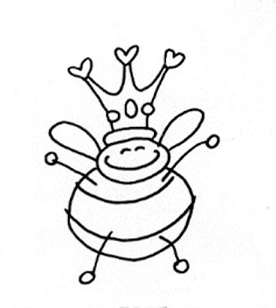
Thank You!
Notes:
21

Slide 22
Swarming Secrets
Shlomi Dolev (BGU),
Juan Garay (AT&T Labs),
Niv Gilboa (BGU)
Vladimir Kolesnikov (Bell Labs)
PODC 2010 (Allerton 2009)

Slide 23
Talk Outline
Objectives
Adversary
Secret sharing
Membership and thresholds
Private computation in swarms
Perfectly oblivious TM
Computing transitions

Slide 24
Objectives
Why swarms
Why secrets in a swarm
Dynamic membership in swarms
Computation in a swarm

Slide 25
Adversary
Honest but curious
Adaptive
Controls swarm members
Up to a threshold of t members
What about eavesdropping?
We assume that can eavesdrop on the links (incoming and outgoing) of up to t members

Slide 26
Secret sharing
Y
Share of Player i
Bivariate Polynomial P(x,y)
i
P(x,i)
P(i,y)
Share of Player i
j
P(i,j)
X
i

Slide 27

Join
Hey Guys,
can I play with you? I’m J!
P_{A}(J,y), P_{A}(x,J)
D
C
P_{C}(J,y), P_{C}(x,J)
J
P_{B}(J,y), P_{B}(x,J)
P_{A}(J,y), P_{A}(x,J)
Sure!
B
A

Slide 28
Leave
Problem:
Member retains share after leaving
Adversary could corrupt leaving member and t current members
Refreshing (Proactive Secret Sharing)
Each member shares random polynomial with free coefficient 0

Slide 29
Additional Operations
Merge
Split
Clone

Slide 30
Increase Threshold
Why do it?
How – simple, add random polynomials of higher degree with P(0,0)=0

Slide 31
Decrease Threshold- t to t*
B, C, D, … also share
random polynomials
D
C
Choose random,
Degree t* Q_{A}(x,y)
Share of
Q_{A}(x,y)
Share of
Q_{A}(x,y)
J
B
Share of
Q_{A}(x,y)
Share of
Q_{A}(x,y)
A

Slide 32
Decrease Threshold- t to t*
Add local
shares
Add local
shares
D
C
Remove high degree
terms
Interpolate
Add local
shares
Add local
shares
J
B
P(x,y) + Q_{A}(x,y) + Q_{B}(x,y) +…
R(x,y)
Add local
shares
A

Slide 33
Decrease Threshold- t to t*
Compute
reduced P
D
C
Compute
reduced P
High mon.
Of P
High mon.
Of P
High mon.
Of P
High mon.
Of P
Compute
reduced P
J
B
Compute
reduced P
Compute
reduced P
A

Slide 34
Computation in a Swarm
A distributed system
Computational model
Communication between members
Input – we can consider global and non-global input
Changes to “software”
“Output” of computation when computation time is unbounded

Slide 35
What is Hidden
Current state
Input
Software
Time
What is not Hidden?
Space

Slide 36
How is it Hidden?
Secret sharing
Input
State
Universal TM
Software
Perfectly oblivious universal TM
Time

Slide 37
Architecture of a Swarm TM

Slide 38
Perfectly Oblivious TM
Perfectly
Oblivious TM
Tape head
α
β
γ
δ
Oblivious TM – Head moves as function of number of steps
Perfectly Oblivious TM – Head moves as function of current position

Slide 39
Perfectly Oblivious TM
Perfectly
Oblivious TM
φ
α
δ
β
Tape shifts right,
copy α that was
in previous cell
Tape
η
β
α
γ
δ
β
φ
Orig. Tape
Head
N
N
Y
N
Transition:
(st, β)→(st2,γ,right)
Transition:
(st, γ)→(st1,φ,left)
Transition:
(st, δ)→(st3,α,left)
Tape shifts right, head
shifts left, Y stays in
place, copy β
Insert result of “real”
transition, φ

Slide 40
TM Transitions
States
Transition Table
st1
1
…
γ
…
st2
st1
…
ns
…
st
…
st
ns,δ
…
…
α
γ
δ
β
…
Tape head
Tape

Slide 41
Encoding States & Cells
States
st1
10…0
st2
01…0
…
st
0…010…0
0…010…0
…
index γ
index st
α
γ
β
…
Tape

Slide 42
Computing a Transition
Goal, Compute transition privately in one communication round
Method, Construct new state/symbol unit vector, ns/nγ, from
Current state - st
Current symbol - γ
ns[k]= Σst[i] γ[j], for all i, j such that a transition of (i, j) gives state k
Construct new symbol vector in analogous way
nγ[k]= Σst[i] γ[j], for all i, j such that a transition of (i, j) gives symbol k

Slide 43
Encoding State Transitions
Current Transition
Transition Table
0
…
1
0
α
…
γ
δ
0
0*0
0*1
0*0
st1
ns,α
st1,δ
St1,β
0*0
0*1
0*0
ns,α
st1,δ
St1,β
…
…
1
1*0
1*1
1*0
st
St2,β
ns,δ
ns,β
1*0
1*1
1*0
St2,β
ns,δ
ns,β
0
0*0
0*0
0*1
0*1
0*0
0*0
st2
ns,β
ns,β
St2,α
St2,α
st2,δ
st2,δ
0*0+0*1=0
…
0*0+0*0+1*1+1*0=1
1*0+0*1+0*0=0
0…010…0
New state is ns

Slide 44
Encoding Symbol Transitions
Current Transition
Transition Table
0
…
1
0
α
…
γ
δ
0
0*0
0*1
0*0
st1
ns,α
st1,δ
St1,β
0*0
0*1
0*0
ns,α
st1,δ
St1,β
…
…
1
1*0
1*1
1*0
st
ns,δ
ns,β
1*0
1*1
1*0
St2,β
St2,β
ns,δ
ns,β
0
0*0
0*1
0*1
0*0
0*0
st2
ns,β
ns,β
St2,α
St2,α
st2,δ
0*0
st2,δ
0*0+0*1=0
…
1*0+0*0+0*0+1*0=0
0*1+1*1+0*0=1
0…01
New symbol is δ

Slide 45
What about Privacy?
Goal: compute transitions privately
Method
Compute new shares using the Σst[i] γ[j],
Reduce polynomial degree

Slide 46
Sharing States & Symbols
Initially
Encode 1 by P(x,y), P(0,0)=1
Encode 0 by Q(x,y), Q(0,0)=0
Share bivariate polynomials for state and symbol
Step
Compute 0*0+ 1*0+ 1*1… by
Multiplying and summing local shares
Running “Decrease” degree protocol

Slide 47
Thank You!!! E.g. http://senseable.mit.edu/flyfire/

Slide 48
Secret Sharing Krohn-Rhodes: Private and Perennial Distributed Computation
Shlomi Dolev (BGU),
Juan Garay (AT&T Labs)
Niv Gilboa (BGU and Deutsche Telekom)
Vladimir Kolesnikov (Bell Labs)
ICS 2011

Slide 49
Model

Slide 50
The Setting
Reconstruction
Outsourcing
Work!
Dealer
k parties
A₁
State 1
S
Initial state
Final state
T
…
γ_{i}
γ_{i+1}
γ_{i+2}
…
…
State k
Automaton A
A_{k}
Dealer wants to outsource computation of A
Automaton A is public, State S is secret
Parties receive the same global, unbounded length input
Each party computes internal state. No communication!

Slide 51
Adversary Model
Adversary knows FSA A
Adversary does not know
Initial state S
Input stream γ₁,…,γ_{i},…
Adversary can
Control up to t executing parties
“one shot” – looks once at memory of executing party. Subsequently, this party stops functioning
Motivation- sensor networks/ UAV/ Cloud computing
We consider honest-but-curious adversary
Robust secret sharing works against malicious adversary

Slide 52
Security
Security definition – Scheme is secure if for adversary every:
Two initial states S and S’
Two input streams: γ₁,…,γ_{i} and γ’₁,…,γ’_{j}
Two corruption timelines ρ₁, ρ₂ of eq. length
The view of the adversary is identical
The adversary’s view includes A and the memory of the parties it corrupts

Slide 53
Why not MPC?
MPC [Yao’82,GMW’87,BGW’88,CCD’88]: n players, t corrupted, each with input x_{i} of the same length, compute F(x₁,…,x_{n}), while keeping x_{i} private.
Known MPC techniques cannot handle combination of
Non-interactivity of online phase
IT security
Unbounded input

Slide 54
FSA
Our model for FSA
States
Input symbols (no output)
Transitions

Slide 55
Our Scheme

Slide 56
Contributions
Scheme for perennial computation for every FSA
Complexity depends on complexity of Krohn-Rhodes decomposition of FSA
Linear for certain interesting cases
n! in the worst case
Complexity measures
Size of FSA (space)
Number of transitions per original transition (time)
Bridging of two “worlds”: IT cryptography and automata theory

Slide 57
A simple Case
Permutation FSA

Slide 58
Permutation Automaton
α
S₁
β
β
α
S₂
S₄
α
β
β
S₃
α

Slide 59
Initialization: Secret Sharing
Permutation FSA
S
Initial state
k instances
…
Each state looks the same
Secret shares of the value 0
Secret shares of the value 1

Slide 60
Online Phase
γ
k parties
A global input for all parties
…

Slide 61
Reconstruction
Dealer collects all shares from every party
Correct final state is associated with a shared 1
All other states are associated with a shared 0

Slide 62
The Full Solution

Slide 63
What’s Missing?
Not every FSA is a permutation FSA!
Our plan:
Decompose FSA into simple components
Permutation FSA
Reset FSA

Slide 64
Reset Automaton
α
α
β
β
S₁
S₂
S₃
S₄
α
β
α
β

Slide 65
Cascade/Wreath Product
γ
FSA 1
S₁
γ₁
…
FSA i-1
S_{i-1}
γ_{i-1}
Component input
Current state of each FSA
Sequence of n Automata
Global input
γ_{i}=ϕ_{i}(γ,s₁,…,s_{i-1})
FSA i
S_{i}
γ_{i}
…
FSA n
S_{n}
γ_{n}

Slide 66
Homomorphic Representation
γ
FSA 1
S₁
Cascade product represents some FSA
…
γ
Mapping between states Ψ(s₁,…,s_{n})=s
FSA i-1
S_{i-1}
Mapping satisfied for every input γ
S
FSA i
S_{i}
Cascade can be used instead of A
Automaton A
…
FSA n
S_{n}

Slide 67
Krohn-Rhodes Theory
[Krohn-Rhodes 1962, 1965] – every FSA can be homomorphically represented by cascade of permutation FSA and reset FSA
[Zieger 1967, Eilenberg 1976] – the Holonomy decomposition – for n-state FSA A, ≤n level cascade, ≤n states in each component

Slide 68
Initialization: Decomposition
…
Dealer input
Permutation FSA, initial state s_{i}
S_{i}
S
Initial state
…
Decompose to cascade of permutation and reset FSA
Ψ(s₁,…,s_{n})=s
Automaton A
S_{j}
Reset FSA, initial state s_{j}
…

Slide 69
Initialization: Secret Sharing
k instances
…
…
Permutation FSA
…
Each state looks the same
Secret shares of the value 0
Secret shares of the value 1
Reset FSA
…
Secret share 1 for correct reset
Secret share 0 for other resets
…

Slide 70
Party Input
k Parties
Decomposition of A to permutation and reset FSA
Cascade functions ϕ₁,…,ϕ_{n-1}
Secret shares for one instance

Slide 71
Party Initialization
…
Every path: cascade representing A
Reset: One child per FSA
Correct path: 1 shares
Permutation: One child per state
…

Slide 72
Online Phase
γ
…
γ_{i}=ϕ_{i}(γ,s₁,…,s_{i-1})
δ_{i+1}=ϕ_{i+1}(γ,s₁,…,t_{i})
γ_{i+1}=ϕ_{i+1}(γ,s₁,…,s_{i})
…

Slide 73
Reconstruction
Dealer collects shares
Reconstructs 1 shares layer by layer
Obtains s₁,…,s_{n}
Computes s=Ψ(s₁,…,s_{n})

Slide 74
Example: Gen. Decision Tree

Slide 75
Summary
Scheme for perennial computation for every FSA
Complexity depends on complexity of Krohn-Rhodes decomposition of FSA
Linear for certain interesting cases
n! in the worst case
Complexity measures
Size of FSA (space)
Number of transitions per original transition (time)
Bridging of two “worlds”: IT cryptography and automata theory

Slide 76

Thank You!!!

