Slide 1
Self-Stabilizing and Self-Organizing Mobile Networks
Shlomi Dolev
Dial M-POMC 2008

Slide 2
Self-Stabilization
Elegant fault tolerant approach.
Started at any state, the system convergences to a desired behavior.
Useful for many distributed tasks.
Routing, clock synchronization, leader election…
Overcome transient faults in the system.
Transient faults: soft-errors (“98% of RAM errors are soft errors”), wrong CRC during communication etc.

Slide 3
Self-Stabilization
The combination and type of faults cannot be totally anticipated in on-going systems
Any on-going system must be self stabilizing (or manually monitored)
E
L
Notes:
Software aging
Fault-Tolerance
-----------------------
Comfort. A Fault-Tolerant System Architecture for Navy Applications, (1983)
(HW) redundancy, cooperation between layers
Laprie. Dependability: Basic Concepts and Terminology, (1992).
For a system to be dependable, it must be available (e.g., ready for use when we need it), reliable (e.g., able to provide continuity of service while we are using it), safe (e.g., does not have a catastrophic consequence on the environment), and secure (e.g., able to preserve confidentiality)
Fault Tolerance from Wiki: "In a sense, fault-tolerant design is a special case of designing for security, where the assumed attacker is Murphy"

Slide 4
First Self-Stabilizing Algorithm: Token Passing [Dij74]

Slide 5
Token Passing
1 P₁: do forever
2 if x₁=x_{n} then
3 x₁:=(x₁+1)mod(n+1)
4 P_{i}(i ≠ 1):do forever
5 if x_{i}≠x_{i-1} then
6 x_{i}:=x_{i-1}

Slide 6
Token Passing Cont.
{0; 0; 0; 0; 0};
{1; 0; 0; 0; 0};
{1; 1; 0; 0; 0};
{1; 1; 1; 0; 0};
{1; 1; 1; 1; 0};
{1; 1; 1; 1; 1};
{2; 1; 1; 1; 1};
{2; 2; 1; 1; 1};
{2; 2; 2; 1; 1};
{2; 2; 2; 2; 1};
{2; 2; 2; 2; 2}
…
Surely works when we start in
x₁ = x₂ = … = x_{n} = 0.
One processor may change a state at a time.

Slide 7
Token Passing: Faults
Transient fault, soft errors, wrong CRC, unexpected temporal severe conditions, etc.
Assigns each processor with an arbitrary state (in the range of its state space).
For example {3; 4; 4; 1; 0}.
p₂; p₄; and p₅ have tokens!
Will the system ever recover?

Slide 8
Token Passing: Automatic Recovery
p₁ changes state infinitely often,
Otherwise, let s₁ be the fixed state of p₁,
p₂ eventually copies s₁ from p₁, then
p₃ eventually copies s₁ from p₂, then
...
p_{n} eventually copies s₁ from p_{n-1}, then
p₁ changes state.
p₁ changes state in the order 4; 5; 0; 1; 2; 3; 4; 5; 0; ...

Slide 9

Token Passing: Automatic Recovery Cont.
In any initial state at least one state is missing, {4; 4; 1; 0; 2}, 3 and 5 are missing.
Once p₁ reaches the missing state e.g., 5, all the processors must copy 5, before p₁ reads 5 from p_{n} and changes state to 0.

Slide 10
Will it Stabilize With mod (n - 2)?
Mod 3
{0,0,2,1,0} p₁ {1,0,2,1,0} p₅
{1,0,2,1,1} p₄ {1,0,2,2,1} p₃
{1,0,0,2,1} p₂ {1,1,0,2,1}
+1 mod 3 !

Slide 11


Slide 12
Talk Outline
Stateless infrastructure
Random walks [DSW06]
Imaginary polygons [DHL06]
Stateless with GPS-Oracle
Virtual Stationary Automaton [DGLSW05]
Virtual Autonomous Automaton [DGSSW05]
Local state oblivious to global changes
Empire of colonies [DT06]
Spanders, spanning expanders [DT06]

Slide 13
Random walk for self-stabilising group communication in ad-hoc networks
Shlomi Dolev (BGU), Elad Schiller (Chalmers), Jennifer Welch (TAMU)
IEEE Transactions on Mobile Computing 2006,
SRDS’02 and PODC’02
Notes:
Hello, I am Elad Schiller. Since I have just graduated from Ben-Gurion University, I am going to present a brief summary of my Ph.D.

Slide 14
Mobile Ad Hoc Networks
Wireless networking, mobile computing
No pre-existing infrastructure
Solely rely on wireless links
Computers re-location, connect, disconnect
transmission faults
transient faults
Violate the assumption made by the system designer
Notes:
Recent developments in wireless networking are making mobile computing a viable technology.
Ad hoc networks do not use pre-existing infrastructure, such as base stations or telephone lines, but instead rely solely on wireless links between mobile computers.
The movement of nodes causes unexpected connection failure, and requires the system to forever follow the location of group members.
Therefore, it is very unlikely, that in such extremely dynamic system, and limited in terms of power and computing resources, will never experience transient faults.

Slide 15
Coping with Chaos by Chaos
Flooding?
Distributed structure (DAG in TORA)?
Forcing nodes to move faster than others, according to a specific pattern?
Random walks!
Notes:
So, how does one muddle through this chaos?
Flooding? Mobile nodes have limited energy! And what if a large number of messages simultaneously arrive at a single node?
Some use distributed structures to coordinate operations. But, if the changes are too frequent, then the structure is never up to date.
Others use “special” nodes… that change their location in a “special way”…
We poses a new strategy, that uses a mobile agent for collecting and distributing information.
The agent traverses the system in a random walk fashion.

Slide 16
Contributions
We handle topology changes automatically
Estimating the number of participating nodes
Notes:
A self-stabilizing system can automatically recover from changes in the topology.
We present new techniques, that fit better the properties of ad hoc networks to support self-stabilizing group communication.

Slide 17
Random Walk of an Agent
Ensures that if an agent exists
it covers the system with high probability
Time-outs are used
to guarantee the existence of at least one agent
If several agents exist
random walk ensures collisions
Self-stabilizes to work correctly
Notes:
The number of agents, at the starting configuration, can be different than one.
If a node does not receive an agent for a pre-defined period of time it produces a new one.
When two agents visits the same node, at the same time, they “collide'', and merge into a single agent. Agent collisions are used to make sure that a single agent survives.

Slide 18

Fixed communication graph
Low frequency of changes w.r.t.
Communication radius
Speed of nodes / an agent
Cover time
The meeting/cover time of a fixed graph
O(n³)
Notes:
There are cases in which we may consider the traversal of the mobile agent, in a similar way that we consider random walk on a fix graph.
The transmission radius influences the frequency of changes, because a big enough radius always reaches every other node, and allows only few changes.
If the speed of processors is much slower than the speed of the agent, then the time in between two changes is greater than mobile agent cover time.
The meeting time and the cover time of a fixed graph O(n3).

Slide 19
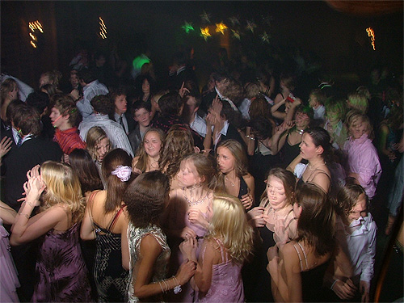
Complete Random Change
Graph can totally be changed between agent moves
The choice of movement can be view as:
A choice of the current neighbors
Then a choice from the neighbors set
Like a random walk on a complete graph
Cover time for a complete graph is
O(n lg n)
Notes:
We now turn to consider a case in which the communication graph totally changes between agent moves.
One may view the choice of movement as a choice of the current neighbor’s sets, and then choice of a neighbor that the agent moves to.
Therefore, this case is similar to a random walk on a complete graph.
Cover time of a complete graph is in the order of n lg n.

Slide 20
Estimating n (simplified ver.)
Problem – the complexity is O(N³ lg N)
Replacement of N by n is desired!
The agent list the nodes it visits
Order by most recently visited
Remove nodes that are not visited
O(t³ lg t) agent moves
t is the order in the list
Output the size of the list as n
ID Mov
585 0
471 1
354 2
784 5
958 87
473 91
gap
Notes:
A good estimation on the number of nodes ensures that the system react faster to changes.
We list the nodes visited by the agent.
The agent removes, from the list, any node that is not visited for large number of agent moves.
When no new node is added, for large number of agent moves, the agent estimates that the list includes all the nodes in the system.

Slide 21
Membership Service
Establish a view
Whenever a node joins/leaves the group
A node may voluntarily join/leave the system
A node is removed from the members list
If not visited for a large number of agent moves
Notes:
The agent carries a list of members.
A node may join or leave a group, when it is visited by the agent.
If a node is not visited, for a large number of agent moves, then it is removed from the membership list.
We establish a new view, whenever the membership changes.

Slide 22
Achievements
Our new approach copes with
Uncertainty nature of ad-hoc networks
Probabilistic group communication
Membership, and multicast
Requirements meet with high probability
Performance tuning by varying the probability
Notes:
We have presented a new approach that copes well with the uncertainty nature of mobile ad hoc networks.
New probabilistic group communication services were developed, that allows performance tuning by varying the probability.

Slide 23
Talk Outline
Stateless infrastructure
Random walks [DSW06]
Imaginary polygons [DHL06]
Stateless with GPS-Oracle
Virtual Stationary Automaton [DGLSW05]
Virtual Autonomous Automaton [DGSSW05]
Local state oblivious to global changes
Empire of colonies [DT06]
Spanders, spanning expanders [DT06]

Slide 24
Polygonal Broadcast, Secret Maturity and the Firing Sensors
Shlomi Dolev BGU
Ted Herman UIOWA
Limor Lahiani BGU
PODC 04, AD-HOC Networks Journal 2006

Slide 25
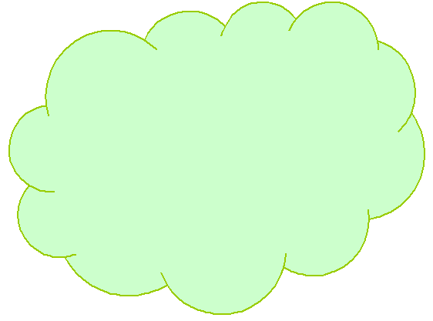

Slide 26
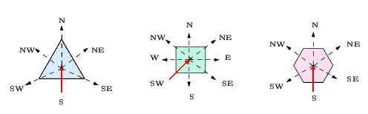
Polygon Relative View
A message either arrives through an edge, namely the S direction, or through a vertex (angle), namely the SW direction.
The other directions are implicitly defined.

Slide 27
N
Initiator
Message
Local transmission

Slide 28
Polygonal Broadcast Schemes
Imaginary (all regular) polygonal tiling
One bit broadcast scheme for square tiling
One bit broadcast scheme for hexagon tiling
Two bits broadcast scheme for triangle tiling

Slide 29
One Bit Broadcast Scheme for Square Tiling
1
1
0
0
1
1
0
1
1
0
1
0

Slide 30
One Bit Broadcast Scheme for Hexagon Tiling
1
0
0
1
1
1
1
1
1

Slide 31
Two Bits Broadcast Scheme for Triangle Tiling
00
01
01
00
01
01
00
10
11
00
11
10
10
11

Slide 32
Talk Outline
Stateless infrastructure
Random walks [DSW06]
Imaginary polygons [DHL06]
Stateless with GPS-Oracle
Virtual Stationary Automaton [DGLSW05]
Virtual Autonomous Automaton [DGSSW05]
Local state oblivious to global changes
Empire of colonies [DT06]
Spanders, spanning expanders [DT06]

Slide 33
Virtual Stationary (Memory and then) Automata for Mobile Networks
Shlomi Dolev, Limor Lahiani
Seth Gilbert, Nancy Lynch, Tina Nolte, Alex Shvartsman, Jennifer Welch
GeoQuorums DISC 2003-4, Distributed Computing Journal 2005, SSS and OPODIS 2005
Notes:
I’ll be talking about the Virtual Stationary Automata programming layer for mobile networks. This is joint work with Shlomi Dolev and Limor Lahiani of Ben Gurion University and Seth Gilbert and Nancy Lynch here. We have just submitted a version of this paper to ICDCS.

Slide 34

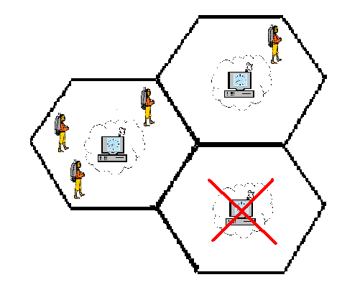
VSA layer implementation
Real mobile nodes and their broadcast services
An individual VSA is emulated by real nodes in its region:
Not all VSAs have to be alive.
Dead VSAs should be restartable.
Fault-tolerant and self-stabilizing.
Notes:
Of course, we have to ask the question: How do we get the VSA layer?
The VSA layer is implemented by the real mobile nodes in the system.
In particular, the VSA at a particular region is emulated by some number of real mobile nodes currently located in its region.
Since not all regions might be populated, VSAs are permitted to fail; if a mobile node later enters the region, the VSA can restart.
The implementation should be fault-tolerant (mobile nodes could die, restart, or leave) and self-stabilizing (mobile node state could be corrupted).

Slide 35

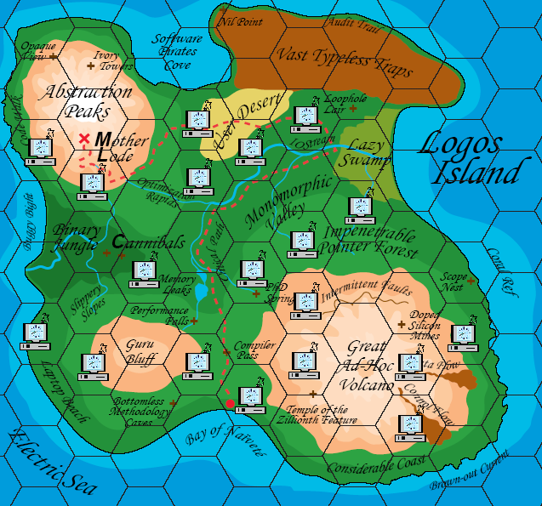
Virtual Stationary Automata layer
Tile the space with globally-known regions.
Put timing-capable virtual stationary automata (VSAs) at various regions.
Allow VSA communication:
With nearby VSAs.
With real mobile nodes in the VSA’s region.
Notes:
How would such an infrastructure look?
We suggest tiling the deployment space, carving up the space into globally-known regions.
We then put timing-capable virtual stationary machines at those regions.
These machines can interact with nearby VSAs and real mobile nodes through a broadcast service.

Slide 36
Virtual Memory Systems and Stationary Automaton
Virtual Storage: GeoQuorums [DGLSW’03]
Atomic read/write memory
Virtual Mobile Nodes [DGLSSW’04]
Untimed automata
Restricted mobile
Notes:
The idea of using static geographic regions as substitutes for real data repositories is not new.
However, most prior work did not attempt to provide a general programming layer; static regions were used in ad-hoc ways in particular algorithms.
The GeoQuorums work tried to rectify this by defining focal points, stationary virtual atomic objects. These focal points were, however, not automata and, once depopulated, could not recover.
The Virtual Mobile Node work suggested the idea of a virtual automaton that would travel a path through the network. These virtual nodes, however, were general automata, not timed automata.
The VSA layer we define here provides timed automata, and suggests using a complete stationary tiling of the network.

Slide 37
Virtual traffic lights
Communicate with cars,
Learn who is approaching,
Decide who has green light.
Offload statistics to Highway Patrol vehicles as they pass.
Notes:
A particular coordination application is that of a virtual traffic light.
Cars with GPS systems connected to computers implement an intersection VN, which is programmed to provide a traffic light service.
It may not be possible to install traffic light infrastructure in certain environs, but it’s easy to install software on car computers.
This service could be extended to have different virtual traffic light VNs coordinate amongst themselves to provide optimal traffic patterns.
They could also be used to collect data about traffic flow that could subsequently be collected.

Slide 38
Virtual Traffic Light
Vehicular networks
Traffic control and safety
E.g., ad hoc traffic light

Slide 39
Talk Outline
Stateless infrastructure
Random walks [DSW06]
Imaginary polygons [DHL06]
Stateless with GPS-Oracle
Virtual Stationary Automaton [DGLSW05]
Virtual Autonomous Automaton [DGSSW05]
Local state oblivious to global changes
Empire of colonies [DT06]
Spanders, spanning expanders [DT06]

Slide 40
Autonomous Virtual Mobile Node
Shlomi Dolev Seth Gilbert
Elad Schiller Alex Shvartsman
Jennifer Welch
SPAA, DIALM-POMC 2005
Notes:
1

Slide 41
Challenges
Locality
Nodes only send messages to nearby nodes
Global coordination is expensive
Locality
Unreliable nodes
Mobile nodes fail,
go to sleep, and
get turned off.

Slide 42
Challenges
Locality
Unreliable nodes
Irregular motion
Locality
Unreliable nodes
Nodes travel wherever they want to go
Mobile nodes fail,
go to sleep, and
get turned off.

Slide 43
Challenges
Locality
Unreliable nodes
Irregular motion
Nodes travel wherever they want to go

Slide 44
Autonomous Virtual Mobile Node
Automaton
New programming abstraction
A virtual general-purpose computing entity.

Slide 45
Autonomous Virtual Mobile Node
Automaton
New programming abstraction
Distinct location at any time
Implemented by “real’’ mobile nodes that happens to be near.

Slide 46
Autonomous Virtual Mobile Node
Automaton
New programming abstraction
Distinct location at any time
Communicates with:
other virtual nodes, and
“real” mobile nodes.

Slide 47
Autonomous Virtual Mobile Node
Automaton
Reliability
Automaton
Reliability
Fault recovery
Automaton
Reliability
Autonomous
Fault recovery
Self-stabilization
On-line movement decision:
current state, and
sensor/environment input.
Example 1
If north-east area appears deserted
go south-west
Tolerate any starting state:
maybe several (undesired) copies, or
none at all.
The group emulation enhances robustness:
some may fail, or
move out of range.

Slide 48
Autonomous Virtual Mobile Node
Automaton
Reliability
Autonomous
On-line movement decision:
current state, and
sensor/environment input.
Example 2
Hitchhike with the traffic, or
Go in the opposite direction

Slide 49
Application Domain
Vehicular networks
RFID tags
Very small, cheap and wireless tagging network.
Limited power supply.
Photoelectric gate
Use flash light to activate the net
The AVMN follows the light
E.g.,
count the number of items
find an expired item
Use microwave instead of light.

Slide 50
Application Domain
Vehicular networks
RFID tags
Swarm computing
Multiple virtual nodes
Hierarchically originated
Performing different task
Collaborating or competing

Slide 51
Implementation
Exactly 1 instance
Three different schemes
Virtual Stationary Automaton
alive messages to known location
of a stationary node (VSA)
VSA keeps track of the AVMN
No message for too long
create a new AVMN
VSA eliminates duplicates

Slide 52
Implementation
Exactly 1 instance
Self-stabilization
Every emulating real node
Keeps a replica of the AVMN
Ensures identical replica
Buffer input events waiting to be applied to the state.
At a fixed interval,
sends replica to all.
Predetermined function resolves conflicts.
<State_{1,} input₁>
<State_{1,} input₁>
<State_{1,} input₁>
<State_{2,} input₂>
<State_{2,} input₂>
<State_{2,} input₂>
<State_{2,} input₂>
<State_{1,} input₁>
<State_{3,} input₃>
<State_{3,} input₃>
<State_{3,} input₃>

Slide 53
Talk Outline
Stateless infrastructure
Random walks [DSW06]
Imaginary polygons [DHL06]
Stateless with GPS-Oracle
Virtual Stationary Automaton [DGLSW05]
Virtual Autonomous Automaton [DGSSW05]
Local state oblivious to global changes
Empire of colonies [DT06]
Spanders, spanning expanders [DT06]

Slide 54
Empire of Colonies: Self-Stabilizing and Self-Organizing Distributed Algorithms
Shlomi Dolev and Nir Tzachar
OPODIS 2006, Theoretical Computer Science Journal

Slide 55

Overview
Self-Stabilizing and Self-Organizing
fast convergence – O(log^2 n)
faster reaction to topology changes – O(log n)
Locally Establish and Immediately Use Overlay Communication Links
Computer Scientists Repeatedly Double to Achieve O(log n)…

Slide 56
Overview
Construct Hierarchy of O(log n) Level of Clusters
Self-Stabilizing and Self-Organizing Versions of
Snapshots, Leader Election, Topology Update…
O(log^2 n) stabilization time!!
And O(log n) per topology change!!!

Slide 57
Self Organization
Convergence time of self organizing algorithms should be sub-linear
Topology changes or transient faults (after convergence) imply even faster convergence

Slide 58
Local Algorithms for Hierarchy Definition
We use clustering to realize hierarchical structure
First, choose leaders in distance X to 2X
Then, continue the clustering algorithm among the chosen leaders…

Slide 59
Synchronous Cluster Construction
(Simultaneously) collect X-neighborhood topology,
Look for leader processors within X-neighborhood
If one was found, p joins that leader’s cluster
If none was found, p declares itself a leader
Leaders within distance X compete…

Slide 60
Cluster Construction
processor
leader
link
X = 2
A few processors notice there are no leaders in their neighborhood – and become leaders
Other processors notice them, and join their clusters

Slide 61
Cluster Construction
processor
leader
link
X = 2
Two processors, which are distanced less than X from each other, see no leader, and declare themselves leaders
After some time, they will notice one another, and battle for leadership

Slide 62
Cluster Construction
processor
leader
link
X = 2
Only One will prevail, and other processors will join its cause…

Slide 63
Cluster Construction
processor
leader
link
X = 2
The algorithm converges from any state…

Slide 64
Conflict Resolution
Each X synchronous rounds, each leader, p, uniformly chooses a new random identifier, rtp_{p}
When a leader, q, notices another leader, r, in its X-neighborhood, the leader with the highest rtp value wins

Slide 65
Stable Processors
processor
leader
link
X = 2
A stable leader

Slide 66
Stable Processors
processor
leader
link
X = 2
Stable processors

Slide 67
Stable Processors
processor
leader
link
X = 2
Unstable processors

Slide 68
Stable Processors
Once a processor is stable, it remains stable
as long as no faults / topology changes occur…
The algorithm converges when all processors are stable

Slide 69
Self Organization - Clustering
Convergence time is O(log n)
Topology changes can affect only a local area, of radius 2X – hence convergence time after a topology change is constant
Each topology change can affect only a constant number of processors, in each level of the hierarchy

Slide 70
Talk Outline
Stateless infrastructure
Random walks [DSW06]
Imaginary polygons [DHL06]
Stateless with GPS-Oracle
Virtual Stationary Automaton [DGLSW05]
Virtual Autonomous Automaton [DGSSW05]
Local state oblivious to global changes
Empire of colonies [DT06]
Spanders, spanning expanders [DT06]

Slide 71

Spanders: Distributed Spanning Expanders
Shlomi Dolev and Nir Tzachar
CRI 2008

Slide 72
Formal Definition of Edge Expanders
Edge expansion parameter :
Where c is a constant
Is larger than a constant
For each subset S of V
The ratio between edges exiting S and the size of S
Such that S is not too large

Slide 73
What Are Expandrs Good For
Cryptography
Error correcting codes
PCP proofs
Etc…
Communication!

Slide 74
Expanders as Communication Networks
Highly connected
Symmetric
Sparse
Small diameter (log n)
Robust for dynamic changes
Fast mixing rate → sampling

Slide 75
Mission Statement
Input: an arbitrary expander graph
Output: a spander (a spanning expander)
Construct expanders in a distributed setting
The construction must be self-stabilizing and self-organizing

Slide 76
Self-Organization
A sub-domain of self-stabilization
Convergence time is sub-linear (o(n))
Quick reaction to topology changes (o(convergence))

Slide 77
Spanning K_{n} with an Expander
We construct a non-regular expander with high probability without using communication
Each node selects d random neighbors
Yields an expander with probability 1-o(1)
Maximal degree O(log n)
Average degree d

Slide 78
Arbitrary Graphs
The previous technique does not work!
Example recipe: take an expander, “clique” half of the nodes.
Solution: each node chooses each edge with probability p
Observation: “fat” cuts in the graph will remain “fat”.

Slide 79
Arbitrary Graphs
Given an expander G=(V,E), with edge expansion clog n
Define: G’=(V,E’) where E’⊂E and
P[(u,v) ∈ E’] = p
G’ has expansion p·O(log n) with probability 1-o(1)

Slide 80
Distributed Construction
Trivially implemented distributively
The construction is probabilistic and (therefore) easily copes with dynamic changes
The construction should be self-stabilizing
→We need a monitoring algorithm (expansion verification)

Slide 81
Monitoring Building Blocks
Snap Stabilizing Reset for message passing systems
Distributed rooted tree
Single shot monitoring using short random walks

Slide 82
Detecting Bad Expansion
If expansion is less than 1/8log³n, nlog(n) random walks do not cover the entire graph with probabiliy at least ½
Intuition: small cuts will not be crossed very often
Detection Gap
O(1/log³n)
O(log n)
Notes:
Add why we need multi shoot, since when one started in the middle!!!

Slide 83
Some More Trouble in Paradise
h
h

Slide 84
Solution: Multi-Shot Monitoring
Use the tree structure to (uniformly) select a random edge from which to start a single-shot monitoring
Repeat a constant number of times to improve detection probabilities (and solve the betweenness problem(

Slide 85
No More Trouble in Paradise

Slide 86
Self-Organization Properties
All of our protocols are self-stabilizing
Use reset protocol that takes O(d) to converge, but is invoked with a very small probability (implies amortized convergecnce)
Nodes may join and leave the graph incuring only local updates

Slide 87
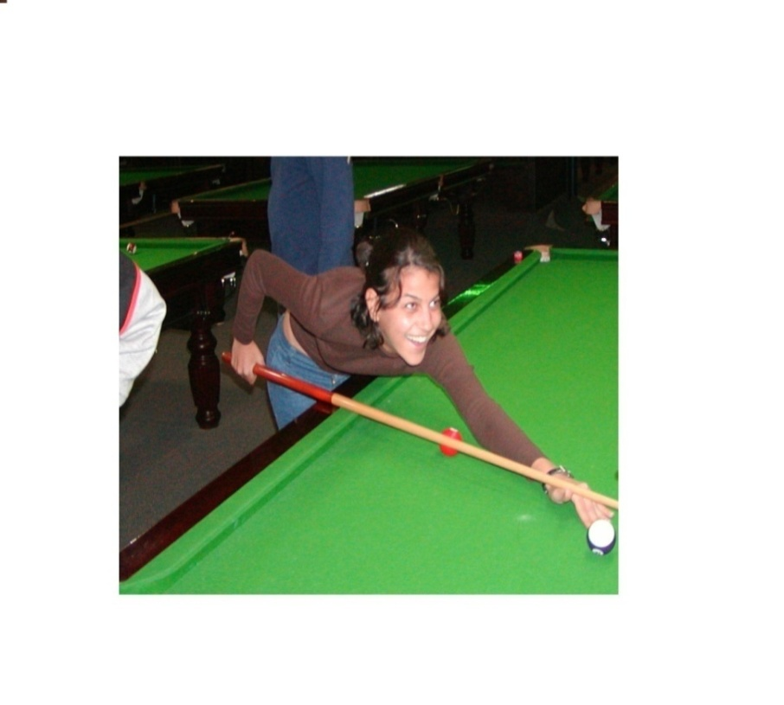



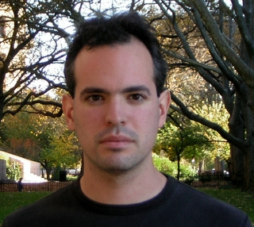
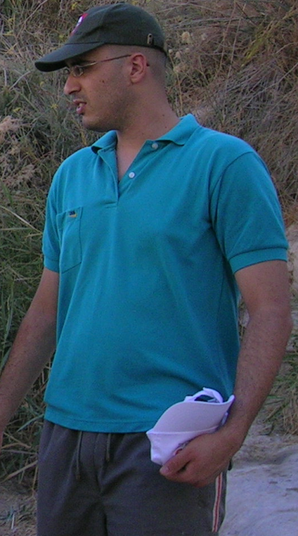
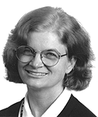
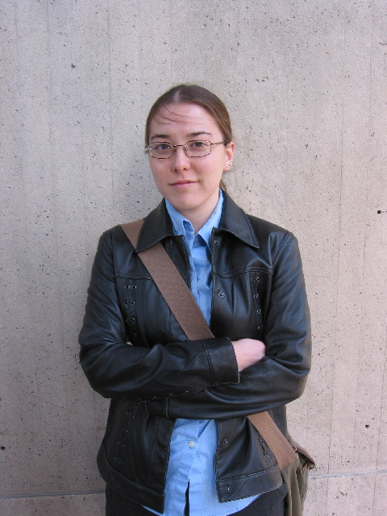


Slide 88
Thanks !

Slide 89
Talk Bonus: Secret Swarm Unit Reactive k-Secret Sharing
Shlomi Dolev¹, Limor Lahiani¹, Moti Yung²
Department of Computer Science
1 Ben-Gurion University , Israel
2 Columbia University, NYC

Slide 90

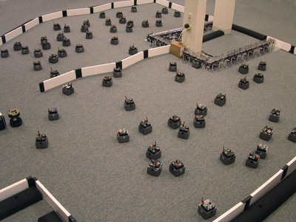

Intro: What is a Swarm
A collection of processors
collaborating on a mission
Mobile sensors
UAVs
Processors / RFIDs
Notes:
90

Slide 91
Intro: Swarm Motivation
Robustness
Fault tolerance
Security
Notes:
Robustness – Potentially robust. many entities with greater potential to success in mission. No single point of failure
Fault tolerant scheme – for the cases that some may fail
Security – some may compromised, mission can be revealed
91

Slide 92
Talk Outline
Introduction & motivation
The problem
Swarm settings
Reactive k-secret sharing solutions
Polynomial based solution
Chinese remaindering based solution
Virtual I/O automaton
Conclusions
Notes:
92

Slide 93


Swarm’s Global Secret
Distributed secret shares
Notes:
93
Example: attack mission

Slide 94
Swarm’s Global Secret
Distributed secret shares
p
Notes:
94
Listening to all communication but not sending message
Capture a process

Slide 95

The Problem
Can members modify the global secret
without knowing the secret
before and after the change
and with no internal
communication?
THINK AGAIN!
Notes:
95

Slide 96
Talk Outline
Introduction & motivation
The problem
Swarm settings
Reactive k-secret sharing solutions
Polynomial based solution
Chinese remaindering based solution
Virtual I/O automaton
Conclusions
Notes:
96

Slide 97

Swarm Settings (1)
n swarm members
Distributed secret shares
Any less thank k cannot reveal
At least k to reveal (p)
Compromising adversary
Listening (no sending)
Compromise at most f < k
Corruptive adversary
Listening (no sending)
Corrupt at most f < k
Notes:
97

Slide 98


Swarm Settings (2)
No internal communication
Avoided/safe area
Simultaneous external input
Controller
Event observed/sensed
X
X
X
X
Notes:
98

Slide 99
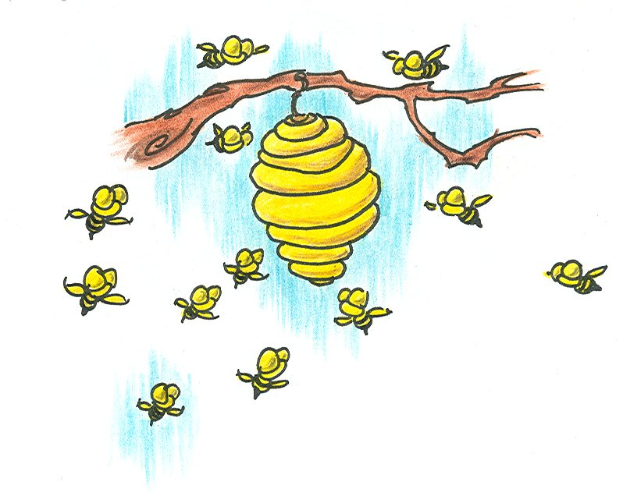
Swarm Settings (3)
Swarm input actions
regainConsistencyRequest()
regainConsistencyReply()
step()
joinRequest()
set()
joinReply()
Notes:
99

Slide 100
Our Polynomial Based Solution Shamir’s (k,n)-threshold scheme
Secret: Globl counter GC
p(x) = a₀+a₁x+a₂x²+…+a_{k}x^{k}
a₁..a_{k} are random
Secret: a₀ = GC
Secret distribution
n distinct points: (x_{i},p(x_{i})), x_{i} ≠ 0
GC = p(0)
Any k points reveals the secret
No less than k reveals it
Notes:
100

Slide 101
Our Polynomial Based counter
Increment counter: GC ← GC+δ
p(x) = GC+a₁x+a₂x²+…+a_{k}x^{k}
q(x) = p(x) + δ
q(x) is defined by ⟨x_{i},p(x_{i})+δ⟩
Multiply : Gc ← GC·μ
p(x) = GC+a₁x+a₂x²+…+ a_{k}x^{k}
q(x) = p(x)·μ
q(x) is defined by ⟨x_{i},p(x_{i})·μ⟩
Notes:
101
Lagranze interpolation imply

Slide 102

Our Polynomial based solution Swarm input: set
set( ⟨x_{i},p(x_{i})⟩)
Notes:
102

Slide 103
Our Polynomial based solution Swarm input: step
step()
δ
⟨x_{i}, p(x_{i})⟩ ← ⟨x_{i}, p(x_{i})+δ⟩
And the same for multiplication by μ
Notes:
103

Slide 104


Our Polynomial based solution input: regain consistency request
regainConsistencyReq()
leader
⟨x_{i}, p(x_{i})⟩
Notes:
104

Slide 105
Our Polynomial based solution input: regain consistency request
leader
Notes:
105

Slide 106
Our Polynomial based solution input: regain consistency reply
leader
⟨x_{i}, p(x_{i})⟩
Notes:
106

Slide 107


Our Polynomial based solution input: join request & reply
joinReq()
joinReply()
Notes:
107

Slide 108
Our Polynomial Based Solution (Corruptive Adversary)
Berlekamp-Welch
Polynomial p(x) of degree k
k+r points
e errors
Decode p(x) if e < r/2
Polynomial based solution
Decode p(x) if f < (n–k–lp)/2
Where lp = num of leaving processes between two regainConsistency ops.
Notes:
108

Slide 109
Other Schemes
Reactive k-secret sharing solutions
Polynomial based solution
Chinese remaindering based solution
Virtual I/O automaton
Conclusions
Notes:
109

Slide 110
From Polynomial Solution to Chinese Remainder Solution
Secret D
Polynomial based solution
⟨x,p(x)⟩ is of order of D
Minimum k·logD space
Chinese remainder solution
0 ≤ D < p₁⋅p₂⋅… ⋅p_{k}
Minimum logD space actually l≥k
Notes:
110
Tradeoff space and info revealed

Slide 111
Our Chinese Remainder Based Solution
Swarm secret: global counter GC
p₁ < p₂ < … < p_{k} relatively primes
M_{k} = p₁⋅p₂⋅… ⋅p_{k}
0 ≤ GC < M_{k}
GC ≡ ⟨r₁,p₁⟩, ⟨r₂,p₂⟩,…, ⟨r_{l} ,p_{k}⟩ [CRT]
r_{i} = GC mod p_{i}
GC ≡ ⟨r₁, r₂,…,r_{k}⟩
Secret share
⟨r_{i}, p_{i}⟩, r_{i} = GC mod p_{i}
Notes:
111

Slide 112
Example ⟨p₁=2, p₂=3, p₃=5⟩, ⟨r₁=0, r₂=0, r₃=0⟩ 0 ≤ GC < 30
0 ⟨0,0,0⟩
Notes:
112

Slide 113
Example ⟨p₁=2, p₂=3, p₃=5⟩, ⟨r₁=0, r₂=0, r₃=0⟩ 0 ≤ GC < 30
0 ⟨0,0,0⟩
1 ⟨1,1,1⟩
Notes:
113

Slide 114
Example ⟨p₁=2, p₂=3, p₃=5⟩, ⟨r₁=0, r₂=0, r₃=0⟩ 0 ≤ GC < 30
0 ⟨0,0,0⟩
1 ⟨1,1,1⟩
1 ⟨0,2,2⟩
Notes:
114

Slide 115
Example ⟨p₁=2, p₂=3, p₃=5⟩, ⟨r₁=0, r₂=0, r₃=0⟩ 0 ≤ GC < 30
0 ⟨0,0,0⟩
1 ⟨1,1,1⟩
2 ⟨0,2,2⟩
3 ⟨1,0,3⟩
Notes:
115

Slide 116
Example ⟨p₁=2, p₂=3, p₃=5⟩, ⟨r₁=0, r₂=0, r₃=0⟩ 0 ≤ GC < 30
0 ⟨0,0,0⟩
1 ⟨1,1,1⟩
2 ⟨0,2,2⟩
3 ⟨1,0,3⟩
4 ⟨0,1,4⟩
Notes:
116

Slide 117
Example ⟨p₁=2, p₂=3, p₃=5⟩, ⟨r₁=0, r₂=0, r₃=0⟩ 0 ≤ GC < 30
0 ⟨0,0,0⟩
5 ⟨1,2,0⟩
1 ⟨1,1,1⟩
2 ⟨0,2,2⟩
3 ⟨1,0,3⟩
4 ⟨0,1,4⟩
Notes:
117

Slide 118
Example ⟨p₁=2, p₂=3, p₃=5⟩, ⟨r₁=0, r₂=0, r₃=0⟩ 0 ≤ GC < 30
0 ⟨0,0,0⟩
5 ⟨1,2,0⟩
1 ⟨1,1,1⟩
6 ⟨0,0,1⟩
2 ⟨0,2,2⟩
3 ⟨1,0,3⟩
4 ⟨0,1,4⟩
Notes:
118

Slide 119
Example ⟨p₁=2, p₂=3, p₃=5⟩, ⟨r₁=0, r₂=0, r₃=0⟩ 0 ≤ GC < 30
0 ⟨0,0,0⟩
5 ⟨1,2,0⟩
1 ⟨1,1,1⟩
6 ⟨0,0,1⟩
2 ⟨0,2,2⟩
7 ⟨1,1,2⟩
3 ⟨1,0,3⟩
4 ⟨0,1,4⟩
Notes:
119

Slide 120
Example ⟨p₁=2, p₂=3, p₃=5⟩, ⟨r₁=0, r₂=0, r₃=0⟩ 0 ≤ GC < 30
0 ⟨0,0,0⟩
5 ⟨1,2,0⟩
1 ⟨1,1,1⟩
6 ⟨0,0,1⟩
2 ⟨0,2,2⟩
7 ⟨1,1,2⟩
3 ⟨1,0,3⟩
8 ⟨0,2,3⟩
4 ⟨0,1,4⟩
Notes:
120

Slide 121
Example ⟨p₁=2, p₂=3, p₃=5⟩, ⟨r₁=0, r₂=0, r₃=0⟩ 0 ≤ GC < 30
0 ⟨0,0,0⟩
5 ⟨1,2,0⟩
1 ⟨1,1,1⟩
6 ⟨0,0,1⟩
2 ⟨0,2,2⟩
7 ⟨1,1,2⟩
3 ⟨1,0,3⟩
8 ⟨0,2,3⟩
4 ⟨0,1,4⟩
9 ⟨1,0,4⟩
Notes:
121

Slide 122
Example ⟨p₁=2, p₂=3, p₃=5⟩, ⟨r₁=0, r₂=0, r₃=0⟩ 0 ≤ GC < 30
0 ⟨0,0,0⟩
5 ⟨1,2,0⟩
10 ⟨0,1,0⟩
1 ⟨1,1,1⟩
6 ⟨0,0,1⟩
2 ⟨0,2,2⟩
7 ⟨1,1,2⟩
3 ⟨1,0,3⟩
8 ⟨0,2,3⟩
4 ⟨0,1,4⟩
9 ⟨1,0,4⟩
Notes:
122

Slide 123
Example ⟨p₁=2, p₂=3, p₃=5⟩, ⟨r₁=0, r₂=0, r₃=0⟩ 0 ≤ GC < 30
0 ⟨0,0,0⟩
5 ⟨1,2,0⟩
10 ⟨0,1,0⟩
1 ⟨1,1,1⟩
6 ⟨0,0,1⟩
2 ⟨0,2,2⟩
7 ⟨1,1,2⟩
3 ⟨1,0,3⟩
8 ⟨0,2,3⟩
4 ⟨0,1,4⟩
9 ⟨1,0,4⟩
29 ⟨1,2,4⟩
Notes:
123

Slide 124
Swarm Input
p_{i}⇔x_{i} , r_{i} ⇔ p(x_{i})
regainConsistencyRequest()
regainConsistencyReply()
step()
joinRequest()
set()
joinReply()
Notes:
124

Slide 125
Our Chinese Remainder Based Solution (Corruptive adversary)
Mandelbaum
p₁ < p₂ <…< p_{k} <…< p_{k+r} , relatively primes
M_{k} = p₁⋅p₂⋅… ⋅p_{k}
0 ≤ GC < M_{k}
e errors
Detect: e ≤ r
Correct: e ≤ r/2
Chinese remainder based solution
Detect: f ≤ n-k-lp
Correct: f ≤ (n-k-lp)/2
Notes:
125
R = redundancy

Slide 126
Other Schemes
Reactive k-secret sharing solutions
Polynomial based solution
Chinese remaindering based solution
Virtual I/O automaton
Notes:
126

Slide 127
Virtual I/O Automaton
I/O Automaton A
Implemented by the swarm
Global state (Global secret)
Current state of A
Replicated at least T ≤ n times
Regain consistency ensures:
At least T+lp+f replicas of the global state
At most T-f-1 replicas of any other state
Global output
Output with at least T ≤ n replicas
Threshold device
Notes:
127
Local(A)= int(acts(a)) U out(acts(A))
Device – the amount of energy when transmitting T laser beems

Slide 128
Virtual I/O Automaton
Secret share
Tuple ⟨s_{i1},s_{i2},…,s_{im}⟩ of candidates
At most 1 state is the global state
Step(δ)
transition step on s_{i1},s_{i2},…,s_{im} and δ
New tuple of candidates: ⟨s’_{i1},s’_{i2},…,s’_{im}⟩
Output actions ⟨o_{i1},o_{i2},…,o_{im}⟩
At least T replicas of the global output
Notes:
128

Slide 129


Thank You!
Notes:
129

