Slide 1
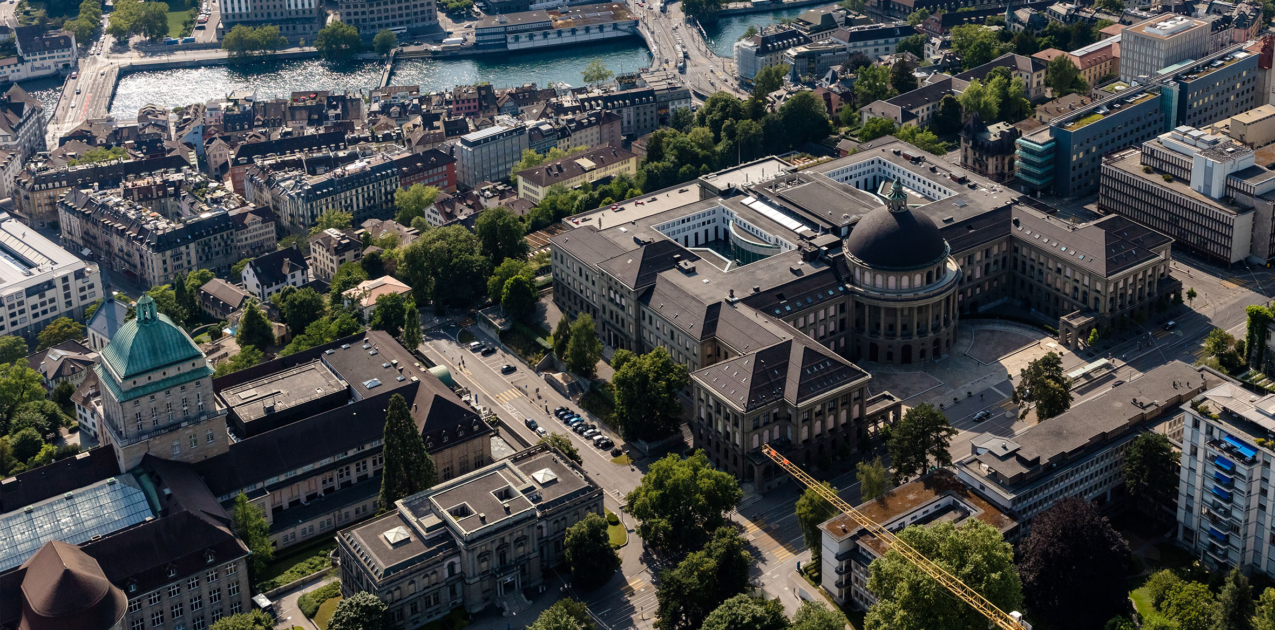
Hier steht der Titel der Präsentation
Organisationseinheit verbal optional auf 2 Zeilen
Prof. Dr. Beat Muster
Funktion des Präsentierenden
TT. Monat JJJJ, Ort
STRENG VERTRAULICH

Slide 2
Agenda
Feature List
Work by far
Data Collection
Research Work for gaze estimation model

Slide 3
What can be fed into network?
Raw Data
3D mesh of the scene
Raw RGB-Videos (including gaze fixations)
Camera Parameters (pose + location)
Extractable featrures
Depth Map (ray casting)
Stacked Optical Flow (2D) (dense flow tool)
Saliency Map (2D) (Gunner Farneback's algorithm)
3D Saliency Map
Object Detection and Tracking (2D + 3D)
Supervised learning (if ground truth object label can be manually annotated on the scene)
Self-supervised learning
Final annotations of the object can be fed into network for gaze estimation

Slide 4
Work by far
ToDo: Put some demo here
RGB Registration
Depth map extraction
Saliency Map

Slide 5
Data Collection
Necessary Data
RGB Video automatically recorded by the eye-tracking device
Dense 3D Mesh of the scene
Using SfM-based tool to reconstrcut the mesh (e.g. colmap)
Scan the scene by a Lidar-based device
Utilization of the extrinsic paramters (calibration with help of markers in the scene)
Registration of gaze target on 3D mesh as ground truth
For Measurement Error: Generate a gaze map instead of one fixed point (e.g. set the center of marker with the highest probability of gaze fixation and add some noise)
Optional Data
3D oriented bounding boxes for 17 categories of room-defining furniture (manally annotate with some toolkit or software, e.g. 3D Bat, MeshLab, …)
Pupil, Eye movments, Iris… for further gaze-related tasks (The Toolkit Pistol is for Pupil Invisible and is able to extract those attributes, but the toolkit is not public yet)

Slide 6
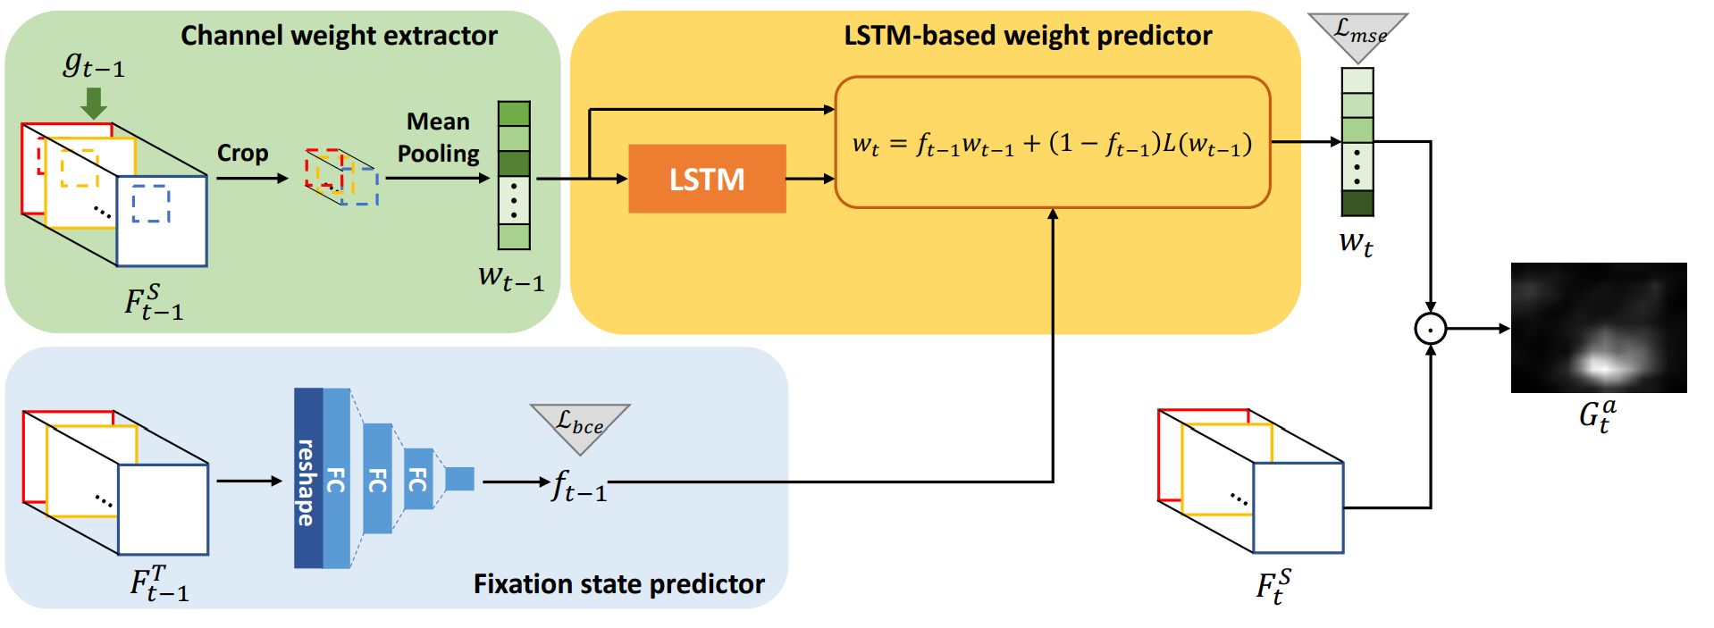
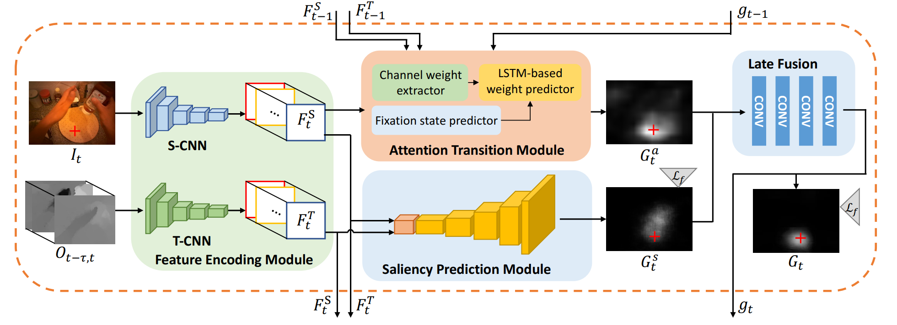
Gaze Prediction Model: Attention Transition (ECCV2018)
Fixation State Predictor estimates a probability score of gaze fixation (f_t) in range of [0, 1]
Channel weight extractor croped the previous features map with projected gaze position and average the value of each channel (get a 1-dimensional weight vector )
LSTM-based weight predictor linearly combines the original and anticipated weight, weighted by the probability score of gaze fixation → weight vector of the current frame (w_t) (Attention transition)
Weighted sum of latent representation →Attention Map
Learn the channel weights for next fixation
Hybrid-Model with saliency and attention map prediction
Task-dependet attention transition
Late Fusion Module for Attention and Saliency Map
Distance-based binary cross entropy loss (down weight the loss of estimation due to the noise of gaze)
3D conv + pooling

Slide 7
Multi-Scale Vision Transformers

Slide 8
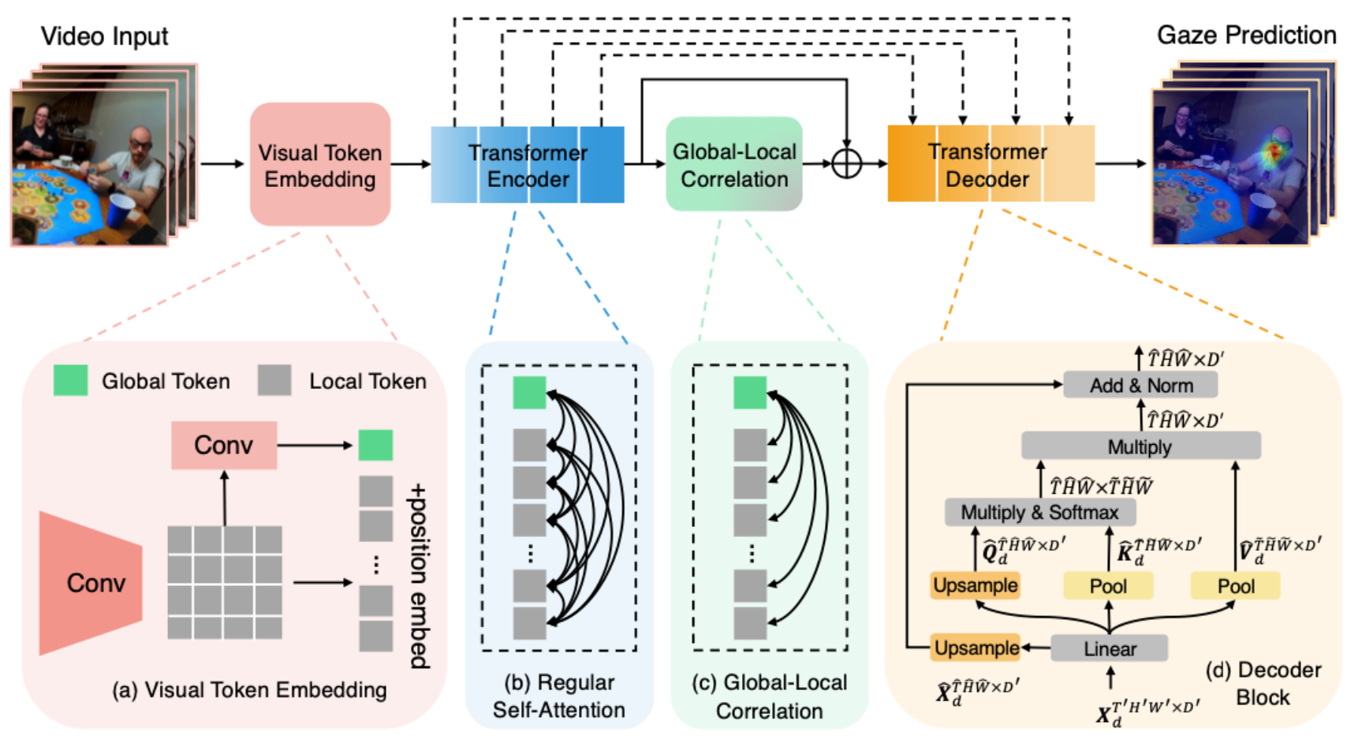
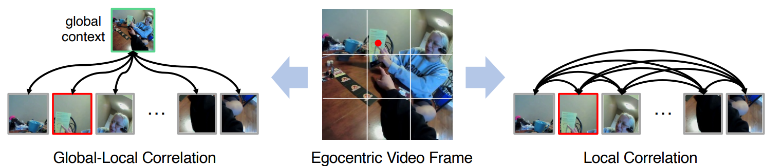
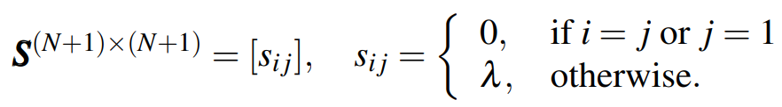
Gaze Prediction via Global-Local Correlation (BMVC2022)
Visual Token Embedding extracts N local Tokens and 1 global Token from input video
Transformer Encoder consists of Multi-Head Self Attention Module
GLC Module computes the correlation matrix (only considering the correlation score between global and local Tokens)
Transformer Decoder has the similar (inverse) structure as the encoder

Slide 9
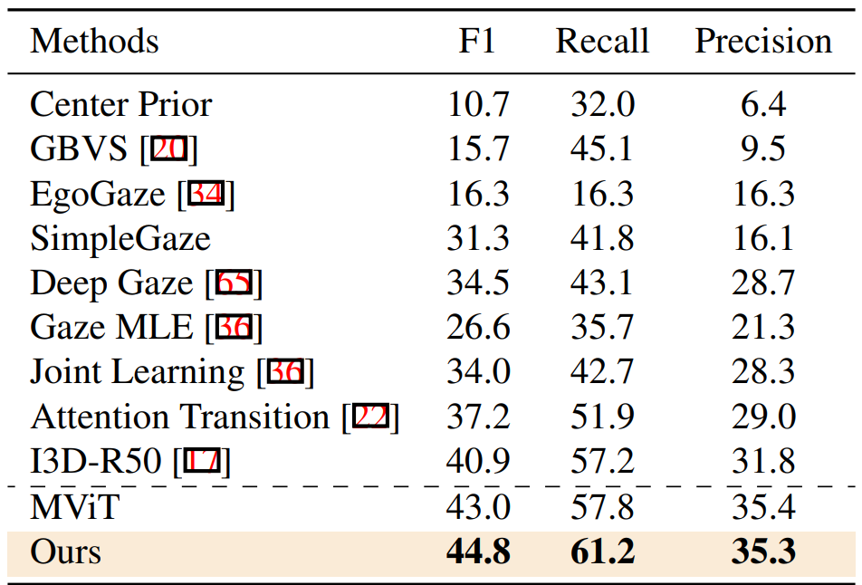
Results of prior work

Slide 10
What features might help for gaze fixation?

