Slide 1
Benchmark study: How to get the ground truth data?
2D annotations (semantic, object-based bbox, RoI, …)
Images from Front-View Camera
Black Box model
Output: 3D gaze locations (with new features)
Depth map
Dense Point Cloud
3D annotations (semantic, object-based bbox,…)
Output: 3D gaze locations (standard output)
Sampling
Scanned 3D scene data (mesh)

Slide 2
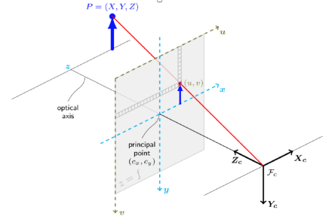
Pupil Invisible
Images from Front-View Camera
Arial Pilot (Meta)
Custom Dataset
Gaze Location on 2D frame
3D gaze locations (camera coordinate)
Benchmark study: Reliable ground truth data?

Slide 3
Benchmark study: Reliable ground truth data?
Pupil Invisible
2D annotations (semantic, object-based bbox, RoI, …)
Images from Front-View Camera
Arial Pilot (Meta)
Custom Dataset
Black Box model
Depth map
Gaze Location on 2D frame
3D gaze location (camera coordinate)
Dense Point Cloud
3D annotations (semantic, object-based bbox,…)
Sampling
Scanned 3D scene data (mesh)

