Slide 1
Paper Reading
Semester Project

Slide 2
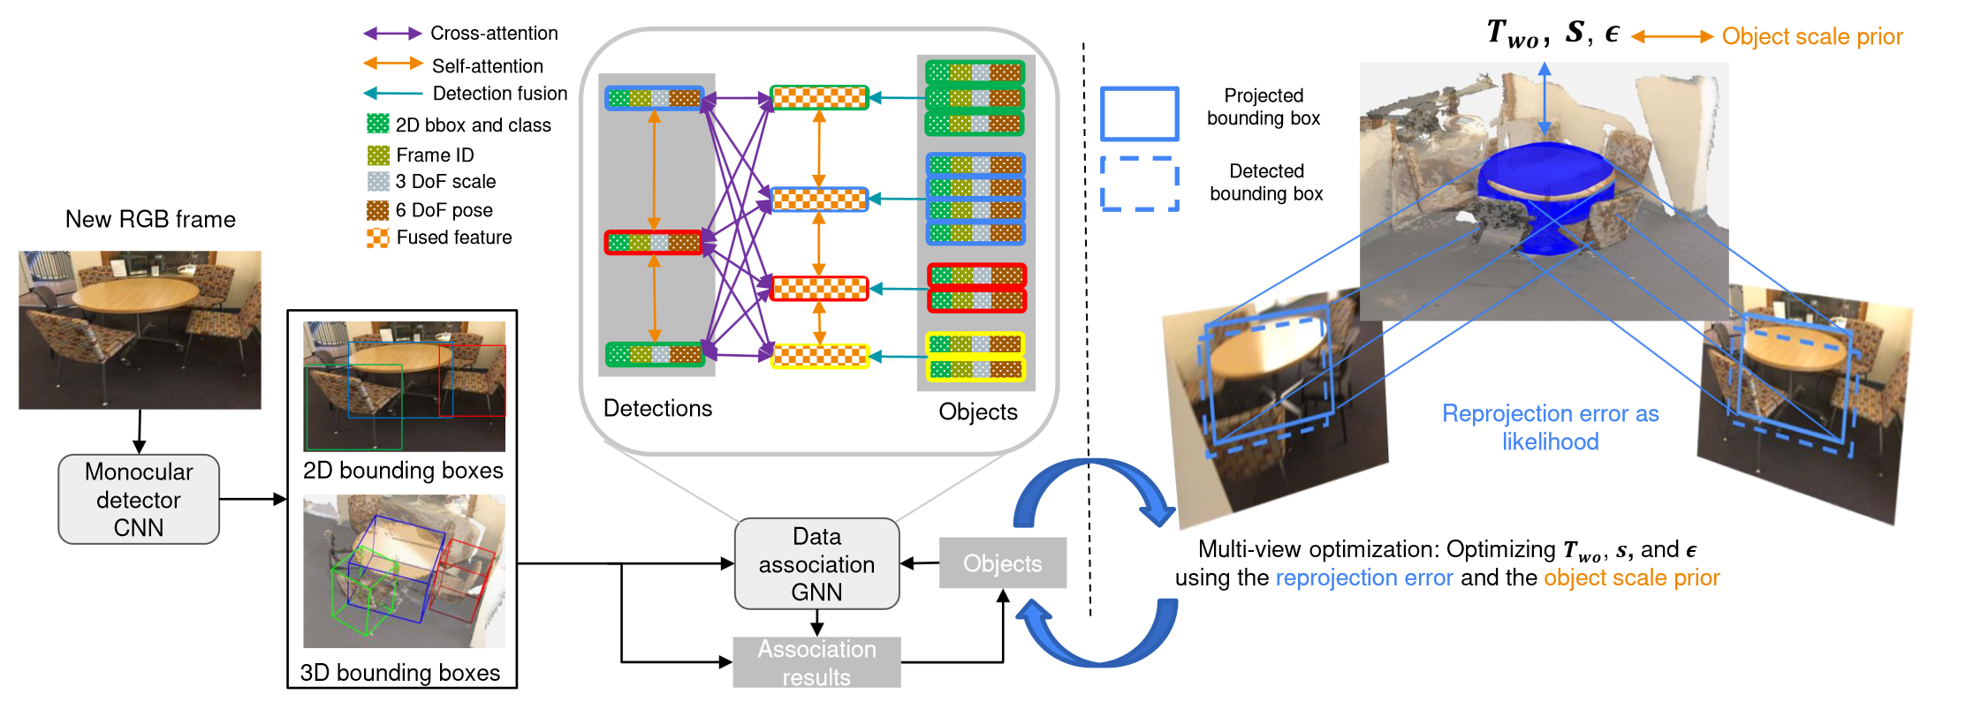
ODAM: Object Detrection, Association, and Mapping using Posed RGB Video
Goal: Localizing objects and estimate their bounding volume (representations) accurately in 3D
Input is only RGB image sequence (Weng et al. uses both 3D point cloud and images)
First step: Estimating 2D attributes (BB and object class) and 3D attributes (translation → depth + 2D center, rotation: three Euler angles)
Second step (Association of Detections): Matching (detections and existing object instances in the map) using an attention-based GNN; Benefits of using GNN: 1. Joint input from different attributes allowed, 2. Info aggragation of attention module (Object fusion + Frame-to-model association)
Third step: Multi-view optimization using super-quadric bounding volume, (a convex set bounded by the intersection region of all frustums)
Notes:
First step: Estimating 2D attributes (BB and object class) and 3D attributes (translation → depth + 2D center, rotation: three Euler angles)
Second step (Association of Detections): Matching (detections and existing object instances in the map) using an attention-based GNN
Benefits of using GNN: 1.

Slide 3
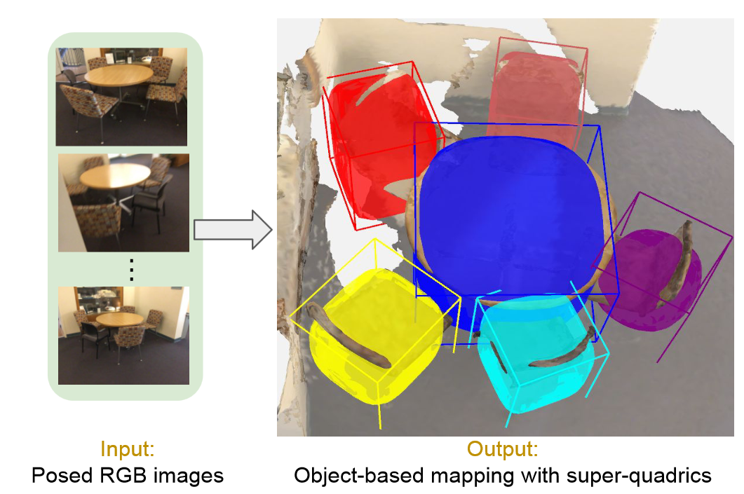
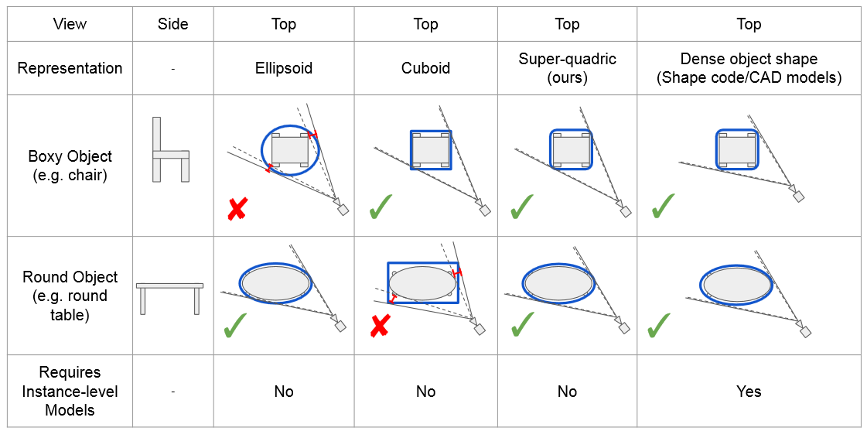
ODAM: Object Detrection, Association, and Mapping using Posed RGB Video
Limitations of object representations in multi-view optimization
Conclusion & Improvement
Comparison with Vid2CAD and MOLTR (metric is mAP of different classes w.r.t case IoU>0.25 and IOU>0.5)
Duplicated objects in V and M (failure in data association) & better orientation of bounding volume
Better performance of super-quadric in contrast to cuboid and ellipsoid
Current method performs well in distantly arranged objects within the same class (bed, table, bath…) but struggles with thin objects (door, window.. ← hard for association)
Implementation
Object detector (DETR)
GNN (3-layer MLP + 4 self-attention layers + Matching Network (similar to SuperGlue))
Optimization details: sample 1000 points on surface

Slide 4
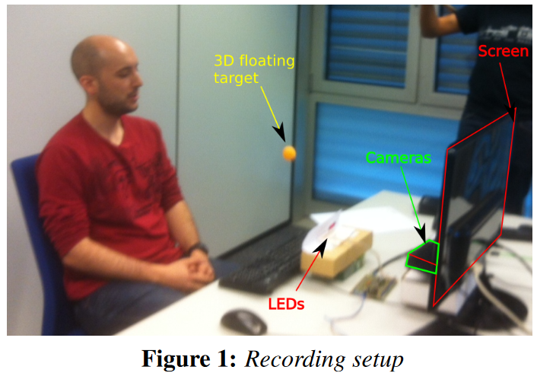
EYEDIAP: a database for the development and evaluation of gaze estimation algorithms from RGB and RGB-D cameras
Head pose variations
Person variation
Ambient and sensing condition
Types of target (screen or 3D object)

Slide 5
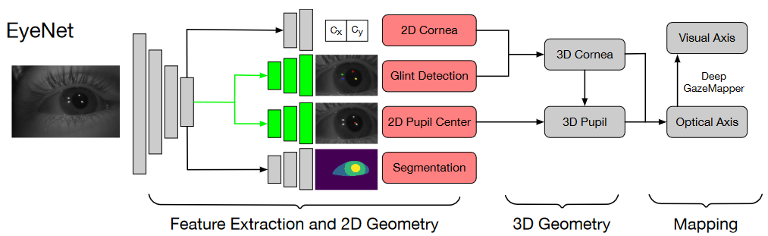
MagicEyes: A Large Scale Eye Gaze Estimation Dataset for Mixed Reality
Green boxes indicate weight sharing

Slide 6
Appearance-based Gaze Estimation With Deep Learning: A Review and Benchmark
Object-based mapping
Region-based
Region of Interest (Region Proposal)
Object Detector
Object-based mapping (semantic label)
Object-based mapping (semantic label)
Object Tracking
Object Tracking
Removing background
Active Object (weighted Module in Neural Network?)
Removing background
Active Object (weighted Module in Neural Network?)
How to encode in Network for gaze estimation?
3D bb represent corresponding object
How to encode in Network for gaze estimation?
3D bb represent corresponding object

Slide 7
Extension of Paper Reading
Next-Active-Object prediction from Egocentric Videos (A.Furnari et.al. 2019) https://arxiv.org/abs/1904.05250
GNN3DMOT: Graph Neural Network for 3D Multi-Object Tracking with Multi-Feature Learning (Weng et.al. 2020) https://arxiv.org/abs/2006.07327
Appearance-based Gaze Estimation With Deep Learning: A Review and Benchmark (Cheng et. Al. 2021) https://arxiv.org/abs/2104.12668
Recurrent CNN for 3D Gaze Estimation using Appearance and Shape Cues (C.Palmero et. Al. 2018) https://arxiv.org/abs/1805.03064v3
Gaze Estimation with Eye Region Segmentation and Self-Supervised Multistream Learning (2021)
Semantic 3D gaze mapping for estimating focused objects (R.Matsumoto 2019)

Slide 8
Object Detection
Object-based mapping
Removing background
Active Object (weighted Module in Neural Network?)

Slide 9
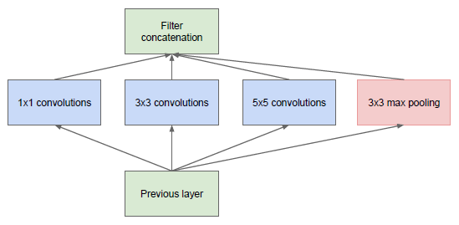
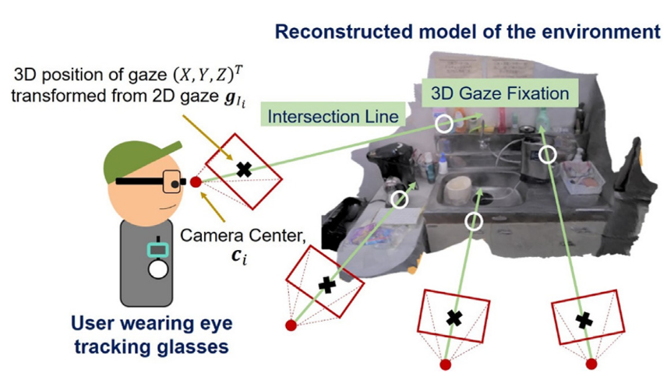

Slide 10
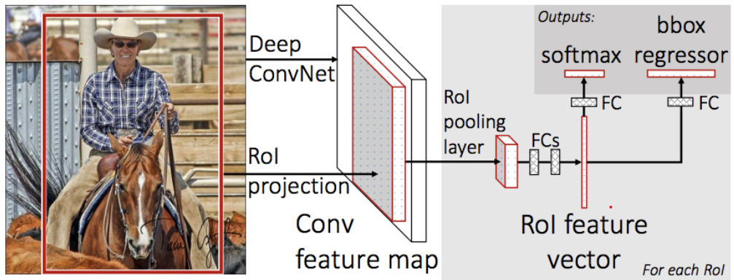

Slide 11
