Slide 1
3DG: Better 3D gaze estimation with the help of 3D scene information
Bin Yang
Supervised by Xi Wang
Semester Project Proposal
28.09.2022

Slide 2
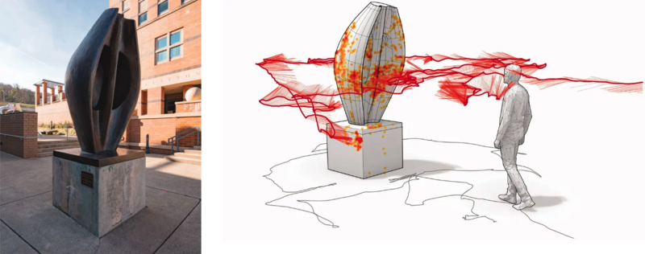
Background
Develop a better model for 3D eye gaze estiamtion task
How to improve?
Usage of corresponding 3D scene
☺ Rich Information
☹ Heavy Computation of large-scale data

Slide 3
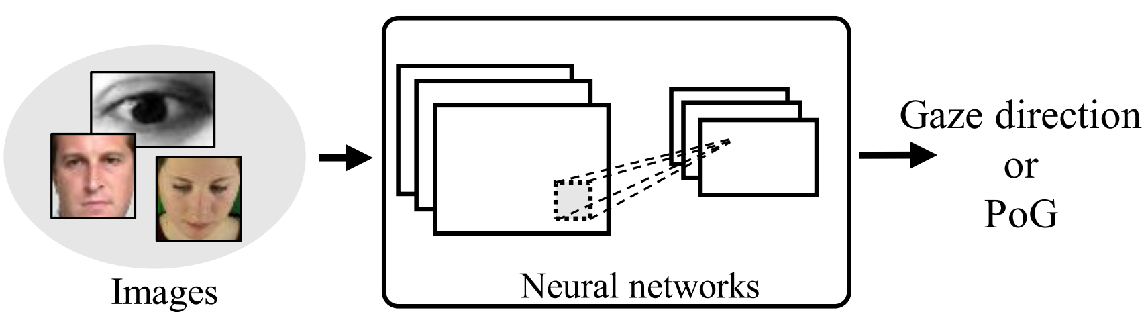
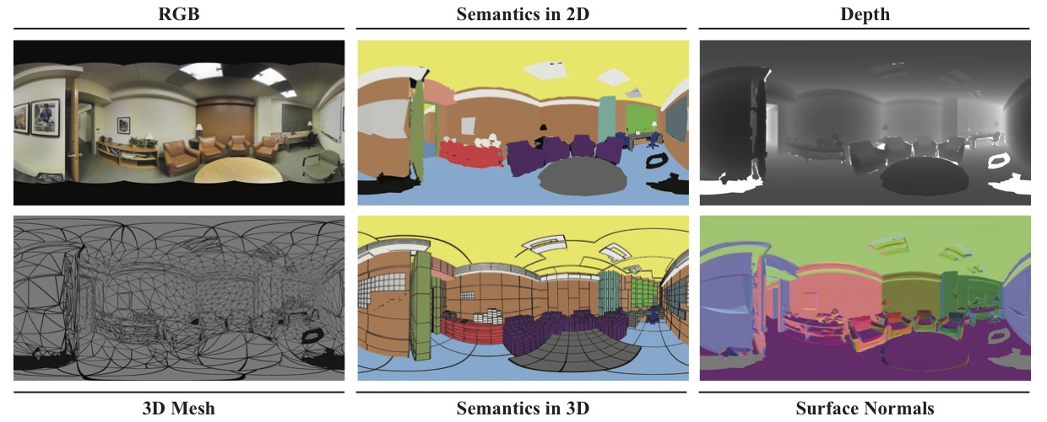
Description of the Project
How to use the 3D scene for tha task?
Extension of model with additional feature for 3D scene
Feature Extraction of 3D scene?
Yiwei Bao Feng Lu Yihua Cheng, Haofei Wang. Appearance-based gaze estimation with deep learning: A review and benchmark. Conference on Computer Vision and Pattern Recognition (CVPR), 2021

Slide 4
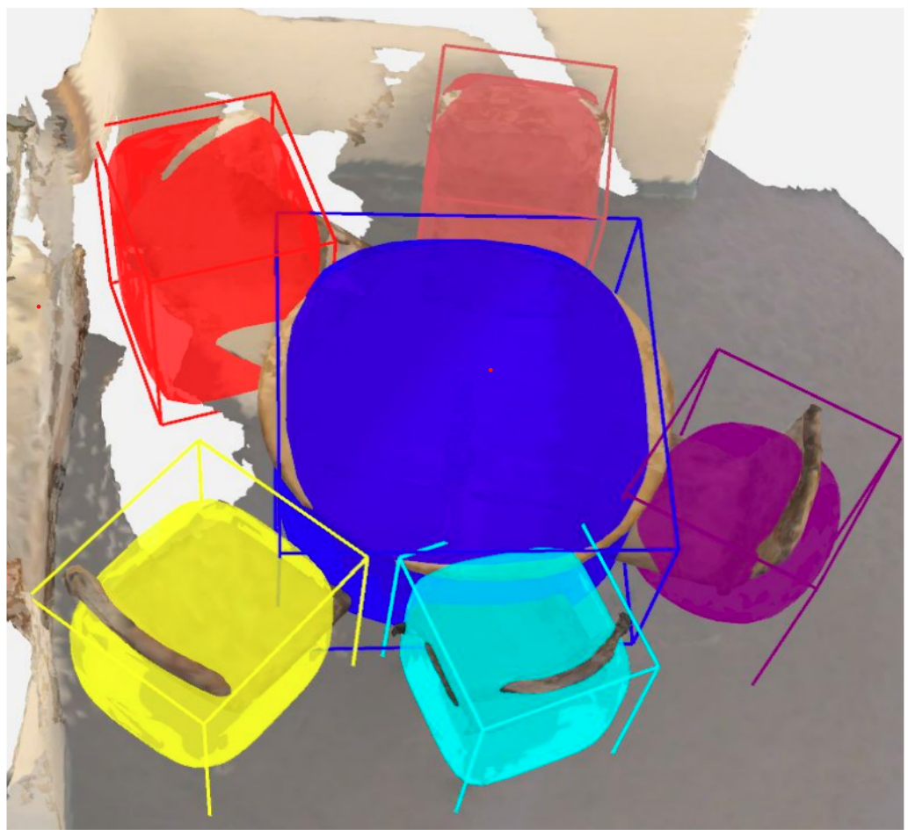
Description of the Project
How to extract the 3D scene information?
Object-based feature extraction
Object Detector
Feature Extraction
Object-based mapping
Region of Interest Detection
Activeness Object
RoI Pooling
Feature Fusion is challenging, might refer to
Multi-scale feature fusion (GoogleNet)
Cross-Attetion module
…
Feature Fusion
Scene-related information
Kejie Li, Daniel DeTone, Steven Chen, Minh Vo, Ian Reid, Hamid Rezatofighi, Chris Sweeney, Julian Straub, and Richard Newcombe. Odam: Object detection, association, and mapping using posed rgb video. In 2021 IEEE/CVF International Conference on Computer Vision (ICCV), pages 5978–5988, 2021.

Slide 5
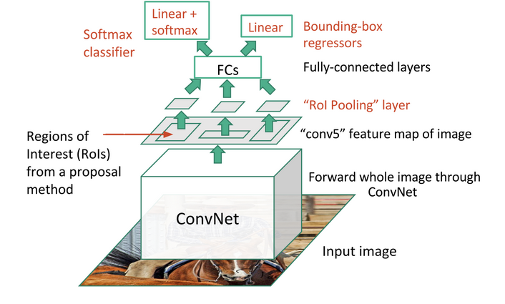
Description of the Project
How to extract the 3D scene information?
Region-based feature extraction
Object Detector
Feature Extraction
Object-based mapping
Region of Interest Detection
Activeness Object
RoI Pooling
Feature Fusion
RoI Pooling used for utilising single feature map for all the proposals generated by RPN in a single pass
Scene-related information
Ross Girshick. Fast r-cnn. In 2015 IEEE International Conference on Computer Vision (ICCV), pages 1440–1448, 2015.

Slide 6
Association of Front-view Camera images and 3D point cloud → e.g. Creating Depth image
Collection of Ground truth data → Benchmark and Review
Improvement with 3D scene
ToDo
Refine the proposal

Slide 7
Work Packages
Implement feature extraction pipeline
Object-based mapping
Feature fusion
RoI detection and pooling
…
Experiments
Outcomes comparison
Ablation study
Visualization
Stage 1
Stage 2
Stage 3
Stage 4
Reproduce Standard model
Extend Model with new features
Review Code
Familarize with datasets

Slide 8
Thanks for your attention
3DG: Better 3D gaze estimation with the help of 3D scene information

