Slide 1
Benchemark Study for related work

Slide 2
Overview of Datasets
Ref: FIRST PERSON (EGOCENTRIC) VISION @ IPLAB https://iplab.dmi.unict.it/fpv/datasets
Ego4d: A massive-scale, egocentric dataset and benchmark suite collected across 74 worldwide locations and 9 countries, with over 3,670 hours of daily-life activity video (https://ego4d-data.org/)
WS_OBJ_DT: (https://iplab.dmi.unict.it/WS_OBJ_DET/)

Slide 3
Ego4d
Portions of the video: audio, 3D meshes of the environment, eye gaze, stereo, and/or synchronized videos from multiple egocentric cameras at the same event.
Collected by 923 participants worldwide
Videos for some examples in the dataset: https://www.youtube.com/watch?v=xmzt9GCo8lE
Datasets provided

Slide 4
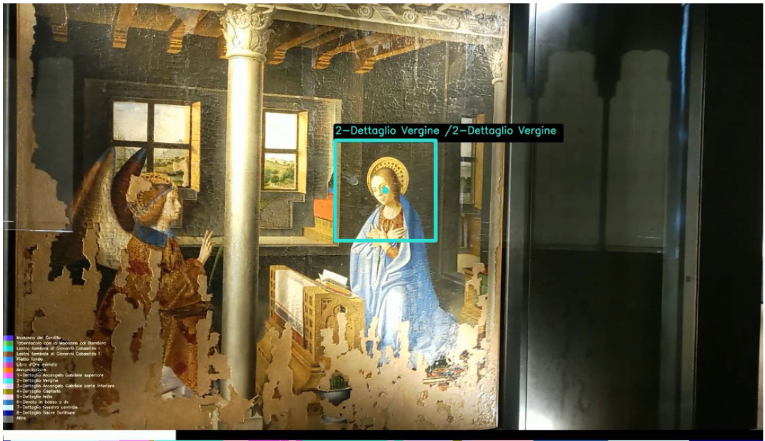
WS_OBJ_DT
Use a Hololens2 to record the video (7 subjects)
Develop a unity functionality to get the gaze and tour data
2D gaze label (gaze_x and gaze_y)
Datasets provided

