Slide 1
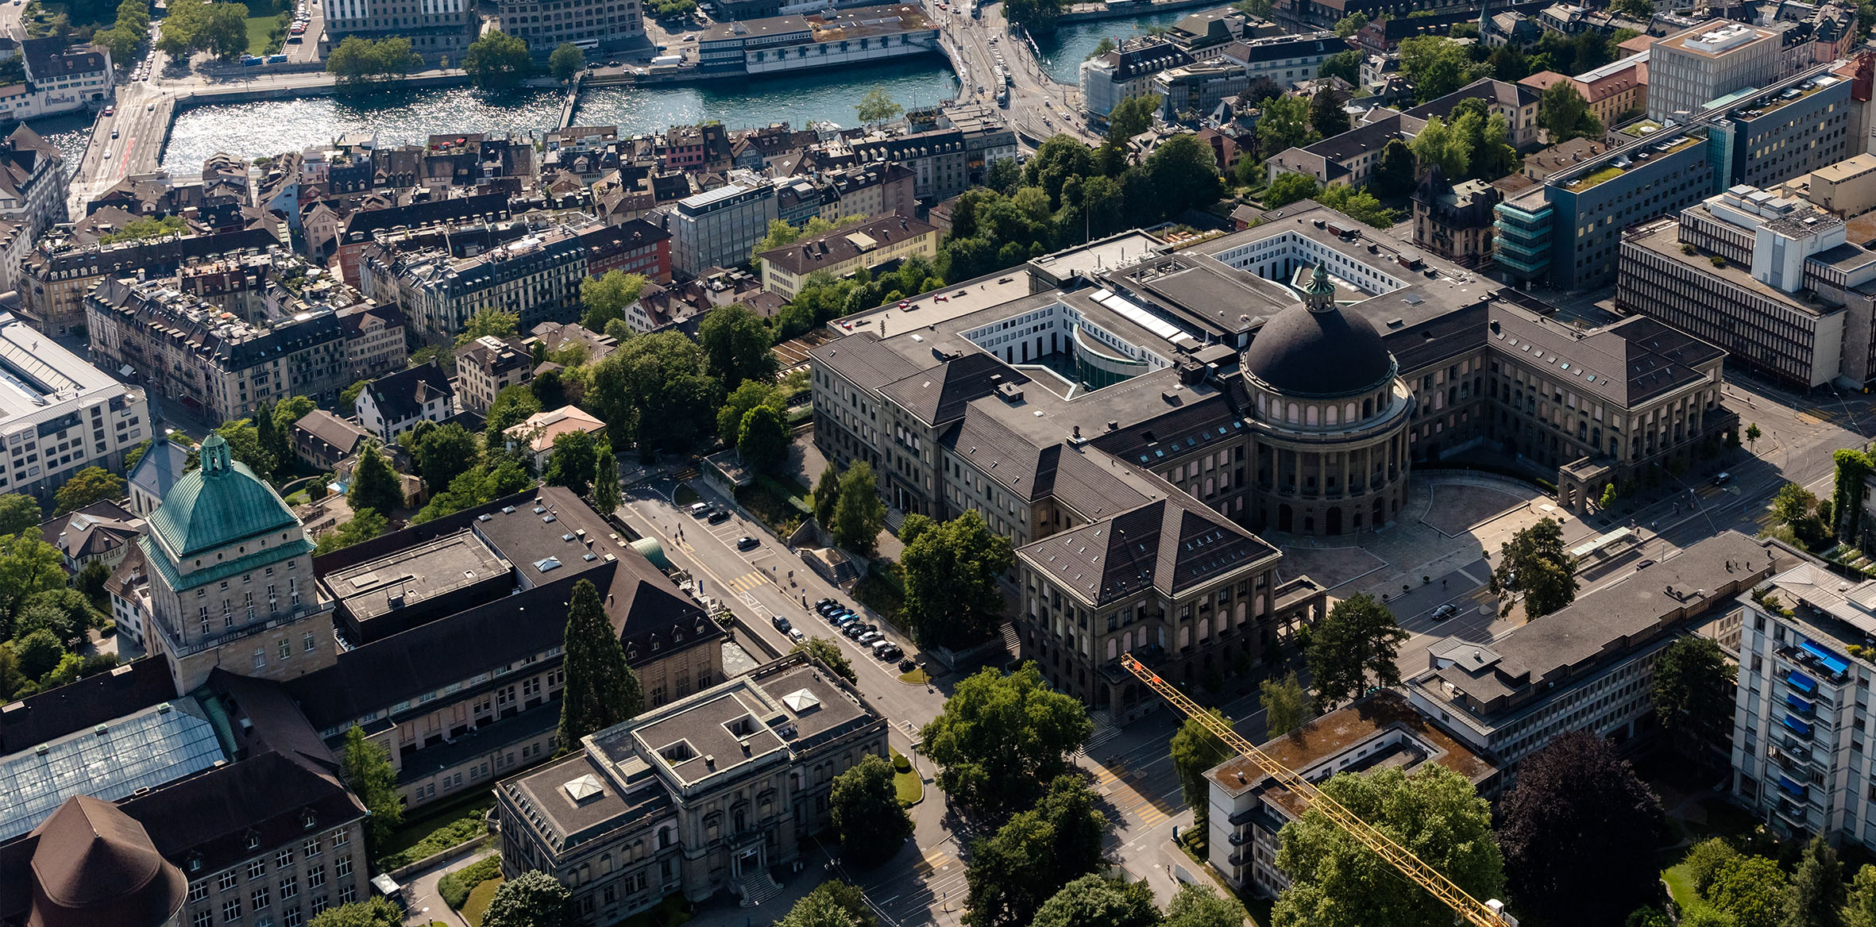
Organisationseinheit verbal optional auf 2 Zeilen
Semester Project Status
Bin Yang
11.11.2022

Slide 2
Agenda
Feature List
Work by far and ToDo
Data Collection
Research Work for gaze estimation model
Organisationseinheit verbal – STRENG VERTRAULICH
24.11.2022
<number>

Slide 3
What can be fed into network?
Raw Data
3D mesh of the scene
Raw RGB-Videos (including gaze fixations)
Intrinsic Parameters
(Estimated) Extrinsic Parameters
Extractable featrures
Depth Map (ray casting)
Stacked Optical Flow (2D) (dense flow tool)
Saliency Map (2D) (Gunner Farneback's algorithm)
3D Saliency Map
Object Detection and Tracking (2D + 3D)
Supervised learning (if ground truth object label can be manually annotated on the scene)
Self-supervised learning
Final annotations of the object can be fed into network for gaze estimation
Organisationseinheit verbal – STRENG VERTRAULICH
24.11.2022
<number>

Slide 4
Work by far and ToDo
Pixelwise RGB image registration on the 3D mesh
Depth map extraction
Feature-based Saliency Map extraction from rgb-image
Optical Flow from raw video
Research work
Gaze Estimation Model
Coding for training on my custom dataset (not finished)
Parameter tuning (they use EGTEA Gaze+ and Ego4D but I don’t have access to both dataset, simply first list the parameter set that could be tuned)
Resource (gpu) request (ask Xi for the access to remote cluster, todo)
Object Detection Module
Dataset: ARKit Scenes (Indoor dataset from Iphon 3D Scanner App, input from Francis)
Integration with Gaze Estimation Model
Organisationseinheit verbal – STRENG VERTRAULICH
24.11.2022
<number>
Notes:
<number>

Slide 5
Data Collection
Necessary Data
RGB Video automatically recorded by the eye-tracking device
Dense 3D Mesh of the scene
Using SfM-based tool to reconstrcut the mesh (e.g. colmap)
Scan the scene by a Lidar-based device
Utilization of the extrinsic paramters (calibration with help of markers in the scene)
Registration of gaze target on 3D mesh as baseline
Optional Data
3D oriented bounding boxes for 17 categories of room-defining furniture (manally annotate with some toolkit or software, e.g. 3D Bat, MeshLab, …)
Pupil, Eye movments, Iris… for further gaze-related tasks (The Toolkit Pistol is for Pupil Invisible and is able to extract those attributes, but the toolkit is not public yet)
Organisationseinheit verbal – STRENG VERTRAULICH
24.11.2022
<number>
Notes:
<number>

Slide 6
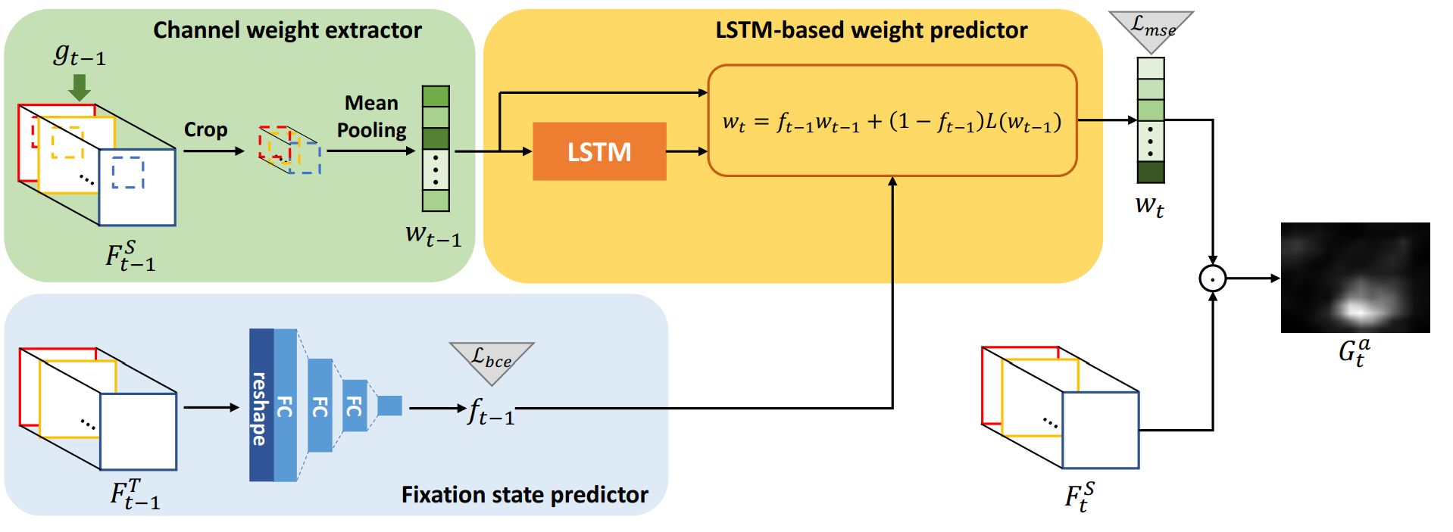
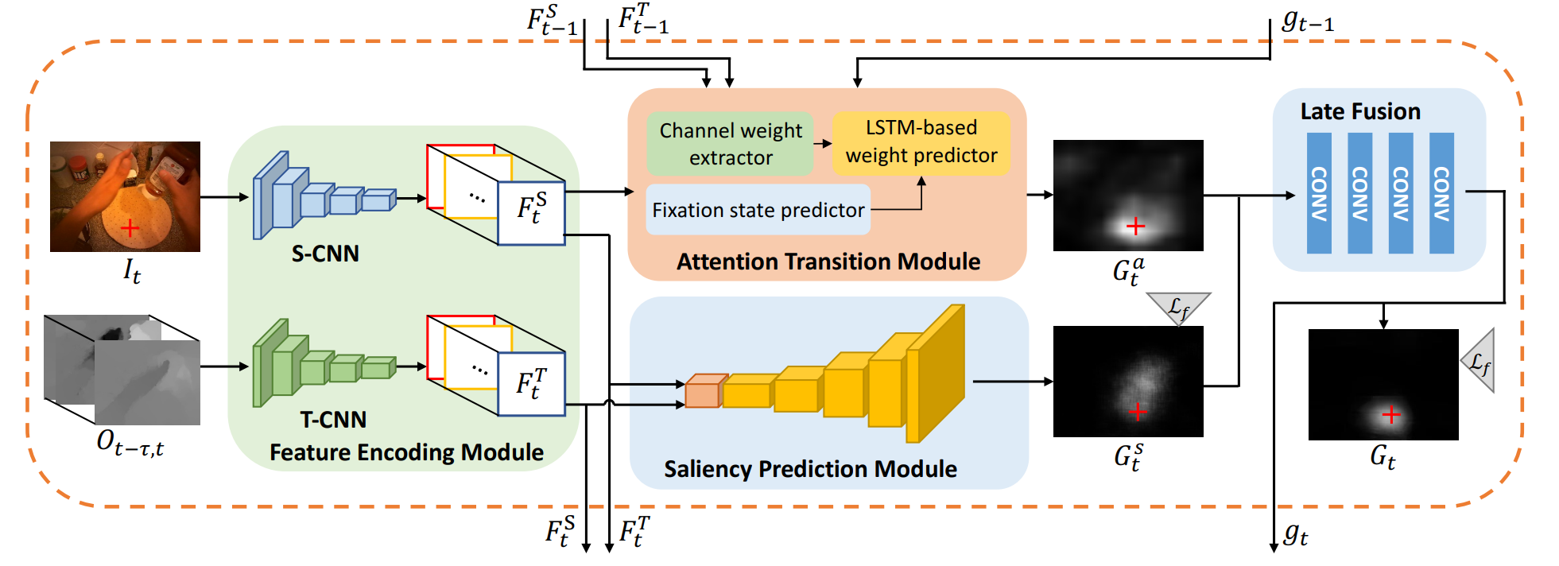
Gaze Prediction Model: Attention Transition (ECCV2018)
Fixation State Predictor estimates a probability score of gaze fixation (f_t) in range of [0, 1]
Channel weight extractor croped the previous features map with projected gaze position and average the value of each channel (get a 1-dimensional weight vector )
LSTM-based weight predictor linearly combines the original and anticipated weight, weighted by the probability score of gaze fixation → weight vector of the current frame (w_t) (Attention transition)
Weighted sum of latent representation →Attention Map
Learn the channel weights for next fixation
Hybrid-Model with saliency and attention map prediction
Task-dependet attention transition
Late Fusion Module for Attention and Saliency Map
Distance-based binary cross entropy loss (down weight the loss of estimation due to the noise of gaze)
3D conv + pooling
Organisationseinheit verbal – STRENG VERTRAULICH
24.11.2022
<number>

Slide 7
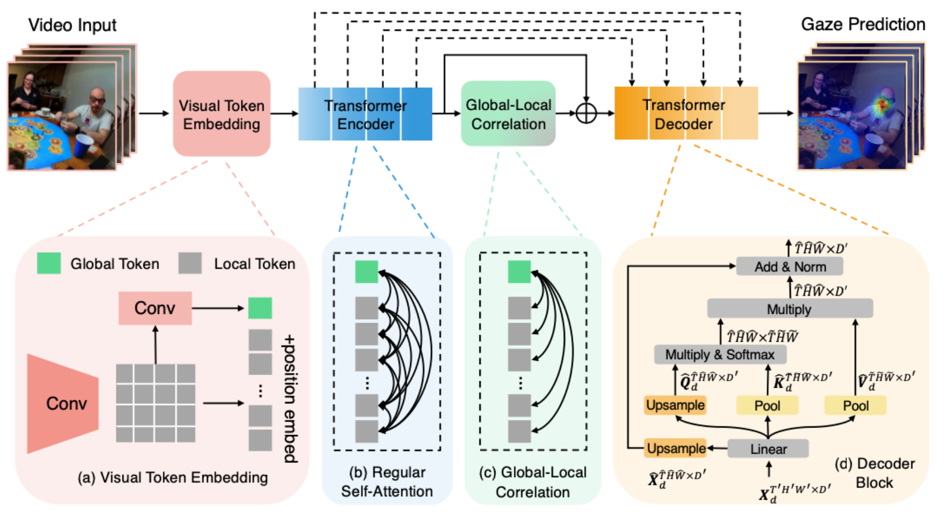
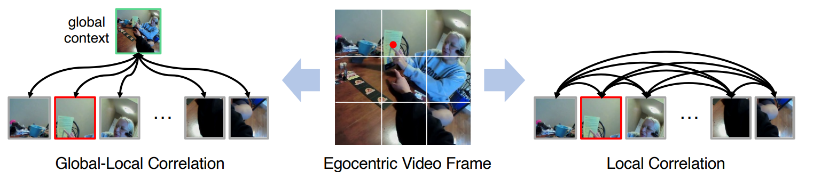
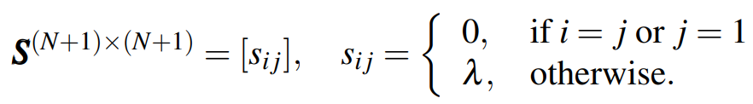
Gaze Prediction via Global-Local Correlation (BMVC2022) (source code not published yet)
Visual Token Embedding extracts N local Tokens and 1 global Token from input video
Transformer Encoder consists of Multi-Head Self Attention Module
GLC Module computes the correlation matrix (only considering the correlation score between global and local Tokens)
Transformer Decoder has the similar (inverse) structure as the encoder
Organisationseinheit verbal – STRENG VERTRAULICH
24.11.2022
<number>

Slide 8
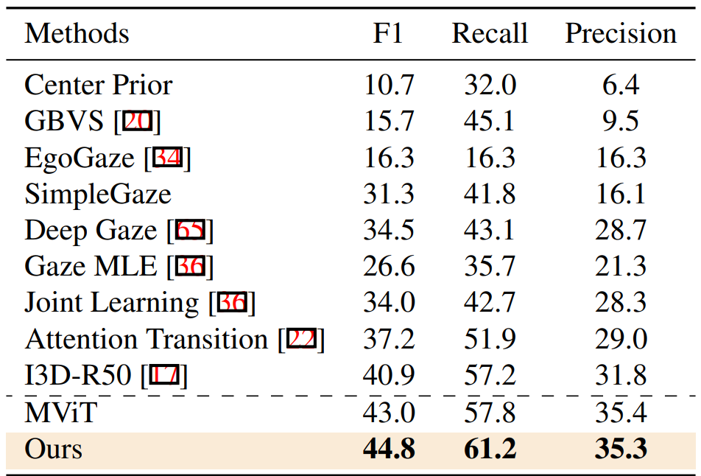
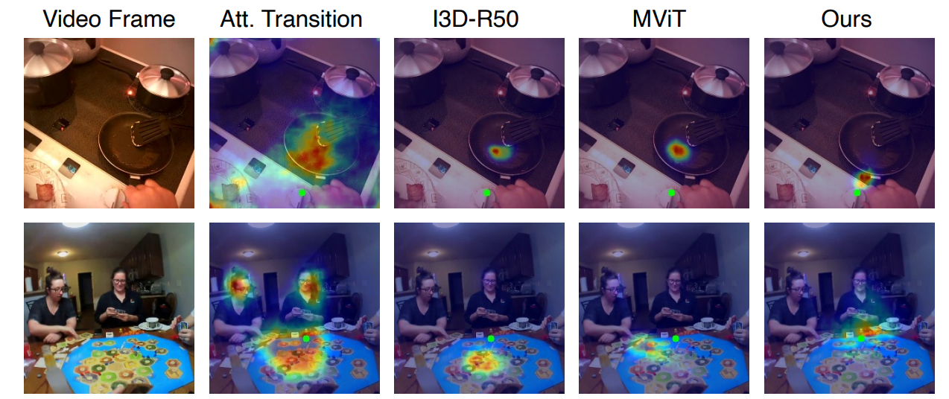
Results of prior work
Key words for gaze estimation model (no 3D input):
Temporal + Spatial Features
Transformer (Self-Attention Module)
Multi-Scale
Organisationseinheit verbal – STRENG VERTRAULICH
24.11.2022
<number>

Slide 9
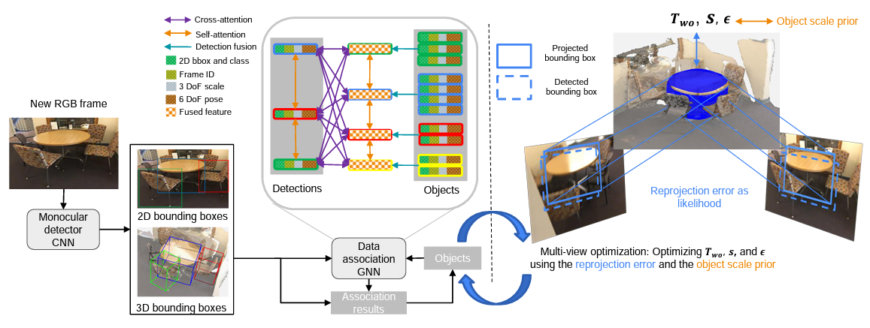
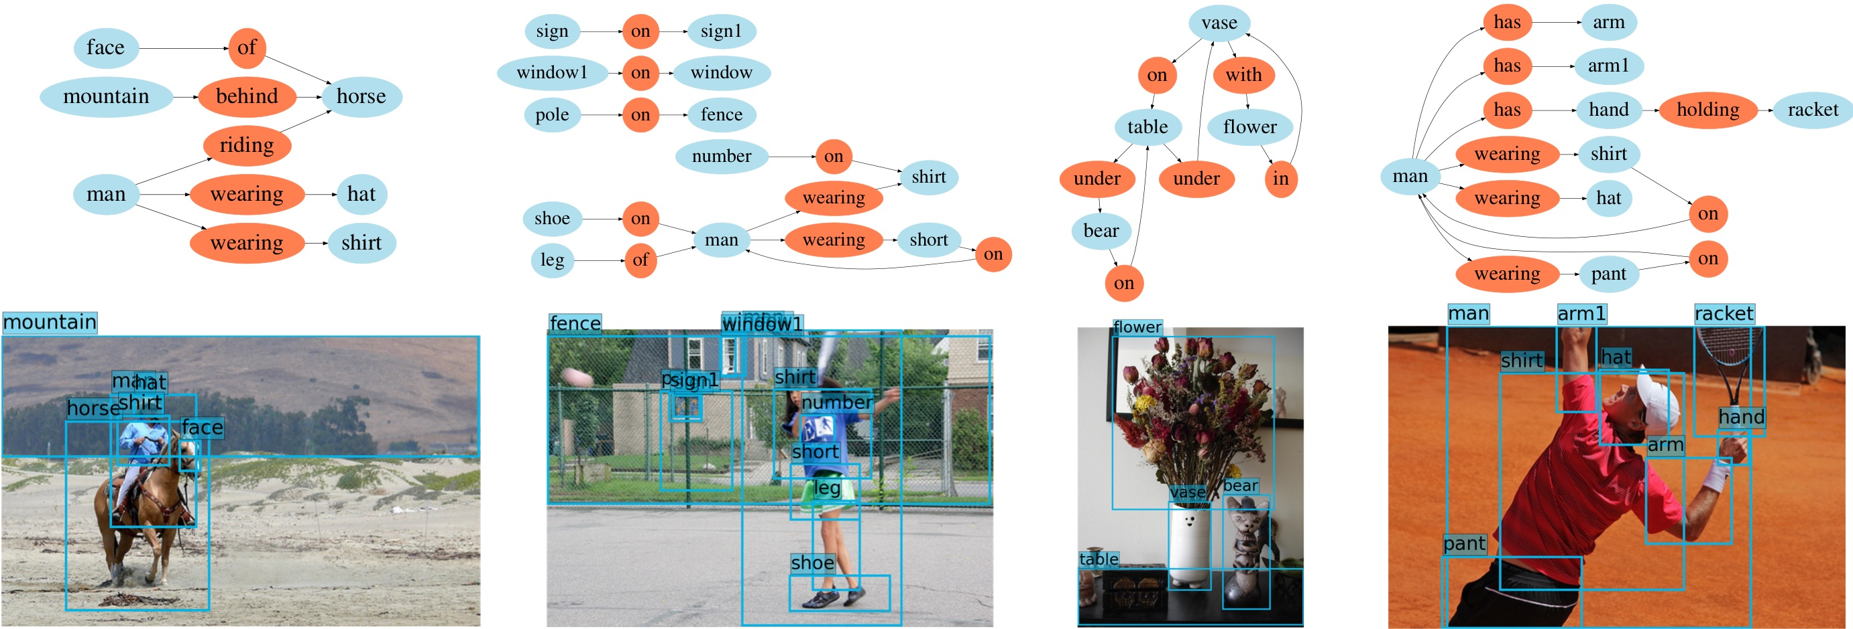
What features might help for gaze fixation?
Objects that human pays attention to
Li K, DeTone D, Chen Y F S, et al. ODAM: Object Detection, Association, and Mapping using Posed RGB Video[C]//Proceedings of the IEEE/CVF International Conference on Computer Vision. 2021: 5998-6008.
Graph-based scene context
Xu D, Zhu Y, Choy C B, et al. Scene graph generation by iterative message passing[C]//Proceedings of the IEEE conference on computer vision and pattern recognition. 2017: 5410-5419.
Organisationseinheit verbal – STRENG VERTRAULICH
24.11.2022
<number>

Slide 10
Datasets
ARKitScenes
No Gaze Info, Not from eye-tracking device
Containing 3D Annotations
2D-3D Semantics
No Gaze Info, Not from eye-tracking device
Containing 3D Annotations
Aria Pilot Dataset
Gaze Info, from eye-tracking device
WS_OBJ_DET
Gaze Info, from eye-tracking device
Other Datasets (GTEA Gaze+, Ego4D)

