Slide 1
Sales Performance Review
& Next Month Sales Plan
Sales Team Meeting | support@stellarstech.com
August 2026

Slide 2
Agenda
02
Meeting flow
1. Performance Overview — key numbers
2. YTD Sales vs Targets
3. Monthly Sales Trend
4. Rep Performance & Sales Share
5. Next Month Sales Plan — key components
6. Sales Forecast — +20% growth
7. How to Boost Sales — team guide
8. Action Items & Next Steps

Slide 3
Performance Overview — Key Highlights
03
Summary of YTD results
Total YTD Sales
Reps Above Target
Growth Jan → Jul
Top Performer
10.80M
6 / 6
+32%
Siraj (175.8%)
All 6 sales reps exceeded their YTD targets — no one is below 100%.
Mustafa leads in absolute volume (2,652,000); Siraj leads in efficiency (175.8% of target).
Monthly trend is consistently rising: 401K in Jan to 529K in July.
Next step: build on this momentum with a +20% growth plan for next month.

Slide 4
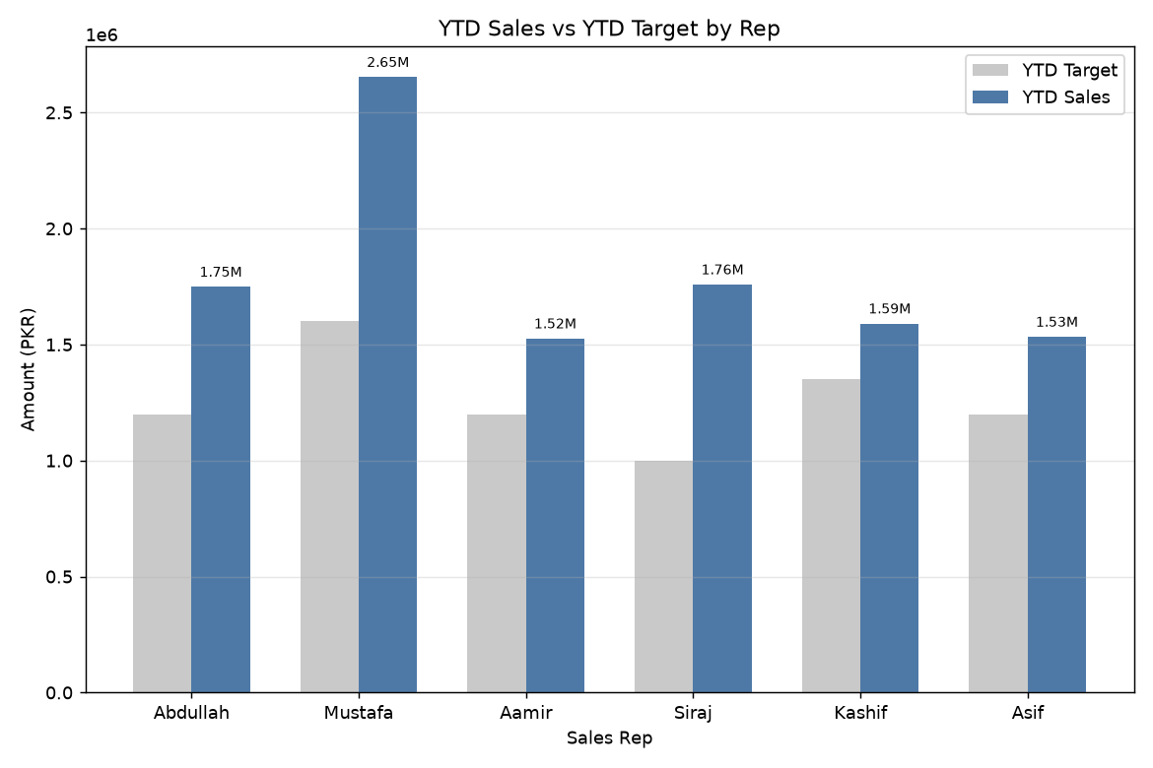
YTD Sales vs Target by Rep
04
Every rep exceeded target

Slide 5
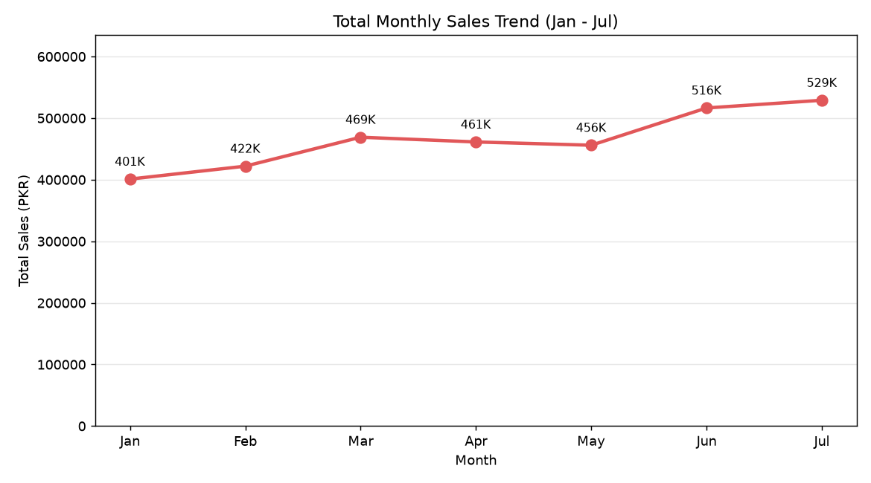
Monthly Sales Trend (Jan – Jul)
05
Consistent upward momentum
Total monthly sales grew from 401K to 529K (+32%)

Slide 6
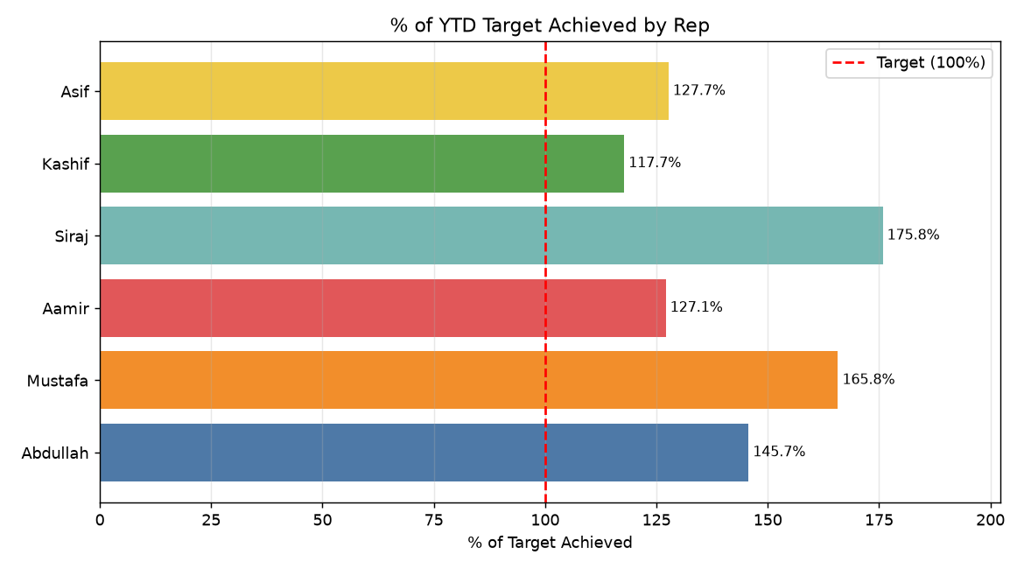
Rep Performance — % of Target
06
Siraj & Mustafa lead the team

Slide 7
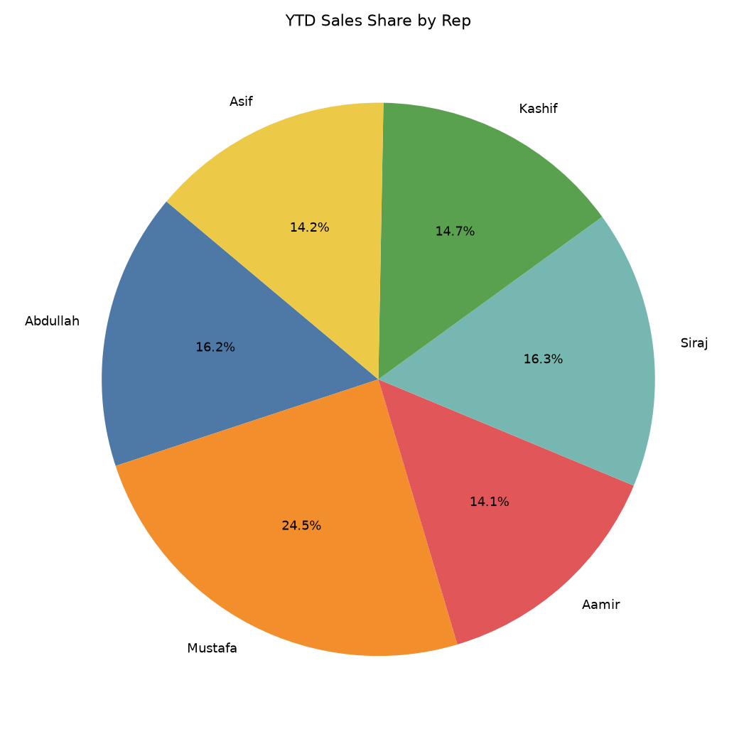
YTD Sales Share by Rep
07
Contribution split

Slide 8
Next Month Sales Plan — Key Components
08
A structured, measurable roadmap
1. Lead Generation
• Increase daily prospecting calls/emails by 25%
• Reactivate old/pending leads database
2. Customer Retention
• Follow-up every existing account at least twice
• Resolve pending queries within 24 hours
3. Upselling & Cross-selling
• Offer add-on products to top 20 customers
• Bundle offers to increase average order value
4. Clear Targets
• Individual target set per rep (see forecast)
• Weekly milestones to track progress
5. Daily Tracking & Reporting
• Daily activity log + CRM updates
• Weekly review meeting every Monday
6. Incentives
• Top performer bonus & recognition
• Team reward for hitting +20% target

Slide 9
Sales Forecast — Next Month (+20%)
09
Baseline: July actuals
Sales Rep | July Sales | Forecast (+20%) | Growth Amount
Abdullah | 85,000 | 102,000 | 17,000
Mustafa | 180,000 | 216,000 | 36,000
Aamir | 58,000 | 69,600 | 11,600
Siraj | 115,000 | 138,000 | 23,000
Kashif | 38,000 | 45,600 | 7,600
Asif | 53,000 | 63,600 | 10,600
TOTAL | 529,000 | 634,800 | 105,800
Next month total target: 634,800 (from 529,000 baseline)

Slide 10
How to Boost Sales — Team Guide
10
Actionable tactics for every rep
1. Prospect Daily
• Set a minimum of 15 new prospect touch-points every day
2. Improve Conversion
• Speed up quote turnaround to under 4 hours
• Follow up hot leads within 30 minutes
3. Grow Account Value
• Upsell/cross-sell to existing customers first
• Ask every customer for one referral
4. Track & Learn
• Log every call, quote and outcome in CRM daily
• Review your own win/loss each week
5. Focus on High-Value Accounts
• Prioritize the top 20% customers by value
6. Team Collaboration
• Share winning pitches & objections handled
• Pair junior reps with top performers
7. Stay Consistent
• Hit daily activity targets every day, not just at month-end
8. Use the Data
• Revisit this dashboard weekly to spot trends

Slide 11
Action Items & Next Steps
11
Owners and timing
Action | Owner | When
Assign individual +20% targets | Sales Manager | Today
Launch daily activity tracker | Team Lead | This week
Reactivate old leads list | All reps | This week
Weekly review meeting (Mon) | Sales Manager | Weekly
Top-performer incentive plan | Management | This month

Slide 12
Thank You
Let's hit the +20% target together
support@stellarstech.com

