Slide 1
A YANG Data Model of Performance Management Streaming (draft-yoon-ccamp-pm-streaming-01)
Bin Yeong Yoon

Slide 2
PM Reporting (ITU-T Q14/15 vs. IETF CCAMP)
Transport network management (pm collection and reporting) | ITU-T SG15, Q14 | Generic function requirements | Technology specific function requirements
 |  | G.7710 (parameters, measurements and reporting) | G.876(Media:L0), G.784 (OTN:L1) G.8051(Ethernet), G.8151(MPLS-TP), MTN(G.8350), G.7721(Sync)
 | IETF CCAMP | Core YANG data model | Technology specific YANG data model with pm reporting by importing the core YANG data model
 |  | pm-streaming | Italo’s proposal

Slide 3
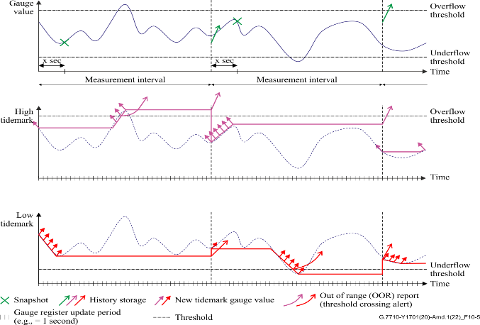
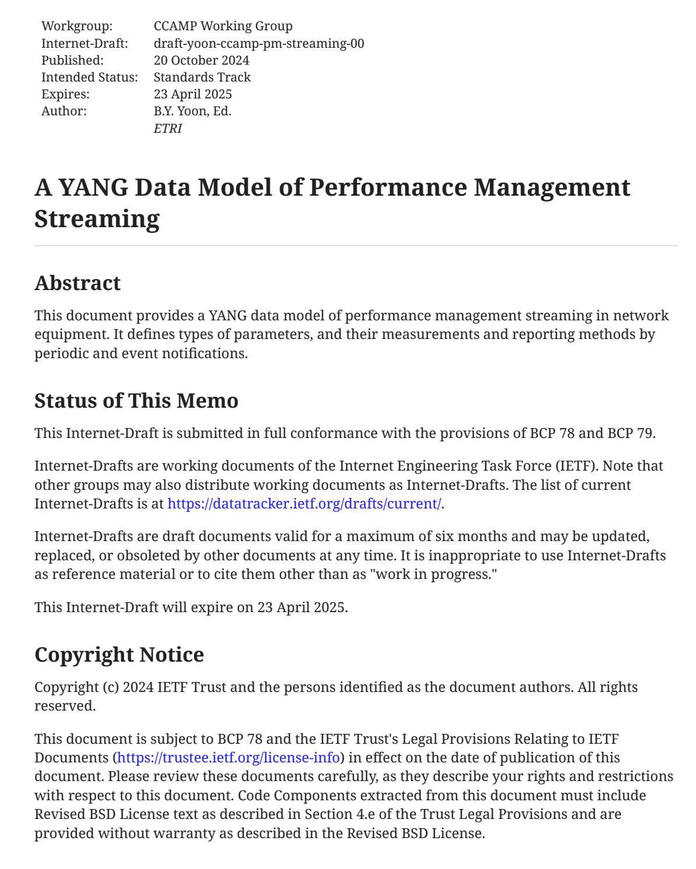
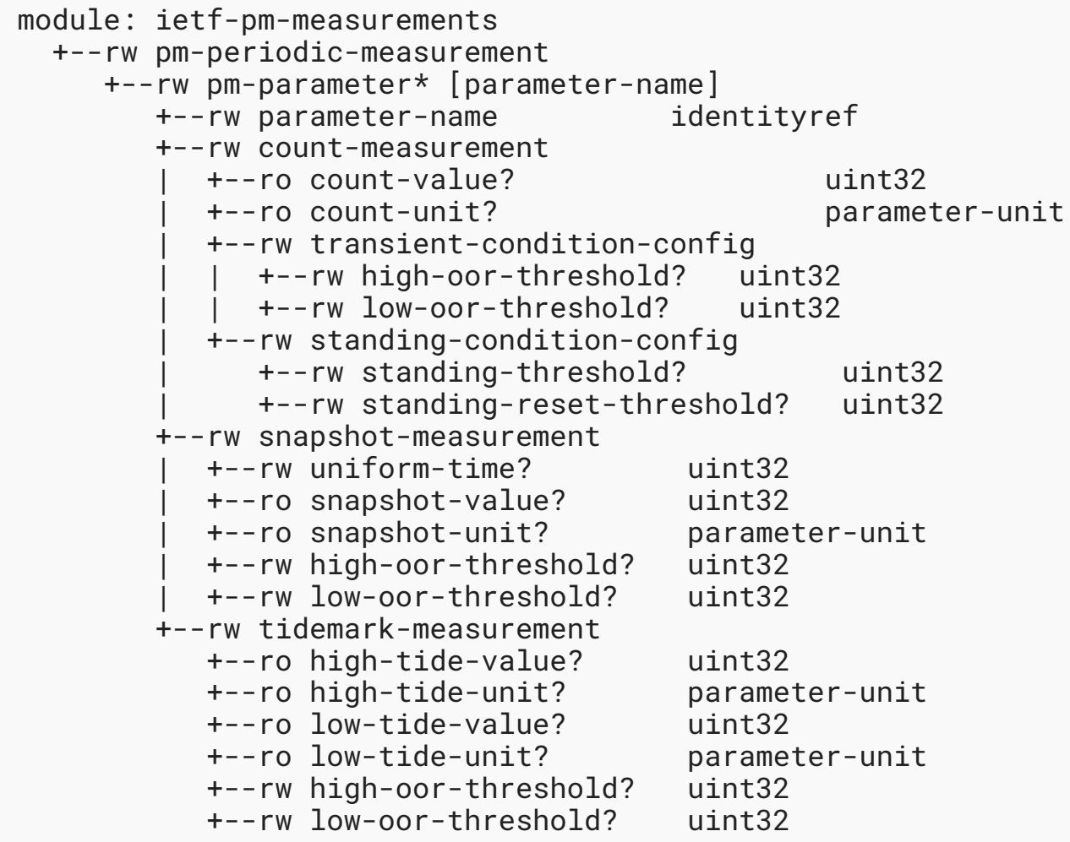
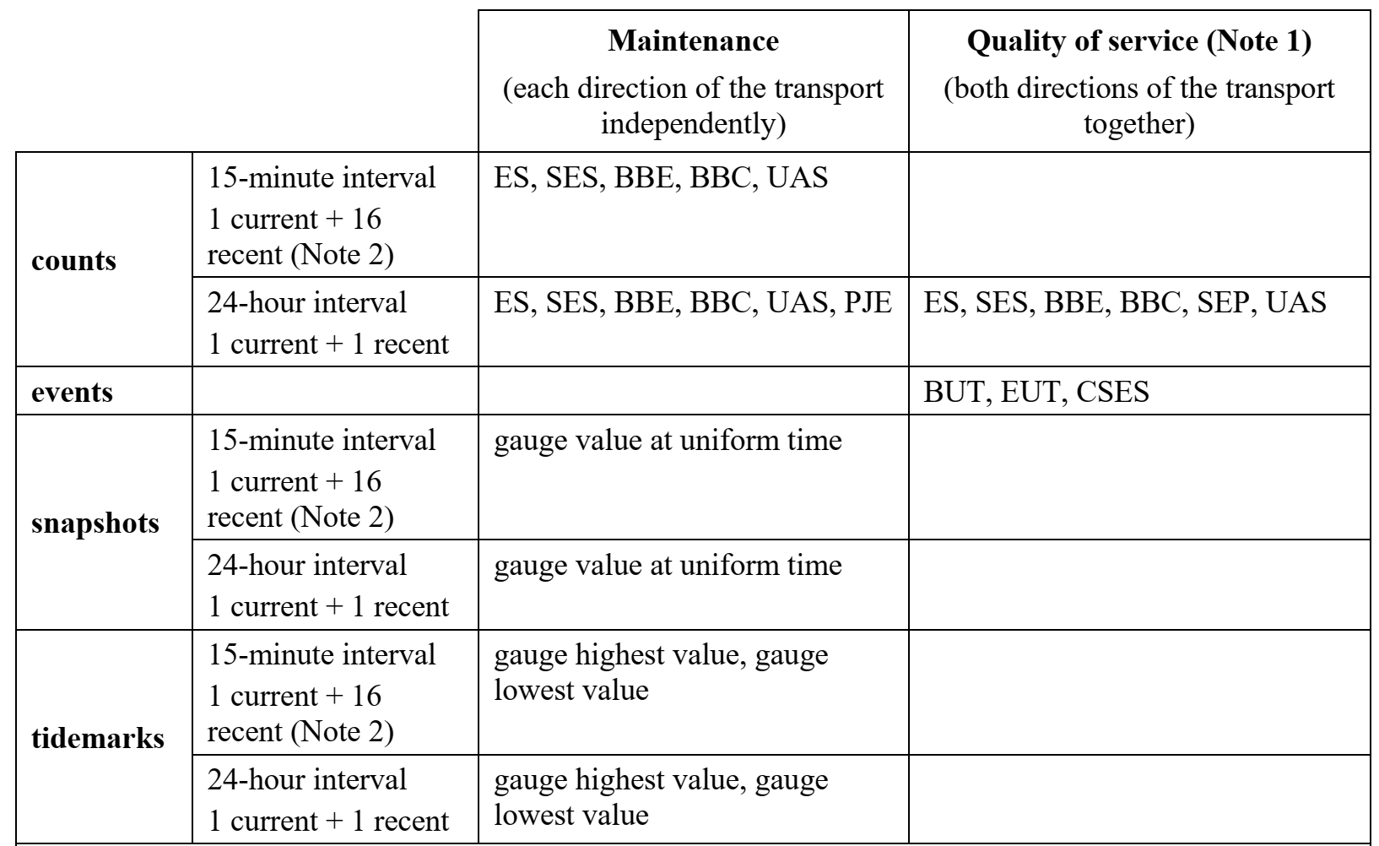
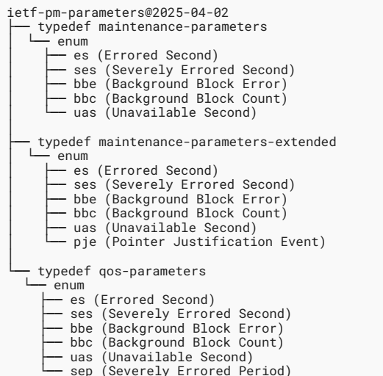
PM Reporting (ITU-T G.7710 vs. Proposed I-D)
ITU-T SG15 G.7710
IETF CCAMP I-D
(PM Measurements Module)
(PM Measurement Methods)
(PM Parameters Module)
(PM Parameters)

Slide 4
Use cases
Generic core components of YANG data modules imported to technology-specific topology and equipment models to support pm reporting
Network equipment
(temperature, …)
import
OTN Topology module
with pm monitoring
pm-parameters
pm-measurements modes
MPLS-TP Topology module
with pm monitoring
Core YANG data modules for pm reporting
Extended YANG data models for pm reporting

Slide 5
Major Changes (from Ver.00 to Ver.01)
Splitting one YANG data module (pm-streaming) into two modules (pm-measurements + pm-parameters)
pm-measurements module:
Define only periodic measurement modes (Count, snapshot, tidemark) and notification of threshold events
“grouping statements” used to define a reusable set of schema nodes for consistency across modules.
pm-parameters module : Three groups of pm parameters classified by time intervals (15min/24hr) and their purposes (operation/service)
According to the changed YANG data modules above, update the examples of the subscription and notification

Slide 6
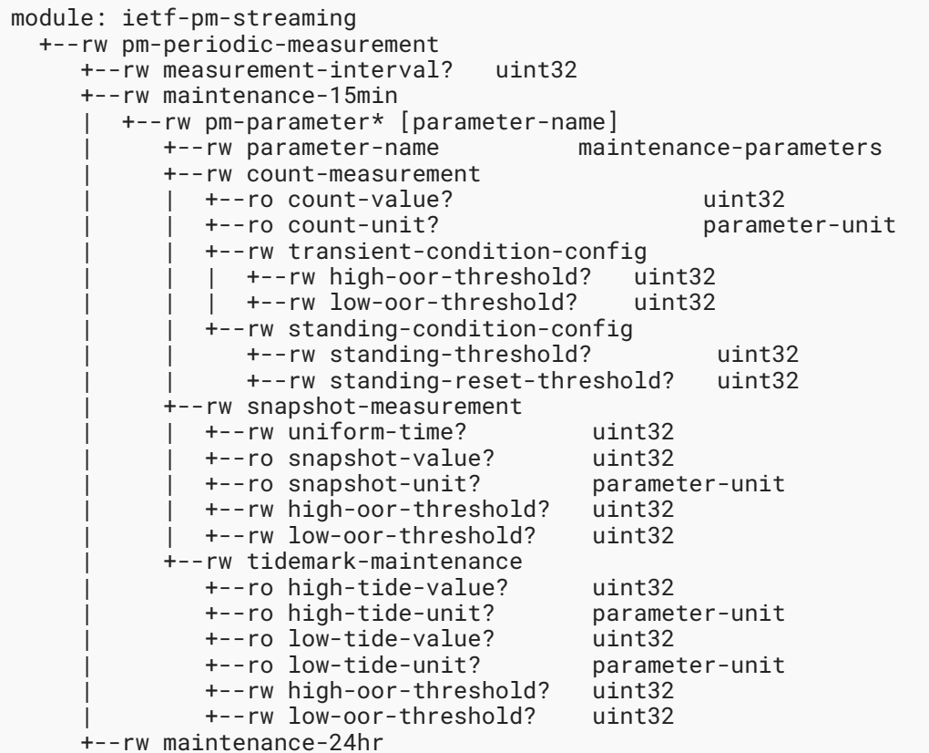
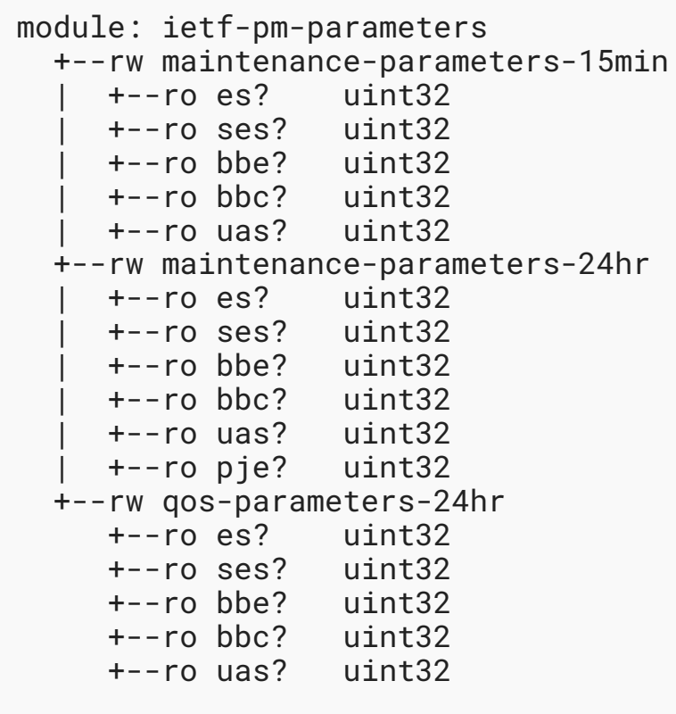
Updated YANG Modules
(Ver. 00)
(Ver. 01)
pm-measurements YANG data Module
pm-streaming YANG data Module
pm-parameters YANG data Module

Slide 7
Updated YANG Module 1 (pm-measurements)
(Ver. 00)
(Ver. 01)
Module 1

Slide 8
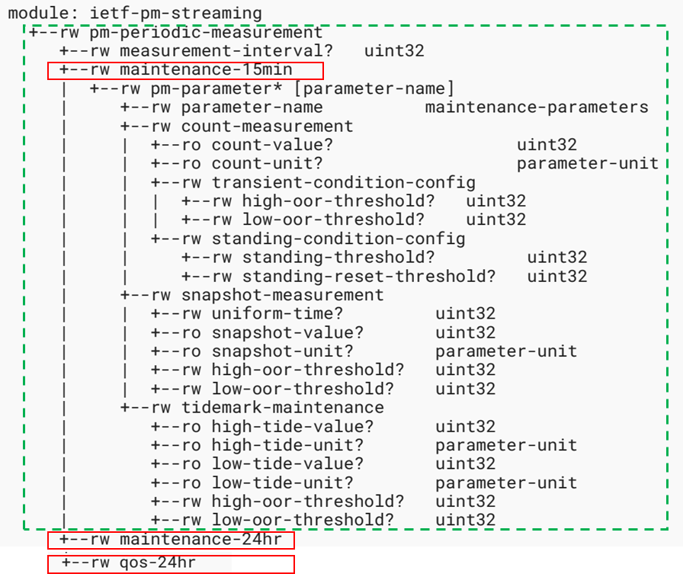
Updated YANG Modul 2 (pm-parameters)
(Ver. 00)
(Ver. 01)
Module 2

Slide 9
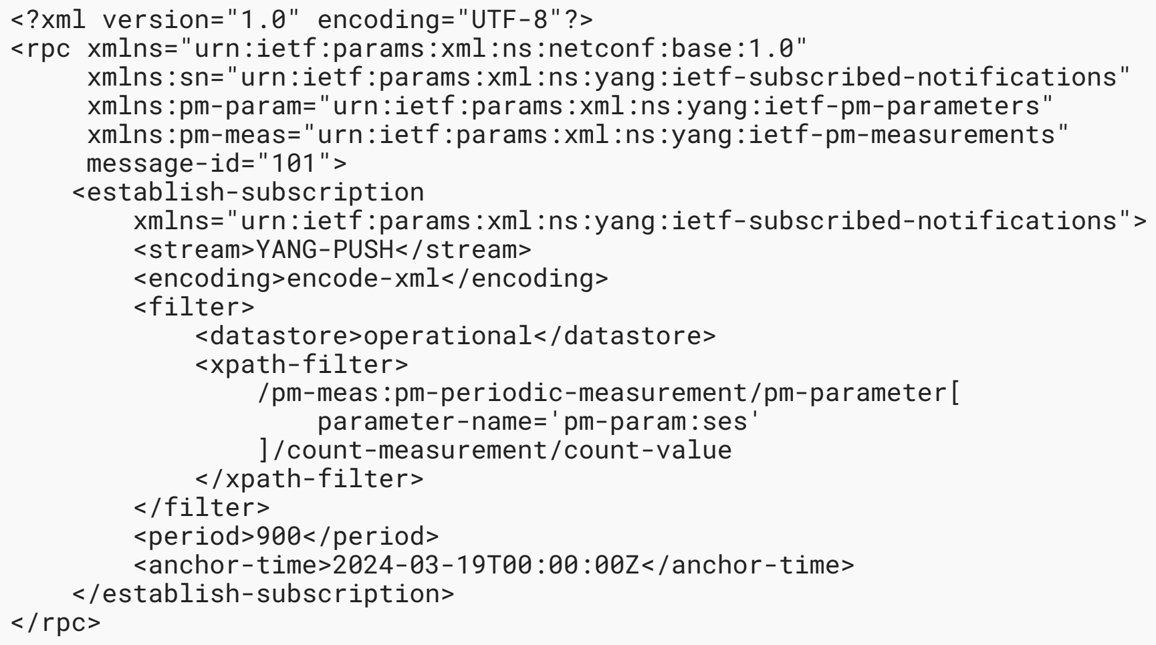
Periodic Subscription Example
Subscribe to “SES” with the following conditions
Periodic subscription
Monitored PM parameter: SES
Measurement method: Counts
Metric values: count-value, count-unit

Slide 10
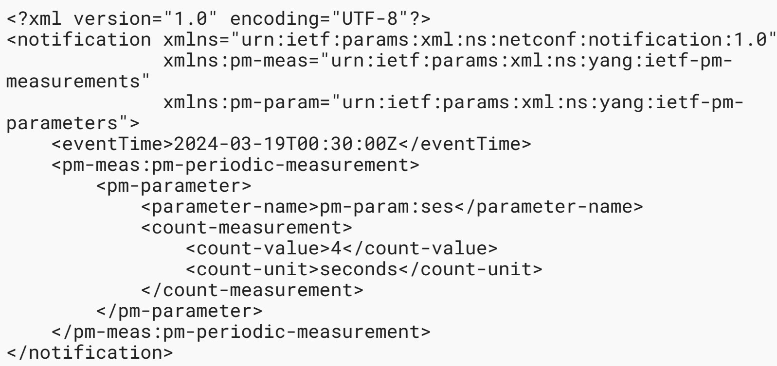
Periodic Notification Example

Slide 11
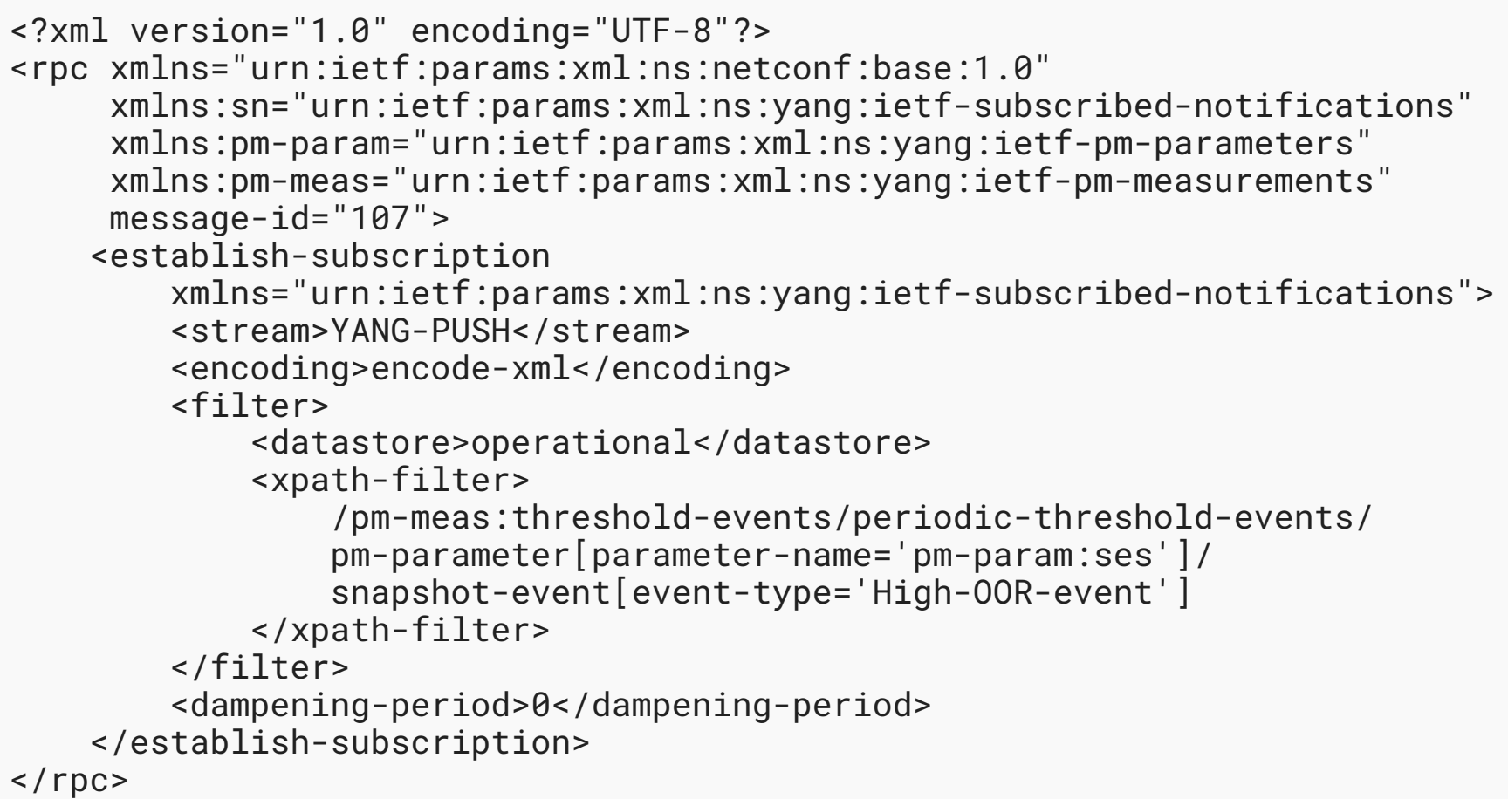
Periodic Event Subscription Example
Subscribe to “SES” with the following conditions
Thresholding event subscription
Monitored PM parameter: SES
Measurement method: Snapshot event (High-OOR-event)
Metric value: Snapshot OOR event, event time

Slide 12
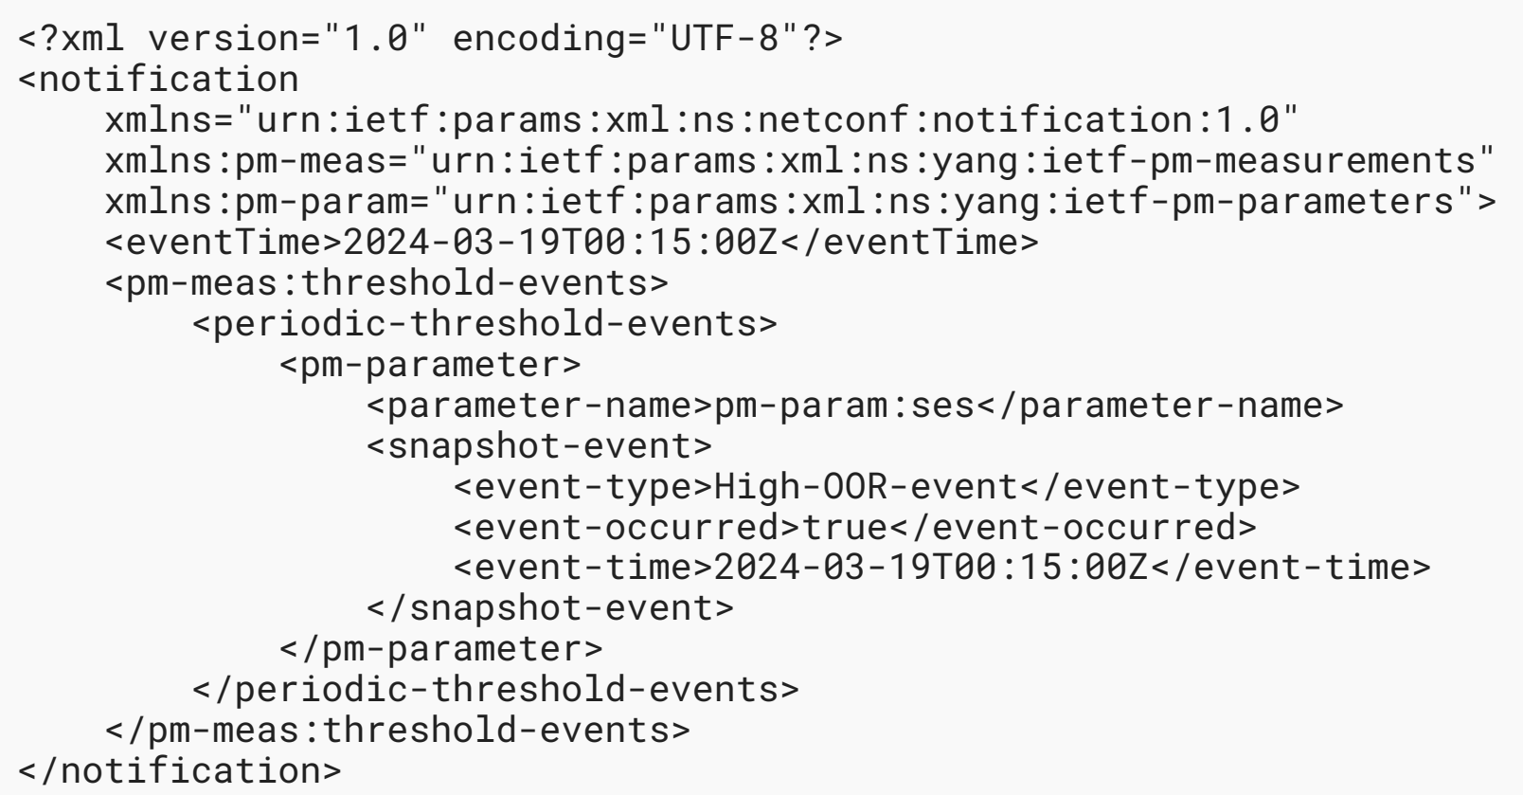
Periodic Event Notification Example

Slide 13
Future Works
Proposed I-D is strictly aligned with the current version of G.7710 for streaming
Currently, support only fixed measurement intervals (15min., 24hr.)
G.7710 will be revised in ITU-T SG15 (Oct. 2025)
Will support variable measurement intervals
Need to be aligned with G.7710
More monitored PM parameters should be added to support packet networks as well as circuit networks
Update the YANG data modules

