Slide 1
CSE5321, Final Presentation
박지홍, 이지우, 조형원

Slide 2
Outline
Part 1. GPT-2 Implementation and Task Overview
GPT-2 Architecture
Sentiment Analysis
Paraphrase Detection
Sonnet Generation
Part 2. Experimental Evaluation
Performance on Sentiment Analysis
Performance on Paraphrase Detection
Performance on Sonnet Generation
Part 3. Additional Research Questions
Evaluation tools for Generation Task
Incorporating Sentiment Information into Poetry Generation
Extending Poetry Generation to Korean Poems

Slide 3
GPT-2 Implementation and Task Overview

Slide 4
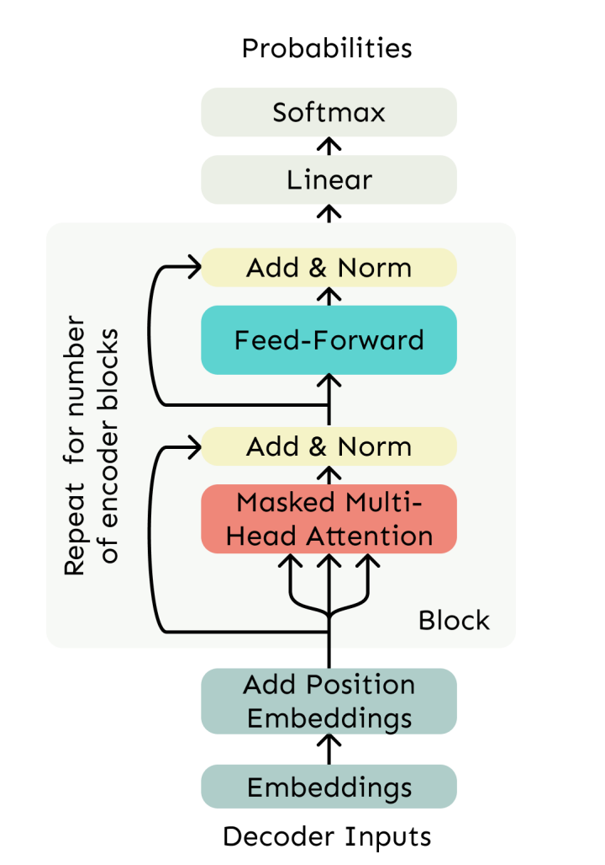
GPT-2 Architecture
Decoder-only transformer
modules/attention.py
modules/gpt2_layer.py
models/gpt2.py
optimizer.py : step ()
Implement Masked Multi-head Self Attention layer
Implement full GPT-2 transformer layers
Implement the token and positional embedding function
Completed the AdamW optimizer implementation, for model training

Slide 5
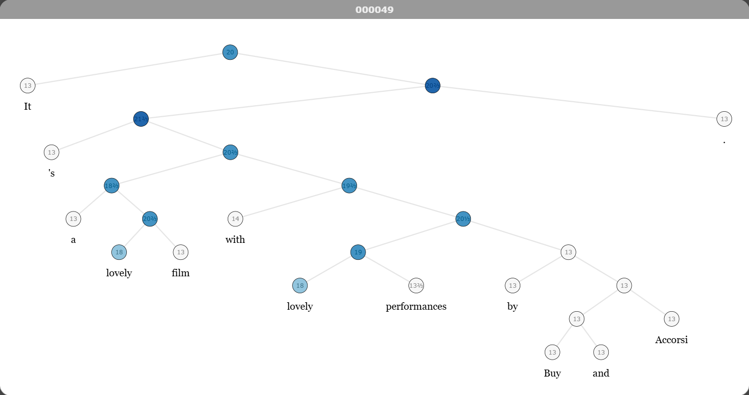

Sentiment Analysis (Classification)
Datasets
SST-5(Stanford Sentiment Treebank-5)
5-class sentiment classification
Movie review sentences
CFIMDB(Counterfactual IMDB)
Binary sentiment classification
Long-from movie reviews
Task
SST-5(Stanford Sentiment Treebank-5)
Multi-class classification ( 0 (Negative) ~ 4 (Positive) )
CFIMDB(Counterfactual IMDB)
Binary-class classification ( 1 (Positive) / 0 (Negative) )
Train with last layer or full layers

Slide 6
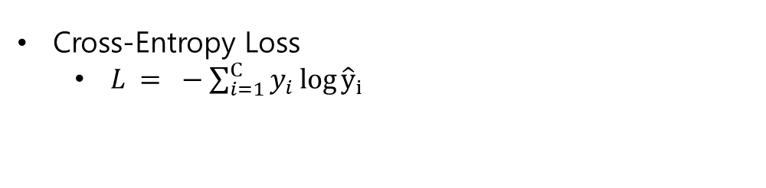
Sentiment Analysis (Classification)
Objective
Cross-Entropy Loss
$L = −\sum_{i=1}^{C}{y_{i}\log{{\hat{y}}_{i}}}$
Evaluation
Macro F1
Average of the F1 scores across all classes
Accuracy
Select best model with accuracy

Slide 7
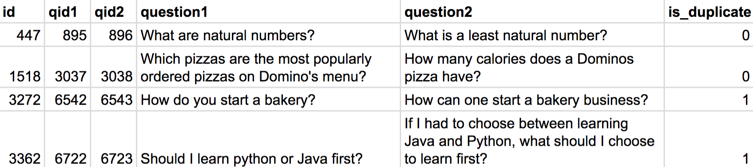
Paraphrase Detection
Datasets
QQP(Quora Question Pairs)
Task
Given a pair of sentences, the model predicts whether they are semantically equivalent.
Evaluation
Binary F1 Score

Slide 8
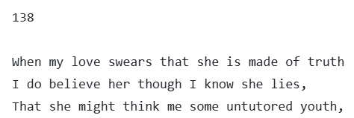
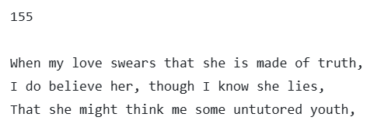
Sonnet Generation
A sonnet is a traditional European poetic form consisting of 14 lines.
Datasets
Shakespears sonnet(154 sonnets)
131 sonnets for train
12 sonnets for dev
12 sonnets for test
(138) in dev = (155) in test
Task
Generate the remaining 11 lines of a Shakespeare-style sonnet given the first 3 lines as a prompt.
Evaluation
The original CS224N project does not provide an official evaluation metric for the sonnet generation task.

Slide 9
Experimental Evaluation

Slide 10
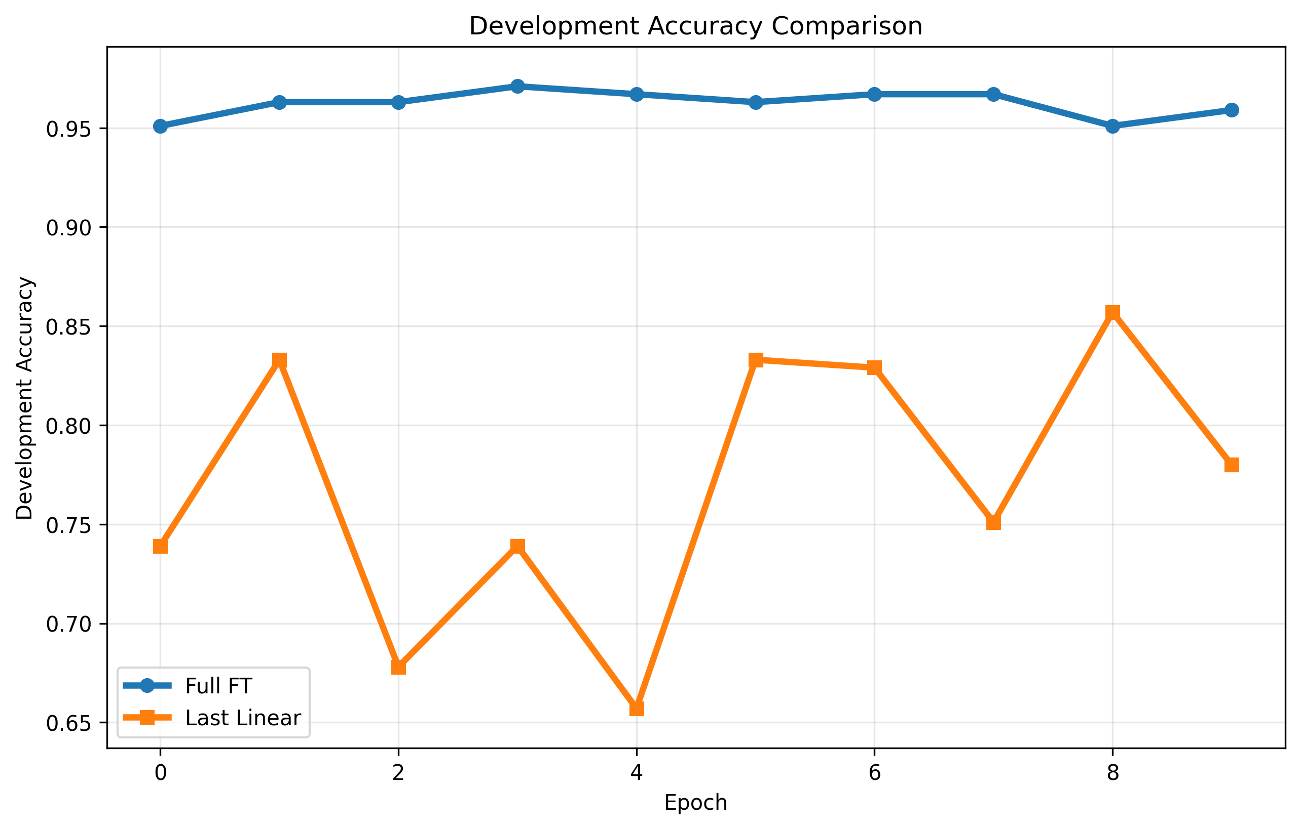
Performance on Sentiment Analysis

Slide 11
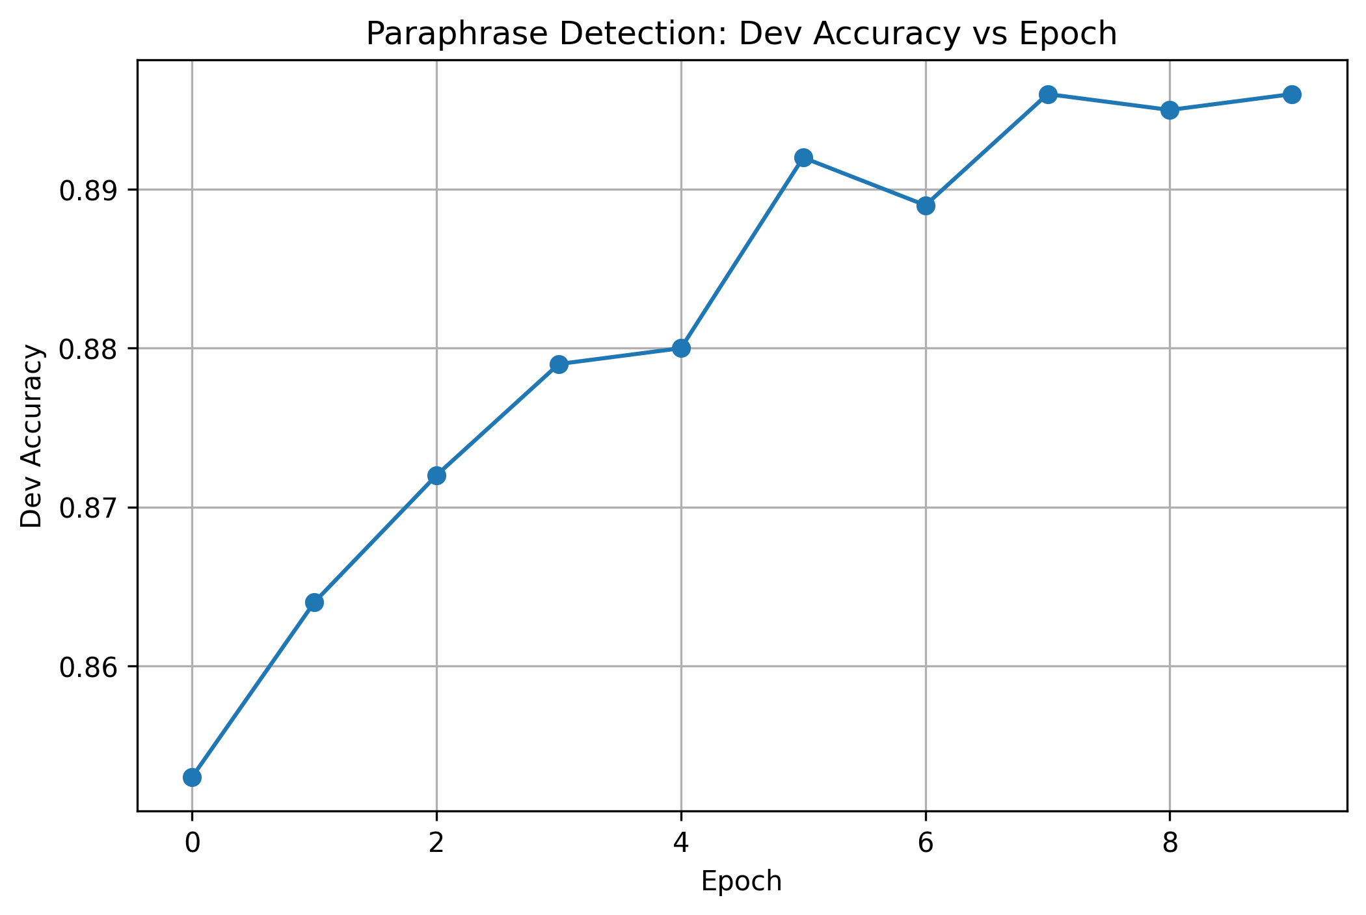
Performance on Paraphrase Detection

Slide 12
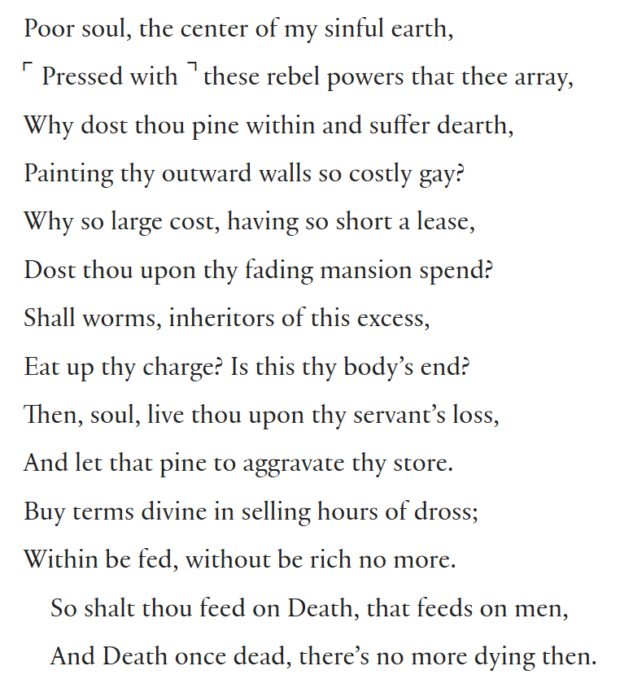
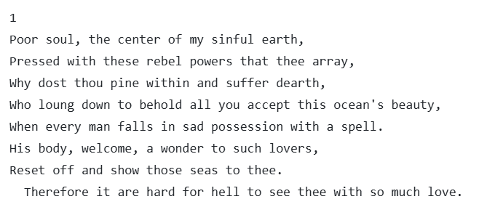
Performance on Sonnet Generation
Sonnet 146(Original)
Sonnet 146(Generated)

Slide 13
Additional Research Questions

Slide 14
Motivation
How can we objectively evaluate the quality of generated poems based on GPT2?
Answer : chrF(ChaRacter n-gram F-score) or BERTScore
chrF Metric is a character-level evaluation method that computes an F-score over n-gram overlaps to capture morphological and inflectional variability.
From chrF++ : words helping character n-grams
BERTScore measures semantic similarity using contextual embeddings, enabling fairer evaluation of generated text. It captures meaning beyond exact word matches, aligns better with human judgment, and works well across tasks and languages.
From bertscore.com

Slide 15
Evaluation Sonnet Generation Task with chrF & BERTScore

Slide 16
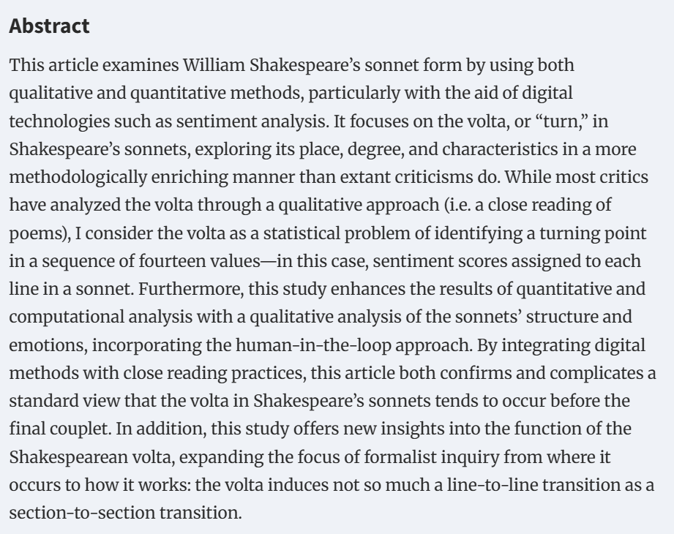
Motivation – Related Work
Sentiment analysis of the volta in Shakespeare’s sonnets
Haram Lee
Sentiment_m
: line-level sentiment score Human-labeled data
Sentiment_v
: Line-level sentiment score generated by VADER
(lexicon-based model)
Sentiment_r
: Line-level sentiment scores generated by RoBERTa
(deep learning model)
https://zenodo.org/records/14965925
https://doi.org/10.1093/llc/fqaf018

Slide 17
Sonnet Generation with Sentiment Data

Slide 18
Sonnet Generation with Sentiment Data

Slide 19
Extending Poetry Generation to Korean Poems

Slide 20
Kim_Sowol Poem generation

Slide 21

Q&A
https://github.com/bio-1220/NLP_gpt2_project.git

