Slide 1
Mini-Workshop
Heng-Cheng, Kuo
Research Center for IT Innovation, Academia Sinica
2020/7/7
Notes:
1

Slide 2
Introduction
Domain Adaptation
Gradient reversal layer.
Model Compression
Probability density distill (teacher-student learning).

Slide 3
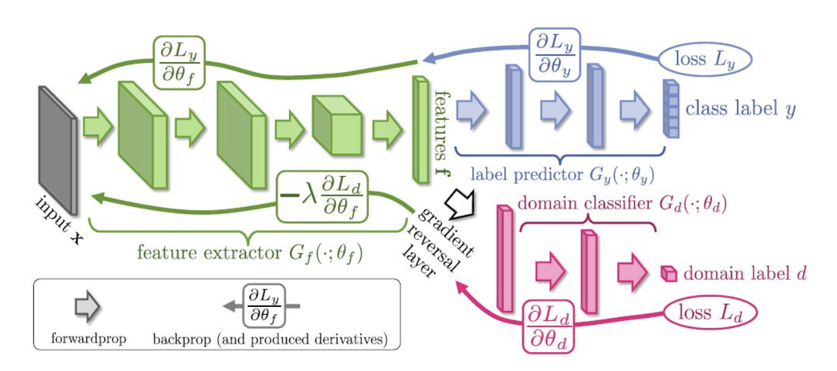
Gradient Reversal Layer
Class label and domain label.

Slide 4
Gradient Reversal Layer
Unsupervised domain adaptation.
class
Posterior
Domain
Posterior
Domain
Posterior
Class
predictor
Domain
classifier
Domain
classifier
GRL
GRL
Feature
Extractor
Feature
Extractor
Source
Input
Target
Input

Slide 5
Probability Density Distill
Trained teacher model and proposed student model.
Deep model, ensemble model, etc.
KL
Divergence
Teacher
Model
Student
Model
class
Posterior
class
Posterior
Layer 4
Layer 2
Layer 3
Layer 1
Layer 2
Input
Layer 1
Input

Slide 6
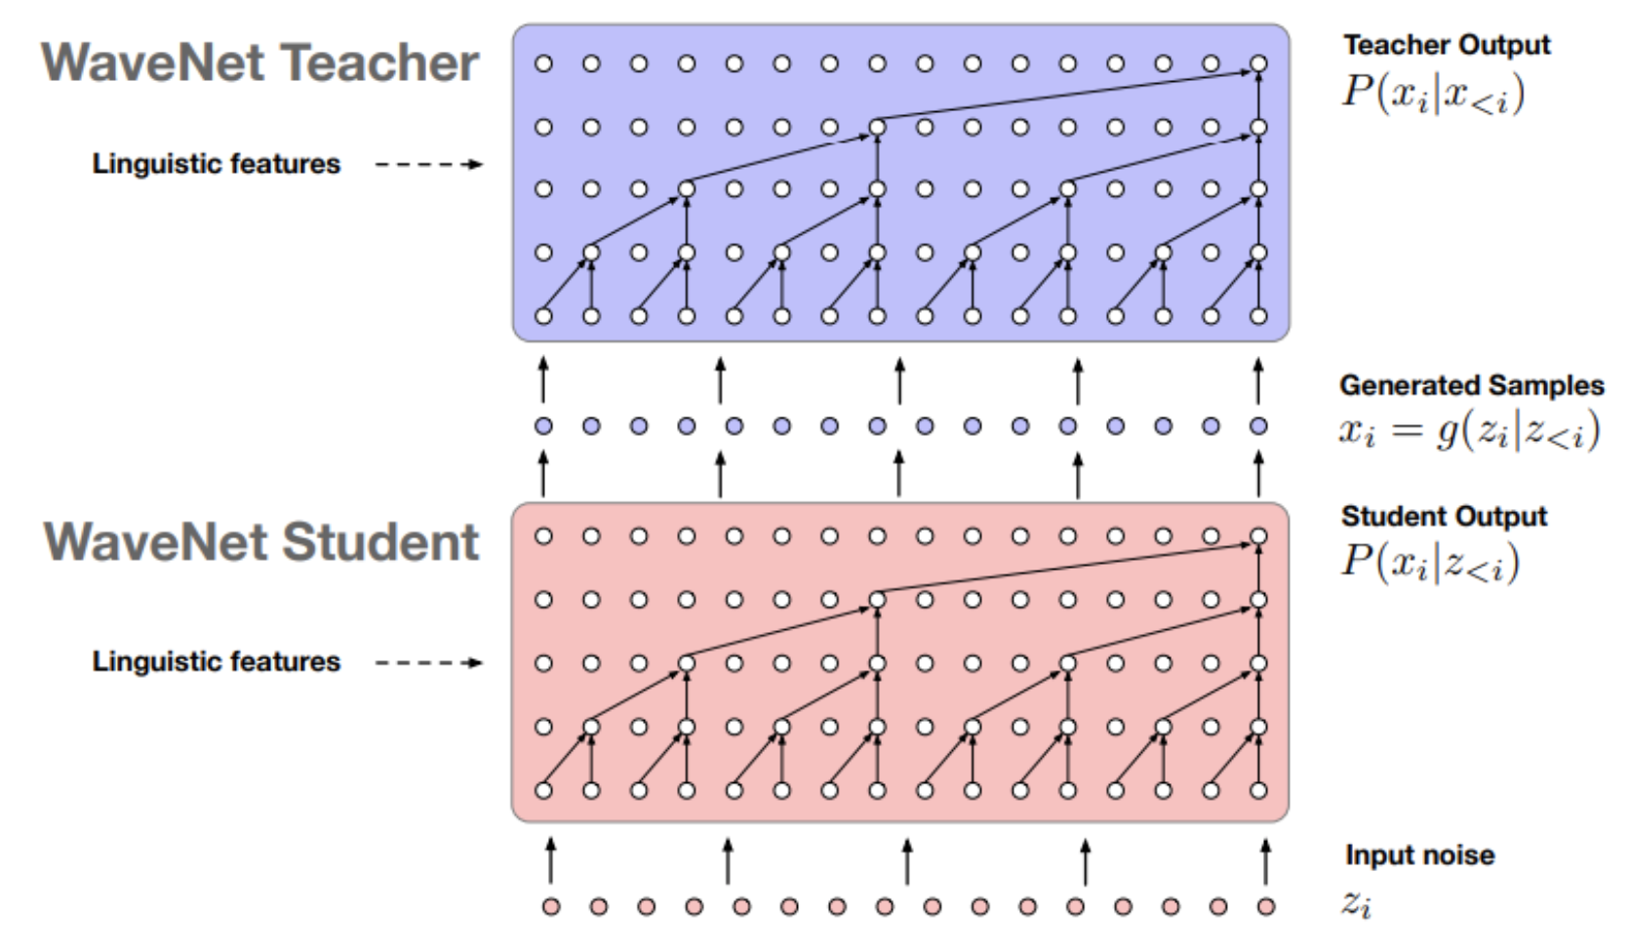
Probability Density Distill
Domain adaptive and inference time speeding up application.
KL
Divergence
Teacher
Model
Student
Model
class
Posterior
class
Posterior
Layer 4
Layer 2
Layer 3
Layer 1
Layer 2
Target
Input
Layer 1
Source
Input
#Need parallel data

Slide 7
Proposed Method
Unsupervised learning.
KL Divergence
DAT Loss
Class
Posterior
Class
Posterior
Domain
Posterior
Domain Label
Teacher
Model
Predictor
classifier
GRL
Extractor
Input Frame
Input Frame

Slide 8
Thank You for Listening.

