Slide 1
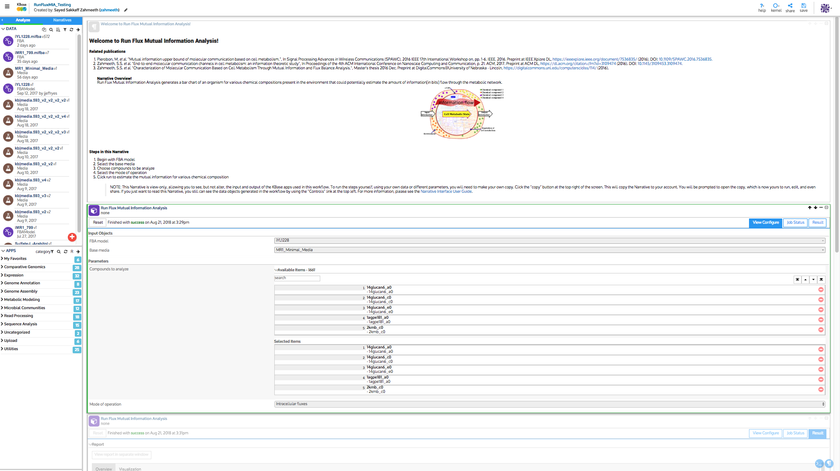



Toolbar
Data
FBA model
Narrative
Apps
Base media
Run Flux Mutual Information Analysis App
Available Compounds
Selected Compounds
Result Report

