Slide 1
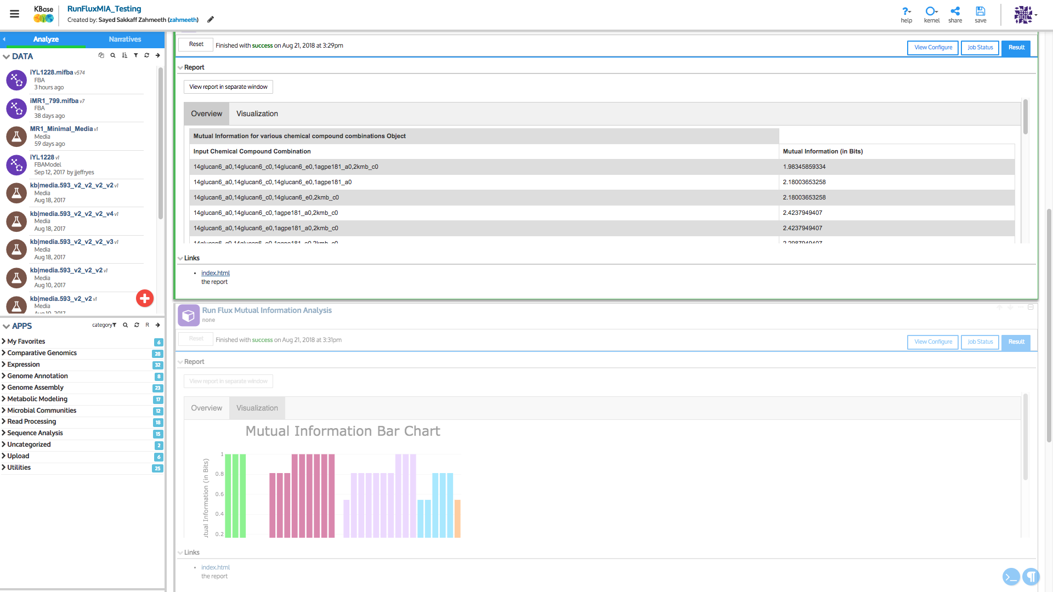

Result Report
List of chemical compound combination
Mutual Information (in Bits)
Bar Chart of Mutual Information (in Bits)

