Slide 1
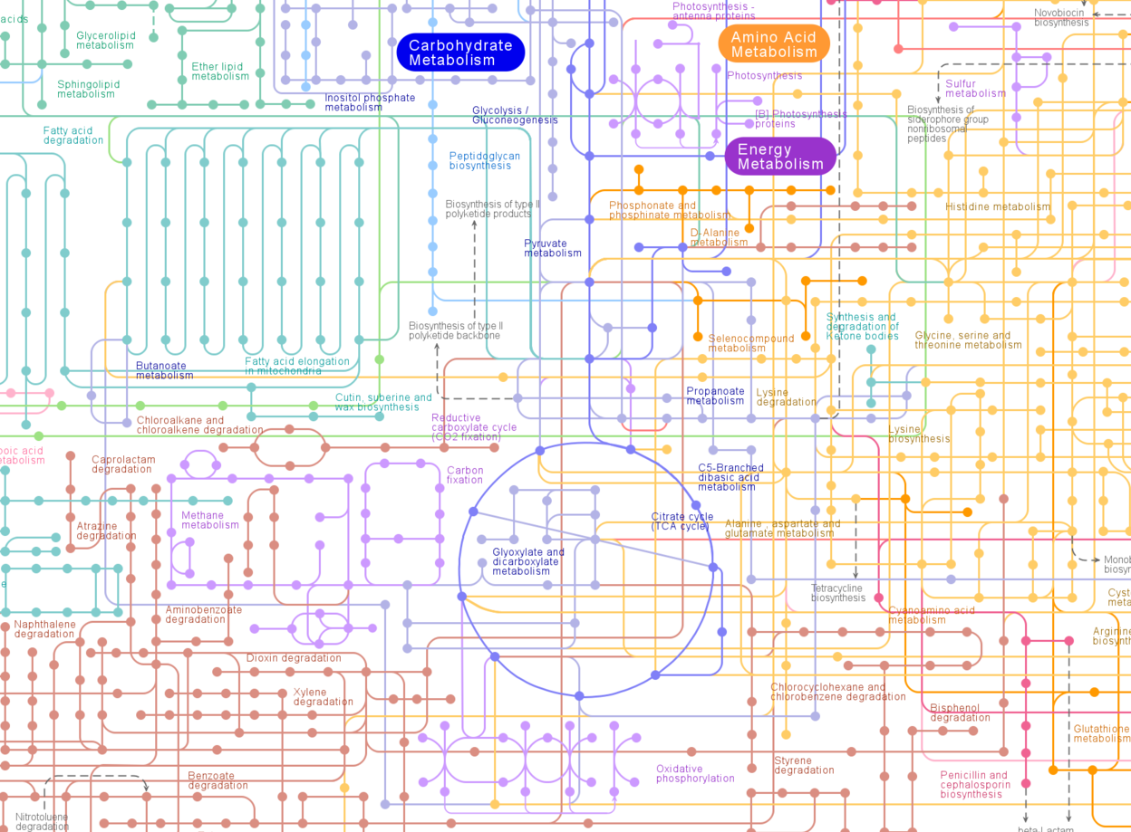

a Cell
Chemical compound 1
Chemical compound 2
Chemical compound 3
Chemical compound 4
Input
Information
Cell Metabolic State
Output
Information
Regulation of
cell metabolism
Environment
Notes:
Overall architecture of our works. So we model processes of biological system as an input binary encoder and digital modulator
Details will be given later

