Slide 1
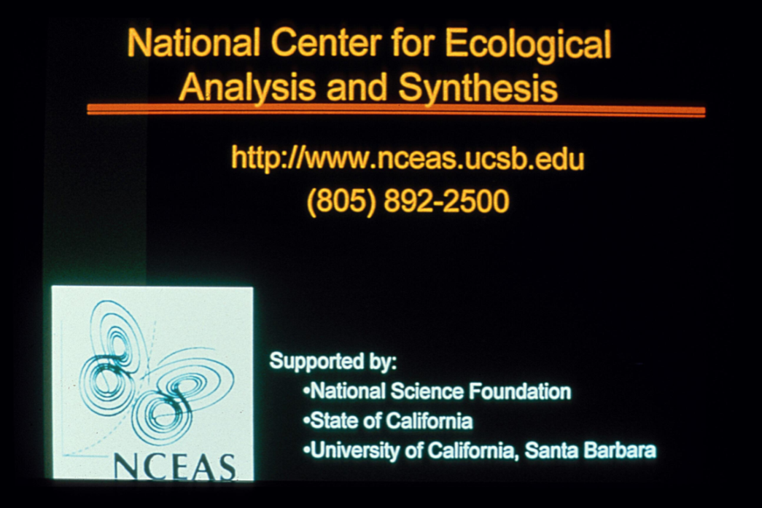
Social Dimensions of Collaboration in Synthesis Centers or
3000 Years Among the Ecologists
John N. Parker
(with contributions from Ed Hackett and Stephanie Hampton)

Slide 2
Overview
Background
Synthesis centers
  Mobilizing Structures
  Mode Two Research
  Islands
The Future…

Slide 3
Scientific Synthesis
Integrates research questions, theories, methodologies and data across disparate forms of expertise, scales and study systems to increase the generality, parsimony, applicability, or empirical soundness of scientific explanations and science-based innovations.
- (Hackett and Parker 2011)
Hyper-specialization
Data overload
Transformative/serendipitous research
Conceptualizing complex problems
Investment

Slide 4
Methods
Observations
Interviews
Surveys
Network analysis
Bibliometric analyses

Slide 5
Synthesis Centers as a Mobilizing Structures
Organizational means for mobilizing collective action (e.g. N.O.W.)
Key Insight: Social movements happen in science
Disciplines, specialty areas also social movements
Leaders, followers, opponents
(Frickel & Gross, 2005; Parker, 2006; Hess, 2007)

Slide 6
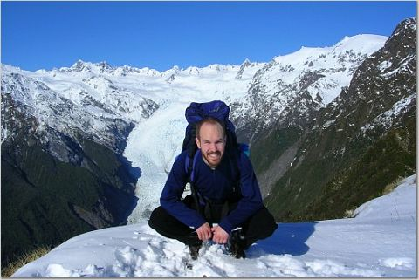
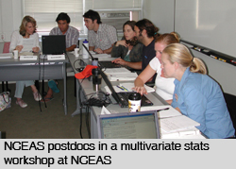
“Moist” transition
Field
Analysis
Molecular Biology
Ecology
Wet
Dry
Primary
Secondary
(Penders et al. 2008)

Slide 7
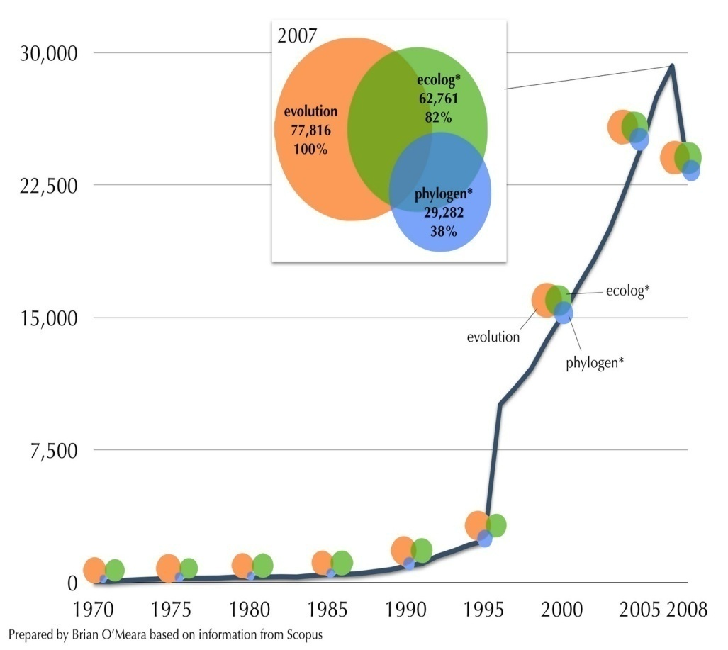
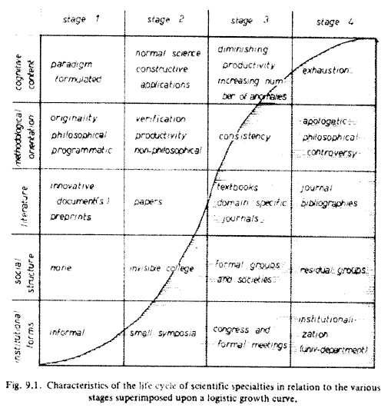
Life Cycles of Scientific Specialties
(O’Meara 2008)
(De May 1992)
More than an organization…

Slide 8
A Genealogy of Scientific Organizations
NCEAS
IPLANT
RAVON
NOAA
NESCent
CUAHSI
ACEAS
NIMBios
AEON
SRC
BioSynC
ISSNSFEO
IPL
Many others…
Disrupting Science Moore, 2008

Slide 9
Synthesis as Mode Two Research
Traditional Ecology
Field
30 meter plots
Primary data
Few collaborators
Single discipline
Single institution
Single nation
Academic setting
NCEAS Working Groups
NCEAS
Huge areas of study
Secondary data
A few hundred
Multiple disciplines
Multiple institutions
Multiple nations
Nonacademic setting
(Hackett 1990; Gibbons et al., 1994; Etzkowitz and Leydesdorff, 2000)

Slide 10
Data Translation
Analysis and synthesis divorced from local context
Result: Temporary loss of local knowledge
WG members travel ‘virtually’ to the field
Strategies: 1)Social capital, 2) Field notes, 3) Expert knowledge, 4) Metadata
Scientists adjust as ecology moves from traditional field sites
Take ecology out of the field…

Slide 11
In-Group Solidarity and Positioning
Span disciplines, institutions, nations
Leave local contexts and enter F2F at center
Result: trust, leadership roles, division of labor
Accomplished in two ways
  Period of ritualized adjustment
  Group symbols and rituals
Allows for: trust, bridging of social groups, and operational division of labor
Trading zones, pidgin, Creole

Slide 12
Age Structure and Interaction
Distinct division of labor
Essential tension (Kuhn, 1977)
Sr. Scientists: socialization, networking, institutional memory, orientation in the field, asking important questions
Jr. Scientists: fresh ideas and techniques, labor, energy, asking challenging questions
However, not always harmonious…
Striking the mother lode/essential tensions

Slide 13
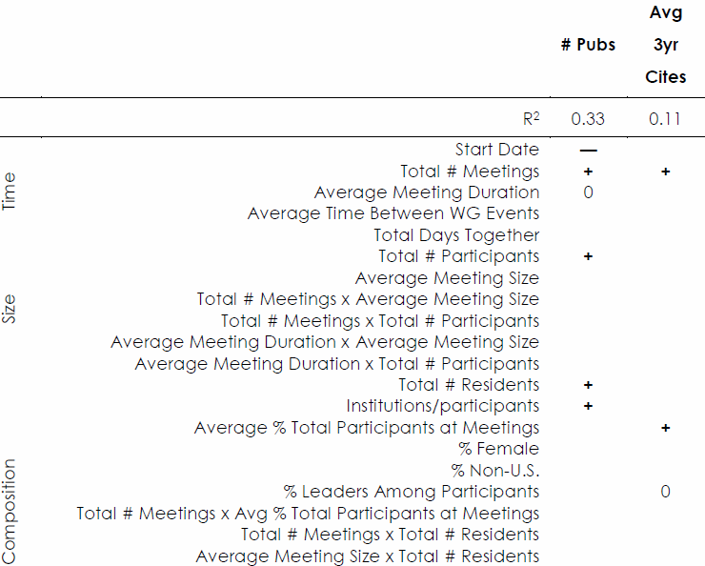
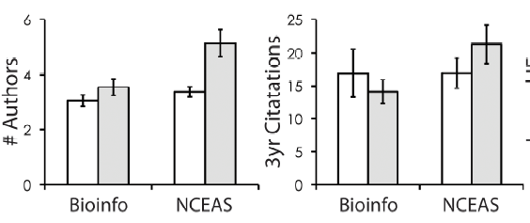
Success in Synthesis
Hampton and Parker (revising) Bioscience

Slide 14
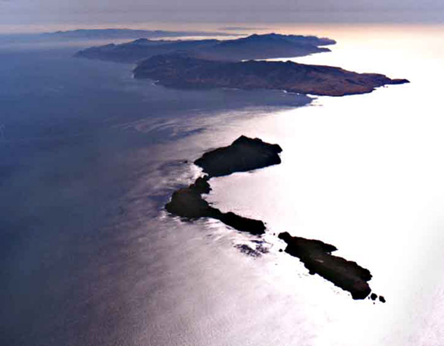
Synthesis Centers as Islands

Slide 15
Island Time
Combines:
Extreme Isolation
Personality Selectivity
Intense F2F
Expertise
Rituals/Informality
Outcomes:
Velocity
Trust
Commitment
Overcome Barriers
Collaborative Flow
Energy/motivation
Transformative research
Ideal microsociological conditions…
(Csikszentmihalyi, 1998; Collins, 2005; Sawyer, 2007)

Slide 16
New Models of Scientific Productivity
Punctuated, “Bursty” form of collaboration
Tradeoff extensive for intensive F2F
E.g. Fusion reaction/Hot Spots and Moments
New models of scientific productivity
(Parker and Hackett, American Sociological Review, Forthcoming)

Slide 17
Opinions and Attitudes
As Result of NCEAS experience…
67% more willing to share data
99% more likely to collaborate with WG members
100% encourage others to participate in NCEAS WGs
N = 131

Slide 18
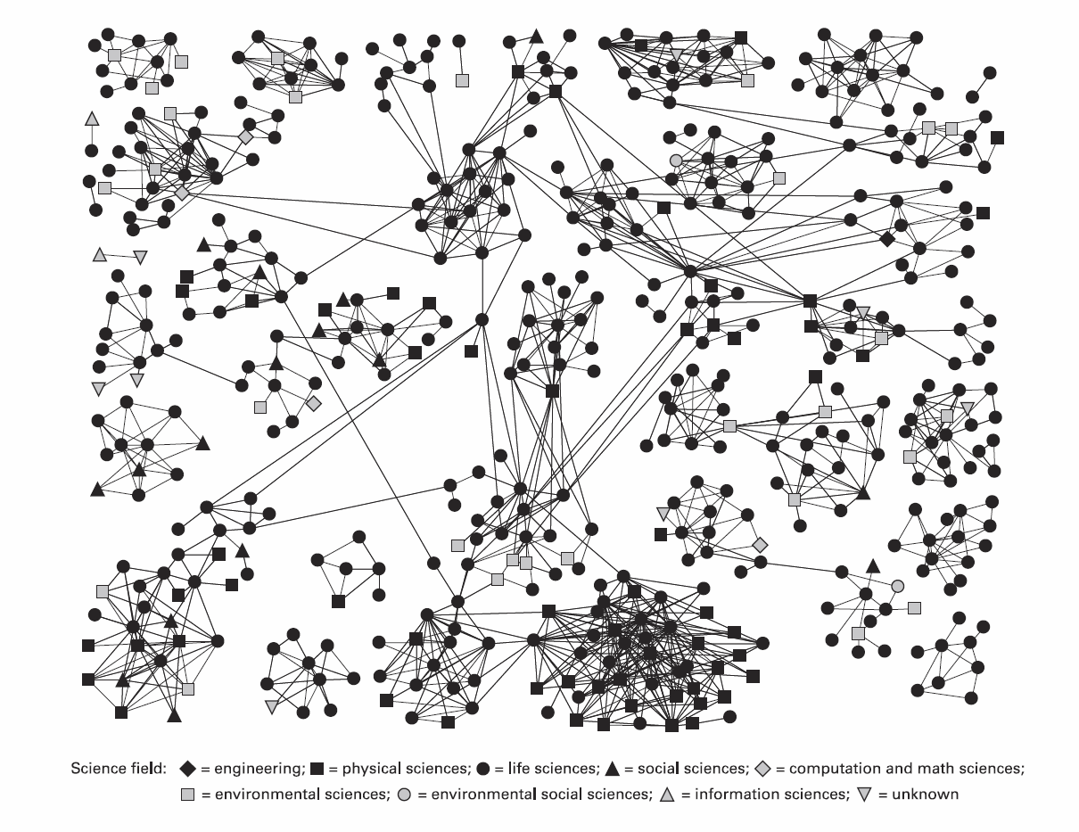
Diana Rhoten

Slide 19
For now, future lies in physical centers with virtual support
- Tacit knowledge transfer
Role and identity formation
Communication
- Trust, cohesion and commitment
- Technological support
- Gravitas
Opportunities for natural experiment

Slide 20
THANKS!
Collaborators
  Edward J. Hackett
  Stephanie Hampton
  Diana Rhoten
  Dave Conz

