Slide 1
Knapsack Problem Approximation
Yangqi Su, Yaying Shi

Slide 2
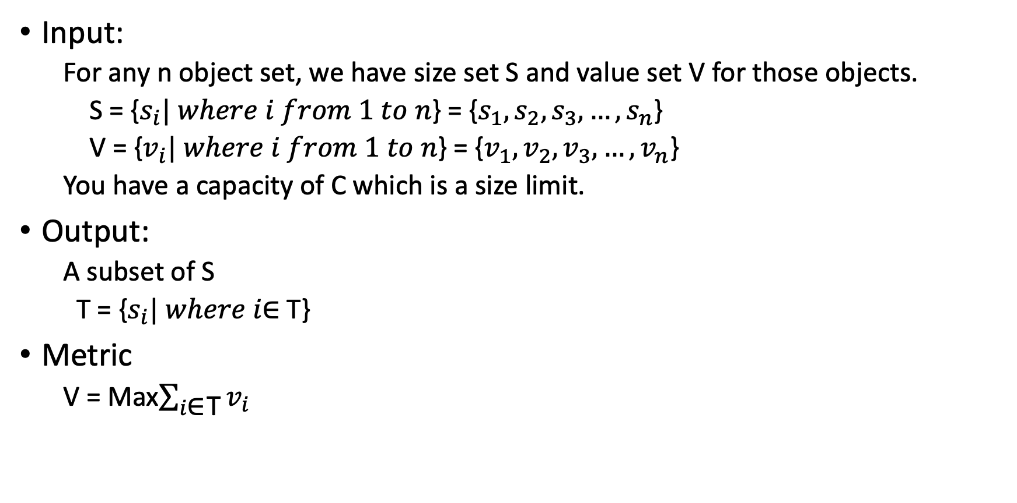
Presentation of the problem
Input:
For any n object set, we have size set S and value set V for those objects.
S = {$s_{i}| where i from 1 to n$} = {$s_{1},s_{2},s_{3}, …,s_{n}$}
V = {$v_{i}| where i from 1 to n$} = {$v_{1},v_{2},v_{3}, …,v_{n}$}
You have a capacity of C which is a size limit.
Output:
A subset of S
T = {$s_{i}| where i\text{∈ }\text{T}$}
Metric
V = Max$\sum_{i\text{∈ }\text{T}}{v_{i}}$

Slide 3
Importance of this problem
Any arrangement and schedule problem with a threshold
If you have an exam tomorrow, how could you select the most value part in limited time.
How could you schedule your travel plan with limited money?
Data download management
Cache select

Slide 4
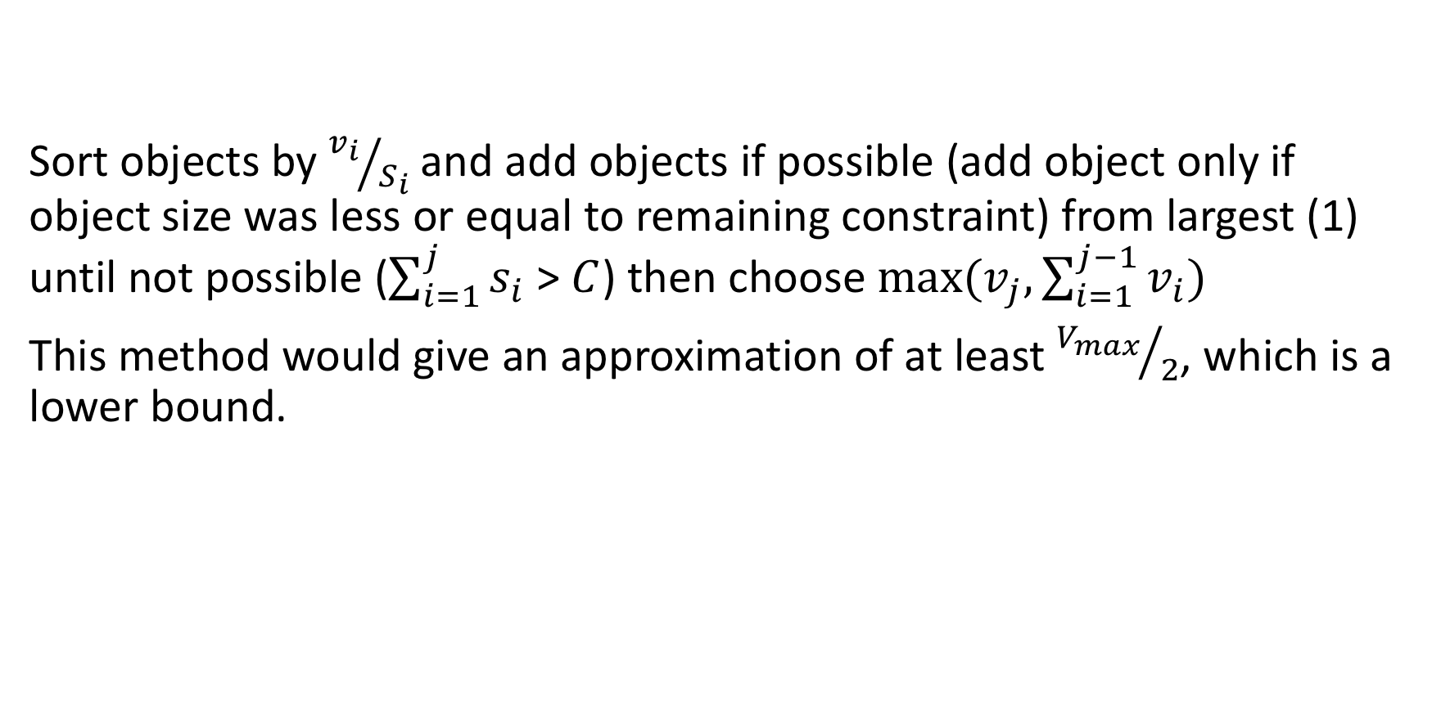
Approximation Lower Bound
Sort objects by ${v_{i}}/{S_{i}}$and add objects if possible (add object only if object size was less or equal to remaining constraint) from largest (1) until not possible ($\sum_{i=1}^{j}{s_{i}}$ > $C$) then choose $max⁡(v_{j},\sum_{i=1}^{j−1}{v_{i}})$
This method would give an approximation of at least ${V_{max}}/2$, which is a lower bound.

Slide 5
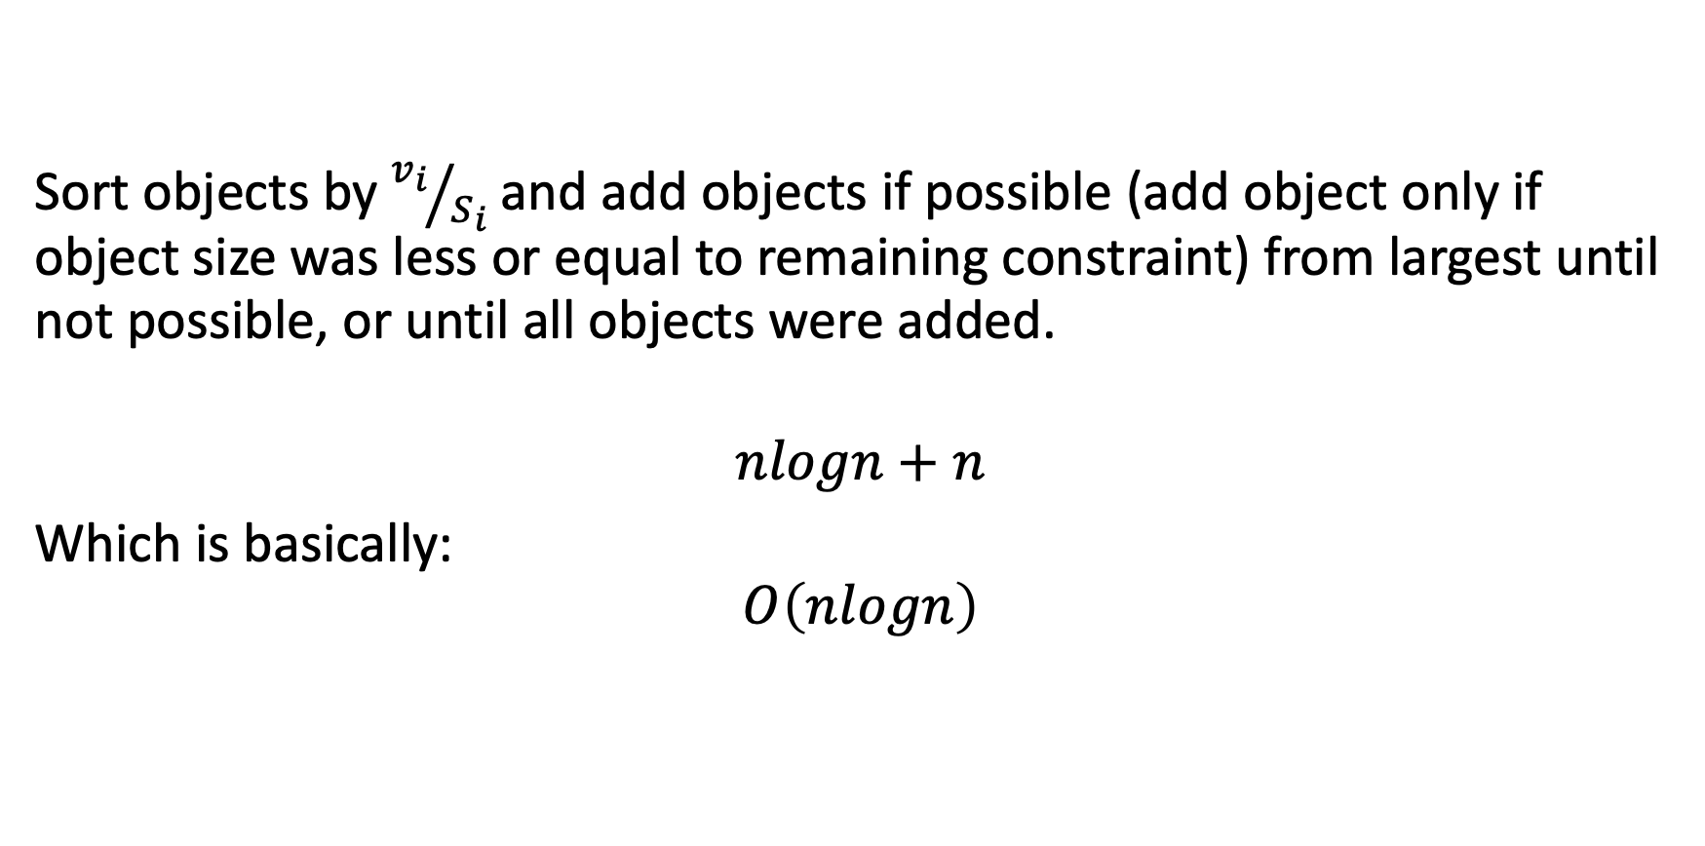
Algorithm and Complexity
Sort objects by ${v_{i}}/{S_{i}}$and add objects if possible (add object only if object size was less or equal to remaining constraint) from largest until not possible, or until all objects were added.
$$nlogn+n$$
Which is basically:
$$O\left(nlogn\right)$$

Slide 6
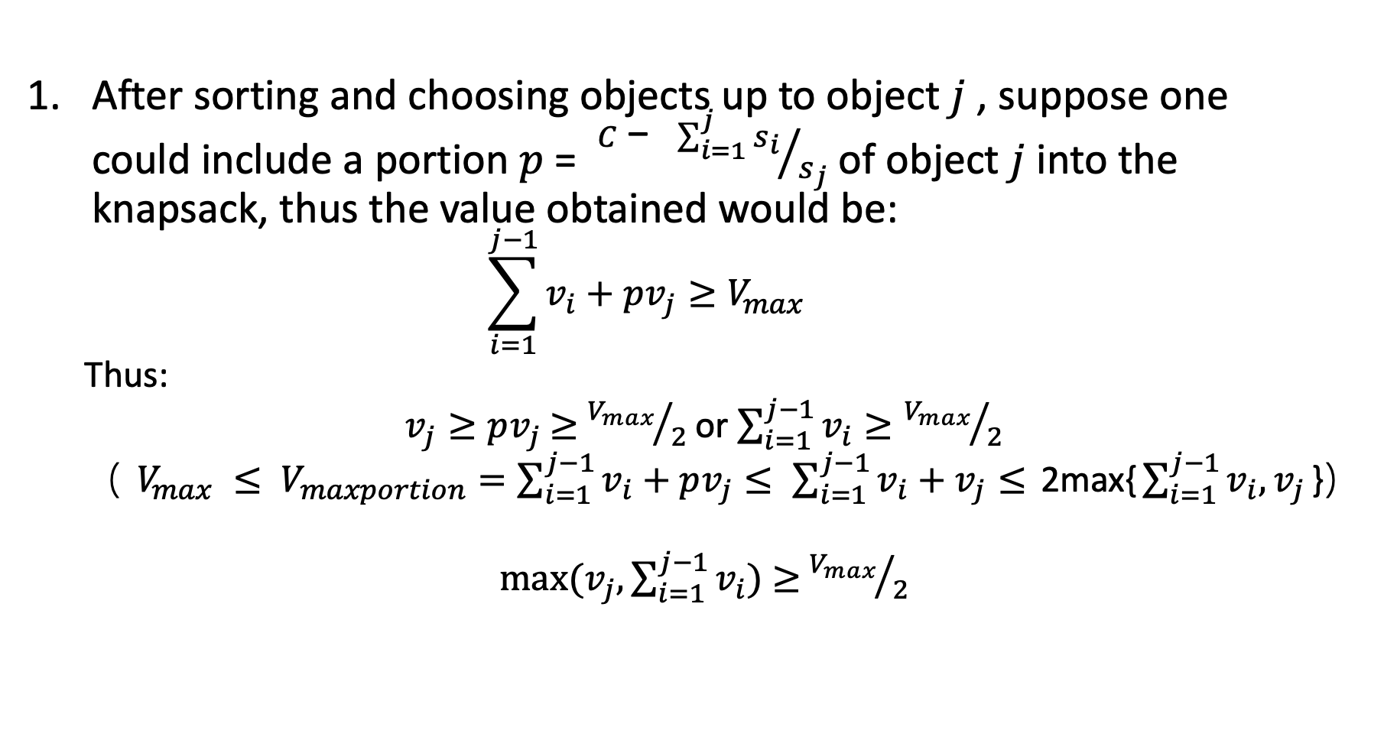
Proof
After sorting and choosing objects up to object $j$, suppose one could include a portion $p$ = ${C\text{ − }\sum_{i=1}^{j}{s_{i}}}/{s_{j}}$ of object $j$ into the knapsack, thus the value obtained would be:
$$\sum_{i=1}^{j−1}{v_{i}+pv_{j}}≥V_{max}$$
Thus:
$v_{j}≥pv_{j}$ $≥$ ${V_{max}}/2$ or $\sum_{i=1}^{j−1}{v_{i}}≥{V_{max}}/2$
（ $V_{max} ≤ V_{maxportion}=\sum_{i=1}^{j−1}{v_{i}+pv_{j}}≤$ $\sum_{i=1}^{j−1}{v_{i}+v_{j}}≤$ 2max{$\sum_{i=1}^{j−1}{v_{i},v_{j}}$}）
$max⁡(v_{j},\sum_{i=1}^{j−1}{v_{i}})$ $≥$ ${V_{max}}/2$

Slide 7
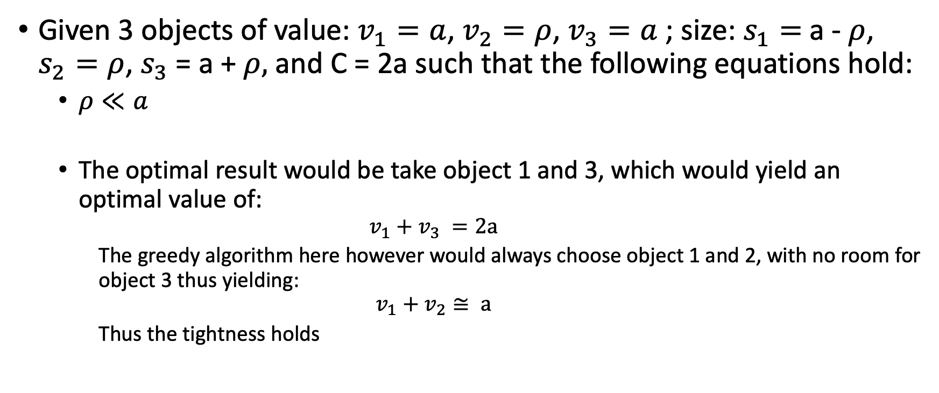
Tightness Analysis
Given 3 objects of value: $v_{1}=a$, $v_{2}=ρ$, $v_{3}=a$ ; size: $s_{1}=$a -$ρ$, $s_{2}=ρ$, $s_{3}$ = a + $ρ,$ and C = 2a such that the following equations hold:
$ρ≪a$
The optimal result would be take object 1 and 3, which would yield an optimal value of:
$$v_{1}+v_{3} =2a$$
The greedy algorithm here however would always choose object 1 and 2, with no room for object 3 thus yielding:
$$v_{1}+v_{2}≅ a$$
Thus the tightness holds

Slide 8
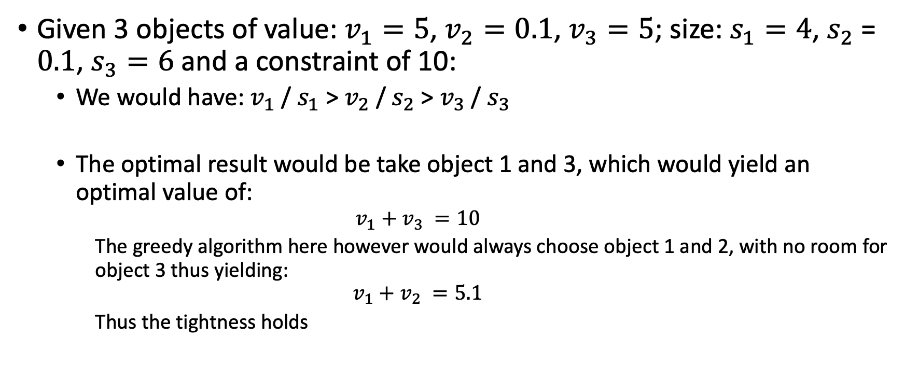
Tightness Example
Given 3 objects of value: $v_{1}=5$, $v_{2}=0.1$, $v_{3}=5$; size: $s_{1}=4$, $s_{2}$ = $0.1$, $s_{3}=6$ and a constraint of 10:
We would have: $v_{1}$/ $s_{1}$ > $v_{2}$/ $s_{2}$ > $v_{3}$/ $s_{3}$
The optimal result would be take object 1 and 3, which would yield an optimal value of:
$$v_{1}+v_{3} =10$$
The greedy algorithm here however would always choose object 1 and 2, with no room for object 3 thus yielding:
$$v_{1}+v_{2} =5.1$$
Thus the tightness holds

