Slide 1
New Labgeneous Architecturing

Slide 2
Target System
Devices
CAM image processing: USB
4 LEDs: GPIO
Trinket (chip): I2C
Devices
4 LEDs: GPIO 4
Filter wheel: GPIO 5 (home)
PD ADC/DAC: I2C
Trinket (chip): I2C

Slide 4
PD interface

Slide 5
Filter wheel
L293D
Motor
GPIO’s
Home sensor

Slide 6
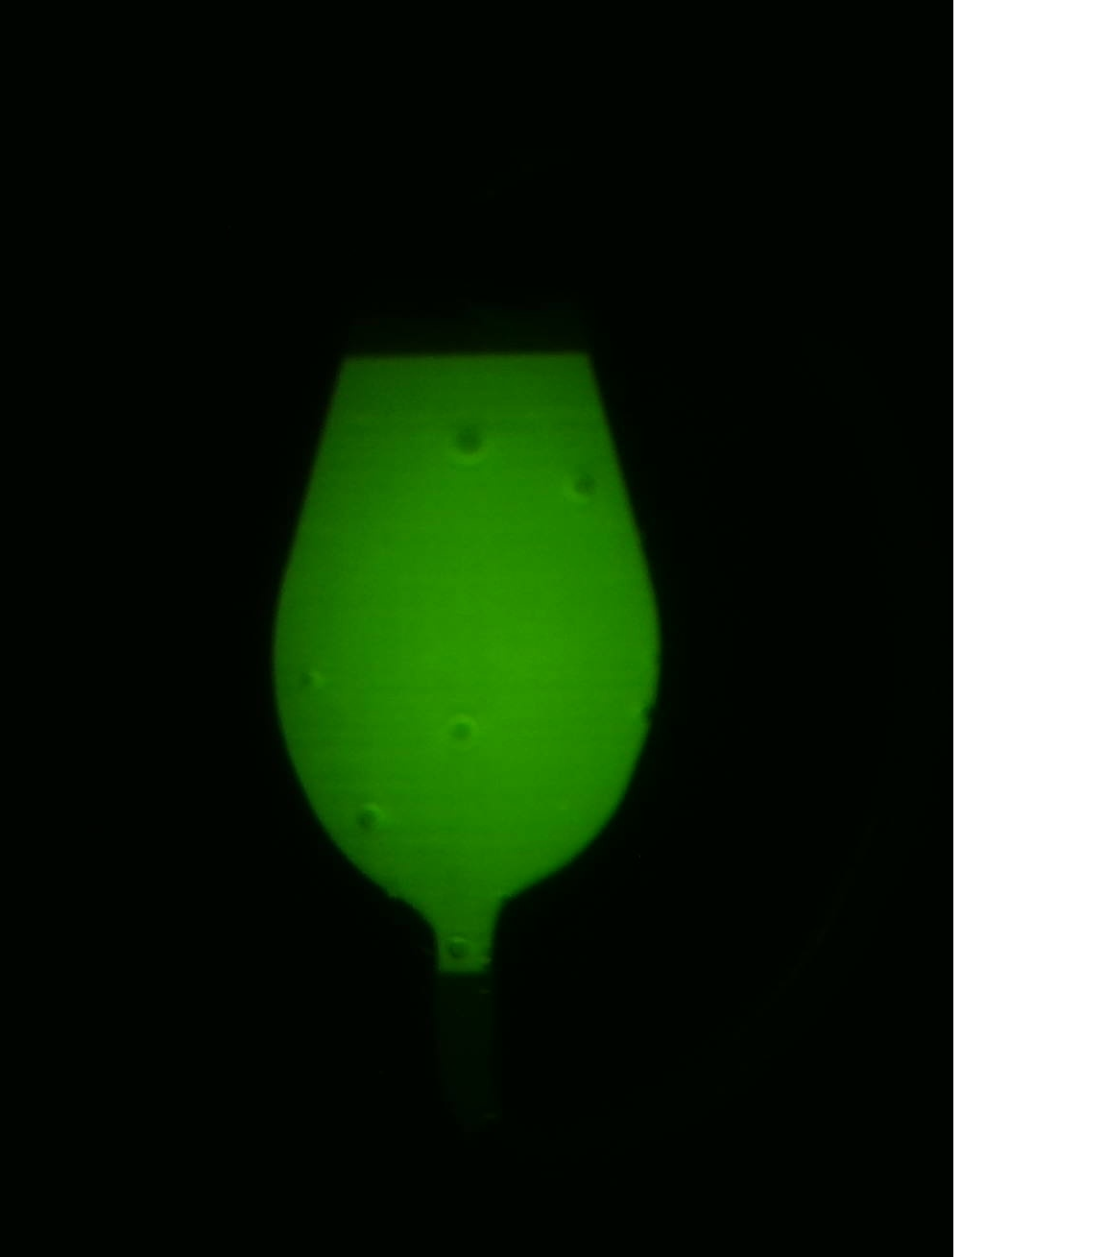
Multi-filter cam
1 image per 1 fluorescence
Different position for each fluorescence

Slide 7
Consideration
pi 대신에 다른 platform
IP over wifi, ethernet, bluetooth, usb ...
protocol manager들을 한 site에 할 것인지? -- 다른 app?
충실하지만 중복되지 않은 test API
Pi porting 전에 PC에서 implementation 권장

