Slide 1
Tutorial How to Run

Slide 2
Flow
1
2
3
4
5
Simulate data
Prepare data for training
Train neural network
Prepare test data
Segment using trained model

Slide 3
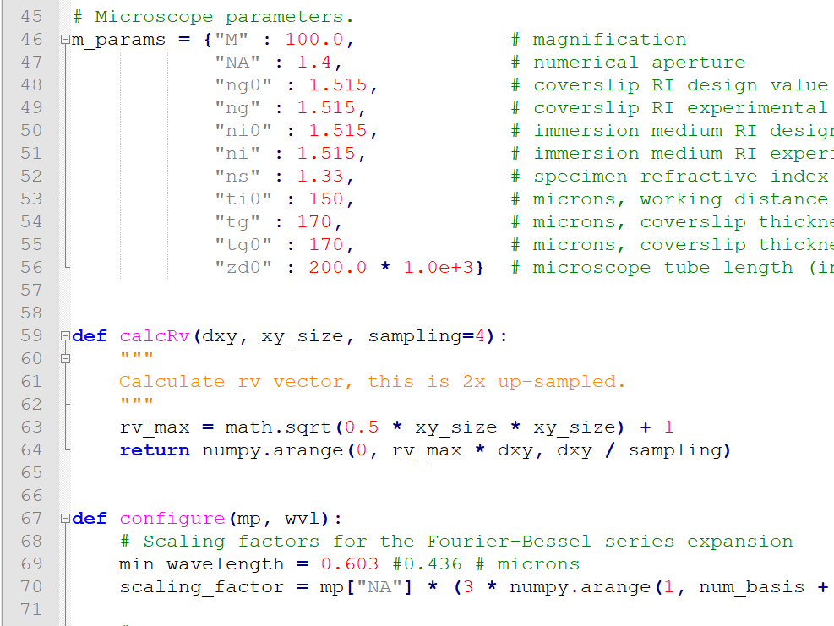
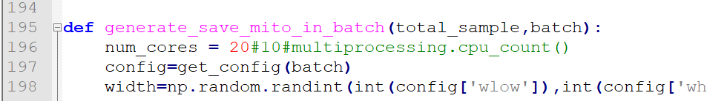
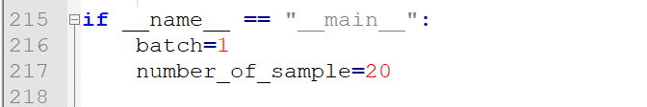
Data Simulation
1. Define batch for simulation (inside batch folder, bXX.csv, XX is batch number)
2. Define microscope parameter
microscPSFmod.py
3. Define simulation parameter
generator_batch_parallel.py
Number of CPU to be used
Batch number and number of sample need to generate

Slide 4
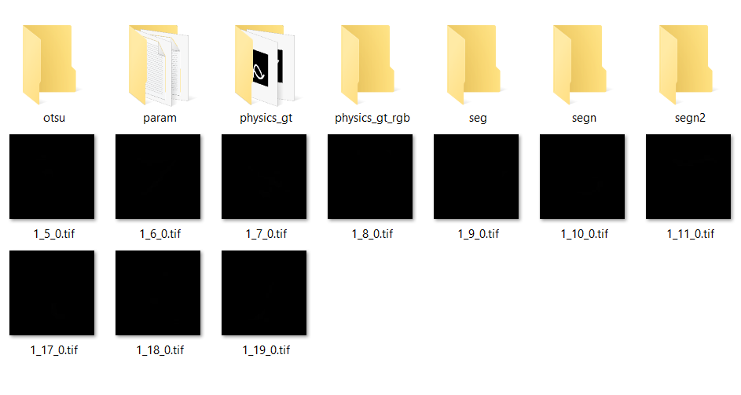
Data Simulation: Expected output
Folder: output/XX, where XX is batch number
Segmentation GT
Microscopy image

Slide 5
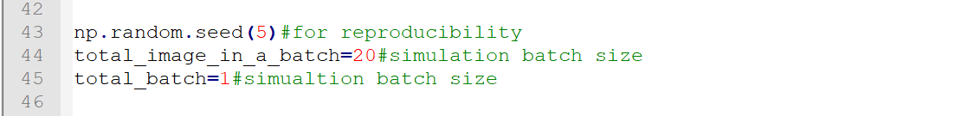
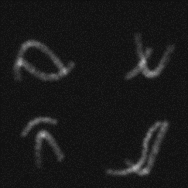

Prepare Data for Training
Folder: 5. Data Preparation and Training/data preparation
You need “output” folder generated by simulator to be copied here
Change the parameters
Batch size given during simulation
Number of batches in simulation
data_generator.py
Expected output:
Inside data folder, two folders (image and segmented) containing 256x256 image and segmentation GT

Slide 6
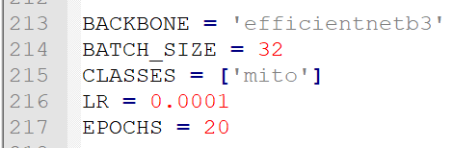
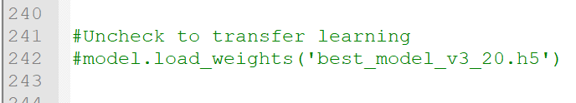
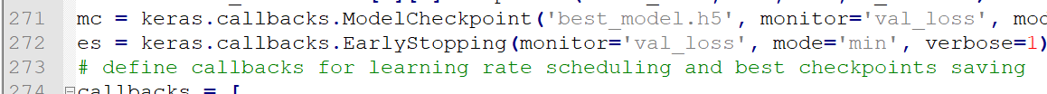
Training the Network
Folder: 5. Data Preparation and Training/train
You need “image” and “segment” folder generated by previous step to be copied inside “datatrain”
Create folder “train” and “val” inside image” and “segment” folder
Split the data into train and validation set
Change the parameters
EPOCHS in line 217
For Transfer learning:
Copy previously trained model here and uncheck line 242
train_UNet.py
Saved model as defined in line 272
Expected output:

Slide 7
Prepare Test Data
Folder: 6. Prepare Test Data
You need “png” folder containing 1024x1024 png file need to segment
Run split_1024_256.py
Expected output:
“data” folder containing 256x256 png files

Slide 8
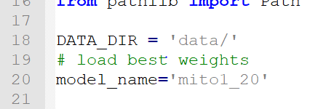
Segment Test Data
Folder: 7. Test Segmentation
You need “data” folder generated by previous step
You need saved model file (.h5) generated during training
Change model name in segment.py
Run segment.py
Change .h5 saved model
Expected output:
“output” folder containing 256x256 segmentation

Slide 9
Thank You

