Slide 1

<YOUR_PROJECT>
HILIC
Settings
Reverse-Phase
WIFF_DATA
MZML_DATA
ABF_DATA_MS-DIAL
WIFF_DATA
MZML_DATA
ABF_DATA_MS-DIAL
Positive.wiff
Negative.wiff
Positive.wiff.scan
Negative.wiff.scan
Positive.mzML
Negative.mzML
Positive.abf
Negative.abf

Slide 2
<YOUR_PROJECT>
HILIC
Settings
Reverse-Phase
WIFF_DATA
MZML_DATA
ABF_DATA_MS-DIAL
WIFF_DATA
MZML_DATA
ABF_DATA_MS-DIAL
WIFF_POS
WIFF_NEG
MZML_POS
MZML_NEG
MS-DIAL_POS
MS-DIAL_NEG
WIFF_POS
WIFF_NEG
MZML_POS
MZML_NEG
MS-DIAL_POS
MS-DIAL_NEG
Positive.wiff
Positive.wiff.scan
Negative.wiff
Negative.wiff.scan
Positive.mzML
Negative.mzML
Positive.abf
Negative.abf

Slide 3

<YOUR_PROJECT>
WIFF_DATA
MZML_DATA
ABF_DATA_MS-DIAL
Settings
WIFF_NEG
WIFF_POS
MZML_NEG
MZML_POS
NEG_MS-DIAL
POS_MS-DIAL
Negative.wiff
Negative.wiff.scan
Positive.wiff
Positive.wiff.scan
Negative.mzML
Positive.mzML
Negative.abf
Positive.abf

Slide 4
ABF_DATA_MS-DIAL
NEG_MS-DIAL
POS_MS-DIAL
Negative.abf
Positive.abf
001_InChiKey-Name
001_InChiKey-Name
002_InChiKey-Name
002_InChiKey-Name
003_InChiKey-Name
003_InChiKey-Name
004_InChiKey-Name
004_InChiKey-Name
Continues...
Continues...

Slide 5
ABF_DATA_MS-DIAL
NEG_MS-DIAL
POS_MS-DIAL
001_InChiKey-Name
001_InChiKey-Name
4uL_negSWATH_vial-1.abf
2uL_negSWATH_vial-1.abf
0-75uL_negSWATH_vial-1.abf
0-25uL_negSWATH_vial-1.abf
4uL_posSWATH_vial-1.abf
2uL_posSWATH_vial-1.abf
0-75uL_posSWATH_vial-1.abf
0-25uL_posSWATH_vial-1.abf
002_InChiKey-Name
002_InChiKey-Name
4uL_negSWATH_vial-1.abf
2uL_negSWATH_vial-1.abf
0-75uL_negSWATH_vial-1.abf
0-25uL_negSWATH_vial-1.abf
4uL_posSWATH_vial-1.abf
2uL_posSWATH_vial-1.abf
0-75uL_posSWATH_vial-1.abf
0-25uL_posSWATH_vial-1.abf
003_InChiKey-Name
003_InChiKey-Name
4uL_negSWATH_vial-1.abf
2uL_negSWATH_vial-1.abf
0-75uL_negSWATH_vial-1.abf
0-25uL_negSWATH_vial-1.abf
4uL_posSWATH_vial-1.abf
2uL_posSWATH_vial-1.abf
0-75uL_posSWATH_vial-1.abf
0-25uL_posSWATH_vial-1.abf
004_InChiKey-Name
004_InChiKey-Name
4uL_negSWATH_vial-1.abf
2uL_negSWATH_vial-1.abf
0-75uL_negSWATH_vial-1.abf
0-25uL_negSWATH_vial-1.abf
4uL_posSWATH_vial-1.abf
2uL_posSWATH_vial-1.abf
0-75uL_posSWATH_vial-1.abf
0-25uL_posSWATH_vial-1.abf
Continues...
Continues...

Slide 6
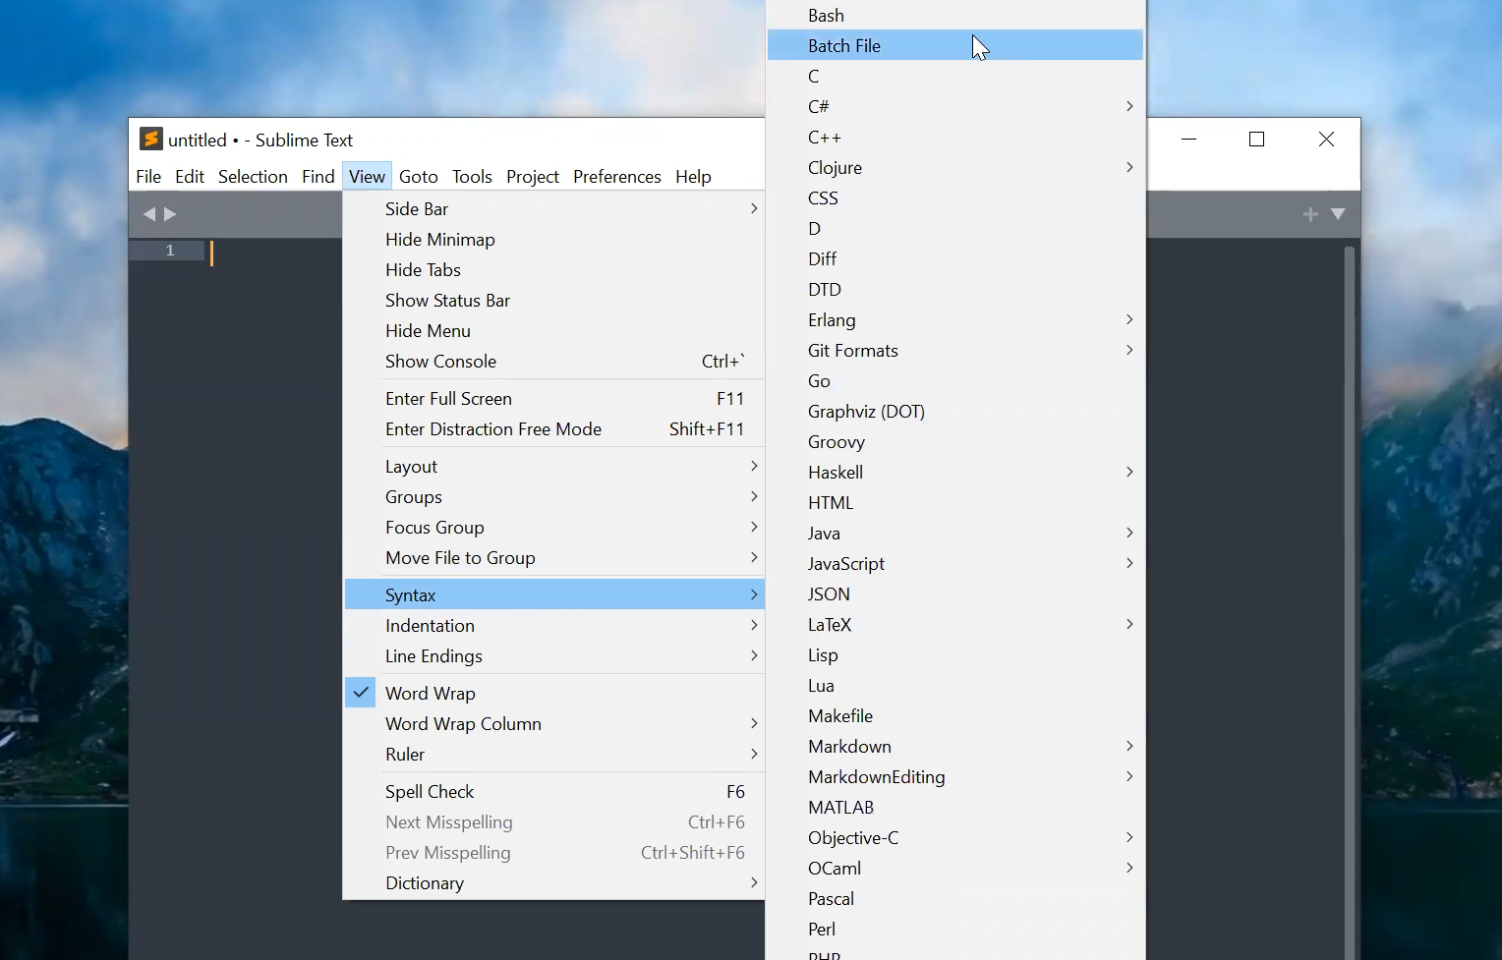

Slide 7
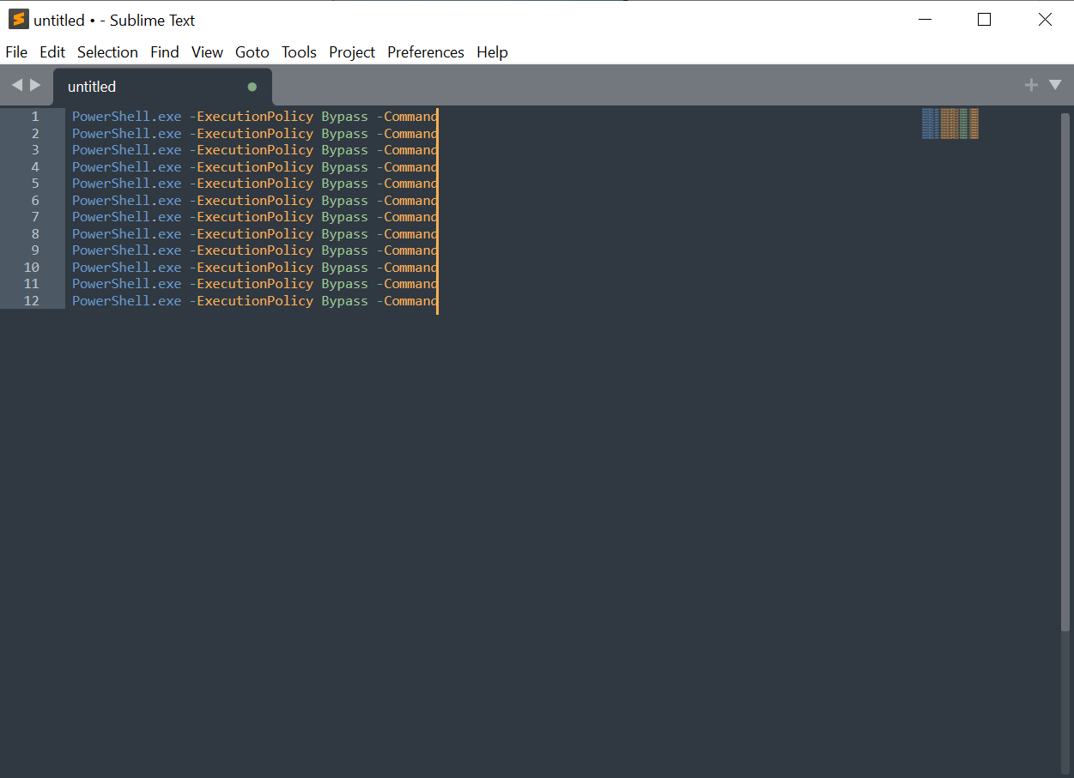

Slide 8
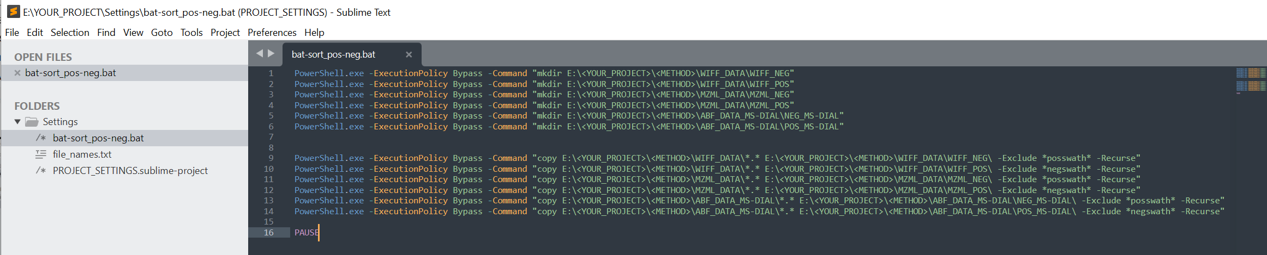

Slide 9
