Slide 1
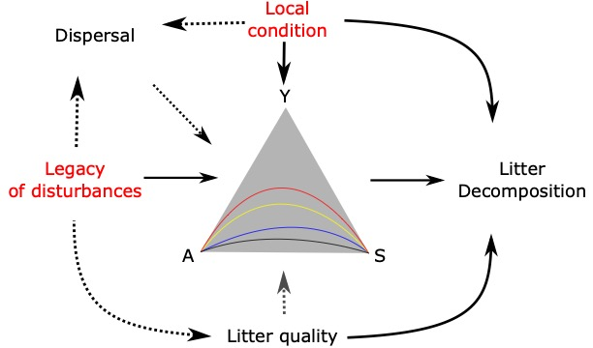
We do not yet know why composition matters in litter decomposition
Conceptual challenge:
-> The ‘Hierarchical Concept’
(Lavelle et al. 1993; Aerts 1997)
-> Proved to be a reasoning fallacy (Bradford et al. 2017 NEE)
(Yield)
❓
Methodological barrier:
-> High functional redundancy
(Allison and Martiny 2008 PNAS)
-> Taxonomy-based approach not revealing
(resource
Acquisition)
(Stress tolerance)
Malik et al. 2020 ISME
We do not appreciate microbial composition in soil biogeochemical modelling

Slide 2
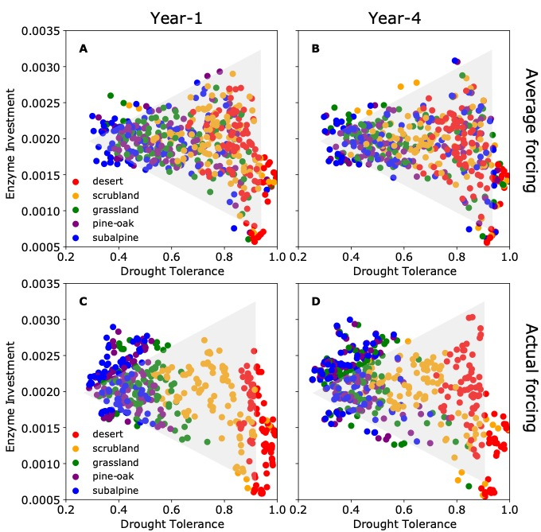
Communities across the gradient consistently lie in a YAS space
Based on transplant simulations with DEMENTpy (Wang and Allison 2021 Ecosphere) across a climate gradient in Southern California, US (Glassman et al. 2018 PNAS)

Slide 3
A framework of empirical prediction of litter decomposition?
Legacy of microbial composition matters!
A 3-way tradeoff may uniformly explain how microbial composition affects litter decomposition.
It offers a potential framework for empirically predicting litter decomposition at scales but entails empirical verification (-omics + ML).
Bin Wang(ORNL) & Steven Allison(UC Irvine)
wangb@ornl.gov
Twitter@bioatmo_sphere
GitHub@bioatmosphere

