Slide 1
Welcome to bioBakery
bioBakery is a virtual machine (VM) environment designed to help you execute metagenomics analyses.
bioBakery and the tools therein were developed by the Huttenhower lab at the Harvard School of Public Health: http://huttenhower.sph.harvard.edu/
bioBakery is based on Ubuntu Linux 12.10.

Slide 2
Using bioBakery tools
This tutorial is designed to familiarize you with the bioBakery environment.
For an overview of the types of software and analyses available in bioBakery, please visit: https://bitbucket.org/timothyltickle/biobakery/wiki/Home
For help with a specific tool, please visit its individual web site; links to individual tool pages are available here: http://huttenhower.sph.harvard.edu/biobakery

Slide 3
Differences between bioBakery and linux
We have customized bioBakery to be a bit more forgiving than the typical linux environment.
In linux, typing “rm file” in the command prompt will permanently delete the file; in bioBakery, this command moves the file to the trash. (Use “hardrm file” to delete permanently.)
bioBakery will also prompt you before overwriting a file. (E.g. if you attempt to copy a file to a location with an identically named file.)

Slide 4
Sharing files with bioBakery
The VirtualBox app runs bioBakery as a “guest” operating system (OS) within your computer’s primary OS, which we call the “host” OS.
By default, the guest OS cannot see files on the host OS. However, it is possible to configure folders to be shared between the guest and host.

Slide 5
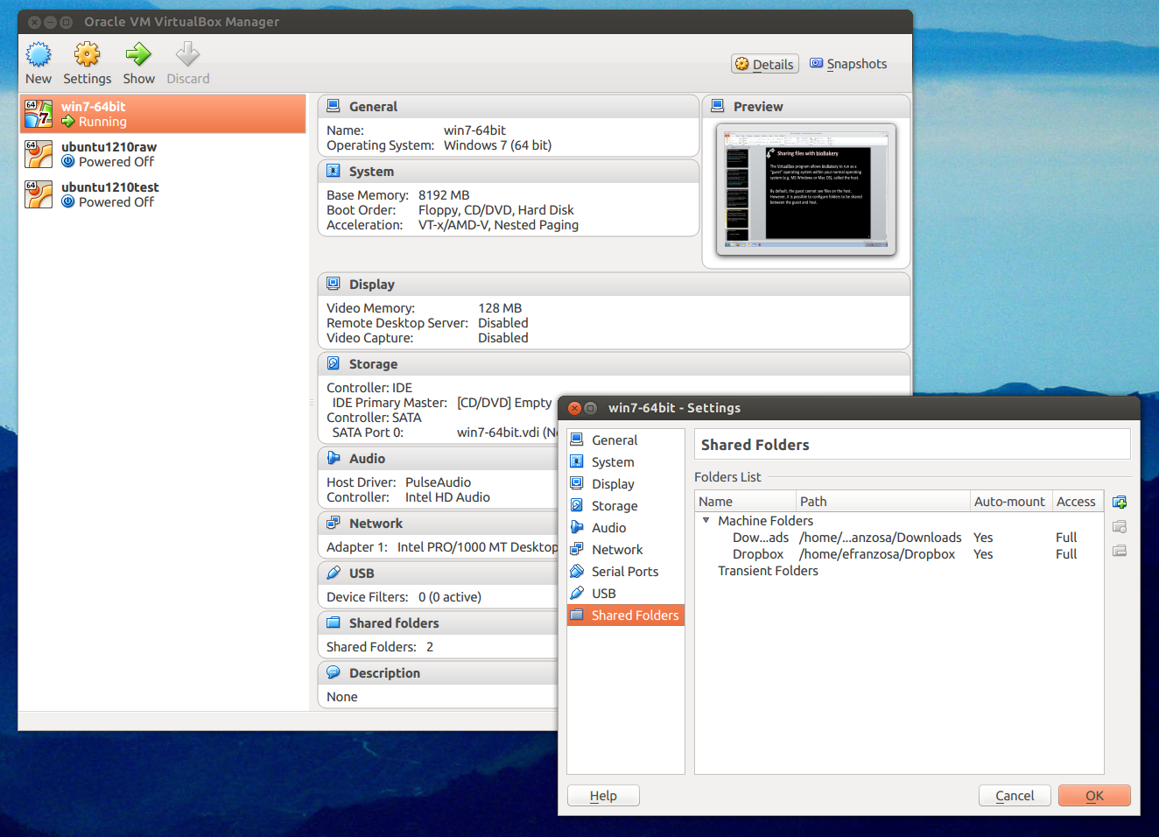
Sharing files with bioBakery
In the VirtualBox app running on the host OS…
Select settings…
Then shared folders…
Then click the tiny plus icon.

Slide 6
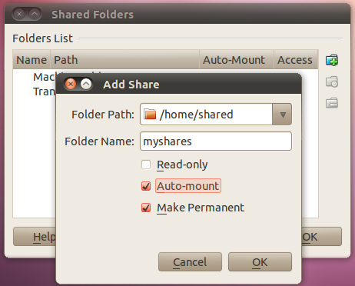
Sharing files with bioBakery
Select a folder on the host OS from the dropdown menu. Tick the “auto-mount” and “make permanent” boxes.
The next time you restart bioBakery, this folder will be available under Computer/Media.

Slide 7
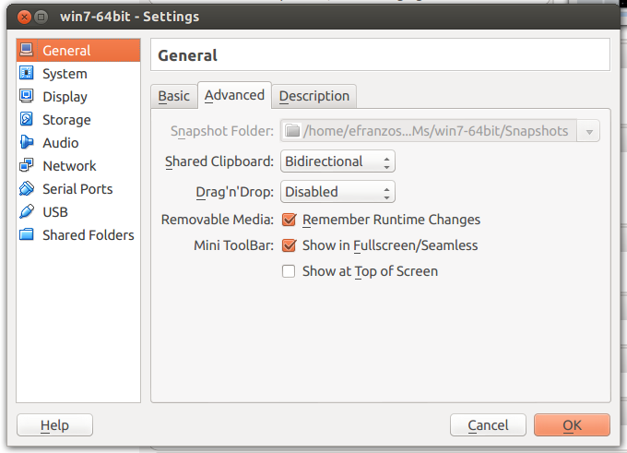
Sharing files with bioBakery
Sharing the clipboard between the host and guest is also helpful (this lets you copy on the host and paste on the guest, and vice versa).
In the VirtualBox app…
Under settings/General…
Select the Advanced tab…
Set “Shared Clipboard” to “Bidirectional”

