Slide 1
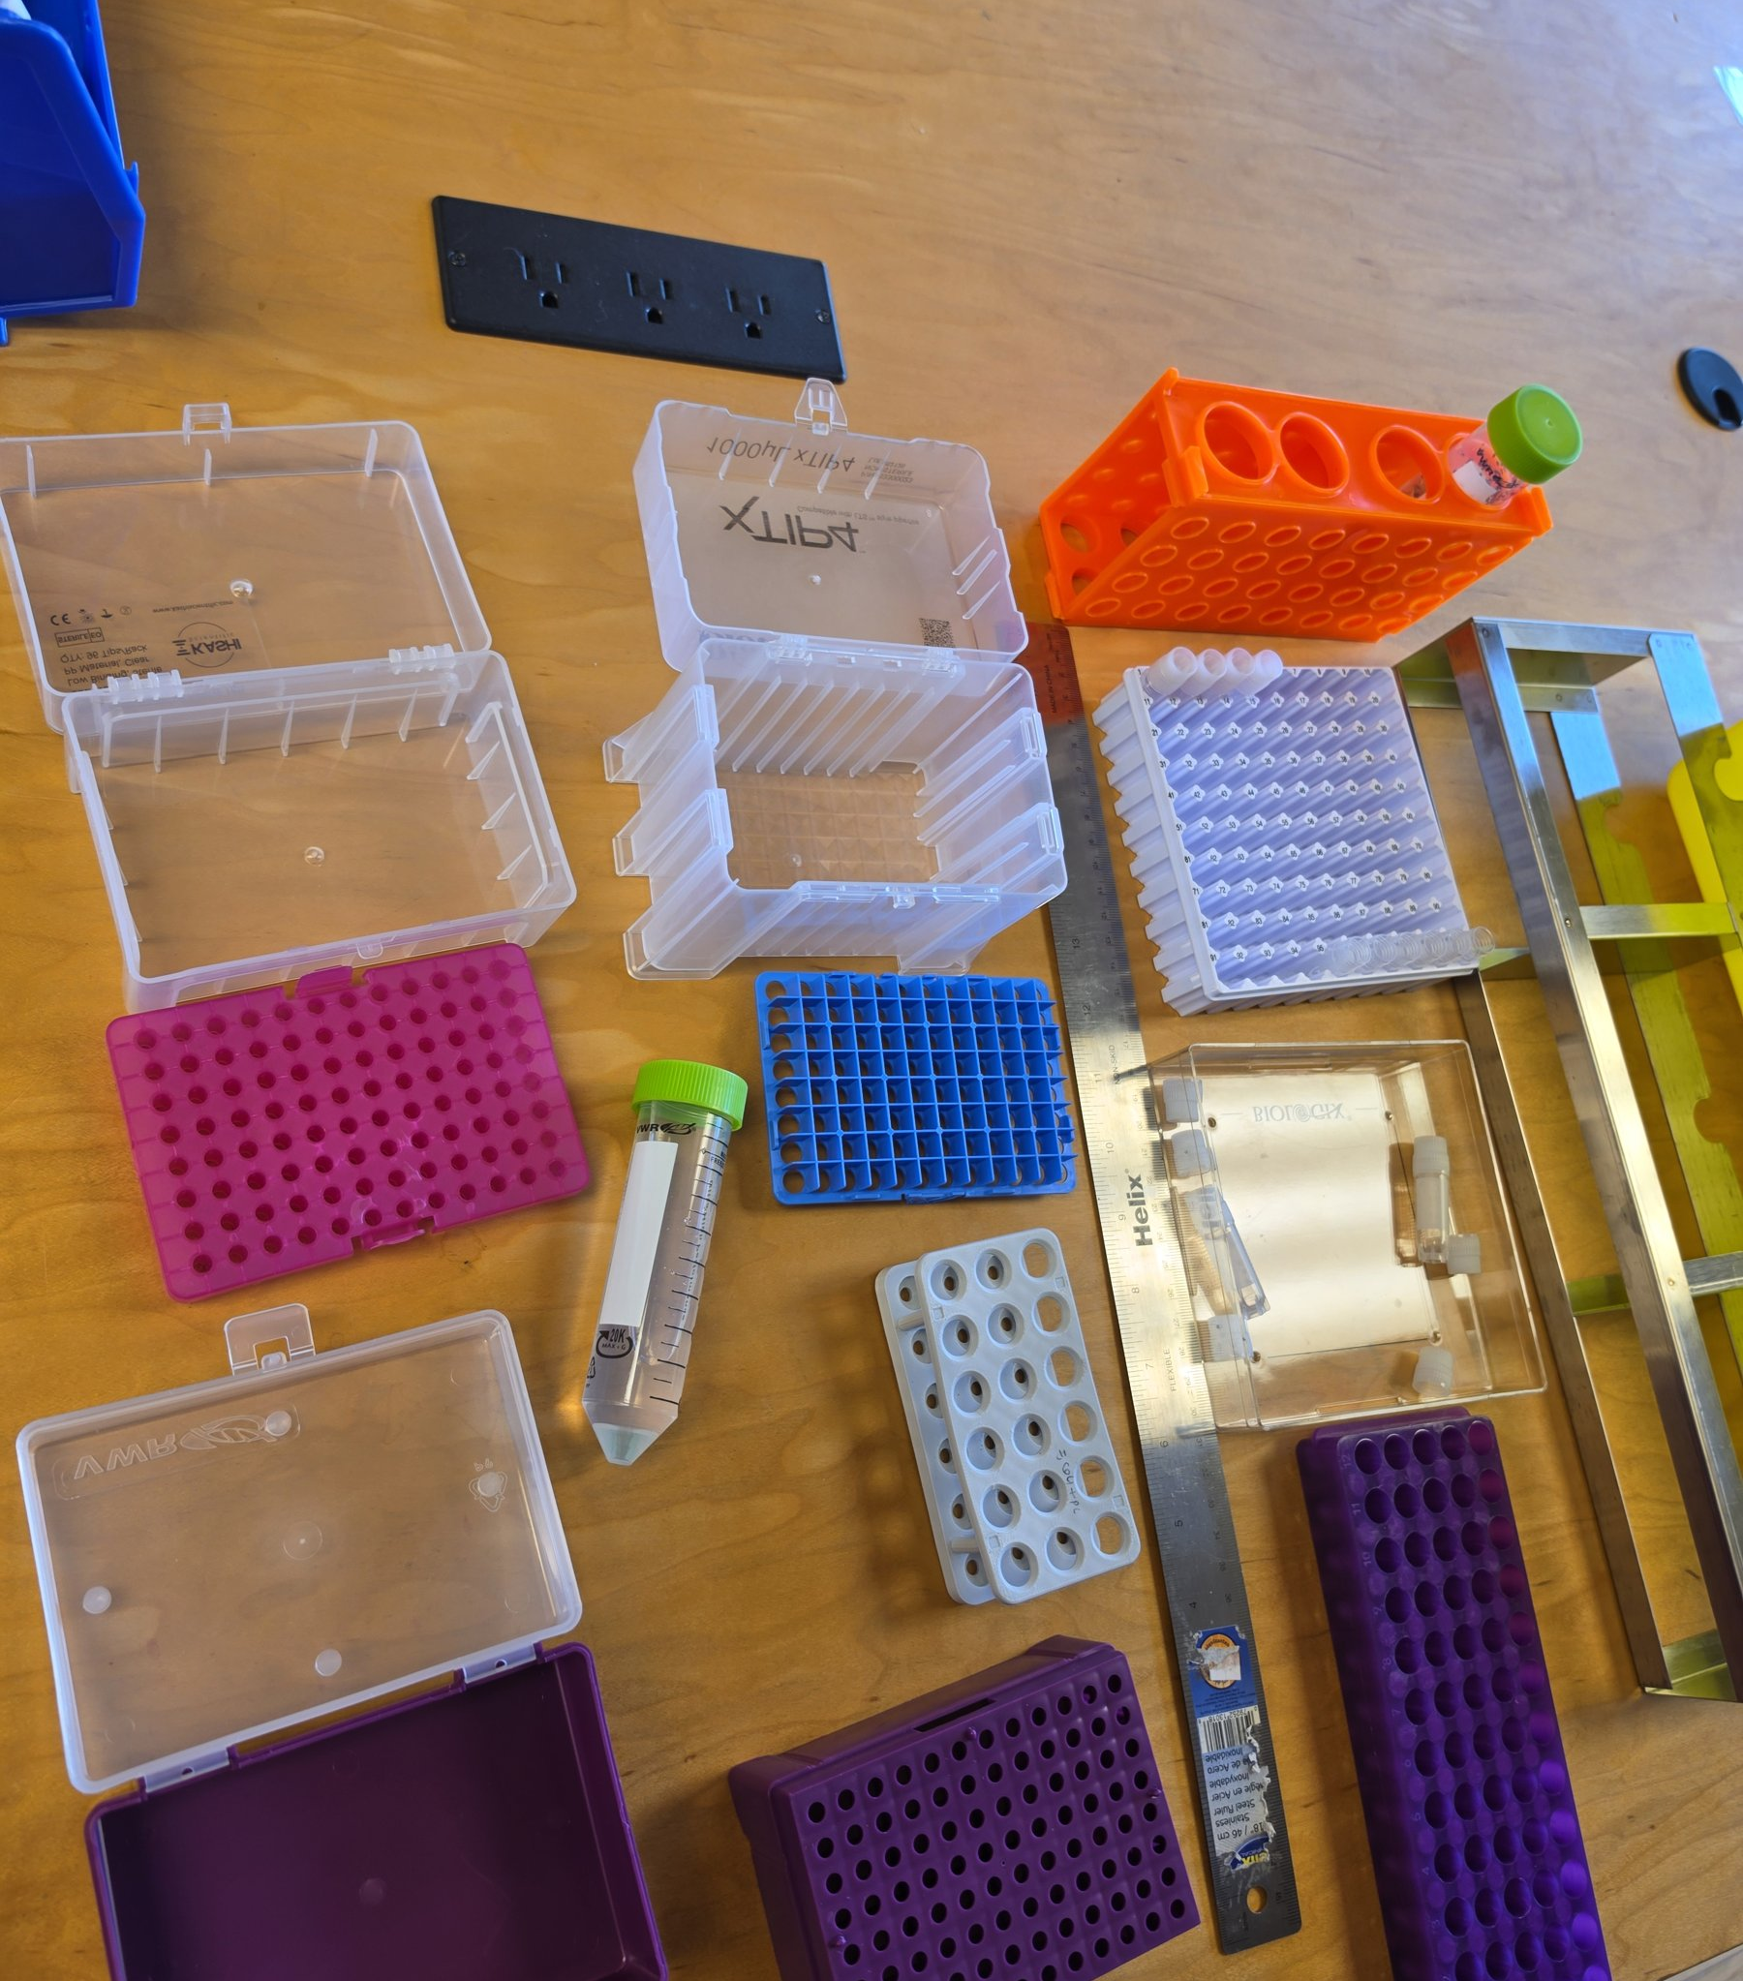
BaeBugs
A virtual lab built from the labware already on the bench
Notes:
BaeBugs. A virtual lab built from the labware already on the bench

Slide 2
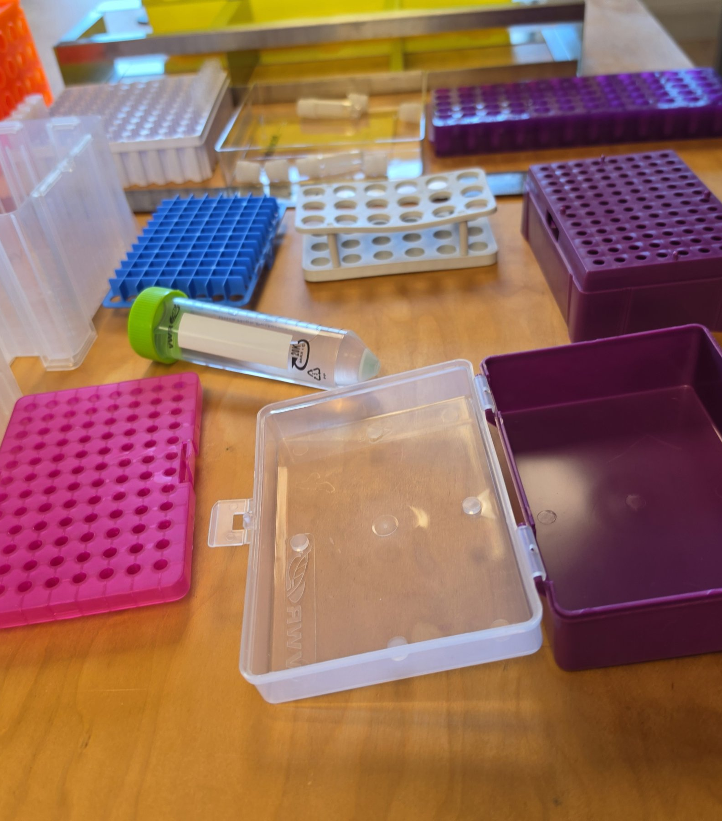
Start with what you have
Tube racks, tip boxes, cryo boxes and conicals, repurposed instead of bought new
Notes:
Start with what you have. Tube racks, tip boxes, cryo boxes and conicals, repurposed instead of bought new

Slide 3
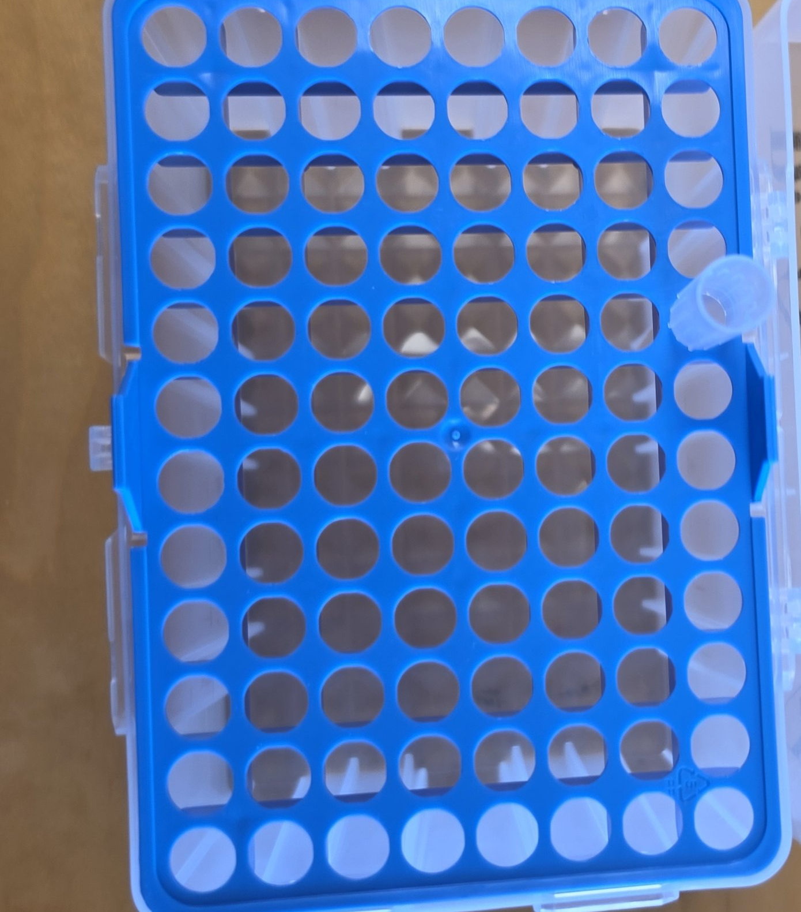
Every rack is a coordinate system
A 96-position tip rack maps straight onto a well grid the robot understands
Notes:
Every rack is a coordinate system. A 96-position tip rack maps straight onto a well grid the robot understands

Slide 4
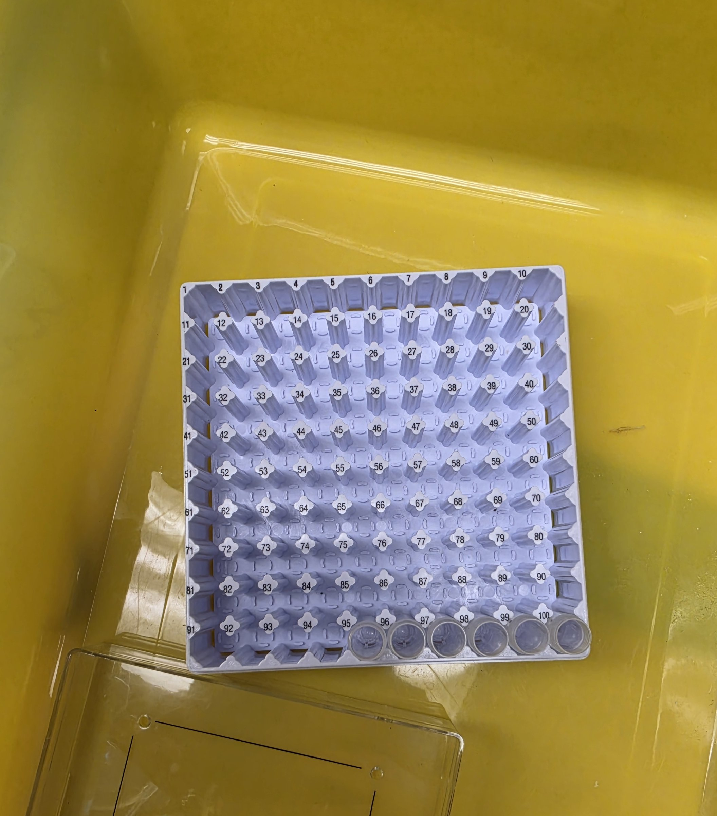
Measured, then modeled
Cryo racks become parametric OpenSCAD models with exact well pitch
Notes:
Measured, then modeled. Cryo racks become parametric OpenSCAD models with exact well pitch

Slide 5
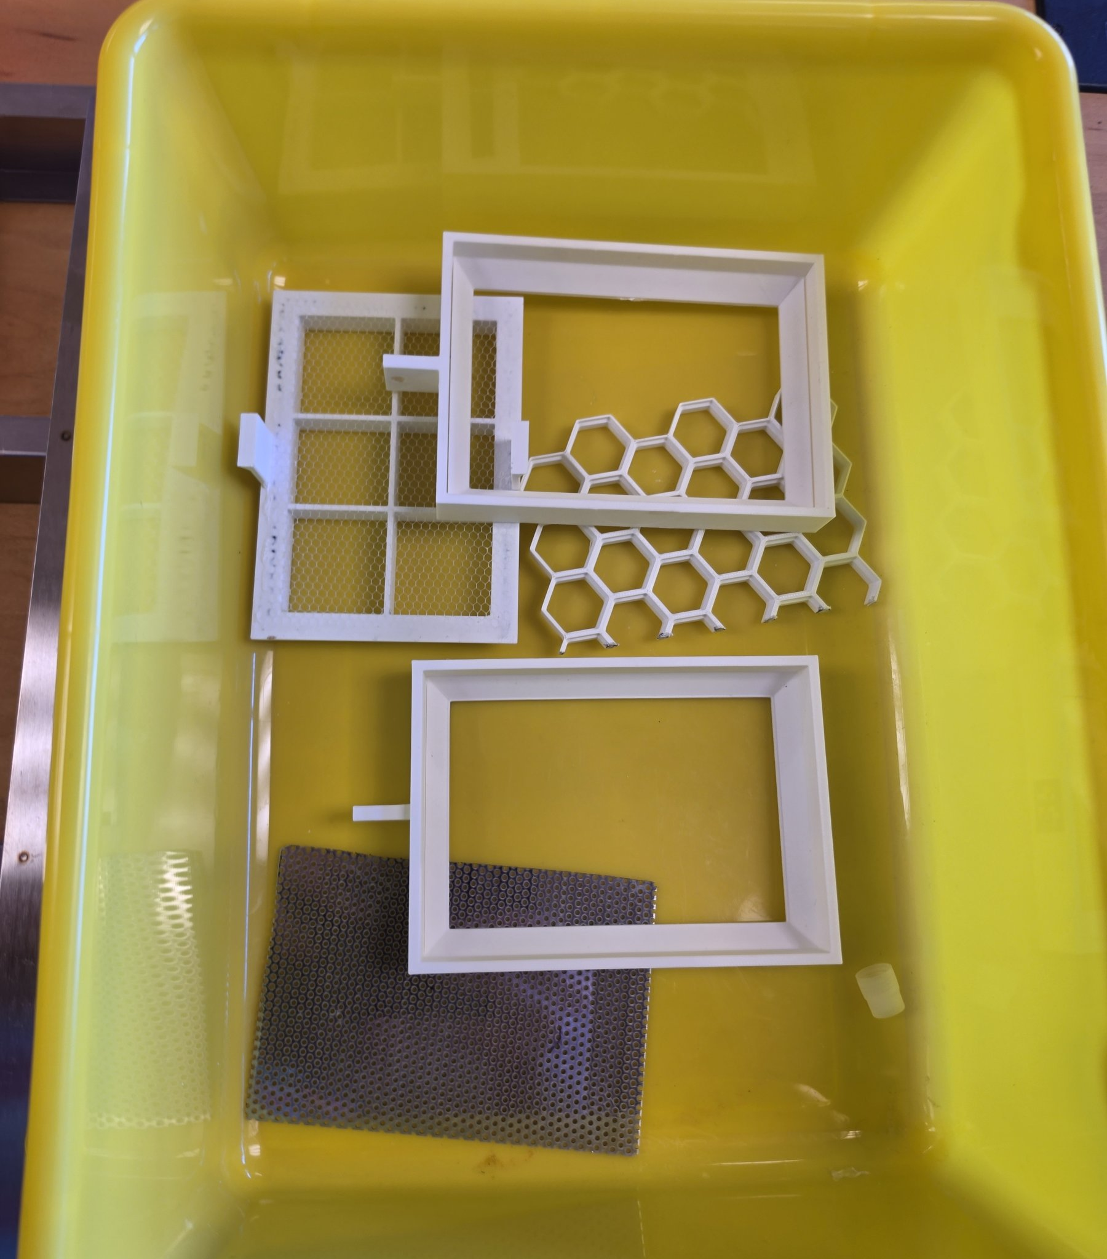
Printable remixes
SBS frame, honeycomb insert and grid mesh, printed from the repo's STL files
Notes:
Printable remixes. SBS frame, honeycomb insert and grid mesh, printed from the repo's STL files

Slide 6
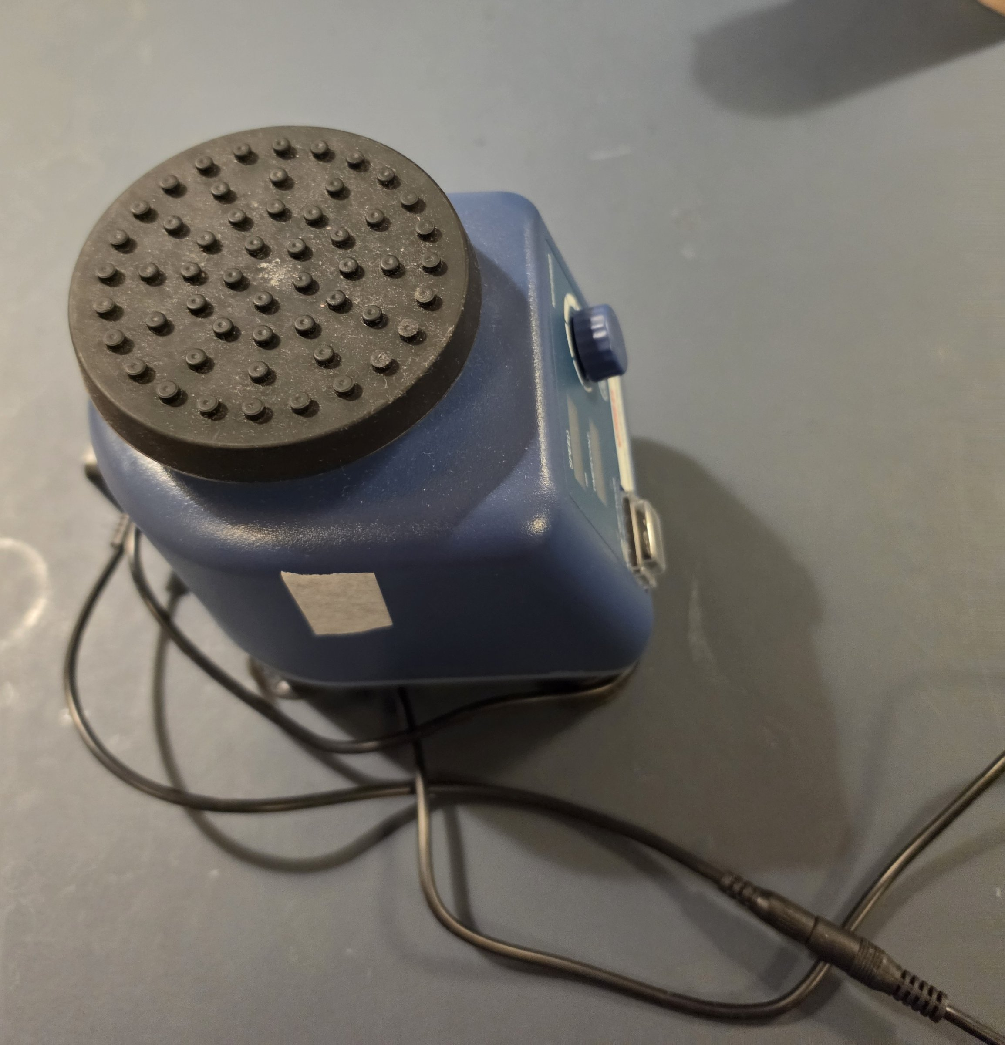
Bench gear stays in the loop
Vortexers and mini centrifuges are tracked alongside the printed parts
Notes:
Bench gear stays in the loop. Vortexers and mini centrifuges are tracked alongside the printed parts

Slide 7
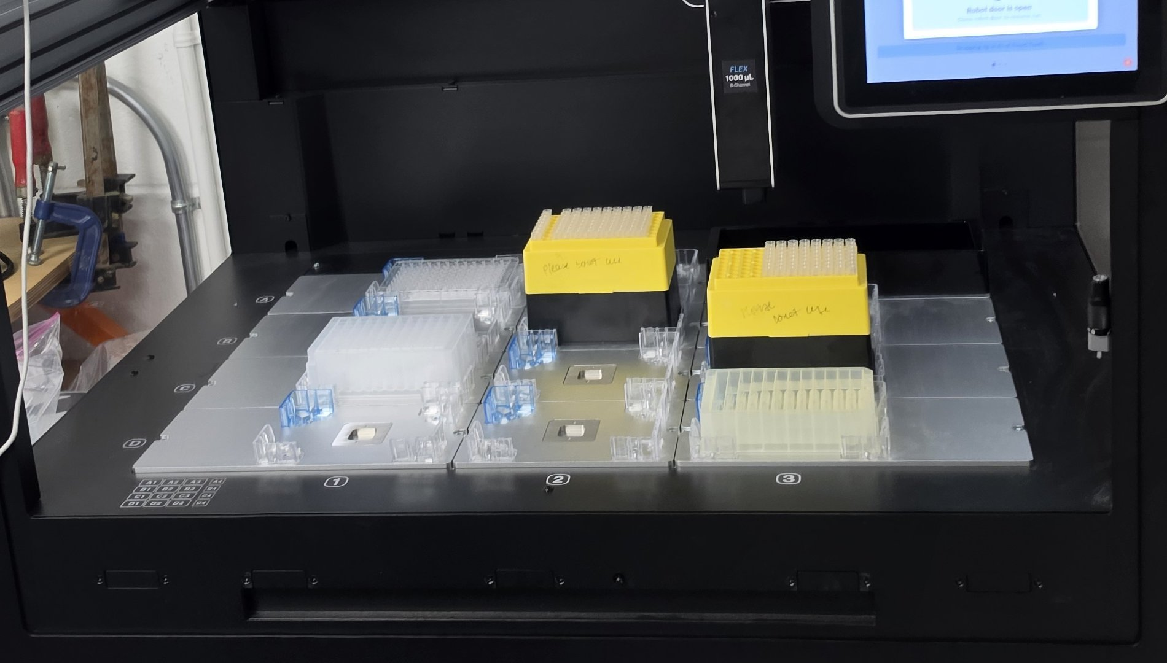
Onto the robot
Custom labware definitions load onto an Opentrons Flex deck
Notes:
Onto the robot. Custom labware definitions load onto an Opentrons Flex deck

Slide 8
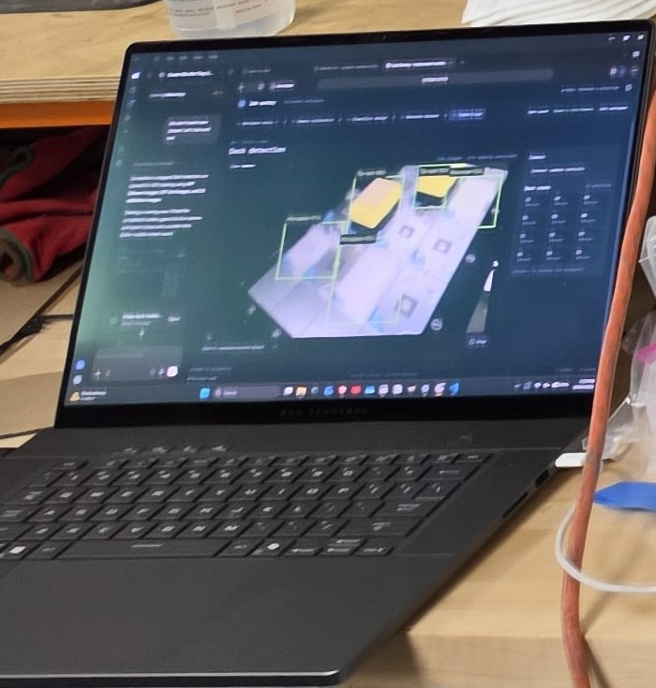
Plan it on screen first
The deck is laid out in 3D before anything touches the robot
Notes:
Plan it on screen first. The deck is laid out in 3D before anything touches the robot

Slide 9
Repurpose. Print. Run. Replay.
github.com/biobitworks/baebugs
Notes:
Repurpose. Print. Run. Replay.. github.com/biobitworks/baebugs

