Slide 1

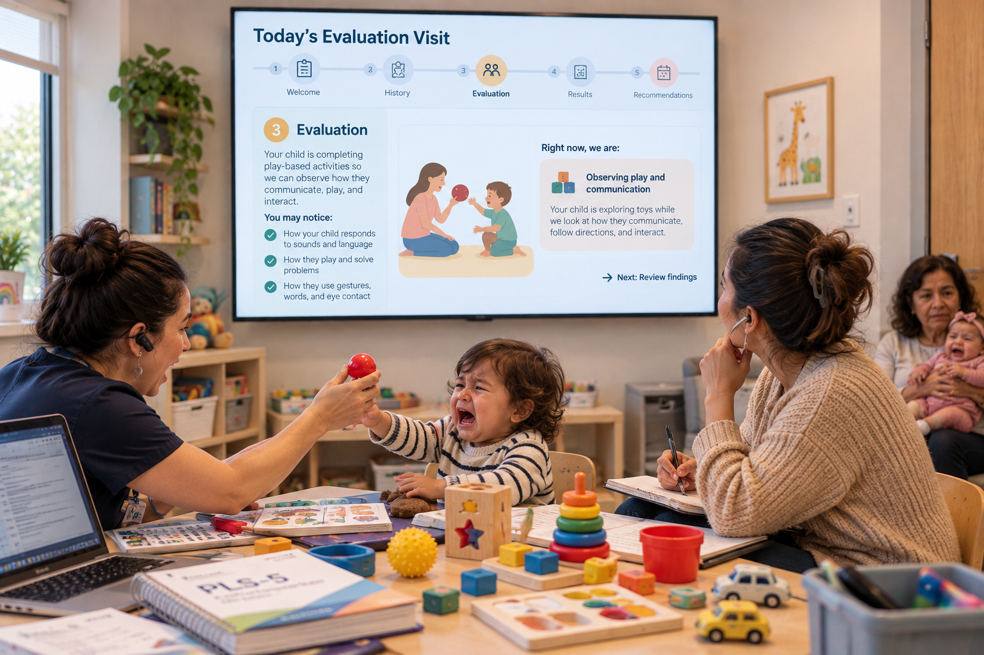
CareScribe
THE CHALLENGE & THE EXPERIENCE
Pediatric speech therapy evaluation
Problem: Speech therapy evaluations can be very overwhelming for everyone involved. Parents can leave a pediatric speech evaluation unsure what happened or what to do next. If the evaluation runs out of time, another visit adds costs and missed work for families and pressure on clinicians. A wait before treatment may then leave families without clear ways to support their child’s communication at home.
TODAY
WITH CARESCRIBE
Enter CareScribe
01
CareScribe / Pediatric speech evaluations
Notes:
Sources: user-provided Value Proposition Strategy conversation preview and two images supplied in this chat. Today is the image without the wall display. With CareScribe is the image with the parent looking at the display. Images illustrate the proposed experience. Intended benefits are not validated outcomes. CareScribe supports clinical judgment.

Slide 2
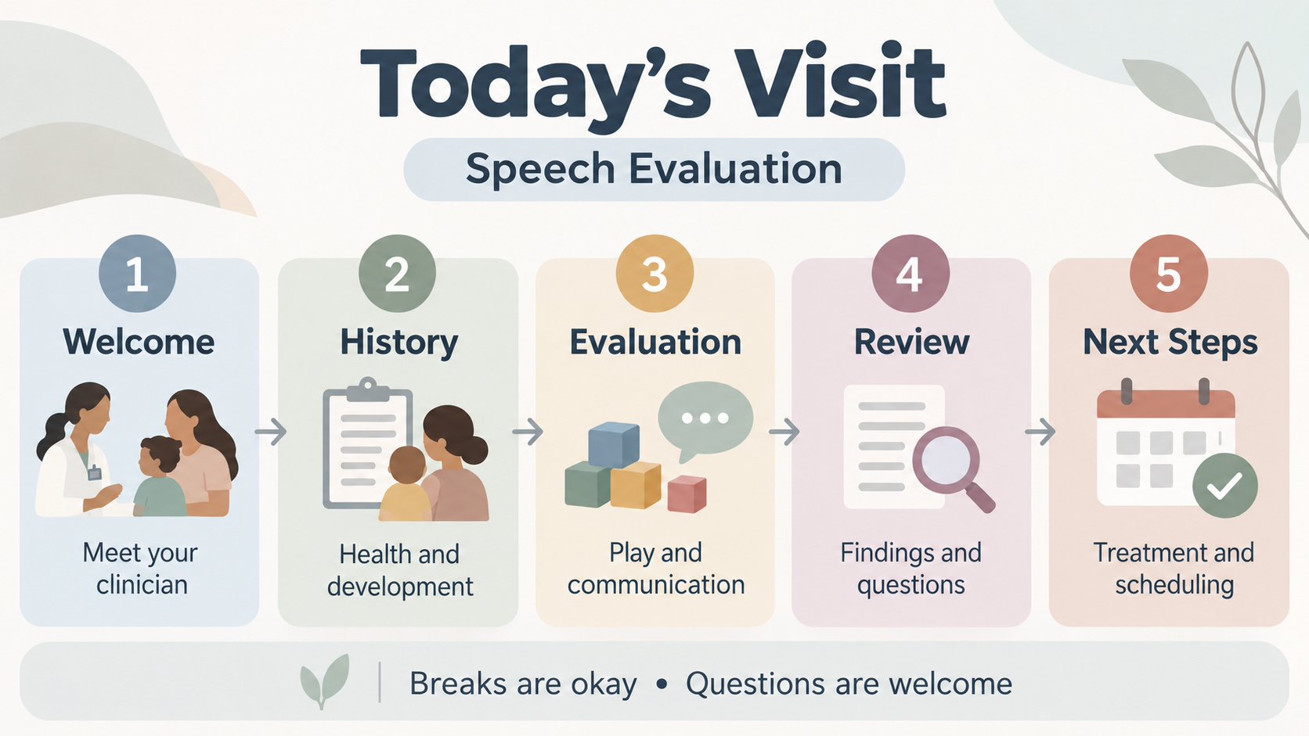
5 min
10 min
20 min
10 min
5 min
Notes:
Screen 1: Today’s Visit.

Slide 3
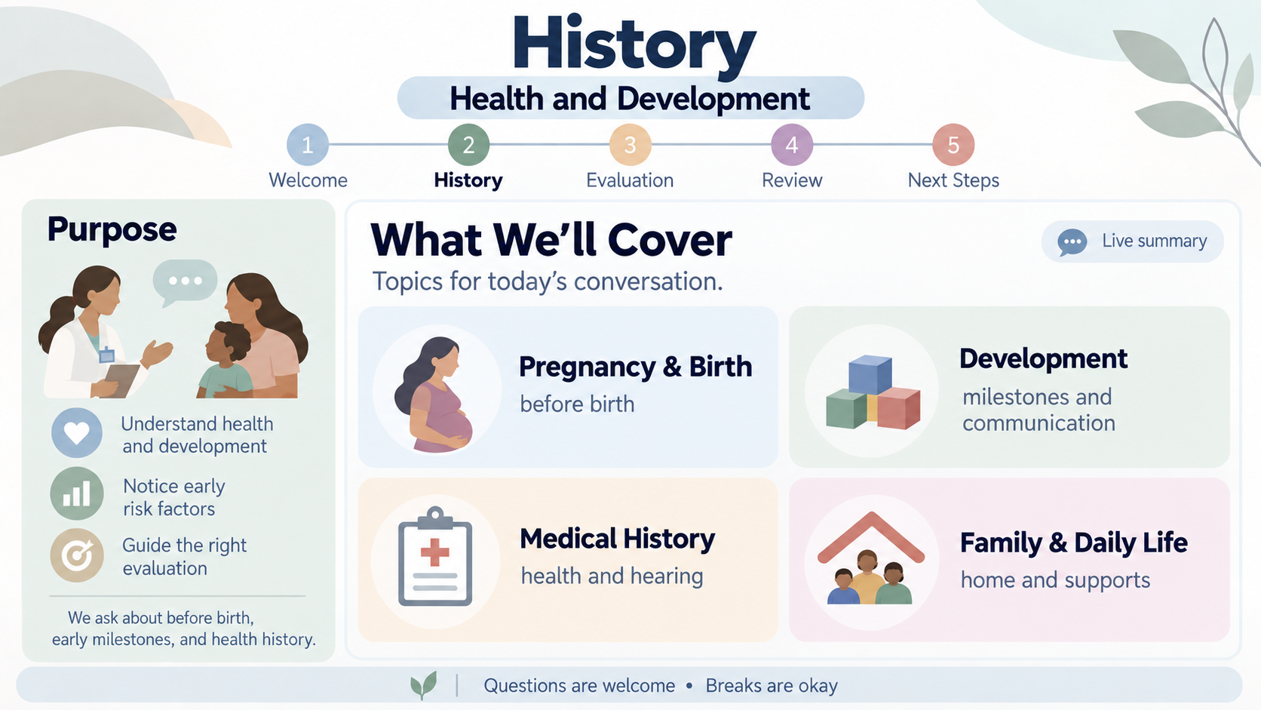
1
2
3
4
5
Welcome
History
Evaluation
Review Results
Next Steps
5 min
10 min
20 min
10 min
5 min
Notes:
Screen 2: History Overview.

Slide 4
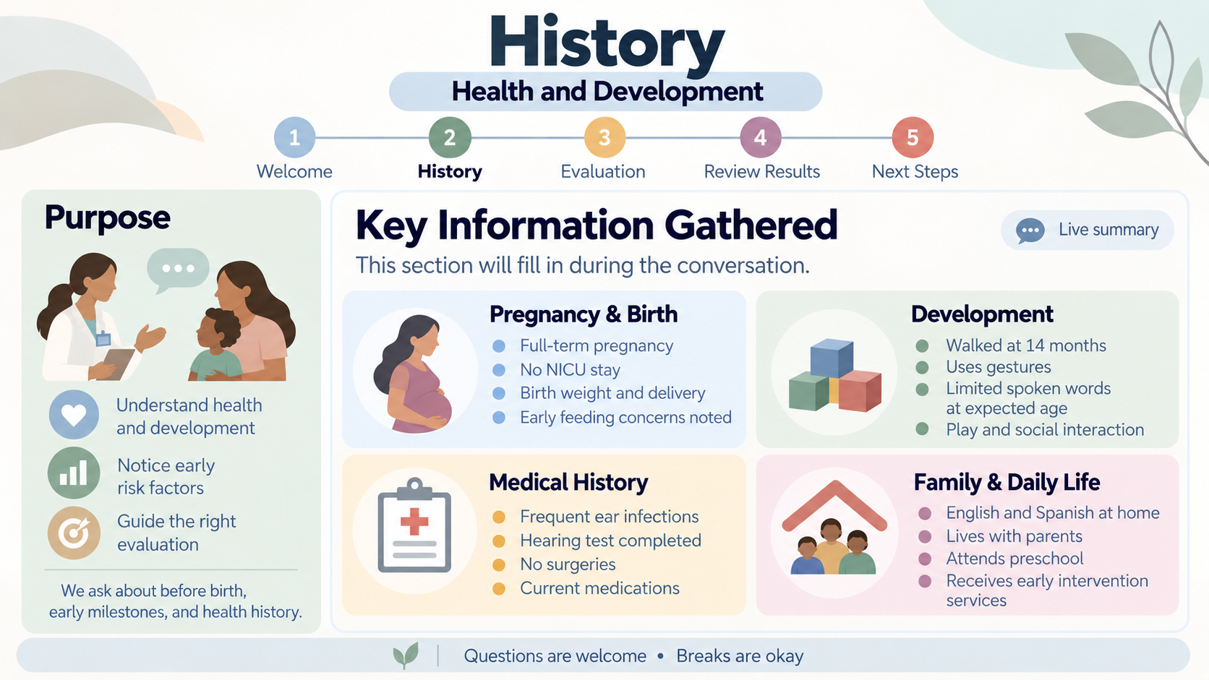
1
2
3
4
5
Welcome
History
Evaluation
Review Results
Next Steps
5 min
10 min
20 min
10 min
5 min
Notes:
Screen 3: History Captured.

Slide 5
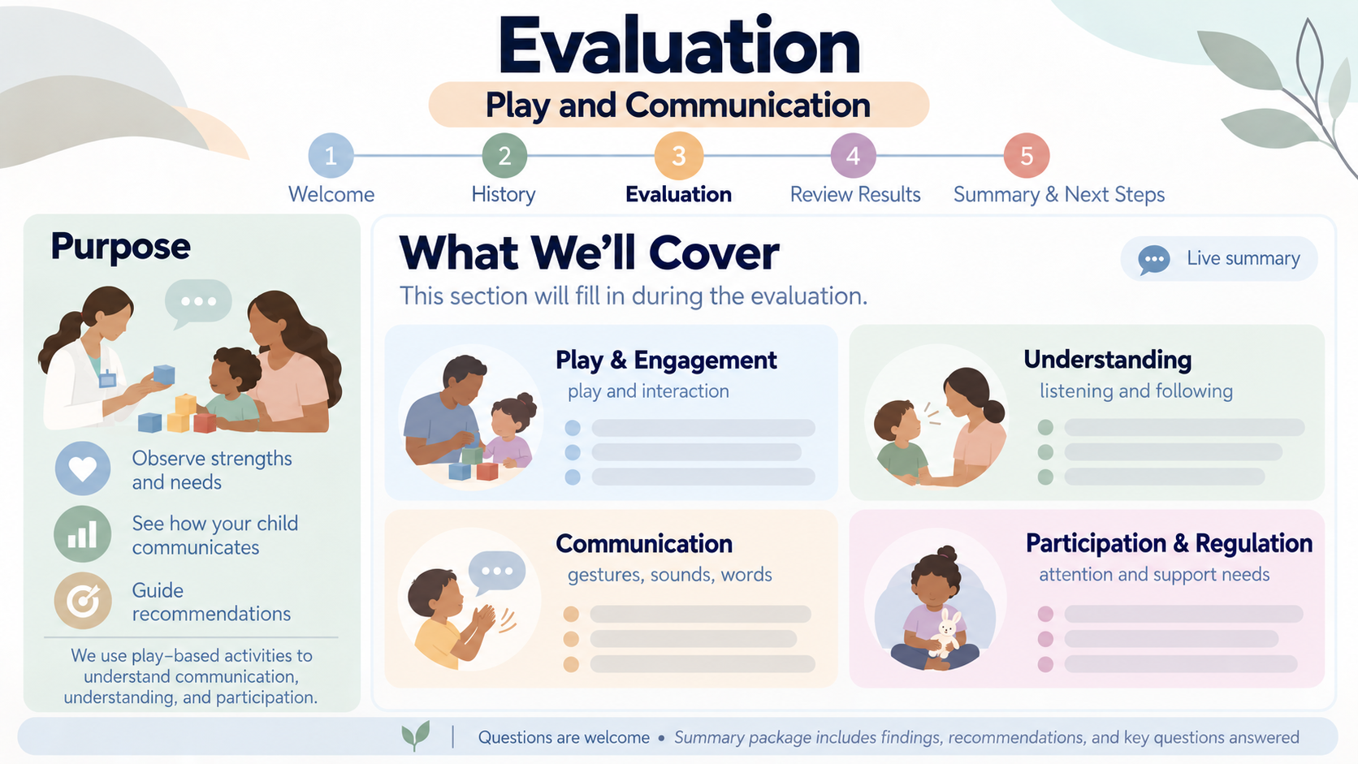
1
2
3
4
5
Welcome
History
Evaluation
Review Results
Next Steps
5 min
10 min
20 min
10 min
5 min
Notes:
Screen 4: Evaluation Overview.

Slide 6
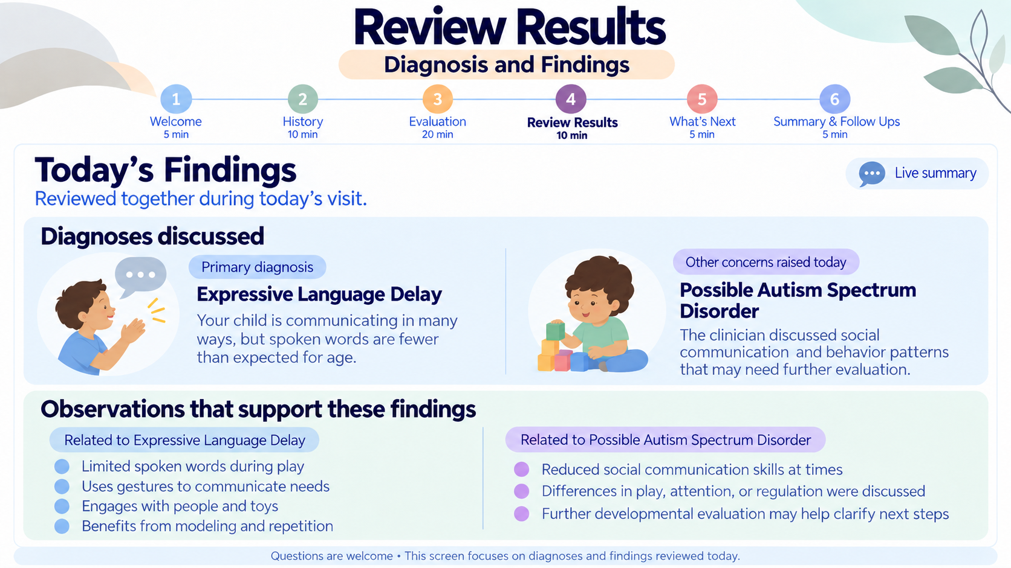
1
2
3
4
5
Welcome
History
Evaluation
Review Results
Next Steps
5 min
10 min
20 min
10 min
5 min
Notes:
Screen 5: Review Results.

Slide 7
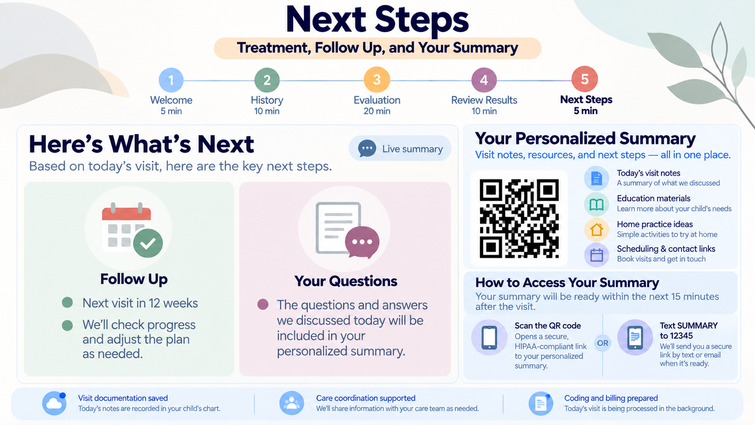
1
2
3
4
5
Welcome
History
Evaluation
Review Results
Next Steps
5 min
10 min
20 min
10 min
5 min
Notes:
Screen 6: Next Steps.

Slide 8
CareScribe
COMMERCIAL VALUE
Better visits. Capacity to grow.
Designed to support clinicians, reassure families and make scarce clinical time go further.
VALUE FOR CLINICIANS & FAMILIES
PROPOSED COMMERCIAL MODEL
Clinicians
Sell to provider organizations
Less cognitive burden and repeat explanation.
A smoother evaluation workflow.
Start with pediatric therapy practices.
Annual subscription: [$ / clinician / month]
Expand to multi-site groups and health systems.
Families
Greater confidence, clearer next steps and
a personalized reference to revisit at home.
Adoption: workflow fit and AI / privacy review
CAPACITY & REVENUE HYPOTHESIS
U.S. MARKET OPPORTUNITY
Time saved can enable more appropriate visits.
Added visits × net revenue per visit = revenue upside
[Eligible clinician seats] × [annual price per seat]
Initial pediatric SLP segment: [seats] / $ price ]
CareScribe / Pediatric speech evaluations
02
Notes:
Source: user-provided Value Proposition Strategy conversation preview and current user request. Commercial model, capacity impact and market size are hypotheses/placeholders. Validate time saved, whether saved time converts into filled visits, demand, clinician availability, realized net revenue, willingness to pay and cost to serve. Revenue logic does not assume additional billing codes per encounter. Economic buyer: practice owner or clinical operations leader. Proposed annual subscription priced per clinician seat; enterprise terms for larger organizations. TAM should measure annual software revenue, not healthcare expenditure: define geography and eligible clinician population, avoid double counting, and multiply by validated annual price. Initial serviceable segment is pediatric speech-language pathology. Replace all bracketed inputs with sourced estimates before external use.

