Slide 1


Title
Peter Belmann, Michael Barton,
Johannes Dröge, Albert Vilella
Dublin BOSC 2015

Slide 2



What is Bioboxes?
Motivated by CAMI & Nucleotid.es
            Reproducibility
            Easy to use
            Continuous Evaluation
A standard for creating interchangeable bioinformatics software containers
Community standard
Based on Docker
Notes:
Bioboxes of one type have the same signature
Independent of the technology

Slide 3
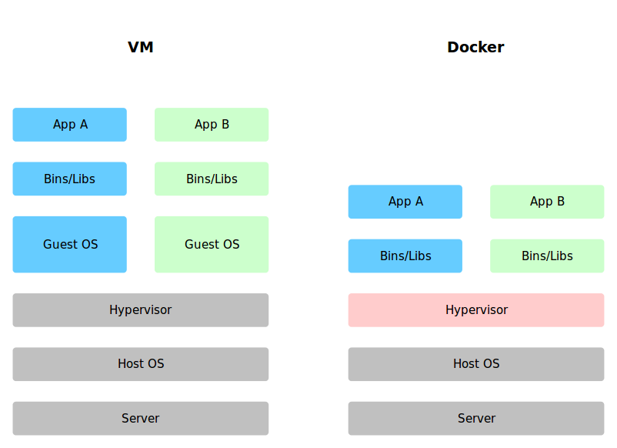
What is Docker?
Platform for creating encapsulated environments
Portable, lightweight runtime
Solves Development vs. Production problem
Notes:
Eliminates the friction between development, QA, and production environments.
Fast because of startup

Slide 4
How does Bioboxes work?
Fastq1
Fastq2
Fasta
Assembler
Biobox
(e.g. Docker)
Yaml
Yaml
Interchangeable
Assembler
Biobox A
(e.g. Docker)
Assembler
Biobox B
(e.g. Docker)
Notes:
Requirements
No missing dependencies
No unreproducible workflows
Complex Parameters

Slide 5
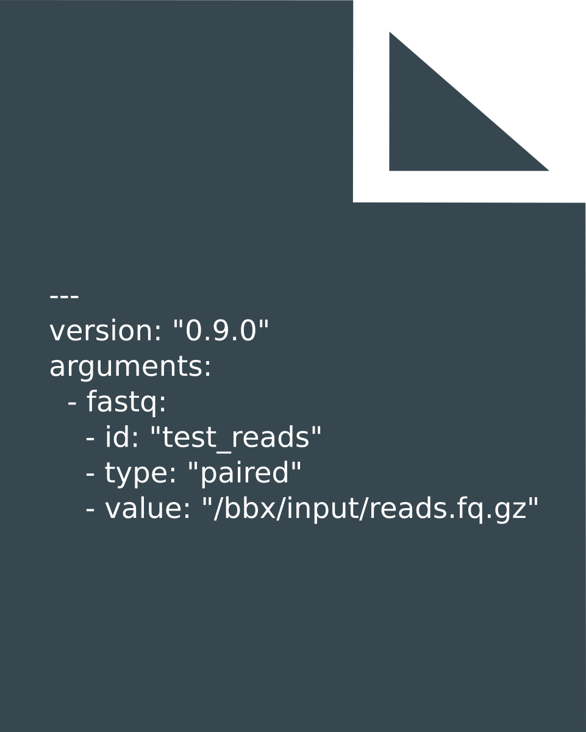
Example YAML

Slide 6

Community Driven
Github
User & Developer Guide
Conferences
Collaborations

Slide 7
Thank you for your attention!
Visit bioboxes.org and shape with us the future of bioboxes.

