Slide 1
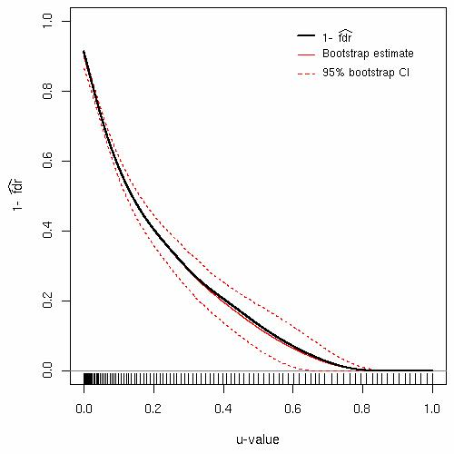
Twilight: Estimating the local false discovery rate
Inference on two-sample designs and correlation tests for gene expression data: Observed and expected scores, p- and q-values (global FDR).
Estimation of local FDR = probability that a gene is not differentially expressed at a certain u-value level (= p-value).
Estimation of overall percentage π₀ of differentially expressed genes.
Diagnostic plots: Expected vs. observed scores, q-values vs. size of gene list, volcano and local FDR plots (see Figure).
Combinatorial functions for complete enumeration of possible permutations.
References:
Scheid, S & Spang, R, A stochastic downhill search algorithm for estimating the local false discovery rate, IEEE Transactions on Computational Biology and Bioinformatics, vol. 1, p. 98-108, 2004.
Scheid, S & Spang, R, TWILIGHT - a Bioconductor package for estimating the local false discovery rate, to appear in Bioinformatics, 2005.

