Slide 1
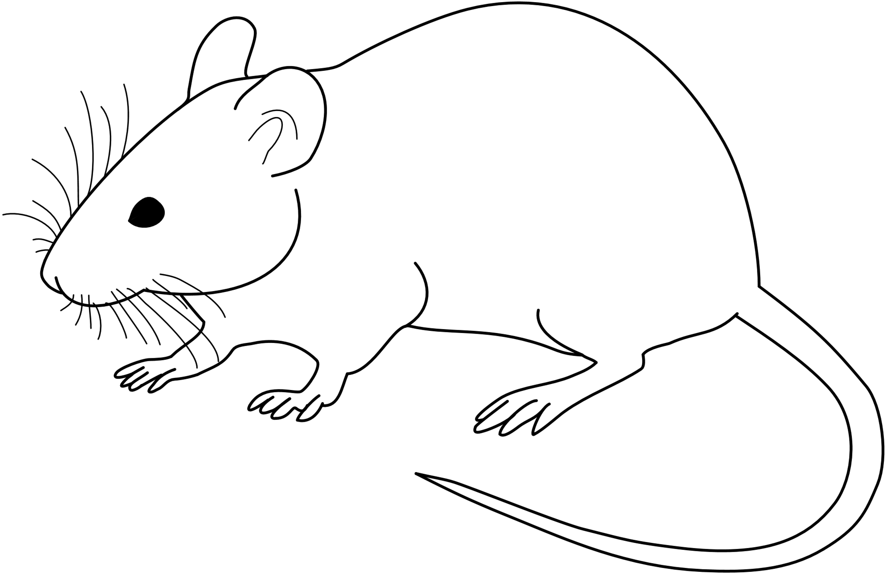
Day 10
DD
= Activity
24/0
18
6
0
6
12
18
24
It has entrained to the two pulses as if they were the signals for dawn and dusk!
12

