Slide 1
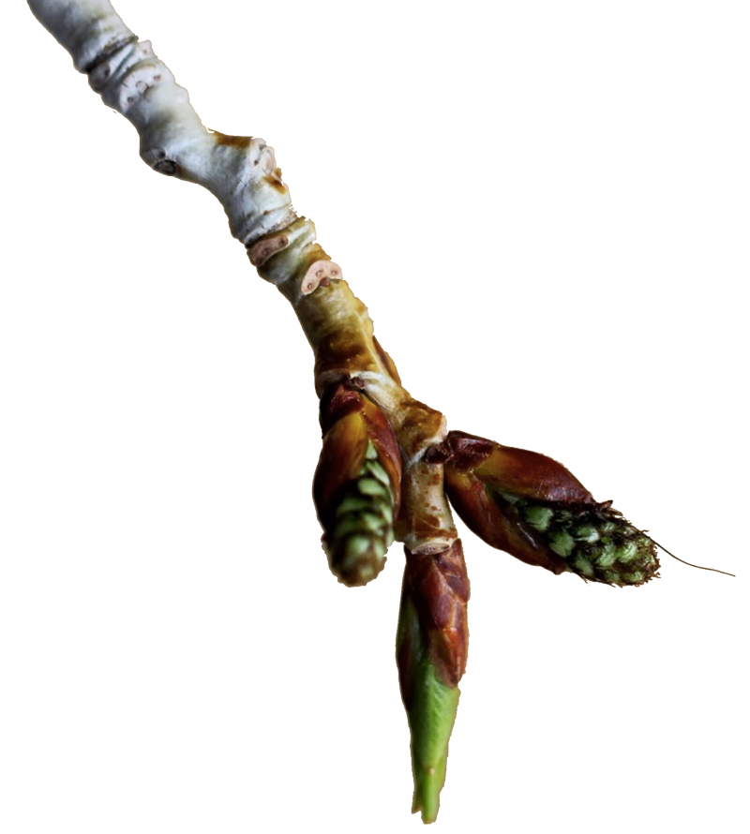
Plant Phenology
Query
Tools
Login
Help
About
Data on plant phenology is made accessible here based on inputs from NPN and PEP725 partners. Incoming trait data is annotated using the biocode field information management system and the plant phenology ontology, with inferred relationships between traits and phenological stages. Our map-based query enables visualization by taxonomy, time, geographic space, and phenological stage.

Slide 2
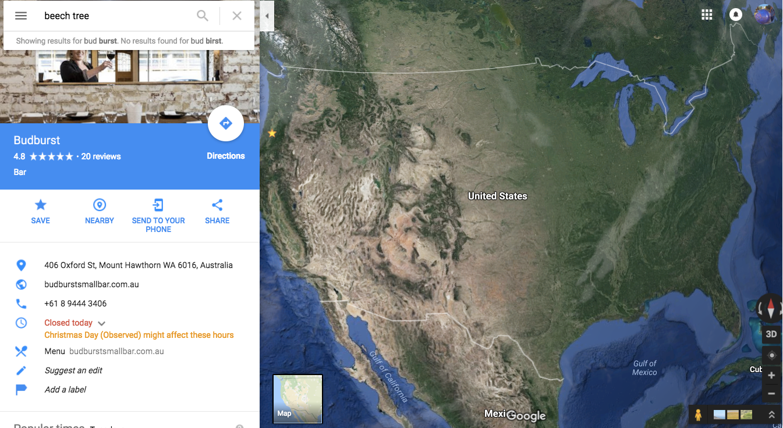

T
Taxonomy: xxxx xxxx
Phenological Stage: {Choose from list}
Choose Time period:
1950
2016
Plant Phenology

