Slide 1
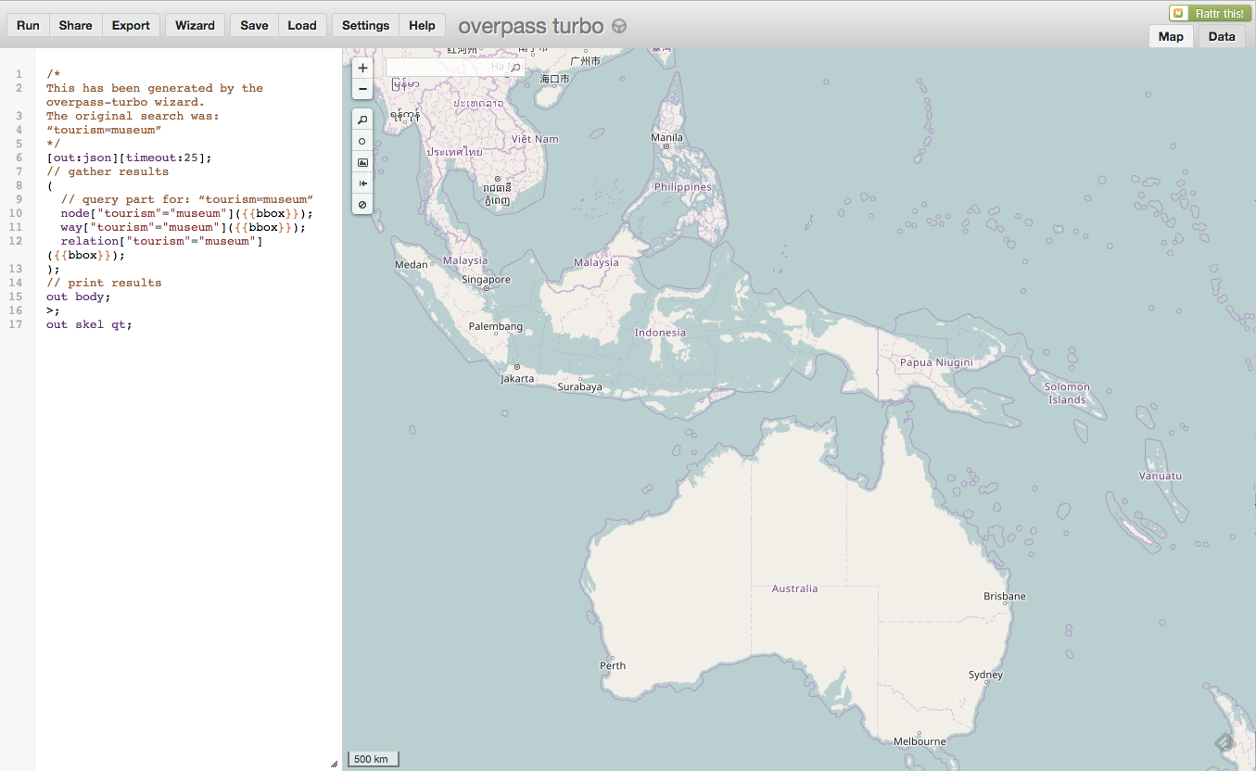

Search Term:
Full-text search
Filters:
Toggle between
Map & Data Results
Map View
Filter on Map View
Country
Filter on Other Attributes
Etc …
Submit
Slide Map & Query panes
Example from: http://overpass-turbo.eu/

