Slide 1
NMNH-FIMS Client
The NMNH-FIMS Client supports offline data entry in a form-based environment. Users can generate templates, create expeditions, and save xForms (https://www.w3.org/TR/xforms/) for use within the FIMS Client environment. Data is saved on the client using
Generate Template, creating expedition and xForm
Add Record
Push to Server through FIMS Client
Offline capable
Must be connected to Internet

Slide 2
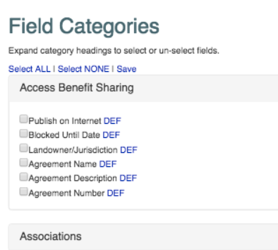
Template Generator Dashboard
Logout
Template Generator
Choose Project
Botany
Config
Default
When clicked, slider will appear below displaying the column definition info
Export Excel
Save As Form

Slide 3
Template Generator Dashboard
Logout
generated via the nmnh-fims “Template Generator”
Dashboard
DEMO_EXPEDITION_1
Action 
DEMO_EXPEDITION_2
Modified
available for offline entry
Action 
would show 10 samples per page
Sample 1
Remove
Sample 2
Remove
Sample 3
Remove
Sample 4
Remove
«
1
2
3
4
5
»
DEMO_EXPEDITION_3
available for offline entry
Action 
Add Sample
Push To Server
Remove From Client
if form is not “available for offline entry”, this would say “Download for offline Use”
would be disabled if offline

Slide 4
Dashboard / DEMO_EXPEDITION_1
DEMO_EXPEDITION_1
Primary Collector 1
Current User
Date Collected (From)
2016 08 14
Habitat
- - Select - -
Aquatic herb
Cespitose herb
…
Elevation From (m)
…
Cancel
Save Sample
Save and New
Save and Close

