Slide 1
NMNH-FIMS Client
Generate templates for your custom forms on a project by project basis, create expeditions to track your personal data, and enter data without an internet connection. The FIMS Client is based on the xForms (https://www.w3.org/TR/xforms/) w3c standard, existing FIMS services, and browser based storage.
Generate Template, creating expedition and xForm
Add Record
Push to Server through FIMS Client
Offline capable
Must be connected to Internet

Slide 2
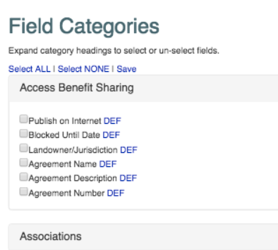
Template Generator Dashboard
Logout
Template Generator
Choose Project
Botany
Config
Default
When clicked, slider will appear below displaying the column definition info
Export Excel
Save As Form

Slide 3
Template Generator Dashboard
Logout
generated via the nmnh-fims “Template Generator”
Dashboard
DEMO_EXPEDITION_1
Action 
DEMO_EXPEDITION_2
Modified
available for offline entry
Action 
would show 10 samples per page
Sample 1
Add Subsample
Remove
Sample 2
Add Subsample
Remove
Sample 3
Add Subsample
Remove
Sample 4
Add Subsample
Remove
«
1
2
3
4
5
»
DEMO_EXPEDITION_3
available for offline entry
Action 
Add Sample
Push To Server
Remove From Client
if form is not “available for offline entry”, this would say “Download for offline Use”
would be disabled if offline

Slide 4
Add popup to enter
Collecting Event data
Dashboard / DEMO_EXPEDITION_1
DEMO_EXPEDITION_1 -- Sample
Select list w/
Error option
Cannot add values
Primary Collector 1
Current User
Collection Event
- - Select - -
Date Collected (From)
2016 08 14
Event1
Event2
ADD NEW
Habitat
- - Select - -
…
Aquatic herb
Cespitose herb
…
…
Depth From (m)
…
Choosing family could narrow down options for Genus (need to think about scope)
Elevation From (m)
…
Family
- - Select - -
…
Culicidae
Apieda
ADD NEW
…
Select list w/
Warning option
Can ADD values
Genus
…
…
…
Cancel
Save Sample
Save and Copy to NEW record
Save and Blank New record
Save and Close

Slide 5
Dashboard / DEMO_EXPEDITION_1
DEMO_EXPEDITION_1 -- Subsample
Return to Parent Sample
Tissue
- - Select - -
Aquatic herb
Cespitose herb
…
Date of Subsample (From)
2016 08 14
Person subsampling
Protocol
- - Select - -
Tweezers
Pipette
ADD NEW
Cancel
Save Sample
Save and Copy to NEW record
Save and Blank New record
Save and Close

