Slide 1
Overview
Sponsor Ballot Process
Name and title of the creator
of the document goes here
Notes:
Welcome to the Overview of the Sponsor Ballot Process webinar. This webinar will cover the highest level of basics related to the IEEE Sponsor Ballot Process.

Slide 2
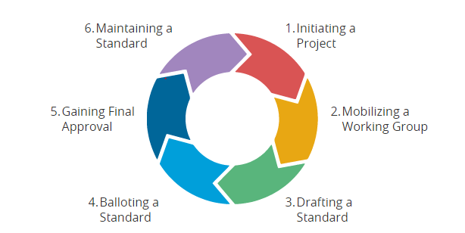
Standards Development Stages
Notes:
This circle represents the Standards Development Stages for IEEE Standards. In this webinar, we will review step 4 of the standards development stages “Balloting a Standard.”

Slide 3
Sponsor Ballot Overview
The process through which consensus on a proposed standard is achieved
Notes:
The Sponsor Ballot process can be summarized as the process through which consensus on a proposed standard is achieved. Consensus (for IEEE requirements) means agreement among the majority. Consensus further implies that minority views have been heard, and therefore all comments provided by balloters must be given consideration.

Slide 4
Standards Development - Process Flow
Idea for New Standard
Maximum of 4 years
Project Authorization Request (PAR)
Standard Draft Development
By the Working Group
Standards Association Standards Board Approval
Sponsor Ballot
Standard Document Publishing
Revise Standards
Maximum of 10 years
Archive
Withdrawn Standards
Notes:
This chart illustrates the standards process in simplified form. Note – The Sponsor Ballot process is only one phase of the full standards life cycle.
Other elements of the standards process include:
Idea: The idea for a standard is usually developed by a group of individuals or entities, and the responsibility for the idea is assumed by the sponsor. The sponsor is usually a society or an existing standards committee. – Note, if a sponsor has not yet been identified, IEEE-SA staff can assist.
Project Approval Process: This idea is then transferred into a Project Authorization Request (PAR) and submitted to the New Standards Committee (NesCom) in the myProject system for approval.
Develop draft standard: The draft is then developed and revised by the working group (either entity or individual).
Ballot draft (which is our focus today): When the draft work is finalized, the sponsor forms the balloting group (made up of either individuals or entities) and ballots the standard.
Standards Board Approval: After the ballot has achieved consensus, the draft then goes to the Review Committee (RevCom) and if recommended for approval by RevCom, is then forwarded to the Standards Board for approval.
Publish Standard: The draft is then edited and formatted by an IEEE Project Editor and published.
The standard is valid for 10 years. However, in order to keep the standard active, a maintenance action must completed prior to the 10 year mark.

Slide 5
Agenda
Invitation Stage
Initial Ballot Stage
Public Review
Comment Resolution Stage
Recirculation Stage
Submit to RevCom Stage
Additional Resources
Notes:
In this webinar, we will review the following 6 stages of the Sponsor Ballot Process, from Invitation stage through submission to RevCom. We will also provide links to additional resources for the Sponsor Ballot Process.

Slide 6
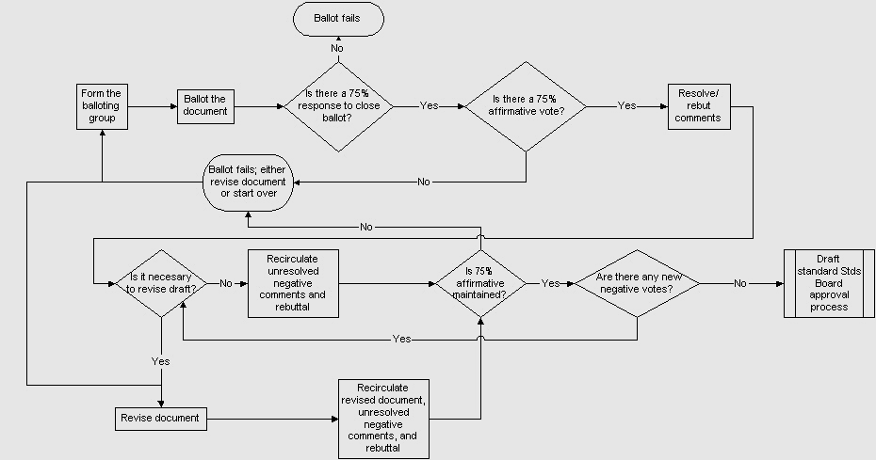
Standards Development – Balloting Process
Start Here
Notes:
This chart illustrates the steps involved in the sponsor ballot process.
In the “Form the Ballot Group” rectangle: The WG Chair, and ultimately the sponsor, are responsible for forming the balloting group. According to IEEE-SA policies, one primary concern is achieving a balance of interests in the balloting group.
In the “ballot the document” rectangle: Most ballots are usually conducted for 30 days. Balloters are expected to return their ballots with one of three votes—approve, disapprove, or abstain.
In the “75% response” triangle: The primary goal is to see if at least 75% of the ballot group members return a vote. Otherwise, the ballot fails and has to start over.
In the “75% Affirmative Vote” triangle: If you have a 75% return, your next goal is to see if you have a 75% approval on your return, and address comments, if any.
In the “resolve/rebut comments” rectangle: If resolved comments cause changes to the draft or if negative comments marked “must be satisfied” are received, you must recirculate the document. This process continues until no new negative comments are received and the working group wishes to make no further changes to the draft.
In the “draft standard standards board approval process” rectangle: When 75% affirmative ballots are received without new negative votes, the sponsor is encouraged to send the draft to the Standards Board for approval.

Slide 7
Invitation Stage
A balanced ballot group is formed using an electronic balloting system called myProject™.
Invitation is typically open for 30 days.
To achieve balance, no one interest group can be more than 1/3.
Composition of the balloting group shall not change after the ballot invitation closes.
Notes:
Now we will go through each stage in detail. For the Invitation Stage, The ballot group is formed through the electronic balloting system called myProject™.
The working group chair initiates an invitation to form the ballot group.
The ballot group must be balanced where no one interest group can be more than 1/3.
The common categories for the interest groups are producer, user, and general interest categories
Those who sign up during the invitation period constitute the ballot group and the composition of the group cannot change once the ballot begins.

Slide 8
Initial Ballot Stage
A sponsor ballot is initiated with the draft of the standard, to be reviewed, commented, and voted on by the ballot group.
75% return response rate from the ballot group, and
75% affirmative (approve) votes are required for the ballot to successfully progress
Notes:
The sponsor ballot process is the means by which consensus is achieved on the proposed IEEE Standard. A project or draft standard is ready for a Sponsor Ballot when it has completed its working group development and a balance ballot group is formed.
The sponsor ballot is initiated through myProject and the ballot group is also informed.
During sponsor ballot period, the ballot group is able to review the document, submit comments, and cast a vote.
Such process is the means by which consensus is achieved on the proposed draft standard.
A initial sponsor ballot is usually conducted for a minimum of 30 days, however this period is flexible and can be extended.
The goal of a ballot is to have a 75% return response rate on a ballot. Anything less, the ballot fails. Once a 75% return response is achieved, the chair should examine the approval rate. Consensus means agreement among the majority. It does not mean unanimity. A balloting group does not need to achieve 100% approval, or even 95% or 90%. According to IEEE rules, consensus is defined as a minimum 75% return of ballots from the balloting group, and a 75% approval rate from that 75% return group. If this is reached, then consensus has been achieved.

Slide 9
Public Review
The IEEE-SA utilizes a Public Review process and application that allows systematic feedback on initial IEEE-SA sponsor ballot drafts.
This is a 60-day process that runs in tandom with the Sponsor Balloting Process.
Support material is available in the help tab within the Public Review application (FAQs, Video Tutorials, User Guide, Support Center)
Notes:
Initiated December 2014, the IEEE-SA Public Review Process is a 60-day public review which allows IEEE to demonstrate how it meets the principles of the World Trade Organization Technical Barriers to Trade Code of Good Practice for the Preparation, Adoption and Application of Standards.

Slide 10
Comment Resolution Stage
  All balloter comments shall be given consideration
  A reasonable attempt shall be made to resolve all negative votes that are accompanied by comments.
  Revised draft and comments shall be recirculated
Notes:
According to the Standards Board Operations Manual: Section 5.4.3.2 “Resolution of comments, objections, and negative votes”
The Sponsor shall consider all comments and objections received before the close of ballot; and make a reasonable attempt to resolve all negative votes that are accompanied by comments. Comments that advocate changes in the document, whether technical or editorial, may be accepted, revised, or rejected.
Comments addressing grammar, punctuation, and style, whether attached to an affirmative or a negative vote, may be referred to the publications editor for consideration during preparation for publication. It should be borne in mind that documents are professionally edited prior to publication.

Slide 11
Recirculation Stage
If substantive changes have been made to the draft, a recirculation will be necessary.
The recirculation should be open for at least 10 days
Ballot Pool members may only comment on the changed portion of the draft.
Recirculations continue until no further changes are made to the draft.
Notes:
During comment resolution, if substantive changes have been made to the draft, a recirculation will be necessary. A good rule of thumb is, if in doubt, recirculate. The purpose of a recirculation is to give balloters the opportunity to review what has been changed and either comment further on changes or not, and possibly change a disapprove vote to an approve vote.
Usually recirculation are open for at least 10 days.
The only material open for vote/comment by balloters is the changed portion of the draft.
Recirculations will continue until no further changes are made to the draft.

Slide 12
Submit to RevCom Stage
Submit the final draft standard to Standard Review Committee (RevCom).
RevCom reviews the submitted documents and materials, and makes a recommendation to IEEE-SA Standards Board for an approval of the draft standard.
IEEE-SA Standards Board reviews the recommendation and approves the draft standard.
Publish Standard
Complimentary copies sent to the WG.
Notes:
The approval of the IEEE draft standard is achieved by submitting the document and supporting materials to Standard Review Committee (RevCom). RevCom determines whether or not the principles of consensus, due process, openness, and balance are maintained throughout the project development, and makes a recommendation to IEEE-SA Standards Board for an approval. The IEEE-SA Standards Board approves or disapproves standards based on the recommendation of its Standards Review Committee (RevCom). This committee makes sure working groups follow all procedures and guiding principles in drafting and balloting a standard. As with PARs, completed draft standards come before the Board four times a year or during the continuous approval process. After approval, the standard is edited by an IEEE-SA editor, given a final review by the members of the working group, and published.
A standard is valid for ten years from its approval date. During this time, a working group can develop and ballot revisions or extensions to the standard, which are appended as amendments. After ten years, a standard is revised or withdrawn.
When your standard has been approved, the last step is to go though the final editing for publication. The approved standard will receive a thorough, detailed edit from a professional IEEE standards editor. It is not an editor's role to make any changes that affect the technical meaning of the standard. The editor also ensures that the document meets the rules for IEEE standards style manual.
After the publication of the standard, a complimentary copy is sent out to the working group members. The published standards are then available to the user. A copy of the standard can be obtained for purchase from IEEE –Shop.

Slide 13
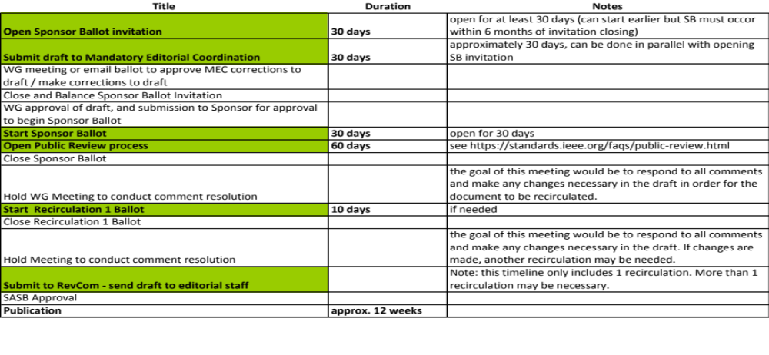
Sample Sponsor Ballot Process Timeline
Notes:
This table summarizes the sponsor ballot process timeline, along with the duration for each step.
*Note to facilitator: review steps & duration as a webinar summarization*
**This would be great as a Gantt chart: see table below…some durations are averaged or indicated as the longest of a possible duration**

Slide 14
Standards Development – Balloting Process
Notes:
This process flow chart serves as a summary of what we have reviewed today, from forming the ballot group, through submitting the draft standard to the IEEE-SA Standards Board for approval.
*Note to facilitator: review steps as another webinar summarization*

Slide 15
Additional Resources
IEEE-SA Standards Board Bylaws
  http://standards.ieee.org/develop/policies/bylaws/
IEEE-SA Standards Board Operations Manual
  http://standards.ieee.org/develop/policies/opman/
IEEE-SA Website
  http://standards.ieee.org/index.html
  Public Review
  http://standards.ieee.org/develop/publicreview.html
myProject
  https://development.standards.ieee.org/my-site
IEEE-SA Style Manual
  https://development.standards.ieee.org/myproject/Public/mytools/draft/styleman.pdf
Notes:
The following resources are available through our Web Site: http://standards.ieee.org/.

Slide 16
Thank You!
Notes:
Thank you for your time today, as we reviewed the steps for balloting a standard, in the IEEE-SA Standards Development Lifecycle.

