Slide 1
Data Tidying

Slide 2
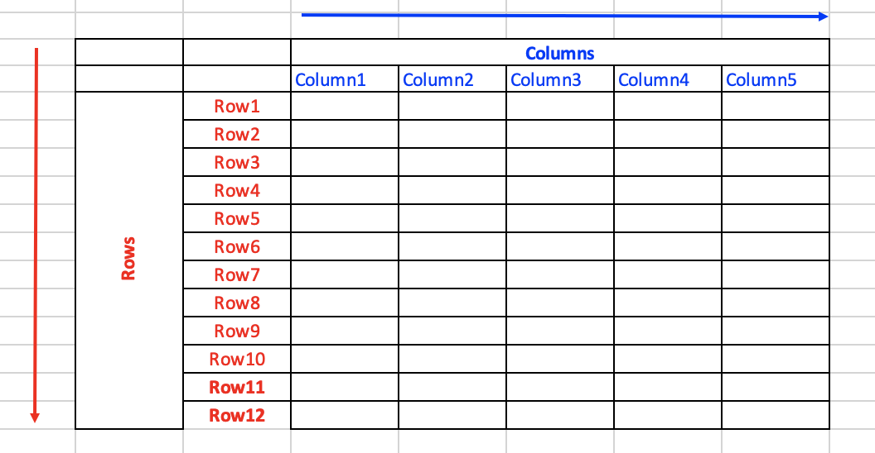
Datasets
Datasets are data frames made up of rows and columns
Columns: are almost always labeled
Rows: sometimes labeled

Slide 3
Semantics data
Semantic data is data that has been structured to add meaning to the data
A dataset: a collection of values (quantitative or qualitative)
Every value belongs to a variable and an observation
Variable: A variable contains all values that measure the same underlying attribute (like height, temperature, duration) across units.
Observation: An observation contains all values measured on the same unit (like a person, or a day, or a race) across attributes.

Slide 4
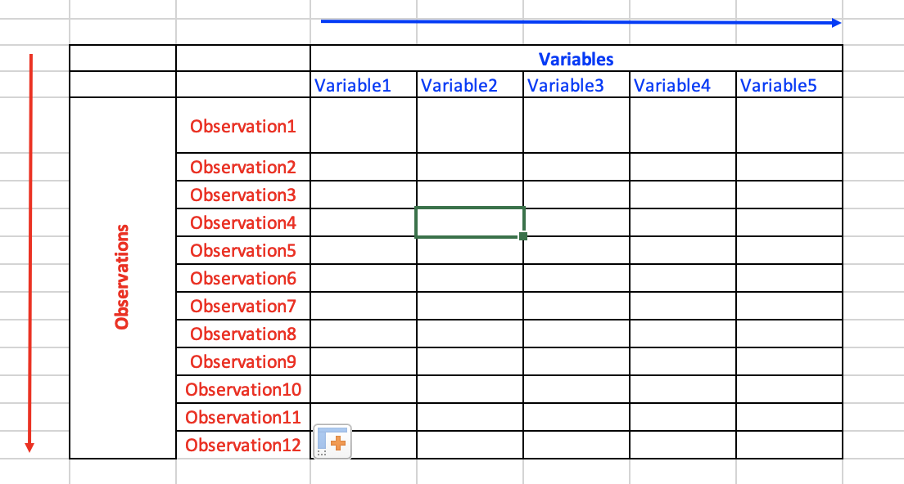
Variables and observations

Slide 5
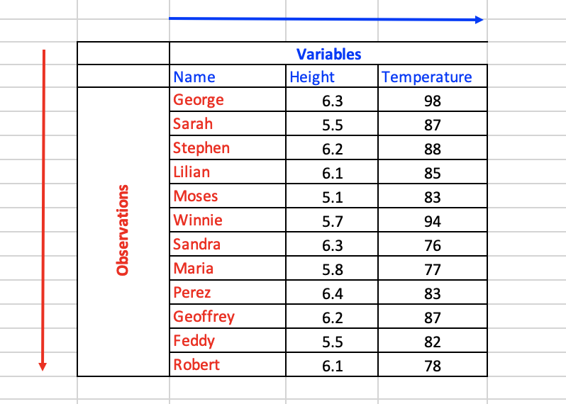
Variables and observations
The dataset: Has 36 values, 12 observations, and 3 variables.

Slide 6
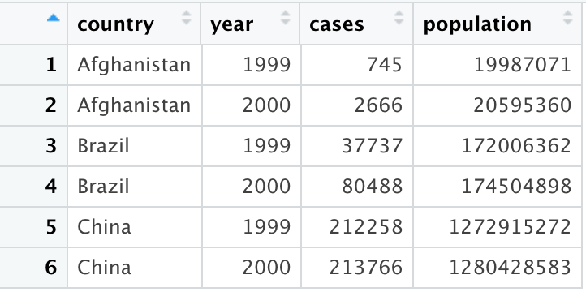
Tidy data: table1

Slide 7
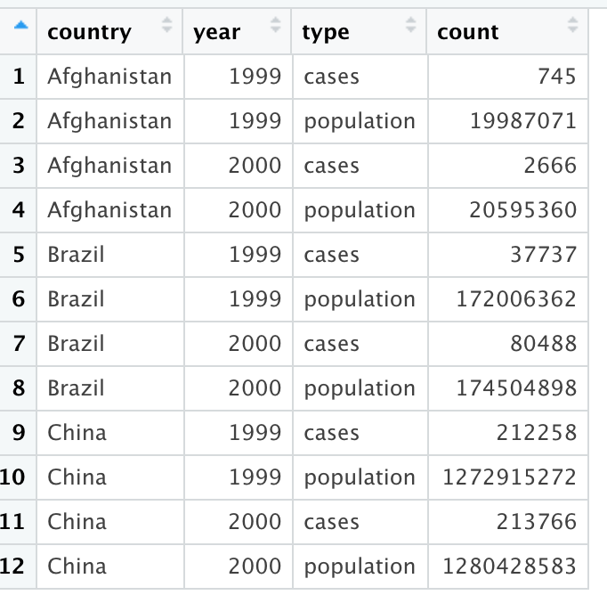
Tidy data: table2

Slide 8
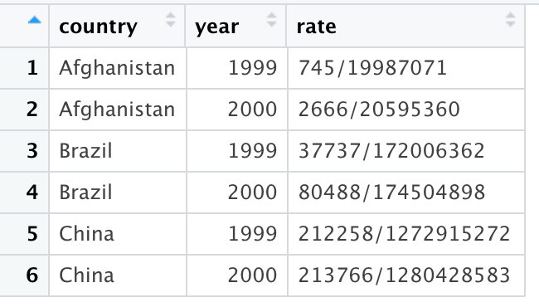
Tidy data: table3

Slide 9
Tidy data: table3

Slide 10
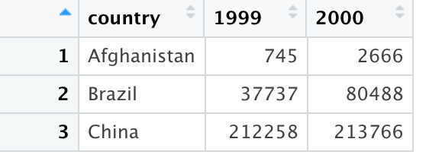
Tidy data: table4a

Slide 11
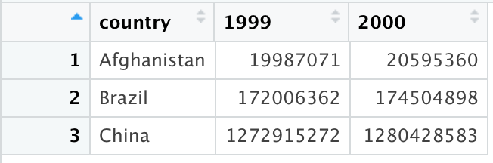
Tidy data: table4b

Slide 12
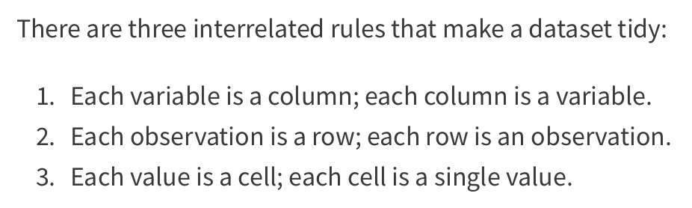
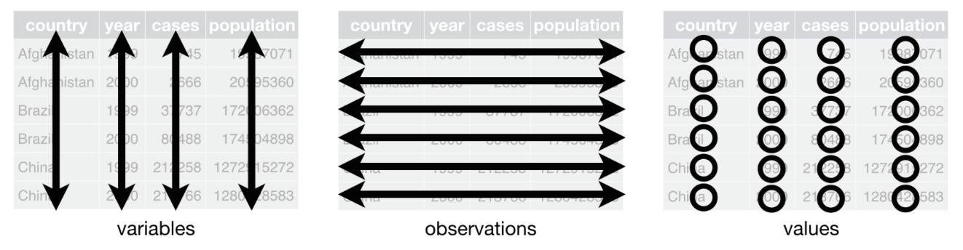
Tidy data

Slide 13
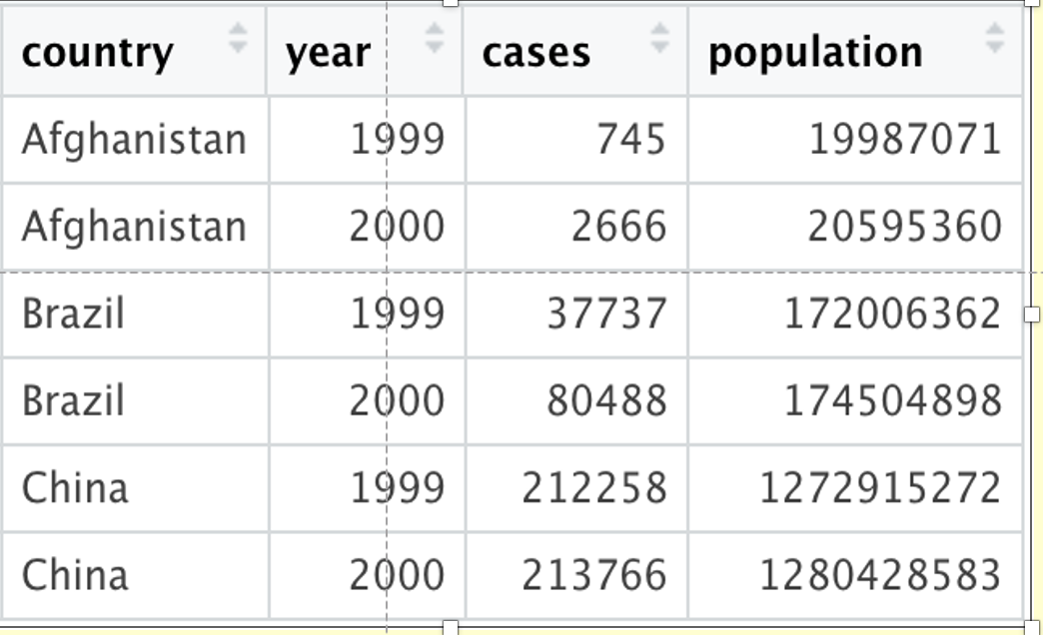
variable.names(table1)
column

Slide 14
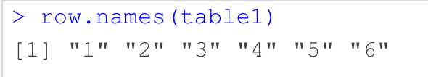
row.names(table1)
Observation
Row

Slide 15
row.names(table1)
Observation
Row

