Slide 1
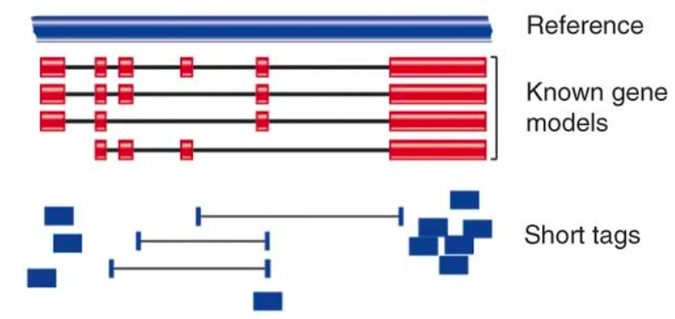


de novo assembly
map to transcriptome
map to genome

