Slide 1
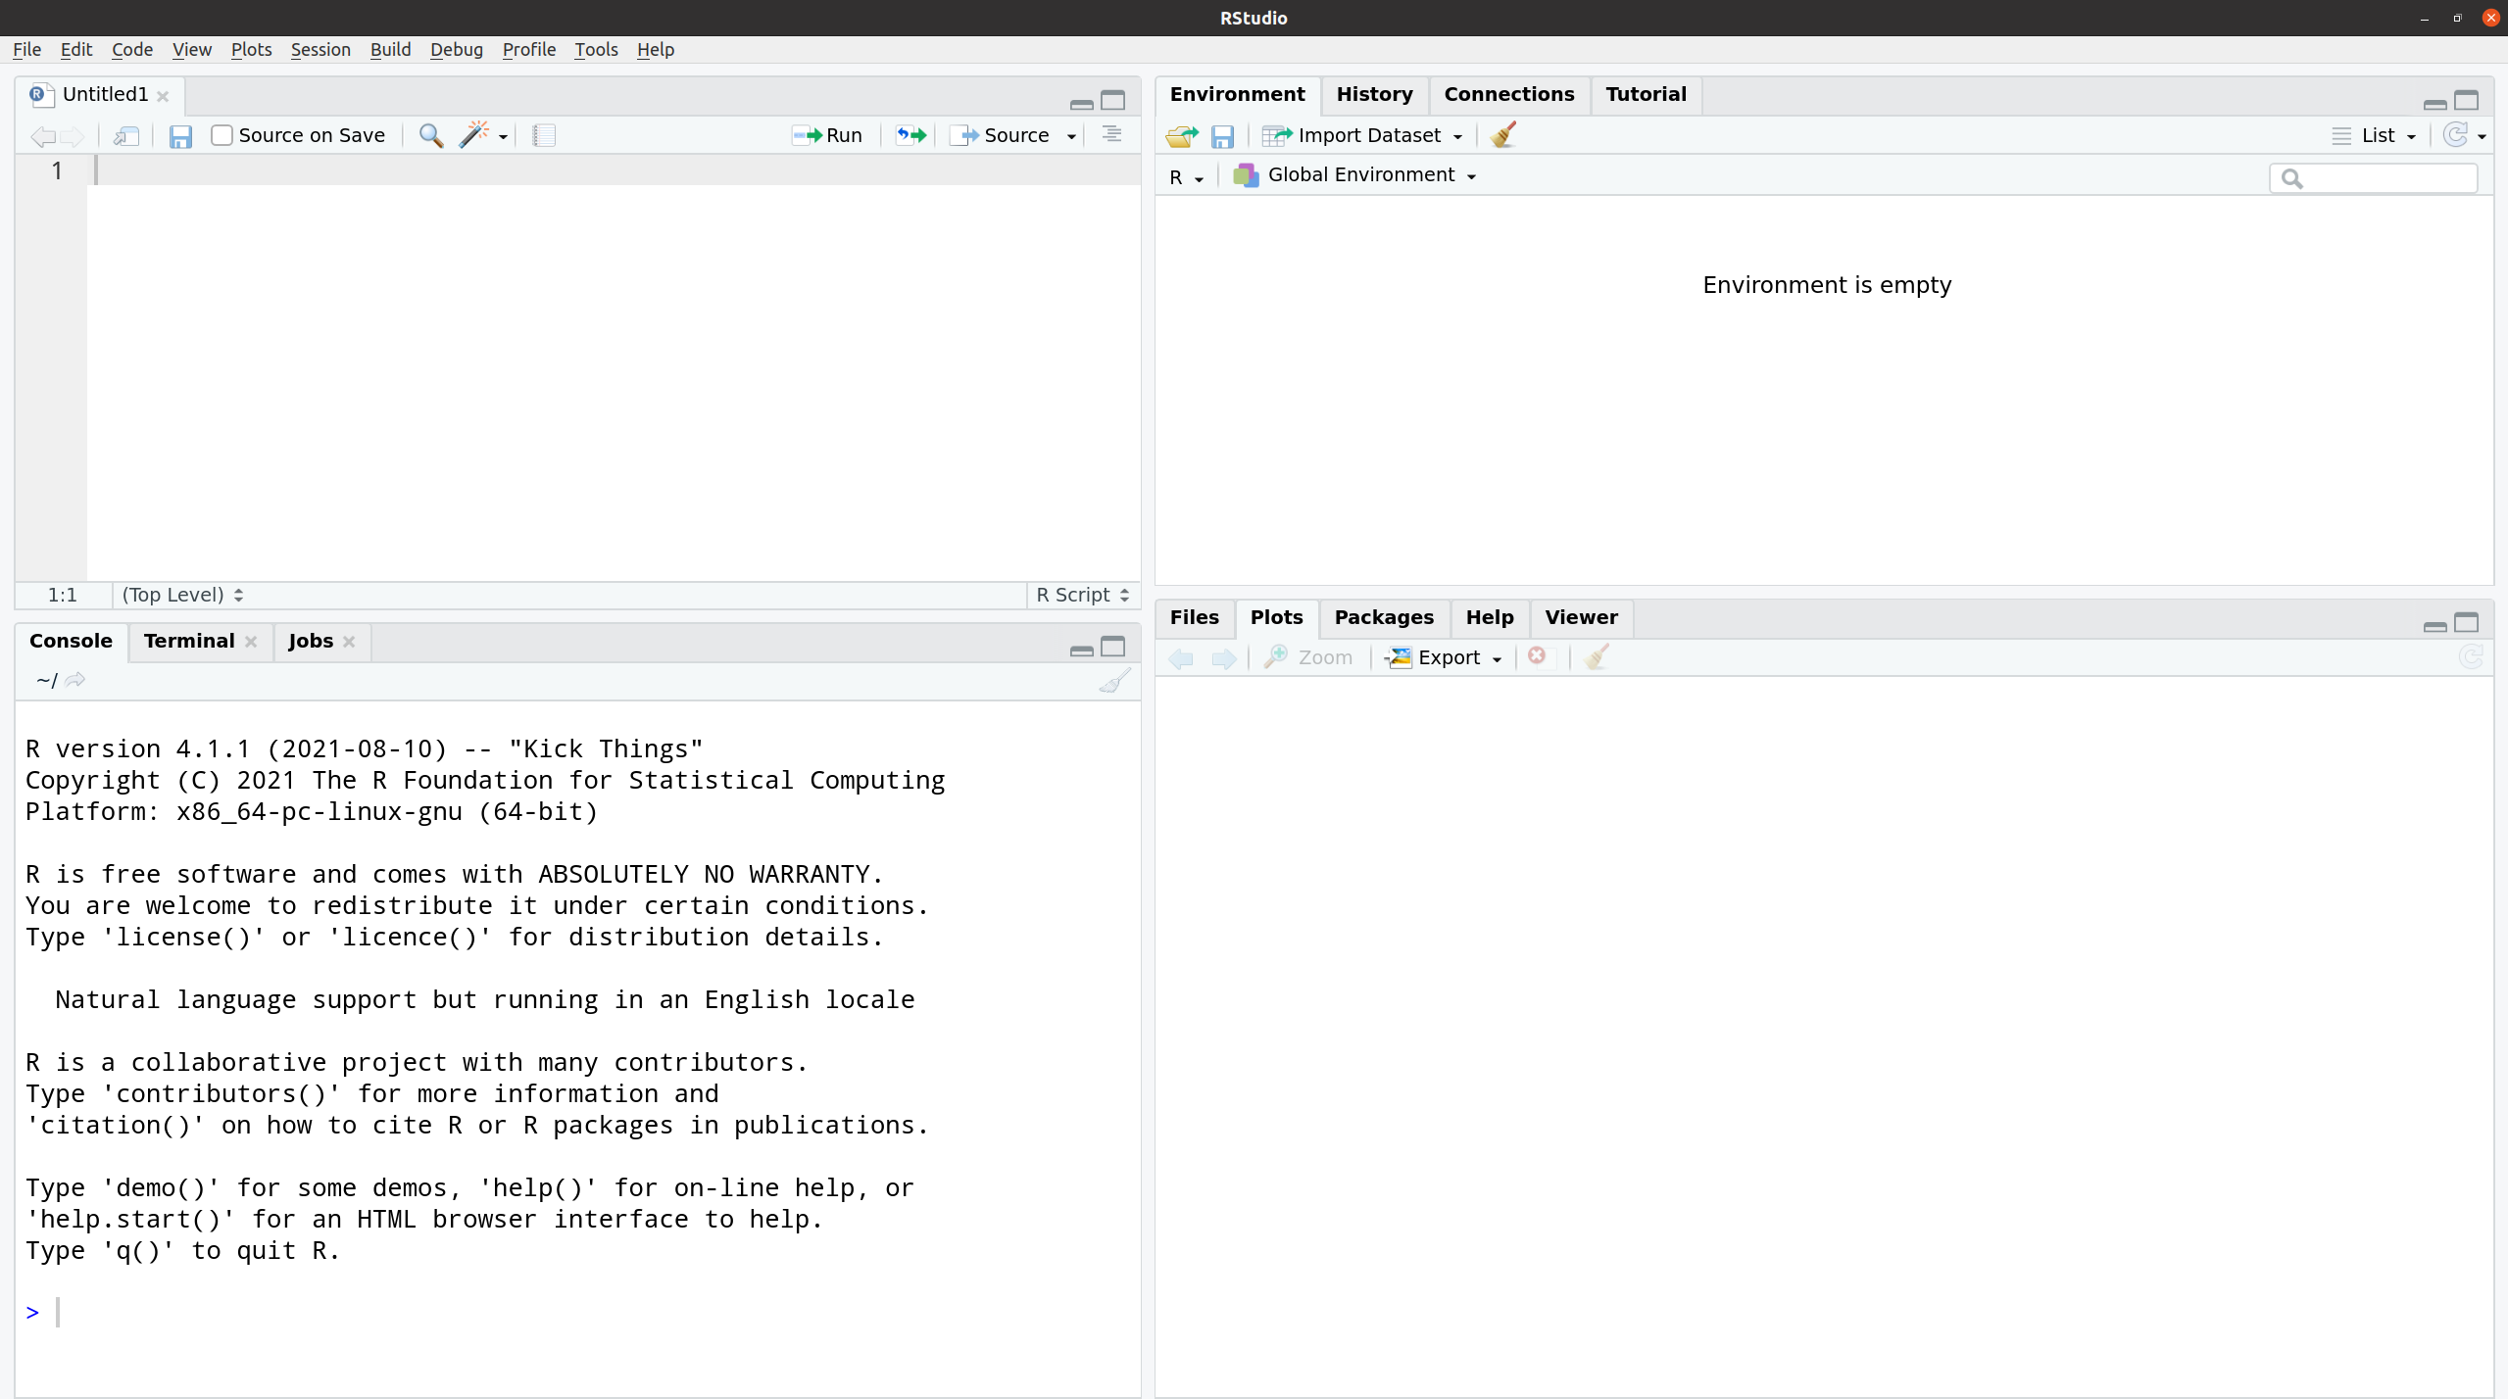
editor
environment
files / plots / help
console

