Slide 1
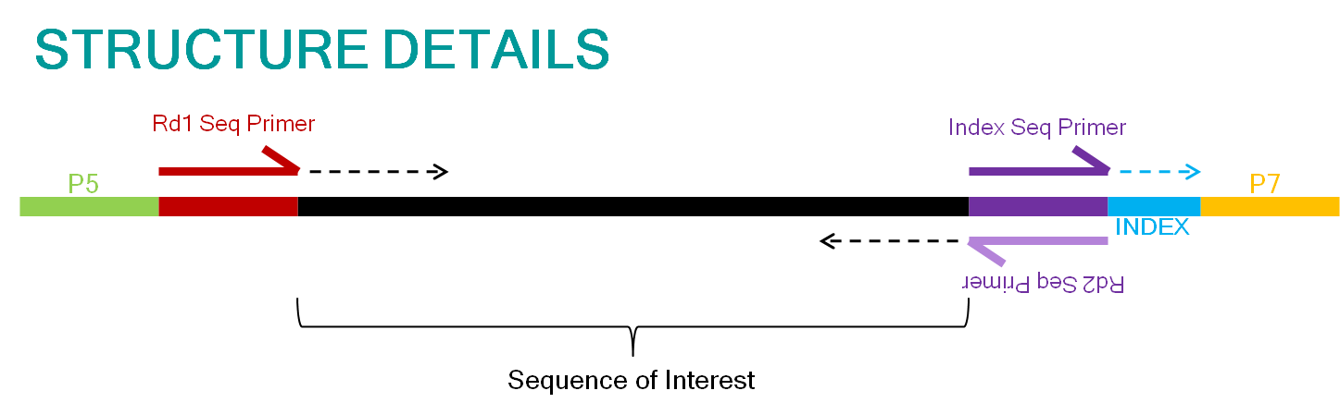
forward
read
reverse
read

