Slide 1
α-amilasa va kreatin kinaza fermentlari faol markaziga 9 xil ingibitor moddalarning ta’siri
Rutin, kversetin, sinorozid, firul k-ta, rosavin, digidrokversetin, galik k-ta, salidrodsid, akarboza

Slide 2
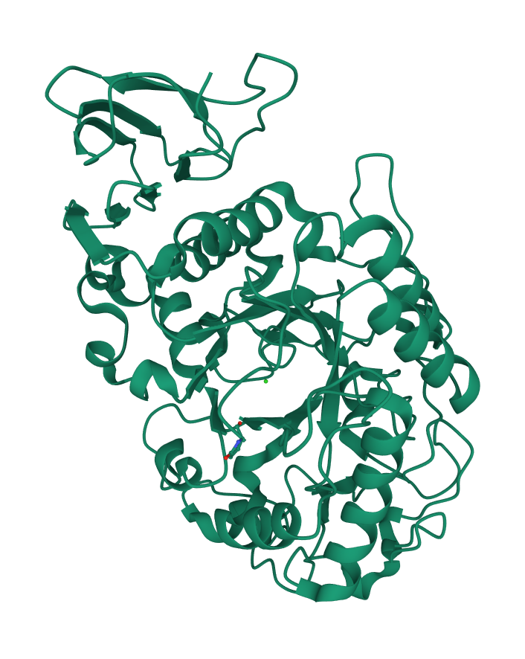
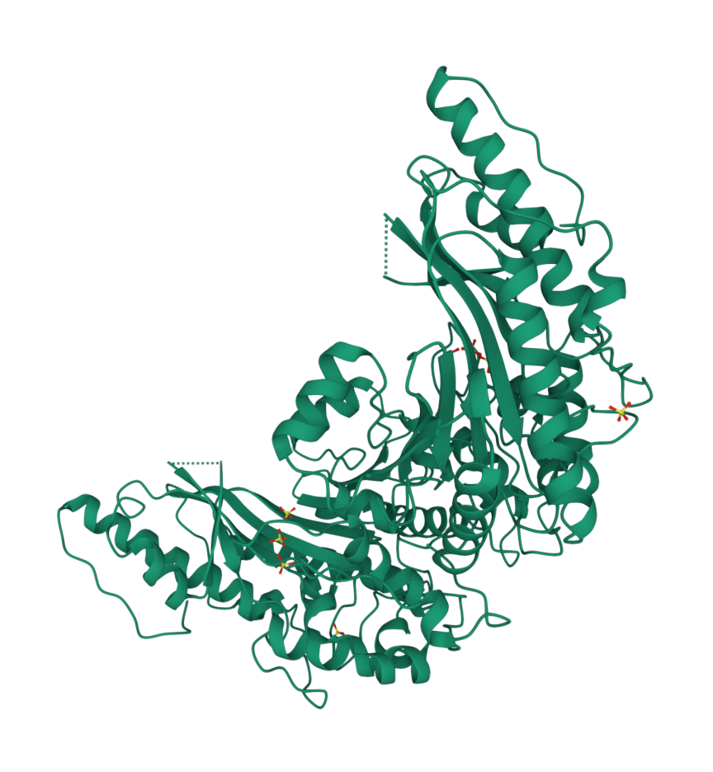
Fermentlarning 3D tasvirlari
α-amilaza
Kreatin kinaza

Slide 3
Alfa-amilaza fermenti faol markaziga ingibitorlarning ta’siri
 | Final Intermolecular Energy, kcal/mol | vdW + Hbond + desolv Energy, kcal/mol | Electrostatic Energy, kcal/mol | Final Total Internal Energy, kcal/mol | Torsional Free Energy, kcal/mol | Unbound System's Energy [=(2)], kcal/mol | Estimated Free Energy of Binding, kcal/mol
Rutin (10) | -8.56 | -7.89 | -0.68 | -6.25 | 4.77 | -6.25 | -3.79
Quercetin (5) | -8.04 | -7.43 | -0.61 | -2.58 | 1.79 | -2.58 | -6.25
Cynoroside (4) | -8.7 | -8.4 | -0.3 | -4.45 | 3.28 | -4.45 | -5.42
Firul-acid (1) | -7.96 | -7.07 | -0.89 | -0.4 | 1.49 | -0.4 | -6.47
Rosavin (6) | -9.3 | -8.78 | -0.52 | -4.53 | 3.88 | -4.53 | -5.42
Dihidroquercetin (9) | -8.13 | -7.5 | -0.63 | -2.79 | 1.79 | -2.79 | -6.34
Galic acid (9) | -5.39 | -4.65 | -0.74 | -1.94 | 1.49 | -1.94 | -3.9
Salidrodside (7) | -9.23 | -8.53 | -0.7 | -2.42 | 2.98 | -2.42 | -6.25
Acarbose (1) | -8.52 | -7.5 | -1.02 | -9.94 | 6.56 | -9.94 | -1.96

Slide 5
Kreatin kinaza fermenti faol markaziga ingibitorlarning ta’siri
 | Final Intermolecular Energy, kcal/mol | vdW + Hbond + desolv Energy, kcal/mol | Electrostatic Energy, kcal/mol | Final Total Internal Energy, kcal/mol | Torsional Free Energy, kcal/mol | Unbound System's Energy [=(2)], kcal/mol | Estimated Free Energy of Binding, kcal/mol
Rutin (1) | -7.68 | -5.91 | -1.77 | -7.03 | 4.77 | -7.03 | -2.9
Quercetin (10) | -6.05 | -5.67 | -0.38 | -2.66 | 1.79 | -2.66 | -4.26
Cynoroside (7) | -7.97 | -6.55 | -1.42 | -3.81 | 3.28 | -3.81 | -4.69
Firul-acid (6) | -5.92 | -5.61 | -0.31 | -0.98 | 1.49 | -0.98 | -4.43
Rosavin (1) | -7.93 | -7.19 | -0.74 | -3.96 | 3.88 | -3.96 | -4.06
Dihidroquercetin (4) | -8.92 | -7.92 | -1 | -5.79 | 3.88 | -5.79 | -5.05
Galic acid (6) | -7.28 | -6.43 | -0.85 | -5.46 | 3.88 | -5.46 | -3.41
Salidrodside (1) | -7.1 | -7.02 | -0.08 | -5.95 | 3.88 | -5.95 | -3.22
Acarbose (8) | -7.79 | -7.34 | -0.45 | -4.47 | 3.88 | -4.47 | -3.91

