Slide 1

SBDI Deployment 2.0
Technical Overview
Manash Shah / Hans Höök
2022-06-09

Slide 2
Automated provisioning & deployment
Ansible
Documented procedures
Ansible playbooks
Uniform deployment structure
Reproducible & Configurable for Production & Staging
https://github.com/biodiversitydata-se/automation

Slide 3
Tightened security/access
Public & Private subnets
Public access using SSH to 2 access nodes
Proxy jump via access nodes to private subnet
Strict user accounts policy adhering to good practices

Slide 4
High availability
2 access nodes with HAproxy
Docker swarm with 3 Swarm managers
Redundancy
GlusterFS for Docker volumes shared by Swarm
Cassandra cluster with replicated data on local volumes
SOLR cloud with replicated data on local volumes

Slide 5
2 Access nodes (public access)
3 Manager nodes
Worker nodes (4 Cassandra, 4 SOLR)
1 Backup director
1 Backup target
1 monitoring node

Slide 6
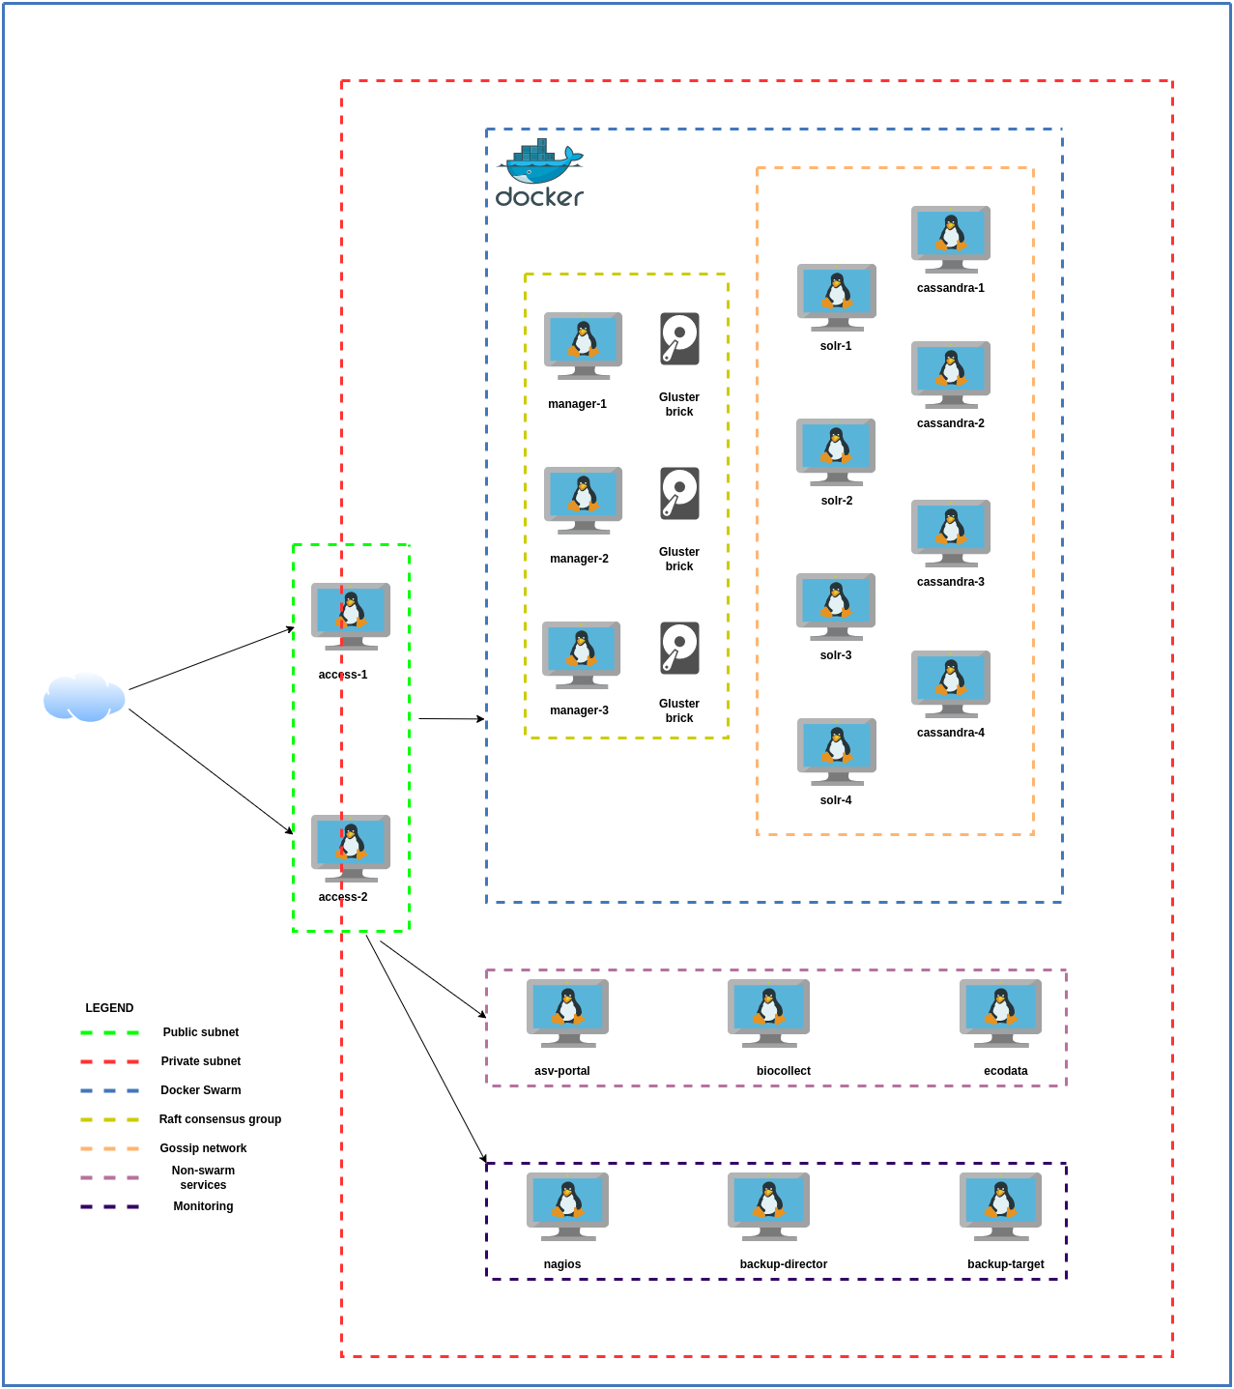
Current problems/questions

