Slide 1

Driving a Continuous ServoMotor with Raspberry Pi
Using PCA9685 (16-Channel Pulse Width Modulation driver)
By: Abiodun Ojo N01178447

Slide 2

Proposal
Relaxation is essential for human minds after a stressful day at work. There is an excitement that comes from playing around with RC Car regardless of the age. With the right attachment, the RC Car can be equipped to be more than just a toy. It can reach spaces that are too small for humans.
Mobility is essential for RC Car, this project is focused on the mobility part. Raspberry Pi is used with 16-Channel Pulse Width Modulation driver PCA9685 to drive the motor that rotates the wheels.

Slide 3
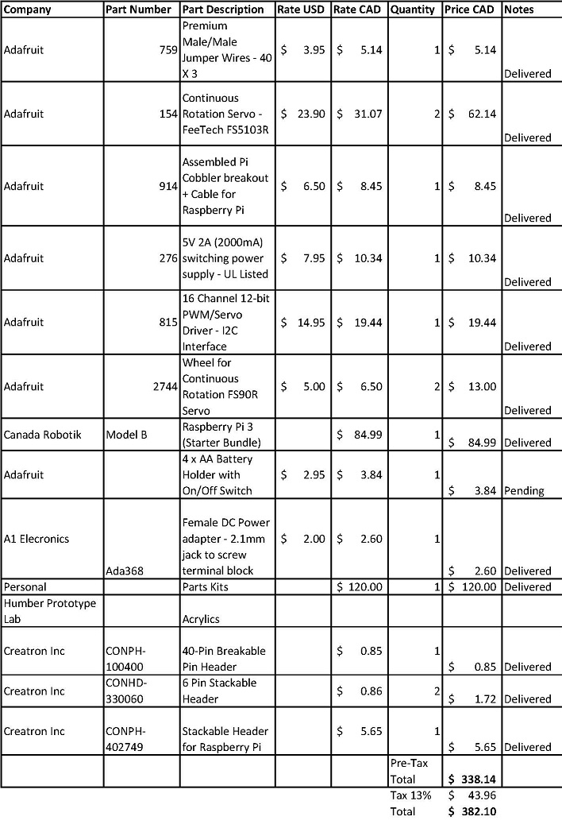
Budget

Slide 4
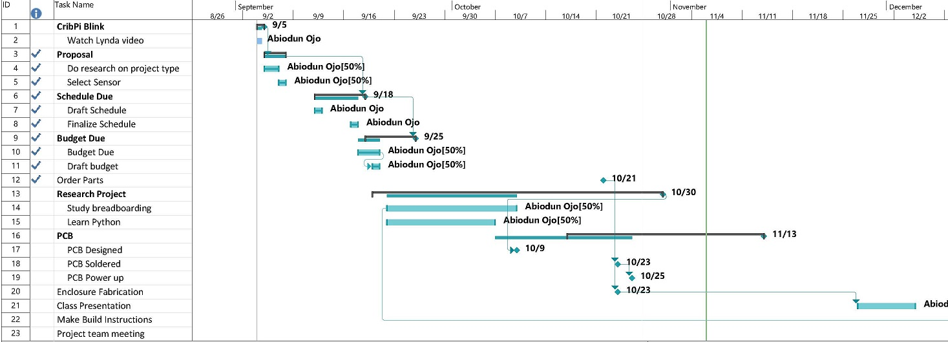
Schedule

Slide 5

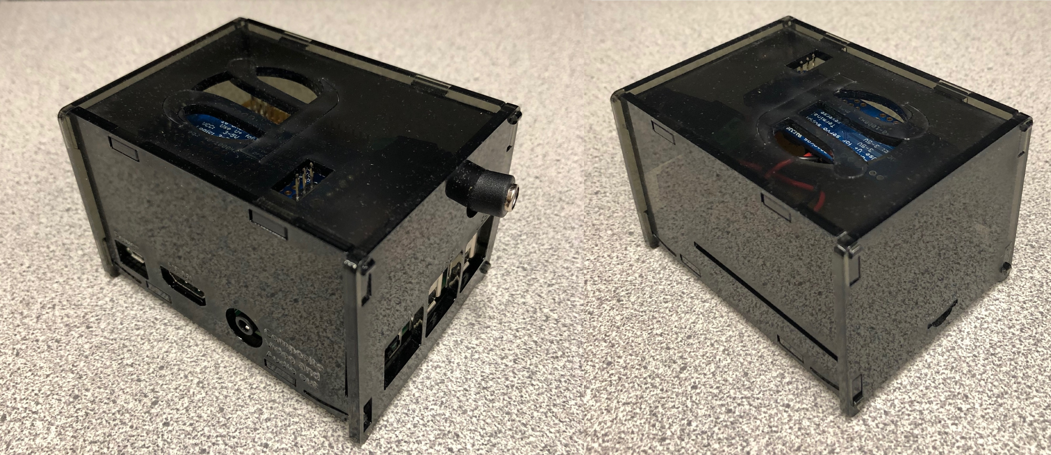
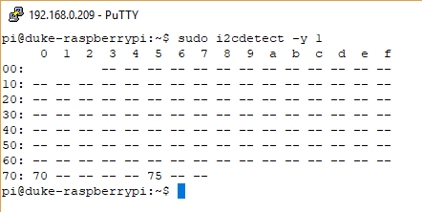
Images and Video

Slide 6
Course Knowledge
Writ 120 – Technical Reading and Writing Skills (Technical Documents)
CENG 215 – Digital and Interface Systems (PWM)
CENG 252 - Embedded Systems (IoT)
Extra mural (Online) – Intro to Python programming

