Slide 2
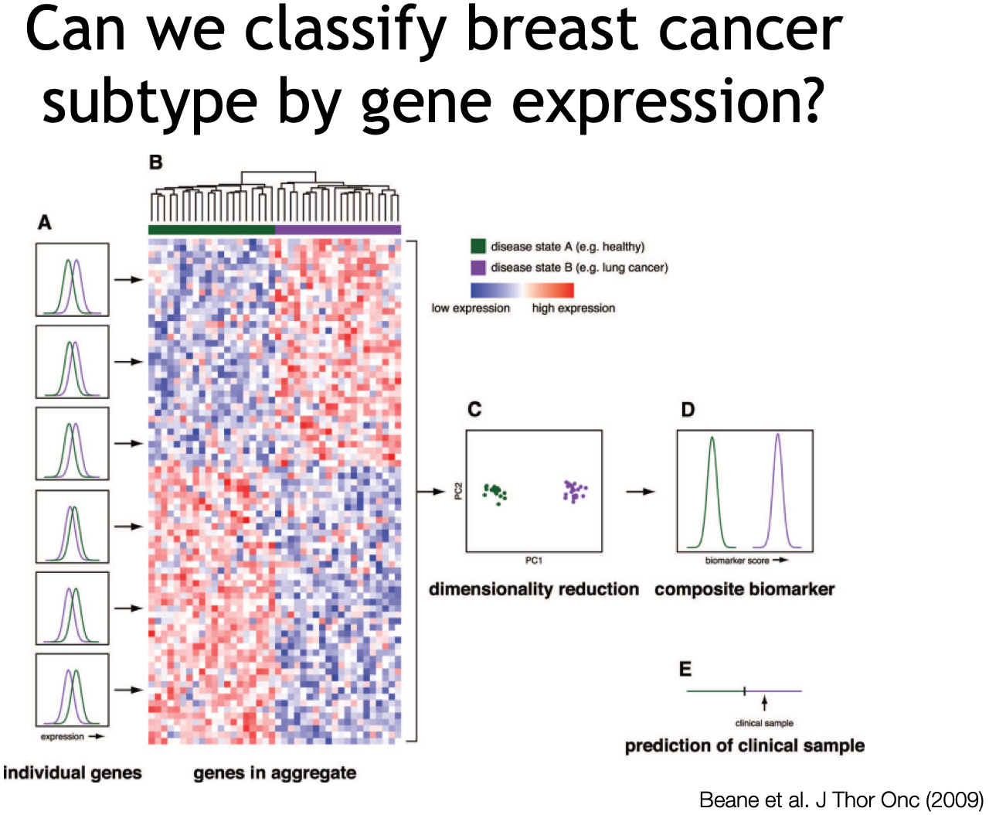
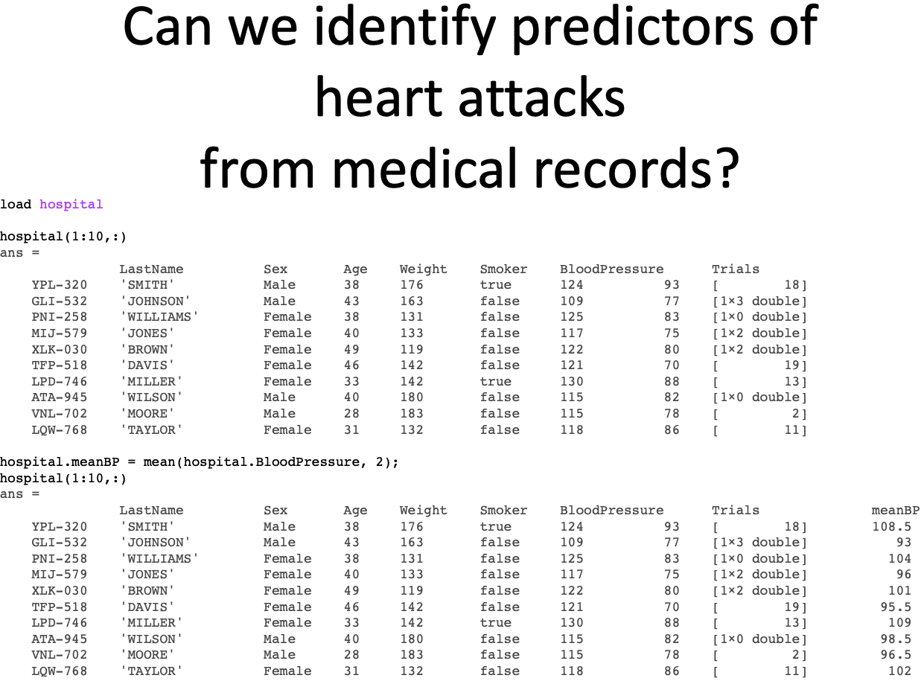
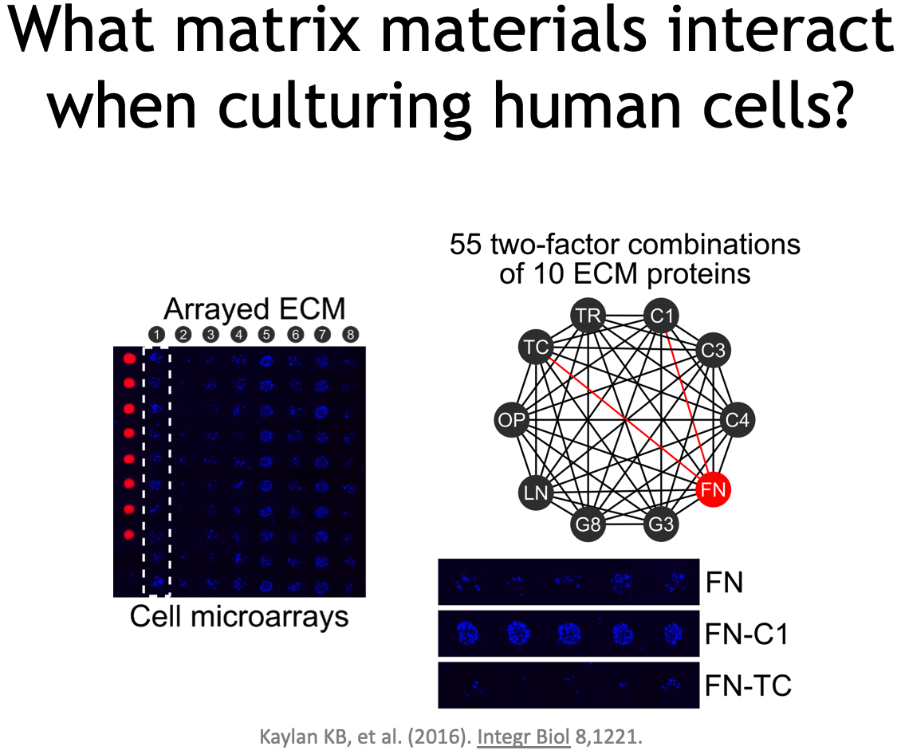
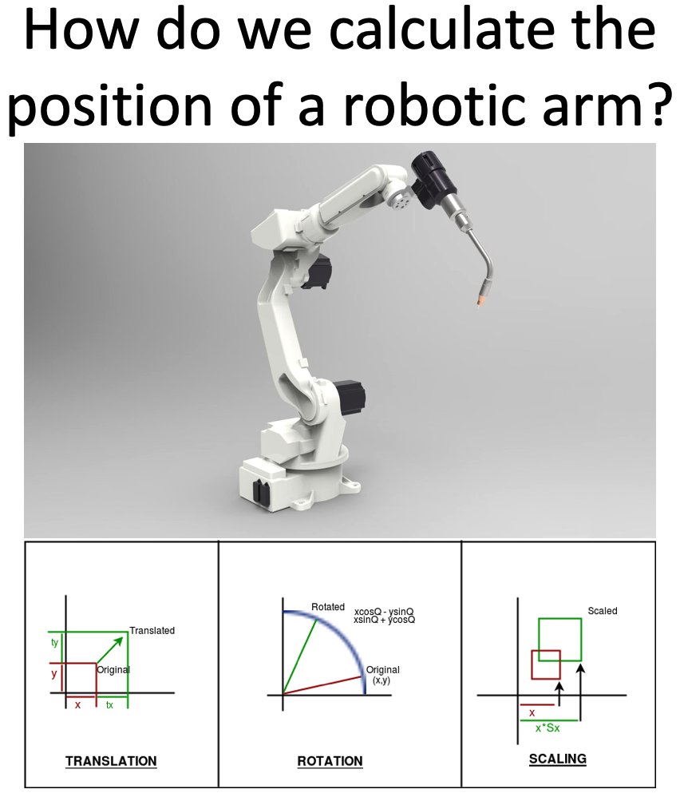
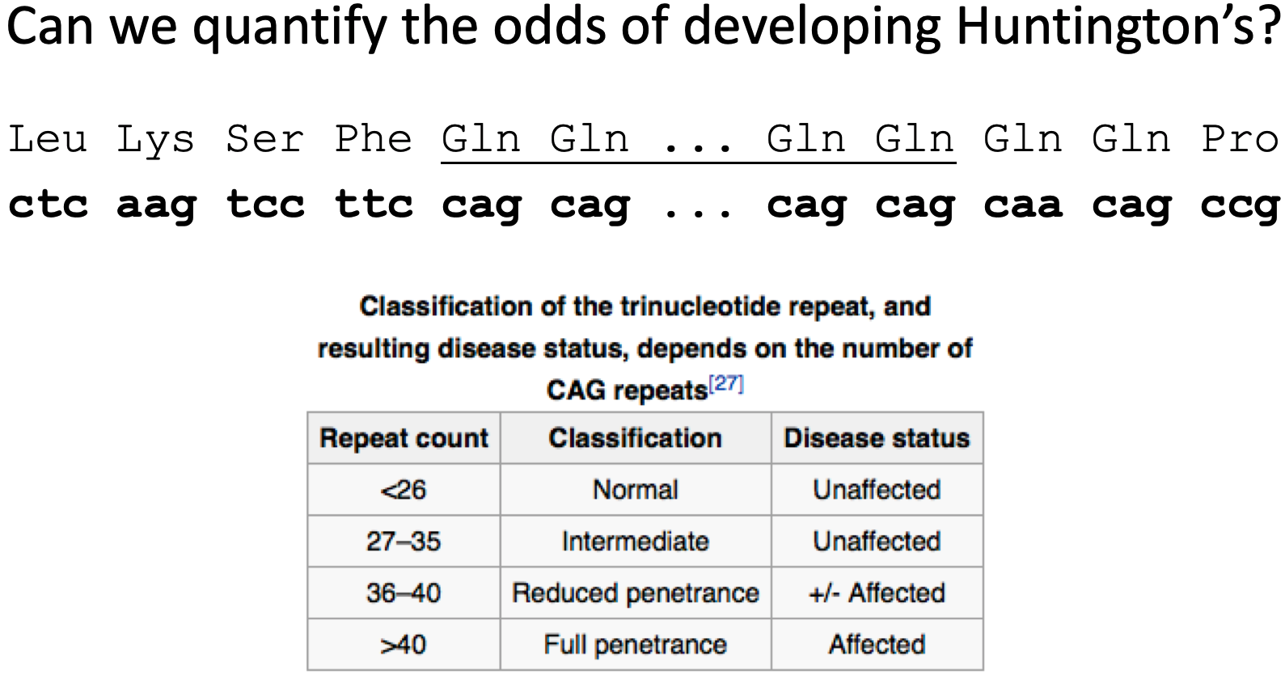
BIOE 210 is a core course, not a computational track elective.
These questions (and more)
are homework problems from Spring 2019.

Slide 3
What’s in BIOE 210
Part I: Linear Systems Field axioms Norms & dot products Multiplication Translation matrices Gaussian Elimination Nonlinear systems Finite differences Inverses, solvability, & rank
Part II: Matrix Theory Basis vectors Orthogonality Eigenvectors/values SVD Low-rank approximations PCA
Part III: Linear Models Convexity Hyperplanes SVM Cross validation Least squares Linear Regression Logistic regression The LASSO

Slide 4
What’s not in BIOE 210?
Several classes use linear algebra or related topics. These topics are referenced, but not covered in BIOE 210:
Linear systems (state space), Laplace & Fourier transforms [BIOE 205]
Probability & statistics, clustering [BIOE 306]
Unsupervised learning, deep learning [BIOE 410]
Design of experiments, reinforcement learning [BIOE 498 PJ]
Topics in other linear algebra courses (MATH 415/416)
Subspaces, quadratic forms, heavy use of the determinant, operator and spectral theory.
These are replaced with more applied topics: statistical models, machine learning, and numerical methods.

Slide 5
Class Structure
Three exams
February 20, April 2, May 5 (last day of class)
Six homework sets
Includes analytical and machine problems.
All work submitted on Gradescope.
Stay tuned to the class website
http://bioe210.github.io

Slide 6
Class Rules
You do not need to come to class.
If you come to class, you will be respectful of your colleagues.
No eating
No talking
No computer or phone distractions
If you have any questions on Rule #2, see Rule #1.

Slide 7
Succeeding in BIOE 210
Linear algebra is powerful, elegant, and beautiful. Trust me.
Everything you need to know is in the book. I’m not trying to keep this stuff a secret.
If you can’t find something, look deeper before you look wider.
There will be no surprises:
Textbook
Lecture
Practice problems
Homework problems
Office hours
Practice exams
Exams

