Slide 2
Which models can be fit with linear regression?

Slide 3
Simple linear regression in Matlab
X = rand(3,3)
X = 0.0467 0.5188 0.5317 0.6587 0.3323 0.5070 0.7573 0.0428 0.2532
y = rand(3,1)
y = 0.0820 0.6530 0.2190
b = pinv(X) * y
b = 14.3966 50.9428 -50.8102
b = X \ y
b = 14.3966 50.9428 -50.8102

Slide 4
Easier modeling with fitlm
1. Create a Matlab table
Column names are taken from the names of the variables in the call to table. To use other names set
tbl = table(x,y)
tbl = 100×2 table
x y ______ ________ 1 0.07747 1.1414 10.604 1.2828 0.24382 1.4242 0.066588 1.5657 2.3857 1.7071 9.643 1.8485 1.2993 1.9899 6.4243 2.1313 6.2049
tbl.Properties.VariableNames = {'name1', 'name2'}
tbl = 100×2 table
name1 name2 ______ ________ 1 0.07747 1.1414 10.604 1.2828 0.24382 1.4242 0.066588 1.5657 2.3857 1.7071 9.643

Slide 5
Easier modeling with fitlm
fitlm(tbl, 'y~x')
model =
Linear regression model: y ~ 1 + x Estimated Coefficients: Estimate SE tStat pValue ________ _______ _______ __________ (Intercept) -42.178 4.4325 -9.5157 1.3623e-15 x 15.561 0.49352 31.531 4.1479e-53 Number of observations: 100, Error degrees of freedom: 98 Root Mean Squared Error: 20.1 R-squared: 0.91, Adjusted R-Squared 0.909 F-statistic vs. constant model: 994, p-value = 4.15e-53

Slide 6
Easier modeling with fitlm
plot(model)

Slide 7
Easier modeling with fitlm
model2 = fitlm(tbl, 'y~x^2')
model2 =
Linear regression model: y ~ 1 + x + x^2 Estimated Coefficients: Estimate SE tStat pValue ________ _______ ________ _________ (Intercept) -2.6376 6.1135 -0.43145 0.6671 x 2.1967 1.7424 1.2608 0.21042 x^2 0.8353 0.10617 7.8676 5.123e-12 Number of observations: 100, Error degrees of freedom: 97 Root Mean Squared Error: 15.8 R-squared: 0.945, Adjusted R-Squared 0.944 F-statistic vs. constant model: 837, p-value = 6.61e-62

Slide 8
Easier modeling with fitlm
plot(model2)

Slide 9
Exploratory Data Analysis with Linear Regression
load hospital
hospital(1:10,:)
ans =
LastName Sex Age Weight Smoker BloodPressure Trials YPL-320 'SMITH' Male 38 176 true 124 93 [ 18] GLI-532 'JOHNSON' Male 43 163 false 109 77 [1×3 double] PNI-258 'WILLIAMS' Female 38 131 false 125 83 [1×0 double] MIJ-579 'JONES' Female 40 133 false 117 75 [1×2 double] XLK-030 'BROWN' Female 49 119 false 122 80 [1×2 double] TFP-518 'DAVIS' Female 46 142 false 121 70 [ 19] LPD-746 'MILLER' Female 33 142 true 130 88 [ 13] ATA-945 'WILSON' Male 40 180 false 115 82 [1×0 double] VNL-702 'MOORE' Male 28 183 false 115 78 [ 2] LQW-768 'TAYLOR' Female 31 132 false 118 86 [ 11]
hospital.meanBP = mean(hospital.BloodPressure, 2);
hospital(1:10,:)
ans =
LastName Sex Age Weight Smoker BloodPressure Trials meanBP YPL-320 'SMITH' Male 38 176 true 124 93 [ 18] 108.5 GLI-532 'JOHNSON' Male 43 163 false 109 77 [1×3 double] 93 PNI-258 'WILLIAMS' Female 38 131 false 125 83 [1×0 double] 104 MIJ-579 'JONES' Female 40 133 false 117 75 [1×2 double] 96 XLK-030 'BROWN' Female 49 119 false 122 80 [1×2 double] 101 TFP-518 'DAVIS' Female 46 142 false 121 70 [ 19] 95.5 LPD-746 'MILLER' Female 33 142 true 130 88 [ 13] 109 ATA-945 'WILSON' Male 40 180 false 115 82 [1×0 double] 98.5 VNL-702 'MOORE' Male 28 183 false 115 78 [ 2] 96.5 LQW-768 'TAYLOR' Female 31 132 false 118 86 [ 11] 102

Slide 10
Exploratory Data Analysis with Linear Regression
fitlm(hospital, 'meanBP ~ Sex + Age + Weight + Smoker')
ans =
Linear regression model: meanBP ~ 1 + Sex + Age + Weight + Smoker Estimated Coefficients: Estimate SE tStat pValue __________ ________ _________ __________ (Intercept) 97.09 5.4093 17.949 2.7832e-32 Sex_Male 0.51095 2.0897 0.24451 0.80737 Age 0.058337 0.047726 1.2224 0.2246 Weight -0.0008026 0.039503 -0.020317 0.98383 Smoker_1 10.088 0.73786 13.672 3.6239e-24 Number of observations: 100, Error degrees of freedom: 95 Root Mean Squared Error: 3.41 R-squared: 0.683, Adjusted R-Squared 0.67 F-statistic vs. constant model: 51.2, p-value = 6.55e-23
A 30 year old, 100 pound female nonsmoker:
meanBP = 97.1 + 0.51(0) + 0.058(30) – 0.00080(100) + 10.1(0) = 98.8
A 50 year old, 260 pound male smoker:
meanBP = 97.1 + 0.51(1) + 0.058(50) – 0.00080(260) + 10.1(1) = 110.4

Slide 11
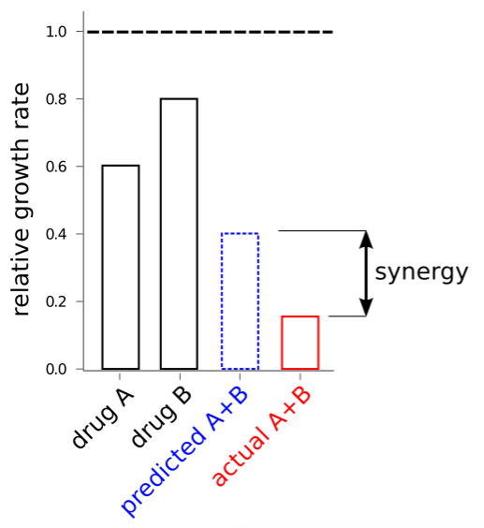
Testing for drug super-additivity (synergy)

Slide 12
The data (log[concentration] reported)
drug = table(response, conc_A, conc_B)
drug = 15×3 table
response conc_A conc_B ________ ________ ________ 2.9375 0.78812 0.056482 6.9199 0.48957 0.51783 2.6542 0.53637 0.075296 9.3316 0.32535 0.88539 8.567 0.82917 0.34905 16.306 0.98211 0.80744 1.6428 0.63671 0.017543 5.6819 0.070839 0.93119 2.5009 0.54116 0.079158 3.9707 0.89685 0.029386 2.2057 0.62384 0.043192 13.62 0.60518 0.98991 14.015 0.892 0.74739 4.924 0.37901 0.39126 4.993 0.15946 0.6222

Slide 13
Linear model
model_lin = fitlm(drug, 'response ~ conc_A + conc_B')
model_lin =
Linear regression model: response ~ 1 + conc_A + conc_B Estimated Coefficients: Estimate SE tStat pValue ________ _______ _______ __________ (Intercept) -5.0689 0.69951 -7.2464 1.0197e-05 conc_A 10.887 0.89216 12.202 4.0126e-08 conc_B 12.378 0.64862 19.083 2.4105e-10 Number of observations: 15, Error degrees of freedom: 12 Root Mean Squared Error: 0.861 R-squared: 0.972, Adjusted R-Squared 0.967 F-statistic vs. constant model: 205, p-value = 5.28e-10

Slide 14
Interaction terms in Matlab
Linear terms
response ~ x1 + x2
Interaction terms
response ~ x1 + x2 + x1:x2
Equivalently
response ~ x1 * x2
Note than an intercept term is added by default. To disable this use
fitlm(..., ‘Intercept’, false)

Slide 15
Model with interaction terms
model_int = fitlm(drug, 'response ~ conc_A * conc_B')
model_int =
Linear regression model: response ~ 1 + conc_A*conc_B Estimated Coefficients: Estimate SE tStat pValue ________ _______ ______ __________ (Intercept) -0.94009 0.71872 -1.308 0.21755 conc_A 4.5727 1.0626 4.3034 0.0012489 conc_B 6.44 0.96668 6.662 3.5531e-05 conc_A:conc_B 9.4829 1.4631 6.4815 4.5414e-05 Number of observations: 15, Error degrees of freedom: 11 Root Mean Squared Error: 0.409 R-squared: 0.994, Adjusted R-Squared 0.992 F-statistic vs. constant model: 618, p-value = 1.55e-12
plot(model_int)

Slide 16
Model comparison: linear vs. interactions.
Linear terms only Linear + interaction terms

