Slide 1
Deep Learning
Supervised Learning with Artificial Neural Networks

Slide 2
Deep Learning is Unreasonably Effective
Imagine you work in drug discovery and fell asleep for 50 years.
When you awoke, you learned that:
Your colleagues now discover an effective drug for every disease.
All drugs are discovered with a single method that you used 50 years ago.
Deep Learning is rapidly conquering every problem we throw at it!
However, there are many reasons by Deep Learning should not work:
Neuroscience: Deep Learning vastly oversimplify the brain.
Statistics: Deep Learning models are overfit to too few data.
Optimization: Deep Learning models cannot be trained optimally.

Slide 3
What is Deep Learning?
Deep Learning uses Artificial Neural Networks to learn input/output relationships.
Artificial Neural Networks are mathematical models inspired by neurons and the brain.
Different types of Artificial Neural Networks perform specialized tasks:
Multi-Layer Perceptrons: Classification
Convolutional Neural Networks: Image recognition and computer vision
Recurrent Neural Networks: Speech processing and synthesis

Slide 4
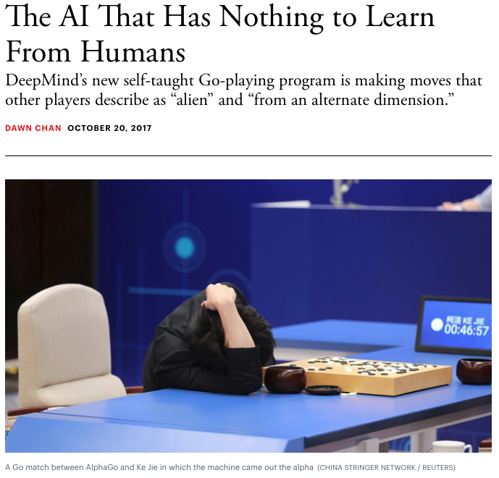
What can Deep Learning do?
Play games
The Atlantic. https://www.theatlantic.com/technology/archive/2017/10/alphago-zero-the-ai-that-taught-itself-go/543450/

Slide 5
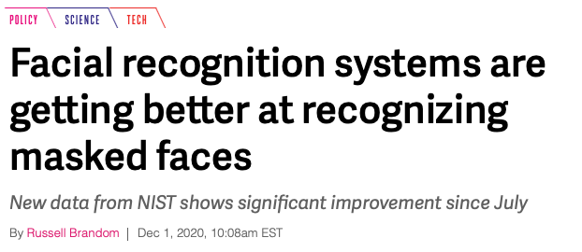
What can Deep Learning do?
Play games
Identify faces
The Verge. https://www.theverge.com/2020/12/1/21755021/

Slide 6

What can Deep Learning do?
Play games
Identify faces
Understand speech
Voicebot.ai. https://voicebot.ai/2020/04/24/google-assistant-can-better-tell-apart-voices-after-enhancing-set-up-process/

Slide 7

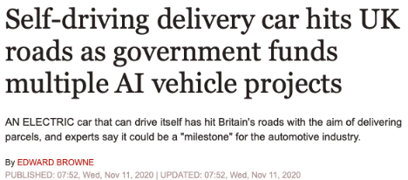
What can Deep Learning do?
Play games
Identify faces
Understand speech
Drive cars
Express. https://www.express.co.uk/news/science/1358726/Tech-news-self-driving-car-UK-government-artificial-intelligence-autonomous-ont

Slide 8

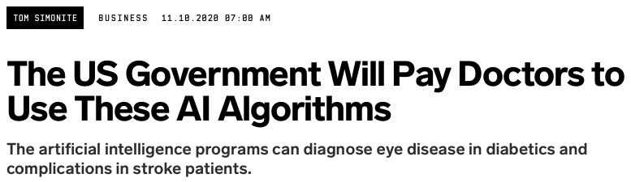
What can Deep Learning do?
Play games
Identify faces
Understand speech
Drive cars
Diagnose diseases
Wired. https://www.wired.com/story/us-government-pay-doctors-use-ai-algorithms/

Slide 9
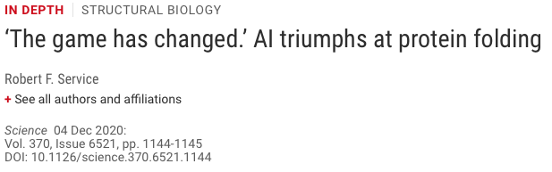
What can Deep Learning do?
Play games
Identify faces
Understand speech
Drive cars
Diagnose diseases
Fold proteins
Science. https://science.sciencemag.org/content/370/6521/1144

Slide 10
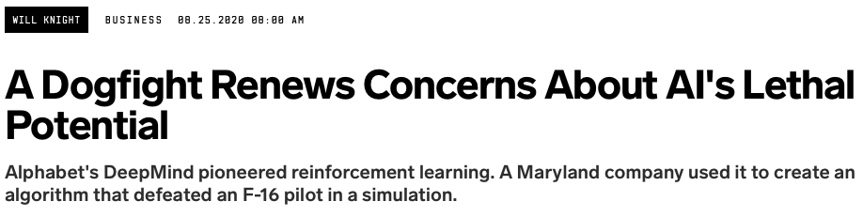
What can Deep Learning do?
Play games
Identify faces
Understand speech
Drive cars
Diagnose diseases
Fold proteins
Fight battles
Science. https://science.sciencemag.org/content/370/6521/1144

